Slide 1
Building resiliency in immunization programs in the time of COVID-19 recovery
Aaron Wallace, Team Lead, Immunization Delivery Science Team, Global Immunization Division, US CDC

Slide 2

Definitions
Essential immunization systems:
A comprehensive structure for ensuring nationally recommended vaccines are delivered in a safe, accessible and predictable manner to aware & engaged communities

Slide 3
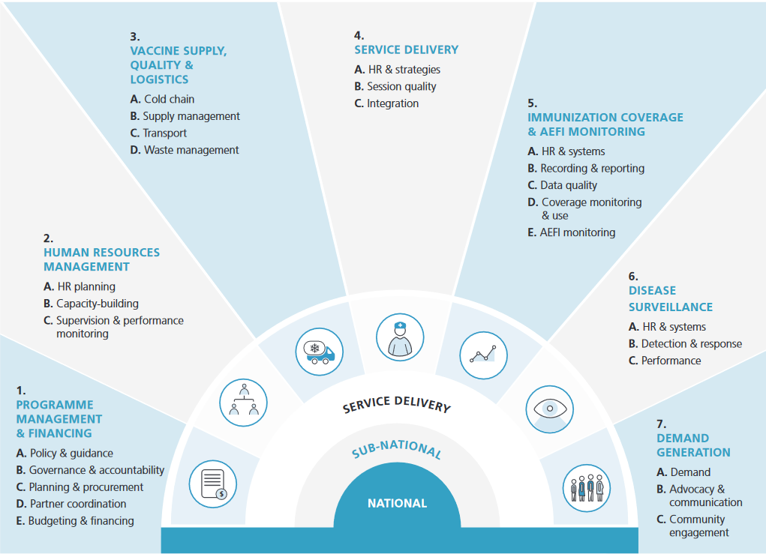
The major components of a national immunization program

Slide 4
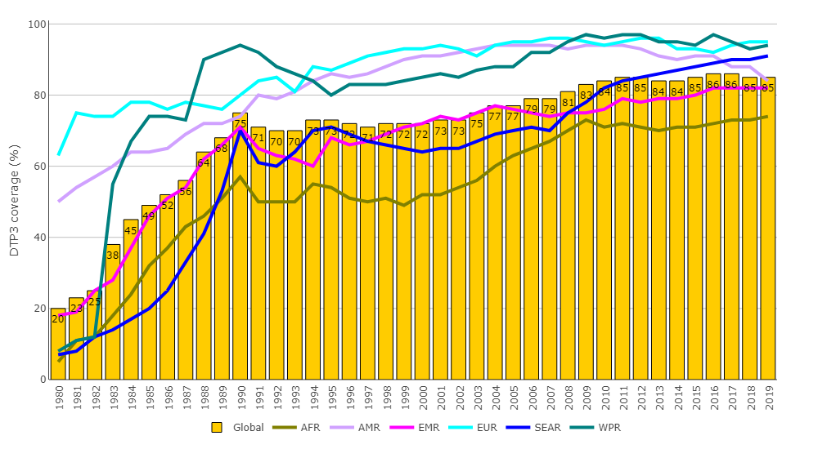
By 2019, national immunization programs had achieved incredible success in providing recommended vaccinations
85% of children were being reached with recommended vaccines worldwide in 2019
Most national immunization programs started around 1980

Slide 5
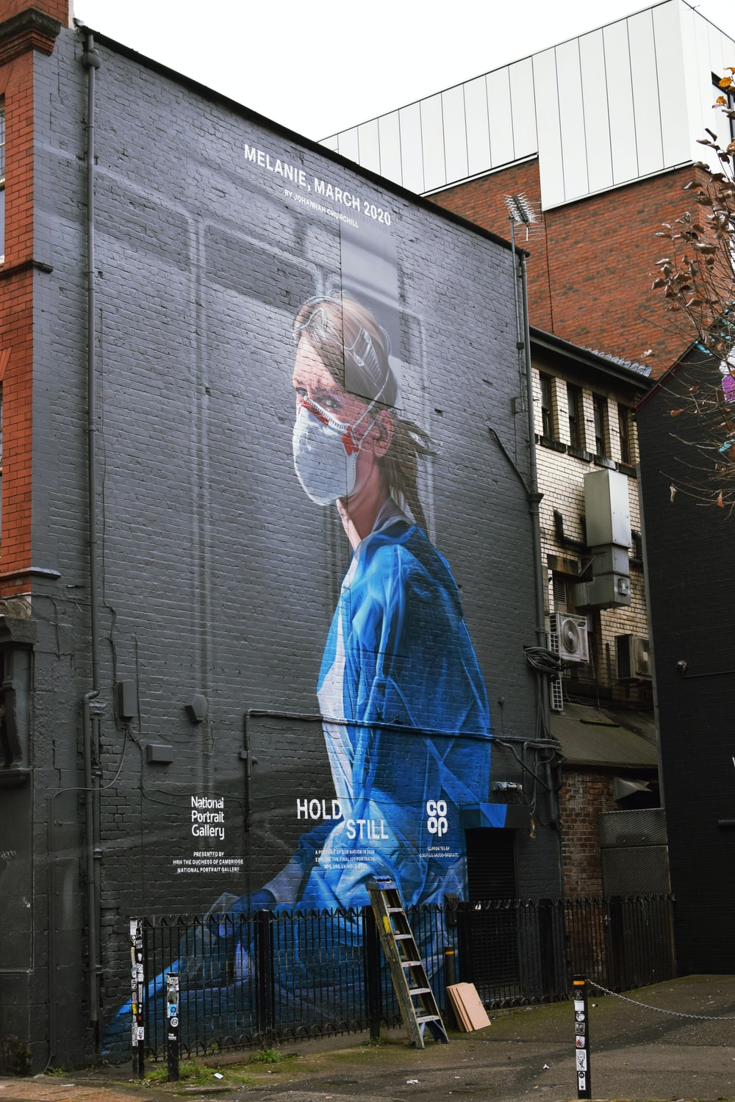
2020:
The COVID-19 pandemic causes major disruptions to health systems worldwide

Slide 6
Global childhood immunization programs were heavily
impacted by COVID-19 pandemic, 2020–2021
Childhood routine immunization coverage in 2020 decreased to levels not seen since 2009
Widespread impacts: routine immunization coverage decreased in 5 of 6* WHO regions (>50% of countries) in 2020 vs 2019
26% increase in under-vaccinated in 2020
22.7 million total under-vaccinated in 2020, 3.7 million more than observed in 2019
>50% of surveyed countries persistent disruptions to routine immunization visits through late 2021
Increasing risk of vaccine-preventable disease (VPD) outbreaks
DTP3 coverage
WPR, 95%
EUR, 95%
SEAR, 85%
GLOBAL, 83%
AMR, 81%
EMR, 81%
AFR, 72%
Data source: WHO/UNICEF DTP coverage estimates, released 15-July-2021. *WPR would also decrease if China coverage not included in 2020
Notes:
Childhood immunization programs routinely deliver vaccines against measles, polio, pertussis, tetanus, rotavirus and many other diseases.
For many years, global coverage had been steady at about 86% (as measured by the third dose of DTP containing vaccine). However, the 3% drop in 2020 set the program back to levels unseen since 2009. Coverage impacts were widespread, with 5 of 6 WHO regions showing decreased coverage, particularly for SE Asia and the region of the Americas.
51% of countries had decreased dtp3 coverage in 2020 (in 2019, this figure was 30%). All resulting in a 26% increase in the numbers un-protected against VPDs, or 3.7million more children in 2020 versus 2019, increasing the total number unprotected to nearly 23 million.
That was a year ago, so how does 2021 look? We won’t know for another few months based on the official WHO/UNICEF estimates, however, repeated pulse surveys of countries to gauge level of disruptions to essential health services indicate persistent disruptions, even with a spike upwards in the latest pulse poll conducted in Q4, 2021.
These results could be a forerunner to what we’ll see with the official estimates and if 2021 figures do not increase from 2020 coverage levels, then the we’ll be seeing nearly 7 million more un-protected children accumulated over a two year time period, leading to a much higher risk of VPD outbreaks than predicted two years ago.

Slide 7
Life-saving vaccines were not introduced during 2020 and 2021 as planned, impacting morbidity and mortality reduction efforts
Pneumococcal, rotavirus, measles 2nd dose, & human papillomavirus (HPV) vaccine introductions most heavily impacted
  Pneumonia and diarrhea - leading causes of preventable child deaths (~22%)
Introductions completed in 2021 also appear much more limited than initially planned
Measles 2nd dose introduction delays increase susceptible populations and risk of large and disruptive outbreaks, posing global health security threat
HPV vaccine delivery for adolescent girls in 2020 doubly impacted due to school & health facility closures - exacerbating gender inequities
Number of vaccine
introductions globally
Planned vaccine introductions that did not occur
Data source: Planned vaccine introductions in 2020 and 2021 based on WHO estimates as of late 2019. 2020 introduction figure based on WHO estimates as of mid-2021. 2021 introduction estimate based on unofficial WHO tracking.
Notes:
The COVID-19 pandemic resulted in over 50% of the planned vaccine introductions in 2020 and 2021 not occurring, setting back child mortality reduction efforts substantially.
The main vaccines not introduced were pneumococcal, rotavirus, measles 2nd dose and HPV vaccines. With Pneumo and diarrhea diseases causing nearly a quarter of all preventable child deaths, such introduction delays cannot be afforded.
HPV vaccine introductions were most severely impacted, as about 15 were planned in 2020.
Although 2021 official vaccine introduction figures are not officially available, based on our observations, less than a third of the originally planned vaccine introductions happened in 2021, compared to planned numbers released in late 2019.
Delay of measles 2nd dose introduction, combined with lower measles 1st dose introduction has a dual effect of quickly leading to major measles outbreaks as measles is highly infectious. The potential for these outbreaks is even worse given delays in immunization campaigns.

Slide 8
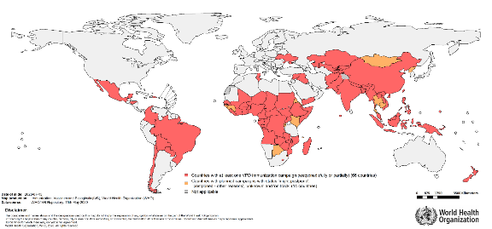
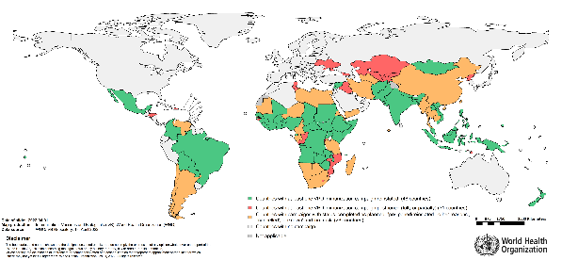
Many campaigns reinstated after initial disruptions in 2020, but many remain postponed in 2022
15 May 2020
1 April 2022
66 countries with at least one VPD immunization campaign postponed due to COVID-19.
  31 countries with at least one campaign postponed due to COVID-19 (35 campaigns postponed: estimated target population affected approximately 133 million).
  48 countries reinstated 92 campaigns (preventive or outbreak response). Of those, 15 countries conducted multi-antigen integrated campaigns (Sept 2020 – March 2022)
Note: *Reinstated (Covid-19) = Campaign which was previously postponed due to Covid-19 but have restarted/ completed
Notes:
Integration: Of the reinstated campaigns above, 14 countries have conducted multi antigen integrated campaigns (Sept 2020 – February 2022)
• Angola (bOPV, IPV and MCV); Bolivia (bOPV and MMR); Brazil (Measles and MR); CAR (Measles, MNT, mOPV, bOPV); DR Congo (YF and MCV 0-dose); Mexico (MR/MMR, polio and hexavalent); Nigeria (Measles, YF and MenA); Paraguay (bOPV and MR/MMR); Philippines (MR and bOPV); Province of Punjab and Islamabad in Pakistan (Phase 2 TCV with OPV); Somalia (Measles and OPV); Sudan (IPV and YF); Viet Nam (MR and bOPV) and Zimbabwe (TCV, IPV and HPV) have re-instated campaigns with multi-antigens.

Slide 9
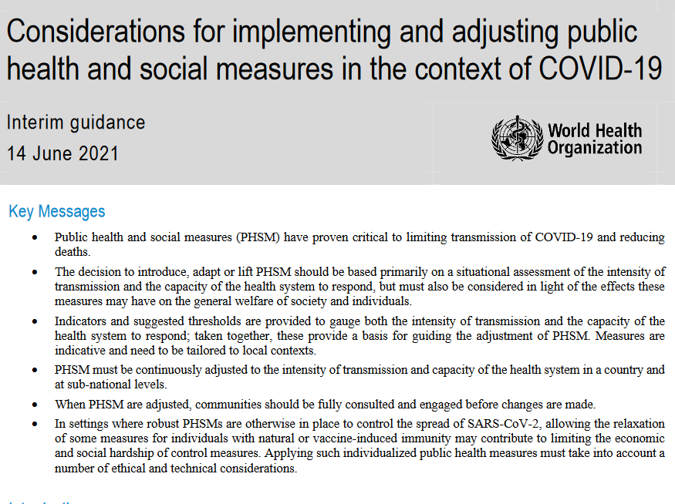
Addressing The COVID-19 Pandemic In the Early Phase: Public Health & Social Measures
Public Health and Social Measures : A comprehensive COVID-19 mitigation approach
Risk-based tiering approach dependent on COVID-19 disease spread
Public health and social measure examples:
  Social distancing, mask wearing, stay at home, closing non-essential businesses, remote working, cancel mass gatherings

Slide 10
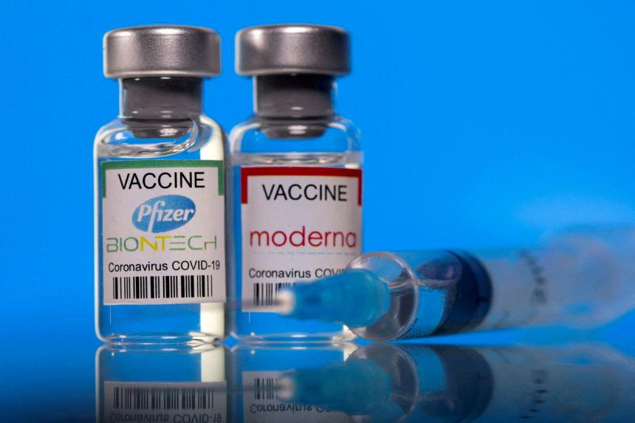
The Next Big Step: Accelerating Development of a Vaccine Against COVID-19
Massive investments by countries and companies in covid-19 vaccine development throughout 2020
By end-2020, first emergency use authorizations given to covid-19 vaccine
High hopes that widescale vaccination would be the silver bullet to stop the COVID-19 pandemic
  And could eliminate need for other PHSM measures

Slide 11
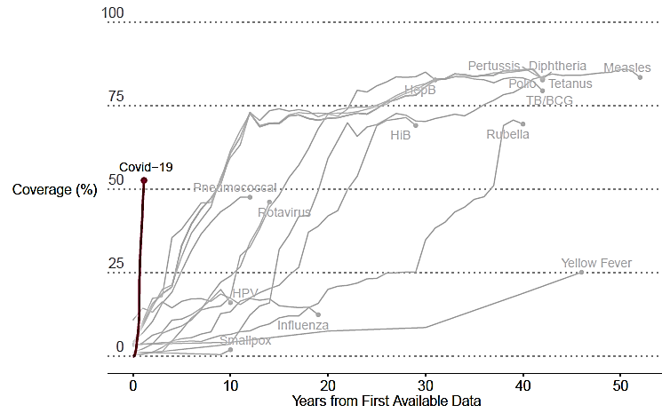
Rapid Covid-19 vaccine introduction - An Impressive Feat
COVID-19 vaccine has achieved more rapid global rollout in one year than any other vaccine
Source: Glassman et al. Center for Global Development. COVID-19 Vaccine Development and Rollout in Historical Perspective. Working paper 607 February 2022. https://www.cgdev.org/publication/covid-19-vaccine-development-and-rollout-historical-perspective
Notes:
Ann

Slide 12

Key Hurdles to High COVID-19 Vaccination Coverage & Immunity Emerge
Vaccine supply: Insufficient supply in early days, particularly for low and middle-income countries
Funding: Insufficient funds to cover vaccine costs for many countries
Logistics: Some vaccines had strict cold chain requirements & short expiry dates, reducing ability to easily use vaccine in certain areas
Demand: Individuals surrounded by misinformation about vaccine safety and effectiveness
Variants: original vaccine schedules less effective against new covid-19 strains
Effectiveness: Vaccines very effective against severe illness, but unable to completely stop infection by COVID-19
  Comprehensive PHSM approach including vaccination becomes key

Slide 13
Existing immunization systems are straining to ramp-up of COVID-19 vaccination alongside delivery of routine child vaccinations
A 6-fold difference exists between the number of routine immunization doses administered in
Q4 2019 versus COVID-19 vaccines administered in late 2021 / early 2022 in the 92 AMC countries
Number of doses administered
(in millions)
2022: increased strain under continued heavy vaccination demands compared to usual levels
To reach 70% goal by mid-2022 AMC countries must administer 555 million doses monthly
Opportunity cost of COVID-19 vaccination scale-up: resource-constrained countries deciding which services to provide, at risk of future VPD outbreaks
6x
RI needs persist & increased due to needs for catch-up and increased birth cohort
Forecast
Feb-Mar
Administered
Jan
Source: COVID-19 Vaccine Implementation Analysis & Insights (WHO-UNICEF-GAVI), February 16, 2022
Notes:
The COVID-19 vaccine rollout largely relies on the existing health workforce in countries, and most importantly the health workers who are already trained to provide routine childhood vaccinations across these countries. However, the massive volume of COVID-19 vaccine that must be administered is approaching nearly 6x the amount of vaccine these health workers typically provide for childhood routine vaccination efforts, drawing concerns about the ability of health systems to cope.
As of Feb 16, 2022, 35% COVID-19 vaccination coverage in AMC countries, 1.4bn fully vaccinated of 3.9billion target. To reach the 70% goal by July 1 for the 3.9 billion target, countries must administer 555 million doses monthly from now through end of June.
Many countries already have limited health resources available; covid-19 vaccination relies on these same health workers that already delivering essential health services, so countries face difficult opportunity cost decisions – do they forgo / delay essential immunizations and other health services to focus on covid-19 vaccine rollout? The potential for further essential health service disruption is high
If essential immunization services are further disrupted, countries increase the risk for vaccine-preventable disease outbreaks such as measles and polio. Already, we have seen just last week the identification of the first wild poliovirus case in Africa, with a paralyzed young child in Malawi. Countries could be facing these outbreaks for years to come if they are forced to scale back essential health services over the next several months.

Slide 14

Building Resiliency During COVID-19 Pandemic
Maintain and Restore Immunization
COVID-19 Vaccination
Catch-up on Missed Vaccinations
Vaccine Preventable Disease
Outbreak Response

Slide 15
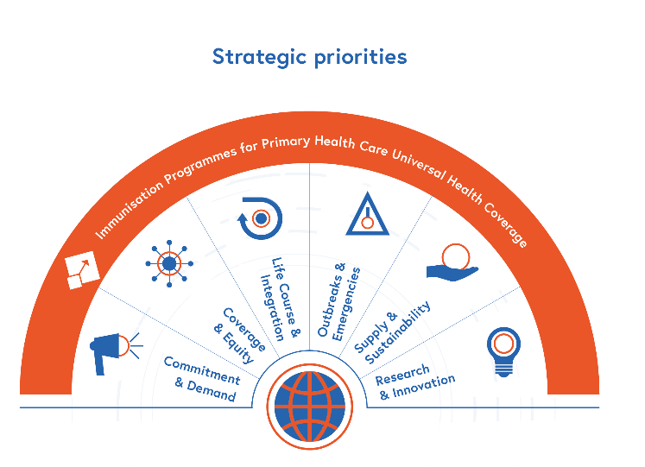
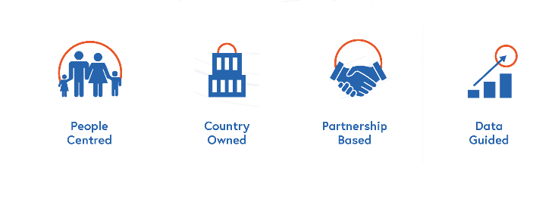
Immunization Agenda 2030 (IA2030) proposes a strategic framework
7 Strategic Priorities
informed by
4 Core Principles for action

Slide 16
IA2030 Strategic Priorities and Immunization Recovery
SP4: expanding life course vaccination, including COVID-19 vaccination; promoting catch-up vaccination and integration with recovery
SP5: outbreak prevention (reinstating postponed campaigns); fragile country recovery
Immunisation Programmes for Primary Health Care Universal Health Coverage
SP6: adapting vaccine forecasting and assessing global supply; fiscal prioritization of essential health services, including immunization; efficient use of resources
SP3: equity and zero-dose children prioritized for recovery and strengthening
Life Course &
Integration
Outbreaks &
Emergencies
SP2: political commitment to immunization; demand generation for routine immunization in midst of COVID vaccine roll-out
Coverage
& Equity
Supply &
Sustainability
SP7: leveraging innovations of COVID-19 vaccine introduction toward routine immunizations
Commitment
& Demand
v
Research
& Innovation
SP1: reviving routine immunization as part of Primary Health Care, recovery of immunization and PHC services, leveraging opportunities of COVID vaccine rollout to strengthen health systems

Slide 17
Guiding Principles for Recovering, Building Resiliency, and Strengthening of Immunization in 2022 and Beyond
Structure
Closing Immunity Gaps and Recovering Immunization Programmes
  Strategies to close immunity gaps
  Strategies to recover immunization programmes
  Vaccine preventable disease surveillance
Strengthening Routine Immunization and Building Resiliency
Notes:
There are two main parts to the document. The first covers closing immunity gaps and recovering immunization programmes while the second part covers strengthening routine immunization in the context of primary health care and building resiliency. Next.
The first part has three sections: strategies to close immunity gaps which is predominantly about campaigns, strategies to recover immunization programmes which is about routine immunization, and then a section on VPD surveillance. Next slide

Slide 18
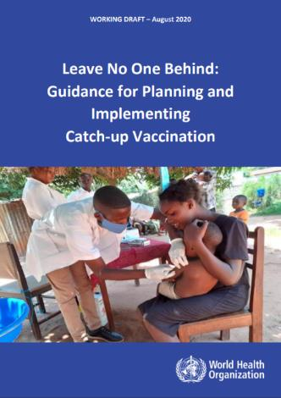
Implement Catch-Up Vaccination Guidance
  Published in August 2020
  Strategies:
    Intensified strategies to close immunity gaps
      One-time catch-up vaccination campaigns to reach those missed during the COVID-19 pandemic
    Continuously implementing catch-up vaccination through routine immunization and primary health care
https://www.who.int/teams/immunization-vaccines-and-biologicals/essential-programme-on-immunization/implementation/catch-up-vaccination
Notes:
The foundation of the guiding principles draft being discussed today is rooted in this catch up vaccination guidance that was published in August 2020. The strategies laid out here include both intensified strategies to close immunity gaps and strategies to continuously implement catch up vaccination through routine immunization and primary health care. Next slide

Slide 19
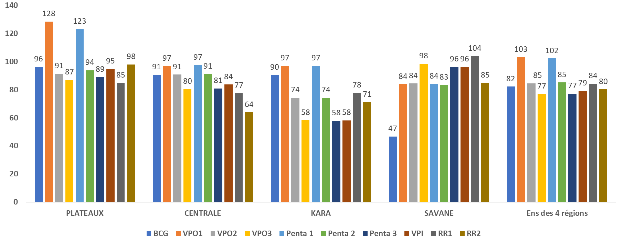
Strategies to Close Immunity Gaps:
Using Campaigns to Facilitate Catch-Up Vaccination
  Mexico, Apr-Sep 2021: used MR campaign to catch up children on routine vaccines (e.g. hexavalent)
  Nepal, Apr 2022: linking a typhoid conjugate vaccine campaign to identify and reach children who missed vaccination
  Togo, Jul-Aug 2021: used campaign of MenAfriVac, Vitamin A, and albendozole to catch up children on routine immunization
Proportion of incompletely vaccinated children who were vaccinated during the integrated Men A campaign, Togo, Jul-Aug 2021
Plan integrated campaigns to the extent possible: every vaccination campaign should be considered for opportunity to deliver multiple antigens and other health interventions
Notes:
Regarding strategies to close immunity gaps, we frequently got feedback about the importance of integrating campaigns and using them as an opportunity to facilitate catch up vaccination. We already heard earlier today about how Mexico used the MR campaign to catch up children on routine vaccinations. Nepal this week is about to launch a typhoid conjugate vaccine campaign as an opportunity to identify and reach children who have missed routine vaccinations. And last summer, Togo used a campaign of MenAfricVac vaccine to also provide Vitmain A for nutrition and albendazole for deworming. But they also decided to use this as an opportunity to catch up children on routine immunization vaccines. And they actually reached a high proportion of children that were incompletely vaccinated. Next.
With all of these experiences in mind, we’ve included the recommendation in the guiding principles to plan integrated campaigns to the extent possible. Every vaccination campaign should be considered for opportunity to deliver multiple antigens and other health interventions. Next slide

Slide 20
VPD campaigns postponed due to COVID-19:
35 campaigns (31 countries) postponed, 1st April 2022
Diseases/ Vaccines | No. of campaigns postponed (fully or partially)
Measles (M/MR/MMR) | 12
Polio (IPV) | 7
Bivalent Oral Poliovirus (bOPV) | 6
Meningitis A (Men A) | 1
Yellow Fever (YF) | 5
Cholera (OCV) | 1
Tetanus (Td) | 3
Total postponed | 35
Among those with dates available, 87% (26/30) originally planned for 2020
Revive postponed or cancelled immunization campaigns with
readjustment of planned target areas and target age groups
Data source: WHO IVB Repository, March 2 2022
Notes:
There are a total of 35 postponed campaigns in those 31 countries. This includes 12 with measles and 7 with IPV. Among those with dates available, 87% were originally planned for 2020 but still have not been reinstated. Next.
Given the likelihood of changing epidemiology, we recommend to revive postponed or cancelled immunization campaigns with readjustment of planned target areas and target age groups. Next slide.

Slide 21

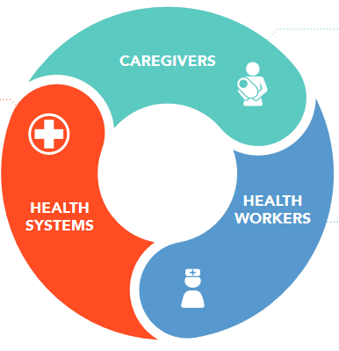
Strategies to recover immunization programmes:
Address restrictive policies and practices
Proportion of Missed Opportunities for Vaccination in low- and middle-income countries:¹
32% (95%CI 27–38%) among children aged 0-23 months
47% (95%CI 30–64%) among women of reproductive age
» Low home-based record retention/not bringing home-based record to clinic
» Lack of awareness of schedule
» Vaccine hesitancy
» Limited hours
» Shortage and stockouts
of vaccines and/or home-based records
» Lack of integration
» Poorly-designed records
» Other adverse policies
» Restrictive policies on age-limits
» Failure to screen
» False contraindications
» Concern regarding catch-up
schedules and eligibility
» Concern regarding vaccine wastage
¹ Sridhar S, Maleq N, Guillermet E, Colombini A, Gessner BD. A systematic literature review of missed opportunities for immunization in low- and middle-income countries. Vaccine. 2014 Dec 5;32(51):6870-6879.
21
Notes:
When it comes to strategies to recover immunization programmes, there was a lot of feedback about trying to address restrictive polices and practices against vaccination. This really is an issue related to missed opportunities for vaccination or MOV.
There’s a high prevalence of MOV in low and middle income countries: with one in three children and one in two women experiencing an MOV. There are multiple reasons for MOV that have been identified: There are those related to health workers, caregivers, and the health system. All of these are significant and worthy of extensive discussion but the two highlighted here received a lot of feedback. First, on the right, there’s the concern or uncertainty among health workers about eligibility. And then under health systems, there’s the restrictive policies on age limits, which is common in low and middle income countries. But the proportion of MOV that I mentioned earlier can be even higher in children greater than 12 months of age. Next slide

Slide 22
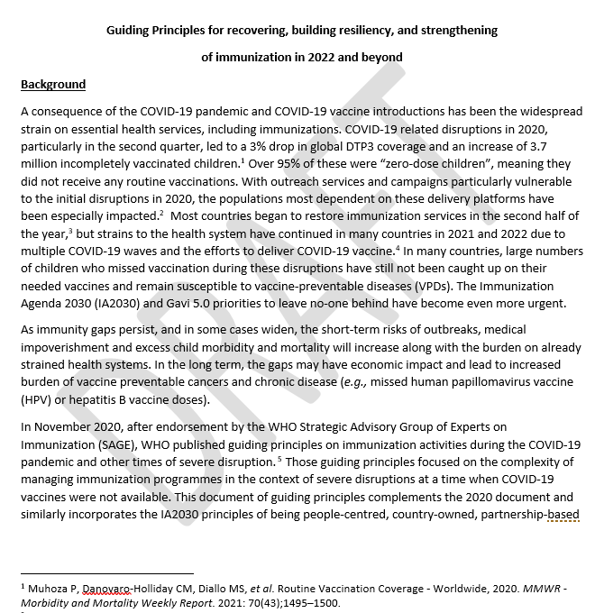
Guiding Principles for Recovering, Building Resiliency, and Strengthening of Immunization in 2022 and Beyond
Structure
Closing Immunity Gaps and Recovering Immunization Programmes
  Strategies to close immunity gaps
  Strategies to recover immunization programmes
  VPD Surveillance
Strengthening Routine Immunization and Building Resiliency
  Governance
  Financing
  Supply chains
  Service delivery
  Demand generation
  Health information systems
Notes:
The second major part of the guiding principles document on Strengthening Routine Immunization and Building Resiliency was broken down into multiple health system sub categories: governance, financing, supply chains, service delivery, demand generation, and health information systems. Next slide.

Slide 23
Leveraging COVID-19 vaccine roll-out to strengthen immunization and primary health care
Main challenges
Key opportunities
Human resources overstretched
Risk of COVID-19 vaccine hesitancy spill over to routine immunization
Public and political pressure to prioritize COVID-19 vaccination over routine immunization
Financial
      increased costs of integrated outreach
      imbalance of funding sources
Uncertainty of future (pandemic/COVID-19 vaccine)
Health system using COVID-19 investments
      cold chain / vaccine management capacity
      Strengthened disease and AEFI surveillance
      social listening/communication capacities
      real-time monitoring and digital tools
      engagement with private sector
Promote broader immunization agenda
      life course immunization
      integrated service delivery
Expanded partnerships
Source: Survey conducted by WHO and UNICEF to explore current status, challenges, and opportunities of Integration of Covid-19 vaccination and RI. WHO: as of February 2022, 48 responses (5 regional offices and 41 country offices). UNICEF: as of December 2021, 54 responses (6 ROs and 34 COs).
Notes:
The topic that generated the most interest when we received feedback was about leveraging COVID-19 vaccine roll out to strengthen immunization and primary health care. A recent survey amongst WHO-UNICEF regional and country offices identified some of the main challenges and key opportunities to this.
Among challenges, there were concerns about human resources being overstretched, and the risk of covid-19 vaccine hesitancy spilling over to routine immunization. There’s also the pressure that countries feel toward prioritizing COVID-19 vaccine over routine immunization and financial concerns because there are increased costs of integrating service delivery. And given the imbalances of funding sources and constraints of that funding, it’s unclear for some if they’re allowed to leverage those funds for integrated delivery. Next.
As for opportunities, there have been covid-19 investments into cold chain and vaccine management, surveillance, social listening and communications, real time monitoring and digital tools, and engagement with private sector. There’s an opportunity to promote the broader immunization agenda toward life course immunization and integrated service delivery. And there has also been expanded partnerships particularly with CSOs that have been utilized for COVID-19 vaccine that can be leveraged for the future. Next slide.

Slide 24
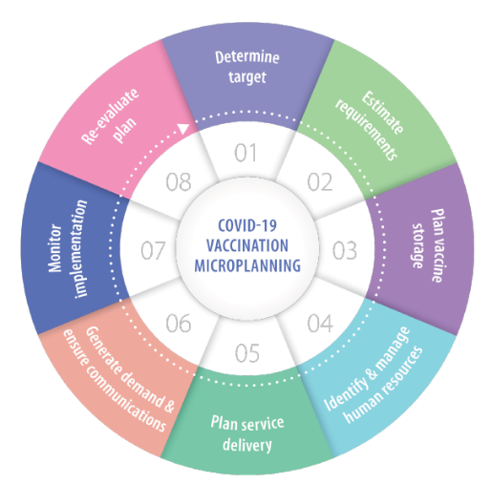
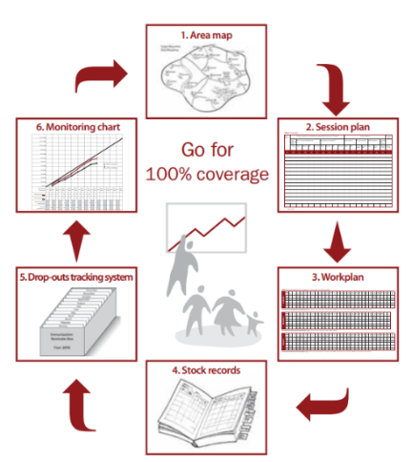
Synergies: Many COVID-19 vaccination tools and guidance are grounded in pre-existing immunization system guidance
Example: COVID-19 vaccination microplanning based on RI microplan guidance
  Source: WHO African Region Guidance on Routine Immunization Microplanning:
    https://www.who.int/immunization/sage/9_Final_RED_280909.pdf

Slide 25
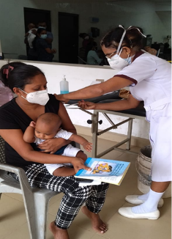
Synergies between COVID-19 vaccination and routine childhood immunization
Sri Lanka¹ – combined delivery strategies
Bolivia² – strengthened AEFI surveillance
RI sessions provided opportunity to screen parents for C-19 booster doses and provide/motivate for vaccination
Few targeted questions facilitated to identify high risk unvaccinated household individuals (e.g., above 60 years, parents with comorbid conditions, immune suppressed individuals) and get them to community or mobile clinics
Sites of mass vaccination complies with AEFI’s technical standards for prevention and care.
Relying on multidisciplinary perspectives from outside Ministry allowed for more detailed investigation and analysis process of serious AEFI cases
1. SEARO Regional Working Group meeting March 2022. WHO. Sri Lanka country experience on combining routine immunization sessions and COVID-19 vaccination.
2. Bolivia. Mini-cPIE results. November 2021.
Seek synergies with COVID-19 vaccination delivery to strengthen immunization and primary health care across life course(e.g. school-based vaccination; adolescent and adult vaccination programmes, including health workers, pregnant women, and the elderly; integrate with other immunizations and health services, when feasible).
Notes:
In terms of country examples, Sri Lanka has already been working toward combined service delivery of both COVID-19 vaccines and routine immunization, partly to help deal with the strained human resources, and in Bolivia, the investments toward AEFI surveillance of COVID-19 vaccine are helping to strengthen overall AEFI surveillance.
It’s important to note that we received feedback expressing concerns about overly promoting combined vaccine delivery because of the potential risk of spill over of COVID-19 vaccine hesitancy. The examples from Sri Lanka and other countries in the regiona; presentations shows that it’s at least feasible in some settings but it probably needs to be carefully considered based on local context. Next.
We do have the recommendation to seek synergies with COVID-19 vaccine delivery but at end mention “when feasible” . Next slide.

Slide 26
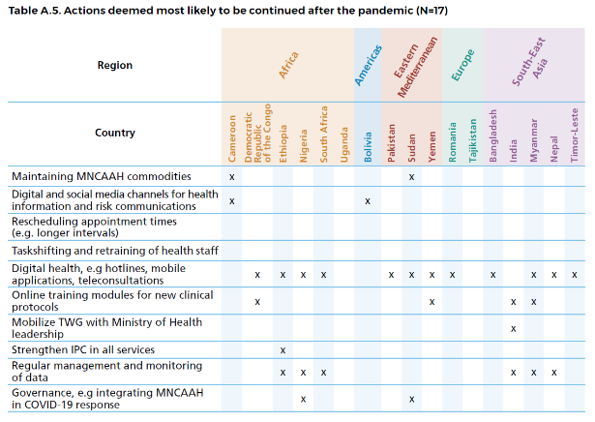
Synergies between COVID-19 vaccination and routine childhood immunization
Invest in robust data systems including expansion of digital solutions and electronic information systems
Source: Maintaining the provision and use of services for maternal, newborn, child and adolescent health and older people during the COVID-19 pandemic: Lessons learned from 19 countries. Geneva: World Health Organization; 2021.
Notes:
There has been a lot of interest in the topic of digital solutions. WHO colleagues with the Department of Maternal, Newborn, Child and Adoloscent Health and Ageing have been supporting 19 countries since the beginning of the pandemic. In their report published last year, countries were asked about what actions they deemed most likely to be continued after the pandemic. The overwhelming majority reported digital health technologies. In the short term, there’s likely to be variability as to which digital tools used for COVID-19 vaccine can be applicable to the immunization programme over the long term. But more importantly over the long term, there’s clearly an increased receptivity and interest to adopt and integrate digital technologies into the health system. Next.
So we have the recommendation to invest in data systems including expansion of digital solutions and electronic information systems.

Slide 27
Conclusion
  Over two years of health system strain and disruptions
  Urgent need to close immunity gaps, recover immunization programmes, and prevent risk of outbreaks
  Goal is to build back better and not just return to pre-pandemic levels
  Transformative opportunity to leverage immunization recovery and COVID-19 vaccination toward resiliency and strengthening of primary health care and leave no one behind across the life course
Notes:
In conclusion, there has now been over two years of health system strain and disruptions in many countries. There’s an urgent need to close immunity gaps, recover immunization programmes, and prevent risk of outbreaks. But the goal is to build back better and not just return to pre-pandemic levels. Right now, we have a transformative opportunity to leverage immunization recovery efforts and COVID-19 vaccination toward resiliency and strengthening of primary health care and leave no one behind across the life course. Next slide

Slide 28
Extra slides

Slide 29
Immunization Recovery at Risk: Domestic Financing Setbacks
52 countries (27% of all countries) will not return to pre-COVID-19 levels of total government spending per capita by 2026 based on World Bank projections¹
Income group | Number | Countries of greatest concern
Low | 7 | Afghanistan, Burundi, Liberia, Mozambique, Sierra Leone, South Sudan, Sudan
Lower-middle | 17 | Algeria, Angola, Bolivia, Cameroon, Comoros, Republic of Congo, Djibouti, Eswatini, Kiribati, Lesotho, Micronesia, Nigeria, Papua New Guinea, Sao Tome and Principe, Timor Leste, Vanuatu, Zambia
Upper-middle | 14 | Belize, Botswana, Costa Rica, Dominica, Ecuador, Fiji, Jordan, Maldives, Mexico, Namibia, South Africa, St Lucia, Surinam, Turkmenistan
High income | 14 | Antigua and Barbuda, The Bahamas, Bahrain, Iceland, Kuwait, Nauru, New Zealand, Oman, Palau, Qatar, Saudi Arabia, St Kitts and Nevis, Trinidad and Tobago, UAE
Total | 52
¹ Kurowski et al. From Double Shock to Double Recovery - Implications and Options for Health Financing in the Time of COVID-19, Technical Update: Widening Rifts. World Bank, September 2021

Slide 30
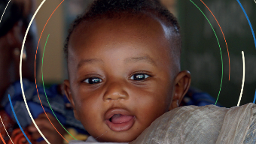
Immunization Agenda 2030 (IA2030): sustaining and advancing immunization coverage during the COVID-19 pandemic
Current context
IA2030 opportunities and focus
Global priority is rapid and equitable scale-up of COVID-19 vaccines
Disruption of immunization and other essential primary health care services due to pandemic and lockdowns
Resources drawn away from routine vaccination activities
Risk of Covid-19 vaccine roll-out impact in vaccine acceptability
Countries using new approaches to target adults
Immunization as a global priority
Strong case for role of vaccine deployment in economic recovery and global security
Focus on recovery and do no harm
Need for collective action to rebuild essential services & systems, while reducing number of zero-dose children
‘Umbrella’ partnership models emerged (e.g., COVAX, ACT-A,…)
Opportunity for life course immunization approach
Source: https://www.immunizationagenda2030.org/

Slide 31
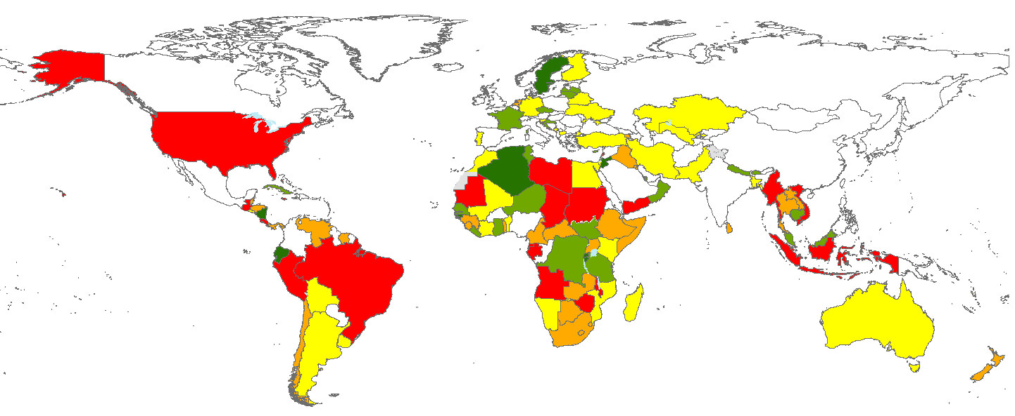
92% (117 of 127) countries reported some extent of disruptions in at least one essential health service
Essential health services disruptions persist across all regions and income levels, Quarter 4 2021
No data
Not applicable
Percentage of services disrupted per country
The designations employed and the presentation of material in this publication do not imply the expression of any opinion whatsoever on the part of WHO concerning the legal status of any country, territory, cito or area of its authorities, or concerning the delimitation of its frontiers or boundaries.
Dotted and dashed lines on maps represent approximate border lines for which there may not yet be full agreement.
Source: Round 3 Global pulse survey on continuity of essential health services, Nov-Dec 2021 (reflecting situation during previous 6 months)
Denominator: represents responses from countries/territories that responded to at least one survey section and consented to data sharing agreement.
Services include 66 services from the following areas: primary care, emergency, critical and operative care, rehabilitation, palliative care, cancer care, community care, and tracer services for reproductive, maternal, newborn, child and adolescent health and nutrition, immunization, communicable diseases, neglected tropical diseases, mental, neurological and substance use disorders, and care for older people

Slide 32
COVID-19 pandemic led to major backsliding on childhood vaccinations in 2020
Infant immunization coverage [third dose of diphtheria, tetanus, and pertussis (DTP-3)] dropped back to 2009 levels (83%)
23 million children missed out on basic vaccines through routine immunization services in 2020 (3.7 million more than in 2019)
Most of these – up to 17 million children – did not receive a single vaccine (zero dose children*)
* Zero dose children defined as those lacking DTP1
Source: 2020 WHO/UNICEF Estimates National Immunization Coverage (WUENIC 2020), 15 July 2021
https://www.who.int/news/item/15-07-2021-covid-19-pandemic-leads-to-major-backsliding-on-childhood-vaccinations-new-who-unicef-data-shows

Slide 33
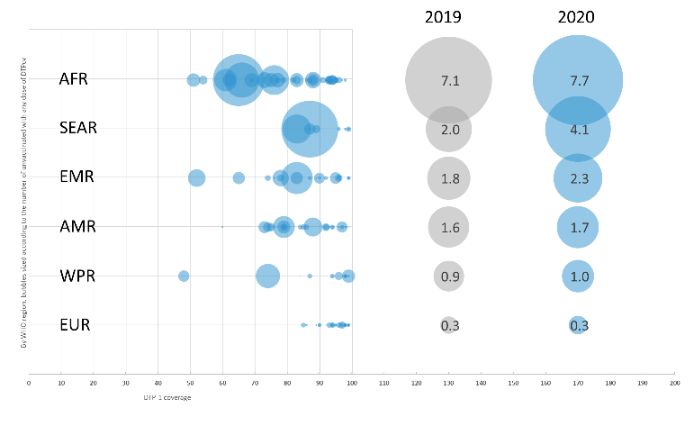
Number of “zero-dose children*” increased across all regions in 2020
Zero-dose children live disproportionally in the African continent & in countries affected by conflict.
Largest increase in SEAR (over double)
Regions with strictest lockdowns experienced largest increases in zero dose children, because service provision & especially outreach were affected.
* Zero dose children defined as those lacking DTP1
Source: WUENIC 2020, 15 July 2021. https://www.who.int/news/item/15-07-2021-covid-19-pandemic-leads-to-major-backsliding-on-childhood-vaccinations-new-who-unicef-data-shows

Slide 34
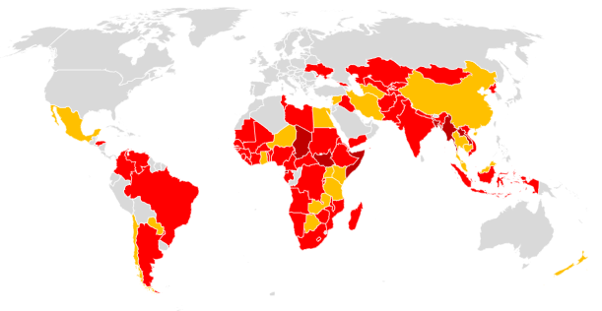


Millions are at increased risk of vaccine preventable diseases due to cancelled or delayed campaigns* due to COVID-19 since March 2020
The impacts of cancelled or delayed VPD campaigns are expected to first be seen with measles outbreaks as >75 million children in 25 countries have not received planned measles vaccine.
Countries with delayed or cancelled campaigns
At least one campaign delayed, no campaign incomplete (21)
At least one campaign delayed and not conducted, no campaign cancelled or status unknown (60)
At least one campaign cancelled or status unknown (8)
*Vaccine Preventable Disease Campaigns:
Polio (IPV, mOPV2, bOPV)
Meningitis A
Measles – rubella (M, MR, MMR)
Cholera (OCV)
Yellow Fever
Tetanus (Td)
Source: WHO, Immunization Repository – 2022-02-23
Notes:
CURRENT IMMUNIZATION CAMPAIGN DISRUPTION NUMBERS
Campaigns are not to replace RI but as a supplementary activity and provide an opportunity to those who may have otherwise been missed by routine services:
To respond to outbreaks
To address population immunity gaps in a specific population/group
To introduce a new antigen/vaccine
Mass vaccination campaigns pause recommended in March 2020 due to SARS CoV-2 transmission
Polio Oversight Board (POB) of the Global Polio Eradication Initiative (GPEI)
Strategic Advisory Group of Experts on Immunization (SAGE)
May 2020 immunization partners established an online repository – Campaign Delay Tracker using an existing WHO Immunization Repository platform.
Mass vaccination campaigns were heavily disrupted by COVID-19.
In May 2020, 105 out of 183 (57%) planned campaigns were postponed or cancelled in 57 countries with an estimated 796 million postponed or missed vaccine doses.
In February 2022, 83 planned campaigns in 60 countries were still postponed that were planned with an estimated 330 million postponed or missed vaccine doses includes 25 measles specific campaign (30%) with an estimated >75 million postponed or missed doses.
The delayed campaigns represent pre-COVID-19 estimates and do not reflect the immunity gaps created by COVID-19 disruptions.

Slide 35
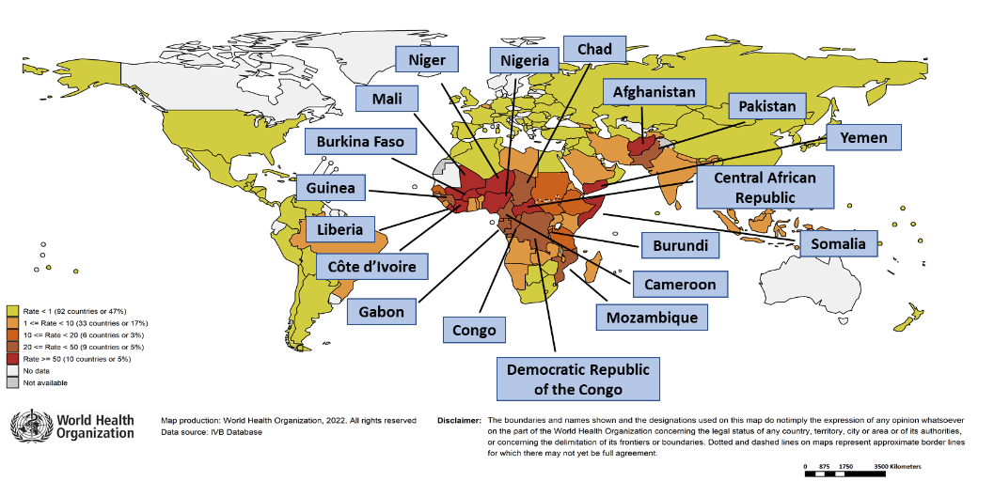
Risk of measles outbreaks are of increasing concern particularly in Africa and South Asia, posing a global health security threat to the US
Country | Cases | Rate/M
Somalia | 6,029 | 369
Yemen | 4,340 | 142
Liberia | 462 | 89
Côte d'Ivoire | 2,352 | 87
Afghanistan | 2,957 | 74
Burkina Faso | 1,573 | 73
Mali | 1,357 | 65
Niger | 1,552 | 62
Central African Republic | 285 | 58
Nigeria | 10,782 | 51
Chad | 775 | 46
Pakistan | 9,313 | 41
Gabon | 89 | 39
Democratic Republic of the Congo | 3,447 | 37
Guinea | 456 | 34
Burundi | 370 | 30
Mozambique | 835 | 26
Congo | 145 | 26
Cameroon | 645 | 24
Notes: Based on data received 2022-02 - Surveillance data from 2021-01 to 2021-12 - Incidence: Number of cases / population * 1,000,000 - Population data: World population prospects, 2019 revision
Notes:
MEASLES – EARLY WARNING
Measles outbreaks have persisted during COVID pandemic with many categorized as large or disruptive (>20 case per million) and despite:
Non-pharmaceutical COVID-19 interventions: school closures, reduced domestic and international travel restrictions, physical distancing, mask mandates;
Disruptions in national vaccine preventable surveillance systems/laboratory networks; and,
Natural immunity gained from large and disrupted measles outbreak 2017-2019.
Measles resurgence is likely to occur before an increase in the incidence of less transmissible diseases are noticed and outbreaks in Africa and South Asia pose a global health security threat to the US – measles as tracer or early warning.
Measles outbreaks can highlight weaknesses in routine vaccination programs and immunity gaps due to the COVID-19 pandemic.

