Slide 1
Comprehensive training
28 June – 21 July 2022
HOSTED BY GAVI, WHO, UNICEF & US CDC

Slide 2
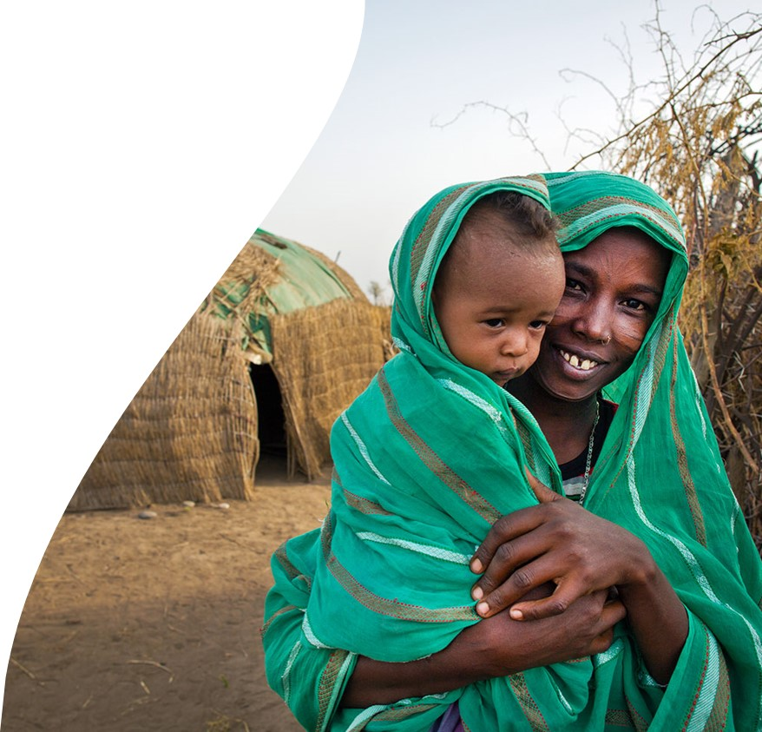
Improving equity in immunisation
Dr. Eric Sarriot
Senior Manager, Country Health Systems
GAVI – Health Systems and Immunisation Strengthing

Slide 3





Definitions
Zero-dose children are those who have not received any routine vaccines. For operational purposes, Gavi defines zero-dose children as those missing a first dose of diphtheria-tetanus-pertussis containing vaccine*.
Under-immunised children are those who have not received a full course of routine vaccines.
For operational purposes, Gavi defines under-immunised children as those missing a third dose
of diphtheria-tetanus-pertussis containing vaccine.
Missed communities are home to clusters of zero-dose and under-immunised children.
These communities often face multiple deprivations and vulnerabilities, including lack of services, socio-economic inequities and often gender related barriers.
Equity: The organising principle of the Alliance’s 2021-2025 strategy, whose vision is Leaving
no-one behind with Immunisation. This entails a laser focus on using all Gavi levers to reach
missed communities and zero-dose children with immunisation

Slide 4
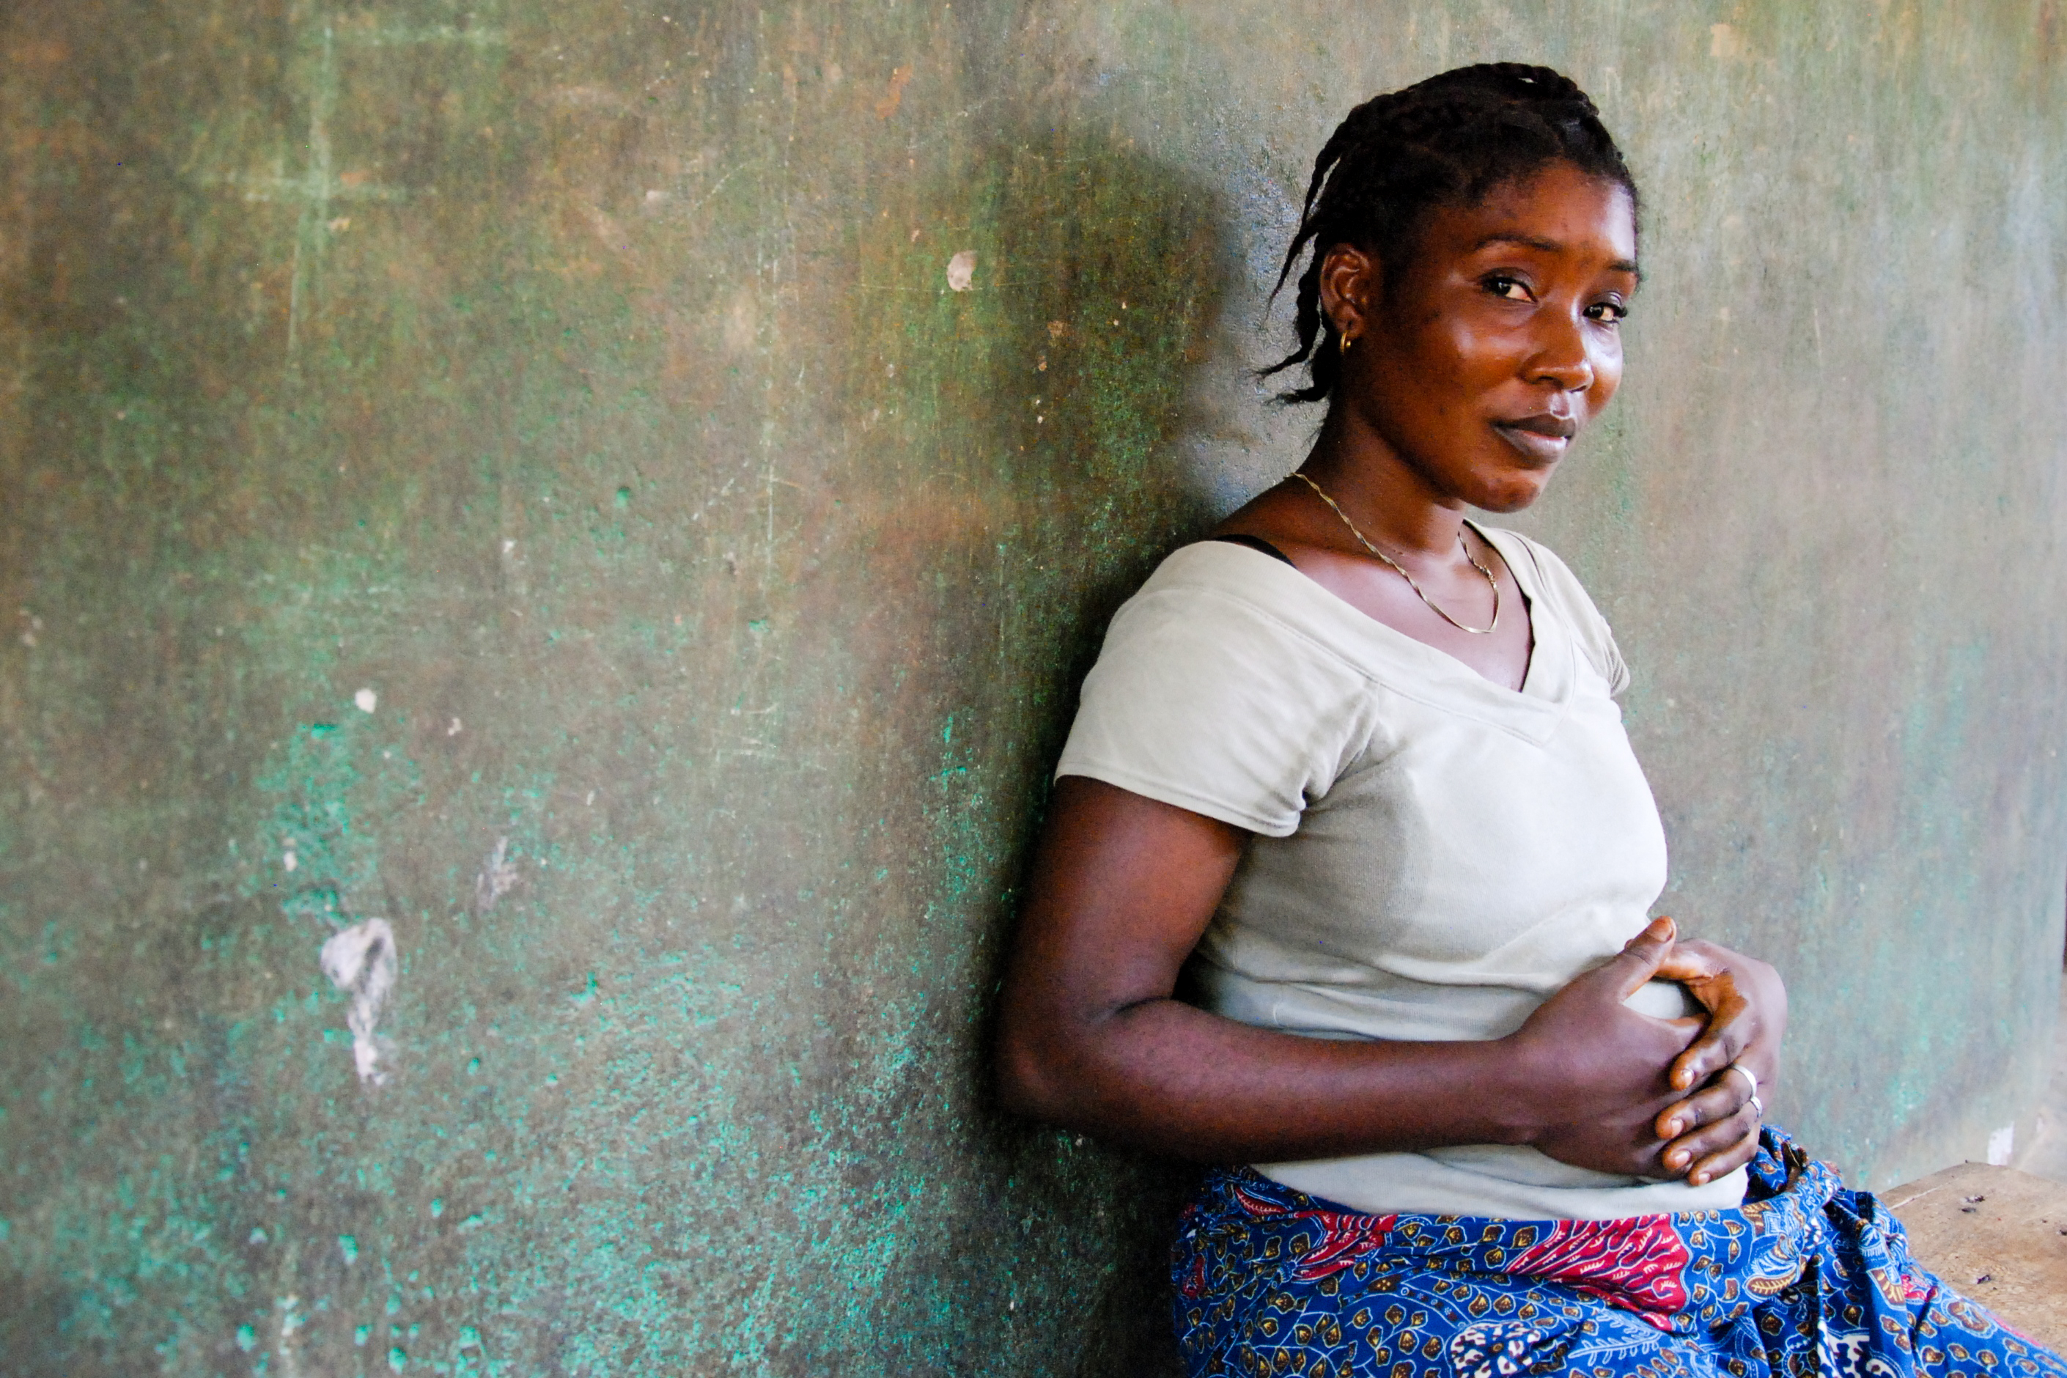
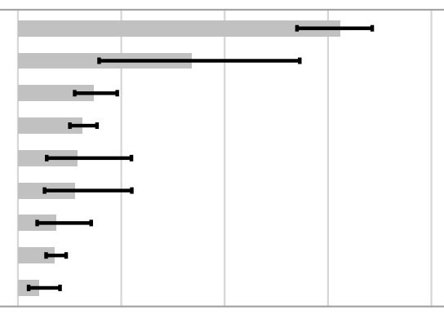


What is the context of zero dose? (1/2)
POVERTY
GENDER
ETHNICITY
Afghanistan
Nuristani
Baloch
Hazara
US $1.90
POVERTY LINE
Pashtun
Other
Pashai
Turkmen
Tajik
Uzbek
0%
25%
50%
75%
100%
Zero dose prevalence
47% zero dose less likely to have mother receiving antenatal care or skilled birth attendance
2 out of 3 zero dose children live in households surviving on less than $1.90 a day
1 in 8 children in Gavi-supported countries are Zero dose, and yet they account for nearly half of all children dying from vaccine preventable diseases.
Large differences in zero-dose prevalence by ethnic groups in many countries

Slide 5
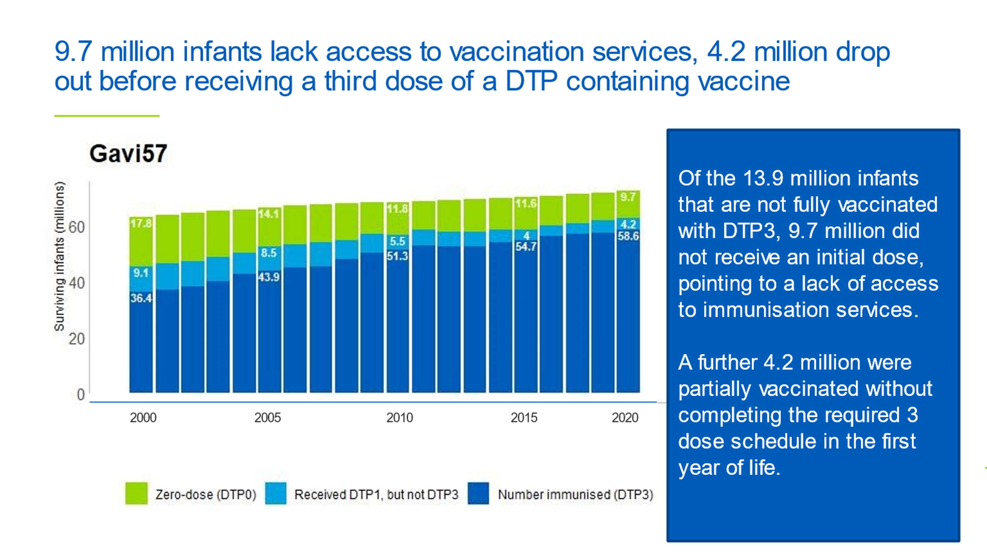
What is the context of zero dose? (1/2)
Every year approximately 13.9 million of the 72.5 million children targeted with Gavi support do not receive their third dose of DTP-containing vaccine.
70% of these children, 9.7 million in total, do not receive a single dose of DTP- containing vaccines and are defined as “zero-dose”.
Reduction in number of zero-dose has plateaued over last decade pointing to persistent inequities

Slide 6





Why should we invest in reaching zero-dose children and missed communities?
Sustainable Development Goals: Reaching every child with immunisation is a first, realistic step to leaving no one behind and universal health coverage
Value for money: Immunisation most cost-effective health intervention – countries
will need to prioritise health spending as they recover from COVID
Greatest impact: Zero-dose children often live in missed communities suffering multiple deprivations, who are least resilient to VPDs
Foundation for Primary Health Care: Immunisation services can be a pathfinder
for reaching missed communities with essential PHC services
Health security: Missed communities' potential source of VPD outbreaks

Slide 7
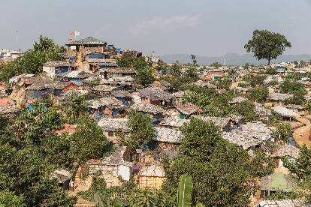
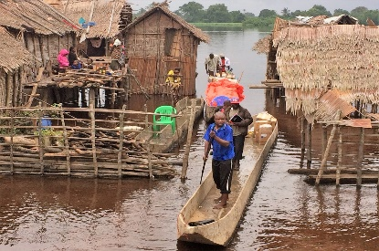
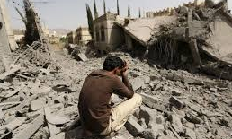
Identifying zero dose children and missed communities is the first step – 50% in urban/remote rural and conflict regions
Urban poor
Substantial variations between & within countries
DRC & Ethiopia have largest number of zero dose children in remote rural areas
Nigeria has the largest number of zero dose children impacted by conflict
Initial Analysis
Remote communities &
nomadic groups
Populations in conflict settings
Notes:
Source: WorldPop Analysis (from ERG pre-reads: Jan 2020)
Further analysis being followed-up by M&E:
Definition/threshold for “conflict”
Are we sure coverage in slums is captured appropriately in “urban” category.
WorldPop Exec Summary for ERG Meeting:
Summary:
~10%: urban: defined as urban areas, noting that specific data on urban poor is not available
~10% remote rural: defined as est. travel time to nearest town/city with >50k people is >180 mins
~30% conflict settings: defined as areas within 50km of registered conflicts with fatalities from Jan 2015 to Dec 2016
Across all GAVI focus countries, more than 30% of children that have not received DTP1/DTP3/MCV live in areas impacted by recent conflict.
Over 10% of children that have not received DTP1/DTP3/MCV in GAVI focus countries live in areas that are more than 3 hours travel time from the nearest town or city, while a similar number live in urban areas.
Substantial variations exist between and within countries, with the children not receiving DTP1/DTP3/MCV living almost exclusively in conflict‐affected areas in some countries (e.g. Yemen, Iraq), and substantial numbers living in remote rural locations for other countries (e.g. Republic of Congo, Chad).
The largest numbers of children living in remote rural locations that have not received DTP1/DTP3/MCV are in DR Congo and Ethiopia, while the largest numbers living in areas affected by recent conflict are in Nigeria.
Large variations exist in the spatial concentration of children that have not received DTP1/DTP3/MCV, with the vast majority clustered within small areas for some countries and more equally spread in others.
The distributions and numbers of under/un‐vaccinated under 1 year old children show strong similarities between the three doses examined, but differences exist, with those not receiving DTP3 and MCV more concentrated in urban areas than for DTP1, and children not receiving DTP1 relatively more concentrated in conflict‐affected areas.
Other data:
Urban slums:
Rapid growth of cities means that over 4 billion people now live in urban areas (nearly 50% more than in 2000), whose rapid and unplanned growth means public services are often not reliably available.
As a result, a growing number of under-immunised live in urban and peri-urban areas including slums
By 2050
68% of the world’s population will live in urban rather than rural areas
2bn more people will be in urban areas in Africa & Asia
Remote rural:
18 years ago (when Gavi started) most of the under-immunised lived in rural communities beyond the reach of routine immunisation services - efforts to extend services mean many of these communities are now being reached.
Although the majority of under-immunised still live in remote areas, there has been a shift to urban areas due to migration and urbanisation
Fragile & conflict settings:
Fragility is also a growing challenge with more under-immunised now living in fragile areas.
For example, the number of state and non-state conflicts has almost doubled over the last ten years
In 2017, of 9 highest countries receiving refugees, 8 are Gavi countries (UNHCR 2017) (Bangladesh, Sudan, Uganda, DRC, Ethiopia, Cameroon, Angola and Tanzania – noting that the country with the highest number is Turkey)
Cumulative total of people forcibly displaced from their homes worldwide was 68.5m at the end of 2017 (i.e. the forcibly displaced population has now overtaken that of the UK). This includes 25.4m refugees, over half of whom are younger than 18.
Nearly 1 person is forcibly displaced every 2 seconds due to conflict or persecution
An estimated 10m displaced people have no nationality. They are denied access to basic human rights such as education, healthcare, employment and freedom of movement
>70 million people displaced worldwide; 84% refugees in developing countries

Slide 8
What is the impact of COVID on the zero-dose agenda?
Equity agenda more relevant than ever
  Many more children will be zero-dose
  Exacerbated inequities, highlighted vulnerability of missed populations
  (e.g., urban poor)
Will exacerbate challenge of
reaching zero-dose
  Reduced fiscal space (may not mean reduced health expenditure)
  Population movement – will stretch services and conflate data
  Diverted health system capacity for COVID response
  Impact on trust and demand
Also presents opportunities
  Highlights threat of infectious disease outbreaks
  Exposes weaknesses in health systems
  Catalyses efforts to increase integration within immunisation
  Catch-up efforts are an opportunity to reach previously missed communities
How can we address these challenges and
capture the opportunities?

Slide 9
How do we tailor the approach in different contexts?
(e.g. Low coverage & acute fragility)
Illustrative
Expected outcome: increased availability of essential services and coverage in key regions
IDENTIFY
REACH
MONITOR & MEASURE
ADVOCATE
Country context
Zero-dose children reside in most areas – less precision needed to identify
Partner with humanitarian actors to identify missed populations in conflict areas
Triangulate data e.g., integrate EPI in assessment of migrants, IDPs, refugees
Focus on identifying barriers for refugees and large displaced populations
Focus on scaling up basic health services/ PHC evolve from outreach to strengthen facility-based EPI
Specific efforts to rebuild trust in conflict-work with affected communities
Partnerships with humanitarian actors and local CSO in areas inaccessible for vaccine supply and service delivery
Monitoring focused on basic operational data e.g., number of sessions conducted
Triangulation with other data sources
Explore community monitoring
Agree on critical indicators amongst partners
Targeted surveys
Explore integrated implementation research
Focus on advocating for availability of maintaining essential health services (e.g., risk of outbreaks)
Partner with humanitarian agencies to –try to align – multiple authorities in conflict settings
Advocate for access to geo / populations
Low coverage nationwide
Very weak health system
Many parts of country conflict-afflicted – limited access
Fragmentation / weak governance and coordination
Humanitarian partners

Slide 10
How do we tailor the approach in different contexts?
(e.g., High coverage, high concentration)
Illustrative
Expected outcome: targeted improvements in coverage in specific zero-dose communities
IDENTIFY
REACH
MONITOR & MEASURE
ADVOCATE
Country context
Triangulation of data to identify clusters of zero-dose children (e.g., in urban areas; migrants, ethnic minority)
Special studies/ research to understand deep rooted demand side barriers
Focus on identifying access side barriers at community level, e.g. service quality, anti Vx lobby, AEFI issues
Tailored strategy to reach the under served population – will require tailored community engagement and service delivery approaches
Partnerships with CSO; community/faith leaders may be needed to access marginalised populations
Ensure HRH and communication adapted and sensitive to local gender dynamics, language / culture
Targeted cluster surveys in communities to learn and adapt strategies
Monitoring focused on subnational/community based data in target communities
Rapid research to adapt strategies
Advocate for prioritisation of services and financing for marginalised groups
Help build accountability framework at local level to reach marginalised communities
Work with and identify existing advocacy platforms and local government institutions
Use participatory methods to work with community advocacy
in specific missed communities
High coverage nationwide
Concentration of zero dose in localised communities or pockets
Strong systems
Decentralised governments?

Slide 11
THANK YOU !

