Slide 1
The Evolution of Nigeria’s COVID-19 response:
How Nigeria have worked to promote vaccine demand, manage the infodemic and restore routine immunization
Presented during
Comprehensive Training on Promotion of Vaccine Demand
to Maintain and Restore Routine Immunization
Tuesday 28th June 2022
Dr Bassey Bassey Okposen
National Primary Health Care Development Agency (NPHCDA)
1

Slide 2
Objectives of the Presentation
To share with the trainee the experiences on how Nigeria have worked to promote COVID-19 vaccine demand and the innovative efforts to get more people immunized, manage the infodemic and restore routine immunization

Slide 3
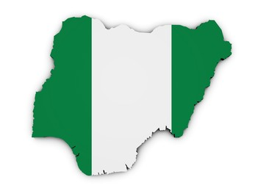
Outline:
The Evolution of COVID-19 Vaccine Rollout in Nigeria
Where we are on COVID-19 vaccine rollout and
Routine Immunization
01
What We Have Done to Promote Vaccine Demand
02
What we are doing to restore routine immunization
03
How we have managed the Infodemic
04
Lessons Learnt and Practical Advice
05
Next Steps: What We Will Do
06

Slide 4
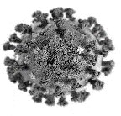
Where We Are on COVID-19 Vaccine Rollout
Burden:
As at 28/0/2022, Nigeria has recorded a total of 256,958 confirmed cases of COVID-19 with 3,144 deaths
COVID-19 Pandemic has affected PHC service delivery:
The COVID-19 pandemic has resulted in an observed decline in access, demand and provision of Routine Immunization (RI) and Primary Health Care Services PHC (RMNCH+N) services, though now improving
The COVID-19 pandemic is affecting societies and economies at their core. Without urgent responses, suffering will escalate, jeopardizing lives/livelihoods for years to come.
States and LGAs are being supported to ensure PHC services optimization

Slide 5
Nigeria has deployed several indigenous and innovative strategies to accelerate and improve on COVID-19 vaccine uptake:
Nigeria is collaborating with Donors/Partners and other stakeholders to roll out COVID-19 vaccines to develop herd immunity and stop the community transmission of COVID-19 virus in the country
The Federal Government through the National Primary Health Care Development Agency (NPHCDA) in collaboration with the Federal Ministry of Health and Partners plans to achieve at least 70% by December, 2022
Nigeria have deployed several indigenous and innovative strategies to accelerate and improve on COVID-19 vaccine uptake:
Phase 1 COVID-19 vaccine rollout was on 5th March 2021; and Phase 2 Launch was in May, 2021
Phase 3 (SCALES Strategy) was Launched in November 2021, and the revised Optimized SCALES 2.0 Strategy was launched on 22nd Feb., 2022

Slide 6
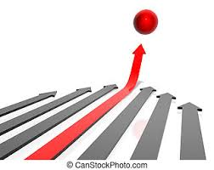
To achieve the set vaccination targets, Nigeria rolled out the indeginous and innovative ‘Optimized SCALES’ 2.0 strategy to ramp up vaccination across all the states in the country
S.C.A.L.E.S Strategy: Description
S.C.A.L.E.S Strategy:
Goal - To ensure effective, efficient, and timely distribution and utilization of Covid-19 vaccines available in-country towards the vaccination of all eligible 112m Nigerians and their children with RI vaccines
S
Service delivery system that delivers vaccines to all eligible persons integrated with other PHC services without compromising efficiency
C
Communication strategy involving targeted advocacy, intensive media engagement, community engagement and participation
A
Accountability system to track vaccination activities, detect and promptly address inappropriate and fraudulent activities
L
Logistics system to adequately forecast, efficiently distribute and track vaccines and ancillary supplies
The Optimized SCALES strategy is targeted to improve integrated service delivery, communication, accountability, logistics, electronic reporting and supportive supervision for the ongoing COVID-19 vaccination
E
EMID platform that provides a harmonised data system for reporting programmatic and logistic data to inform decision making
S
Supervisory system that is robust, leveraging multi-agency collaboration at all levels

Slide 7
As at 26th June 2022, a total of 34,345,916 eligible persons have received 1st dose of COVID-19 vaccine in Nigeria; 20.0% (22,343,792) have been fully vaccinated; 10.7% partially vaccinated and 1,661,579 given booster doses
There is adequate vaccines
in-country:
89.135 m doses of
COVID-19 vaccines
so far received
39 m doses as current
in-country stock
There are pending
vaccine allocations
Source: Daily Call-In Data

Slide 8
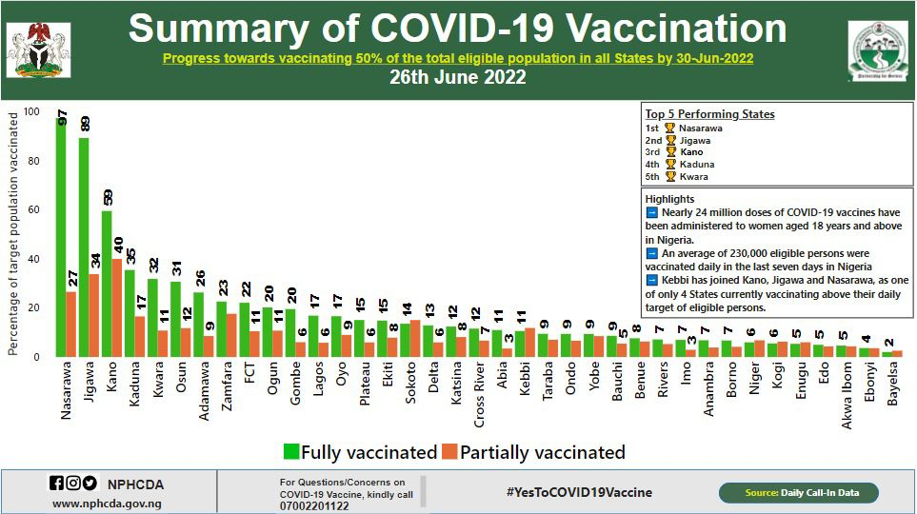
NPHCDA and the Federal Ministry of Health (FMoH) provide overall guidelines and technical support to States to ramp-up COVID-19 vaccination
Source: Daily Call-In Data
*Data is cumulative from start of vaccinations in March 2021

Slide 9
Trend of Monthly COVID-19 Vaccinations in Nigeria- Data as at 24th June 2022
Source: Daily Call-In Data

Slide 10
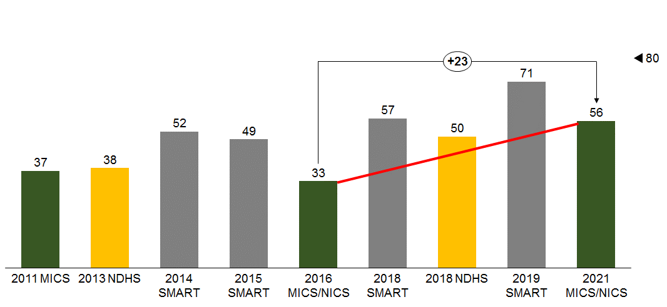
Routine Immunization (Penta 3) Coverage Trend in Nigeria, 2011 – 2021:
There has been a progressive improvement in the RI performance since after 2016, though a slight decline in 2021 due to the COVID-19 pandemic
MICS/NICS
NDHS
SMART
Source: MICS/NICS 2021, 2020 Population Projections (U1) and CHAI Analysis; *2021 MICS/NICS data looks at 2020 Birth Cohort (0-11 months)
Notes:
Measles Coverage (%) and Number of Children Unimmunized in 2018

Slide 11
There has been a very significant reduction in the Variance between the Administrative and Survey data in Nigeria – Penta 3 Coverage, by year %
Variance between Admin and Survey data in Nigeria – Penta 3 Coverage, by year %
Survey
Admin data
+48
+9
+37
+73
+34
+27
+13
+20
NDHS 2013
SMART 2014
SMART 2015
NICS/MICS 2016
NDHS 2018
SMART 2018
SMART 2019
NICS/MICS 2021
Source: DVD-MT, DHIS2, 2013 NDHS, 2014 SMART, 2015 SMART, NICS/MICS, 2018 NDHS and NERICC Data Team Analysis

Slide 12
Trends of PAPA RI-LQAS performance in 18 NERICC states showing proportion and number of Lots: 2017 - 2021
377
379
380
380
376
377
378
377
378
377
21 (6%)
11 (3%)
8 (2%)
2 (1%)
1 (0%)
1 (0%)
1 (0%)
40 (11%)
35 (9%)
40 (11%)
45 (12%)
30 (8%)
32 (9%)
85 (22%)
141 (37%)
148 (39%)
174 (46%)
173 (46%)
161 (42%)
209 (55%)
175 (46%)
196 (52%)
192 (51%)
204 (54%)
187 (49%)
172 (45%)
163 (43%)
117 (31%)
172 (46%)
169 (45%)
176 (47%)
139 (37%)
149 (39%)
21 (6%)
41 (11%)
52 (14%)
85 (23%)
11 (3%)

Slide 13
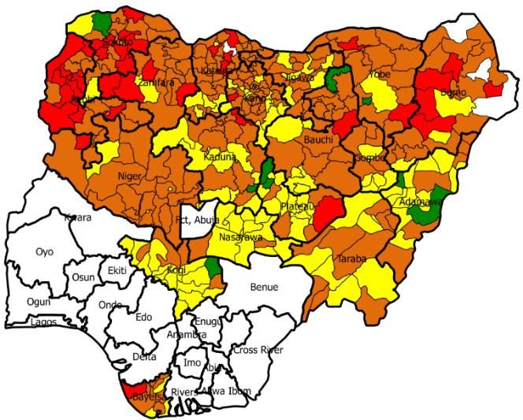
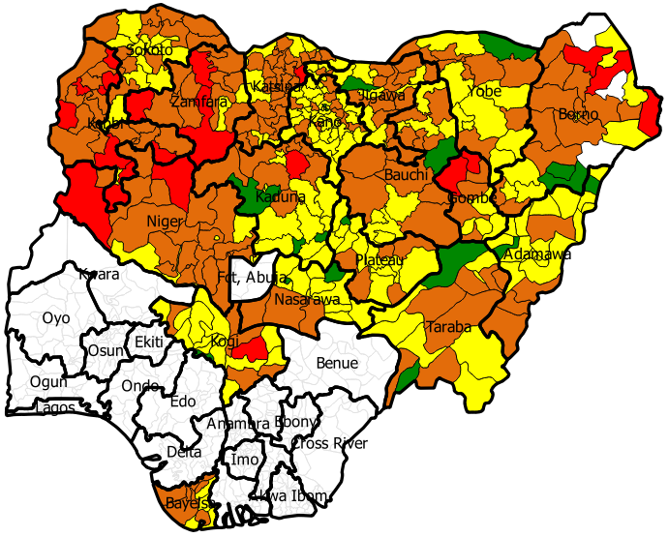
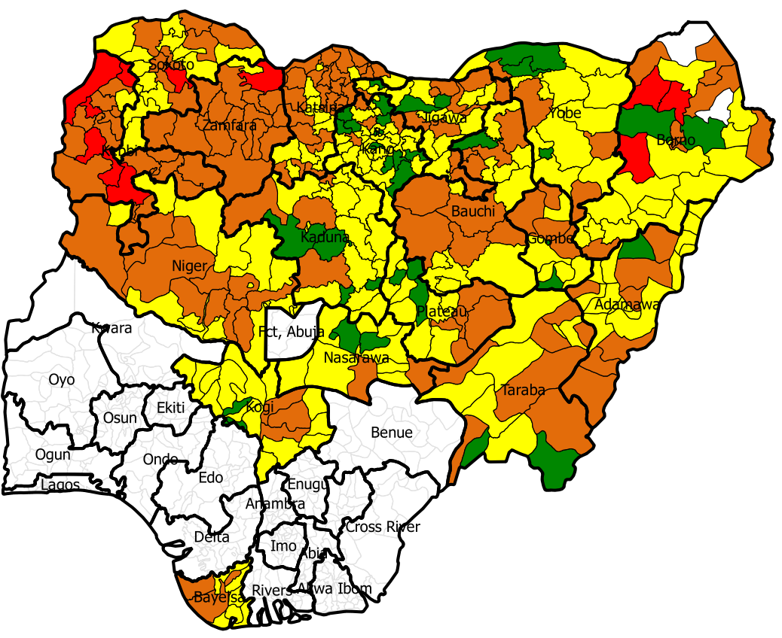
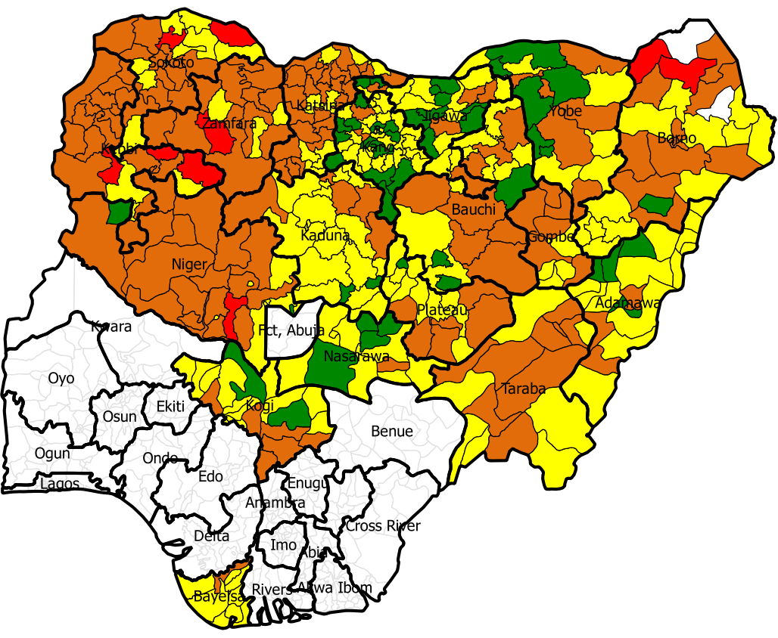
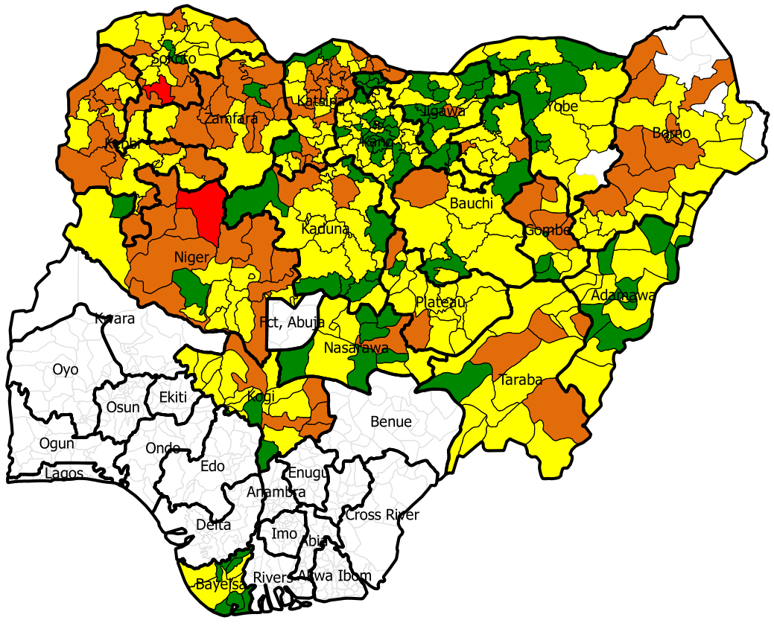
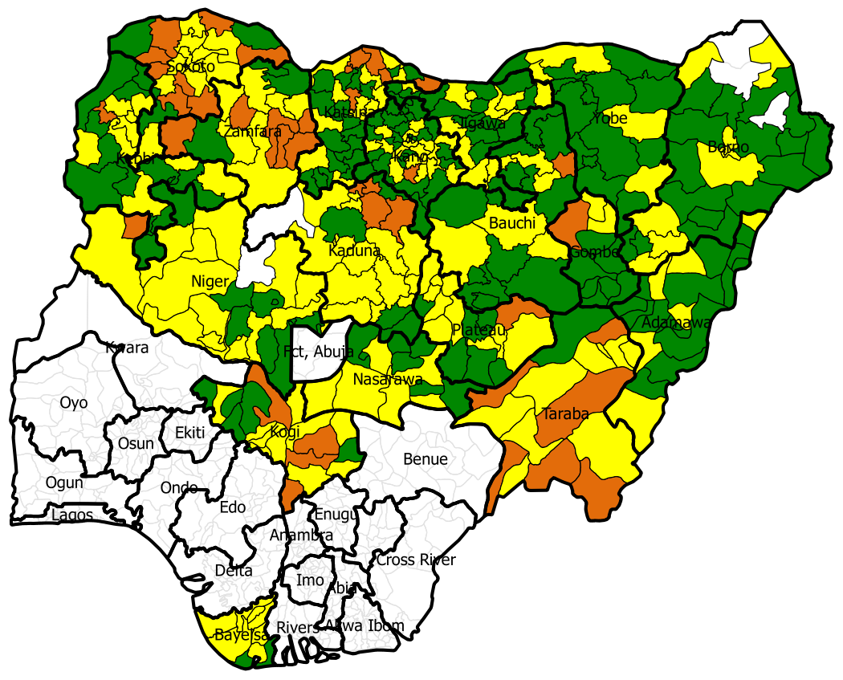
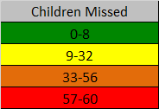
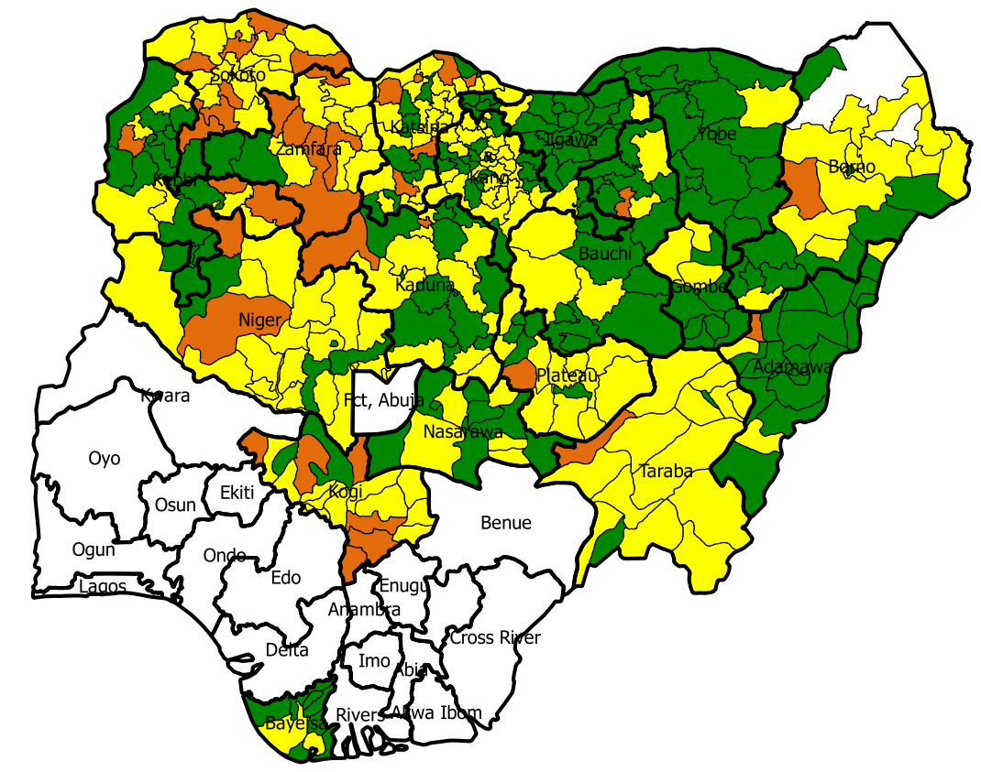
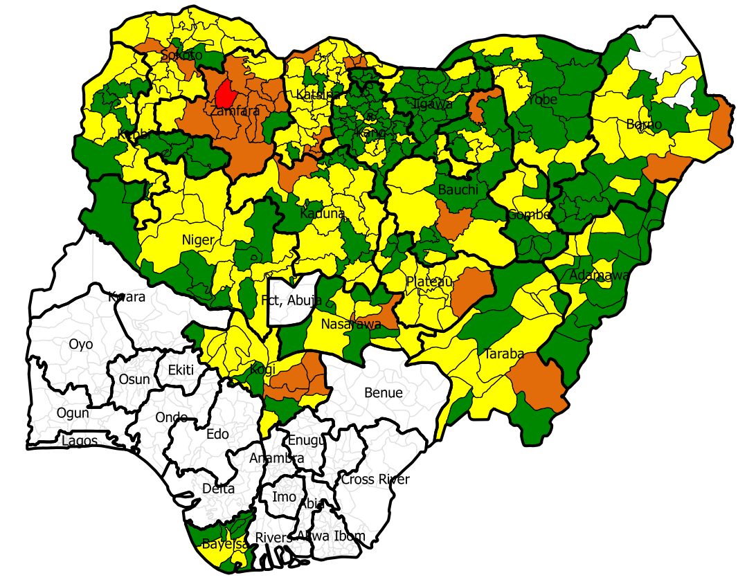
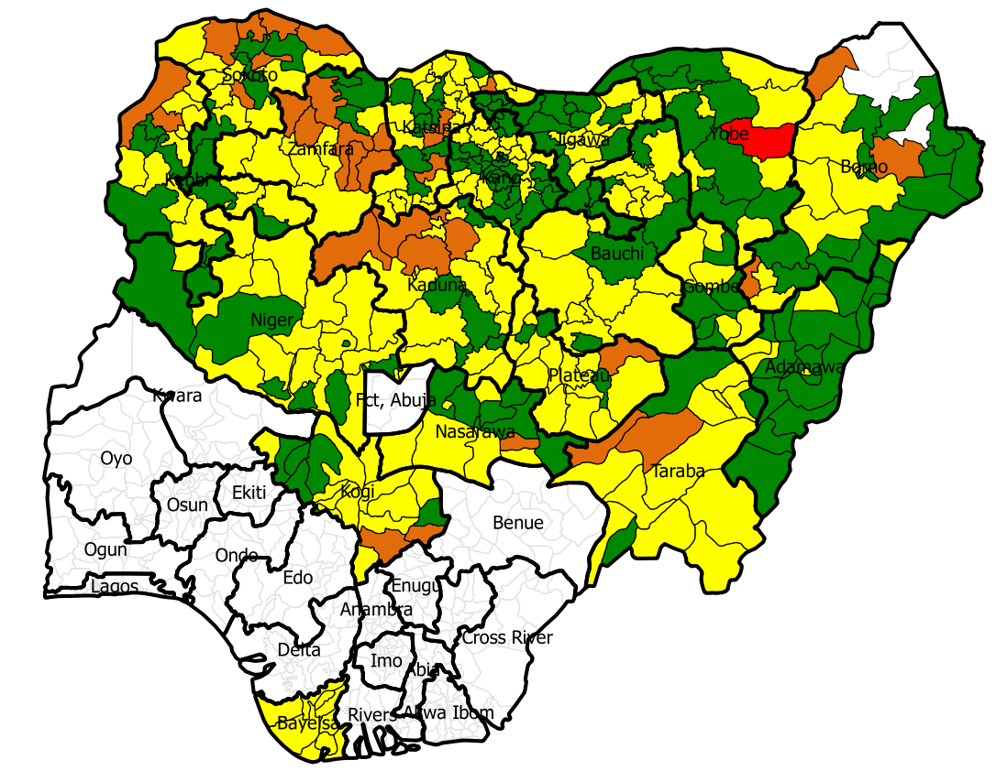
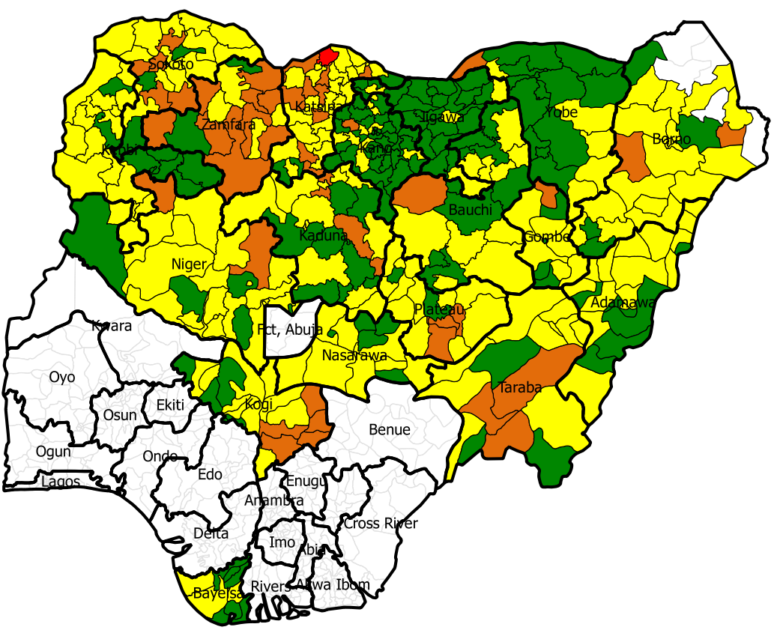
PAPA RI-LQAS results in 18 NERICC priority states, 2017-2021
Q4, 2017
Q1, 2018
Q2, 2018
Q3, 2018
n=380
n=377
Q4, 2018
n=379
n=380
Q4, 2021
n=377
n=375
Q3, 2019
Q2, 2019
Q4, 2020
Q1, 2019
n=378
n=377
n=378
n=377

Slide 14
Outline:
The Evolution of COVID-19 Vaccine Rollout in Nigeria
Where we are on COVID-19 vaccine rollout and
Routine Immunization
01
What We Have Done to Promote Vaccine Demand
02
What we are doing to restore routine immunization
03
How we have managed the Infodemic
04
Lessons Learnt and Practical Advice
05
Next Steps: What We Will Do
06

Slide 15
There were several immediate actions taken during the initial stage of the COVID-19 Lockdown in March 2020
At the Initial stage of the COVID-19 Lock down, the National Technical Working Group (TWG) and Strategy Group were established to coordinate the response. The team met daily to develop relevant guidelines/SOPs on the Preparedness and Response to COVID-19 for the health workers at the PHC facility and community mobilizers
Training Manual on Preparedness and Response to COVID-19 at PHC facility and Community level during the pandemic/SOPs for PHC Workers and Community members were developed
Cascaded trainings at all level were conducted using the training manual; and about 220,000 health workers and over 60,000 community mobilizers were trained
PPEs were provided to the health workers to ensure service delivery at the PHC during the lockdown (especially immunization and ante-natal care services)

Slide 16
There were several other immediate actions taken during the initial stage of the COVID-19 Lockdown in March 2020
Information Education and Communication (IEC) materials were developed and disseminated to the public/communities
Public service announcements (PSAs) were developed and aired to sensitized public on COVID-19 and disperse rumors
Animated videos for community awareness were developed; and sensitization
There were several virtual engagements with religious/traditional leaders, community members, opinion leaders and the CSOs etc
The strategy group (at national) still meet almost every day till date (and is chaired by the Executive Director of the Agency (NPHCDA)

Slide 17
NPHCDA and partners is supporting the states with resources for the vaccination of eligible persons to ramp up vaccination uptake within the states
States have been supported to expand the number of vaccination sites to improve access to the COVID-19 and routine immunization vaccinations
States have been supported with additional teams/funds to be able to conduct COVID-19 mass vaccination campaign integrated with routine immunization in the additional sites
Support have also been provided to states to procure canopies, chairs and tables for the mass vaccination sites at markets, malls and other high traffic areas
GIS maps are being used to identify high density population areas without health facilities for the establishment of Mass vaccination sites

Slide 18
To sustain the quality of the ongoing COVID-19 vaccination in the country that started since 5th March ,2020, Senior supervisors (NPHCDA & Partners) have been trained and deployed to support especially the identified poor performing states
The Agency have trained/re-trained and deploy senior supervisors to all the states, but with additional support to the poor performing states
The supervisors are deployed straight to identified poor performing LGAs in their states of assignment with specific terms of reference (TORs)
On a daily basis, the supervisors are being tracked with GTS for accountability, and are expected to submit ODK reports
The are rewards for outstanding monitors and sanction for any of the supervisors that would be found wanting
The states and the LGAs are also being supported to monitor the COVID-19 vaccine rollout

Slide 19
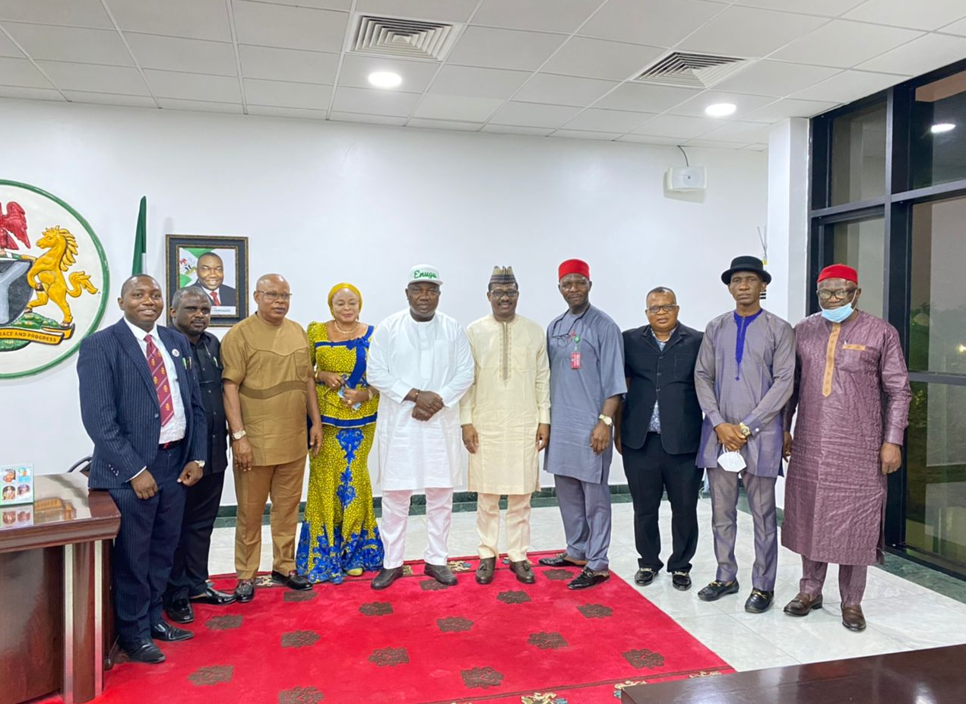
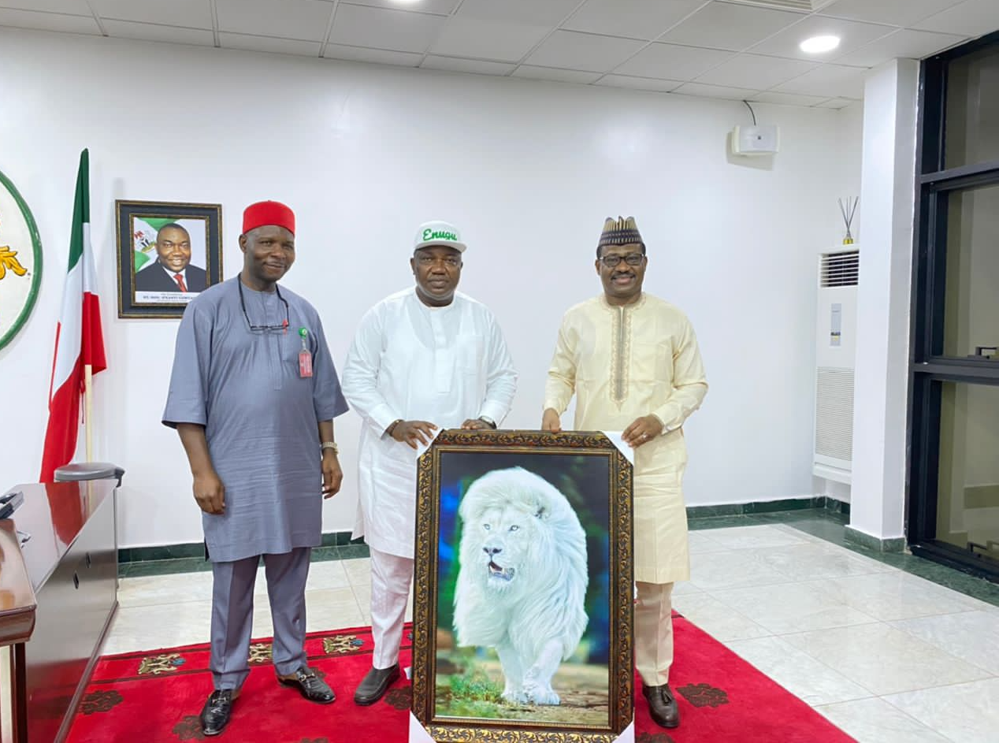
The Agency is engaging with the identified poor performing Zones/States to develop states-specific interventions: Below are some of the pictures during the ED/CEO’s visit to the South East Zone on 2nd – 4th February 2022
Photos showing His Excellency The Executive Governor of Enugu State, Deputy Governor, Senator Otazi, ED/CEO NPHCDA and Commissioners for Health (South East) during the visit to SEZ
Photos showing His Excellency The Executive Governor of Enugu State, Senator Otazi (Senate Committee Chair on PHC) and ED/CEO NPHCDA

Slide 20
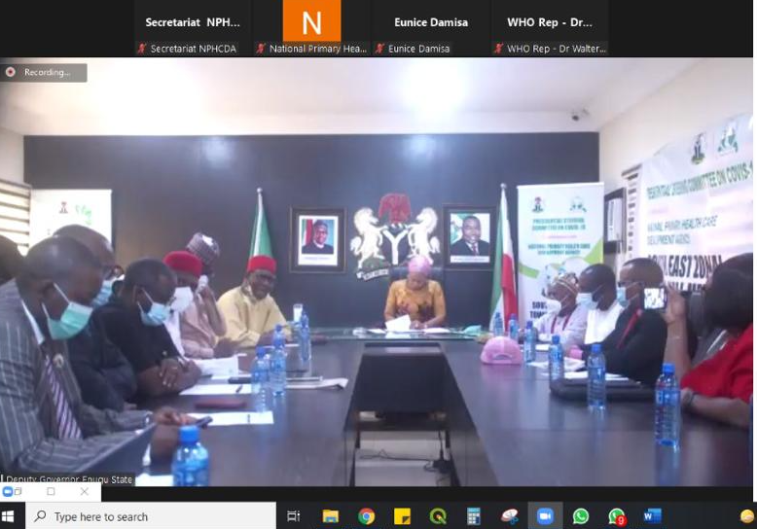
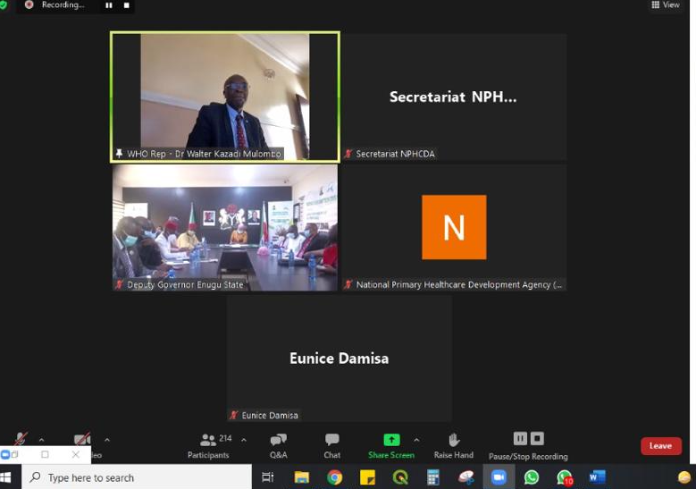
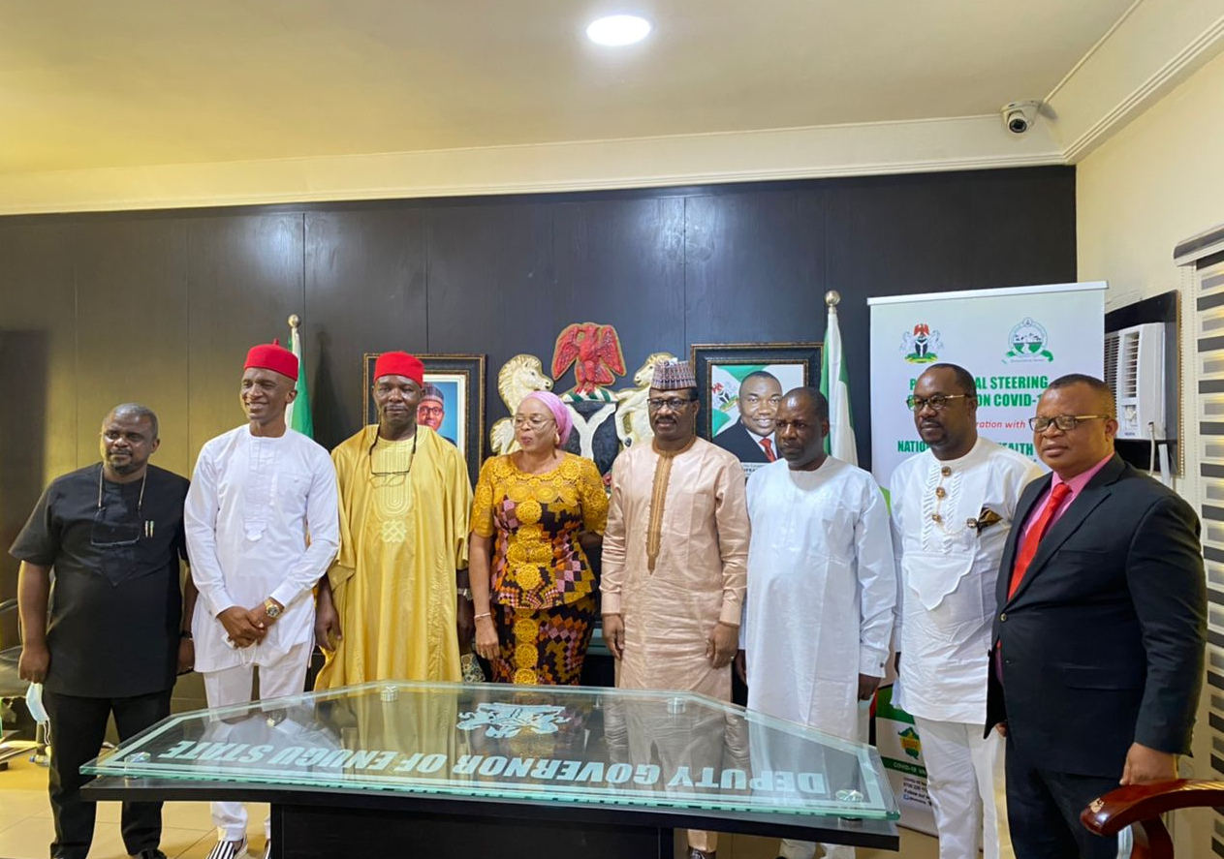
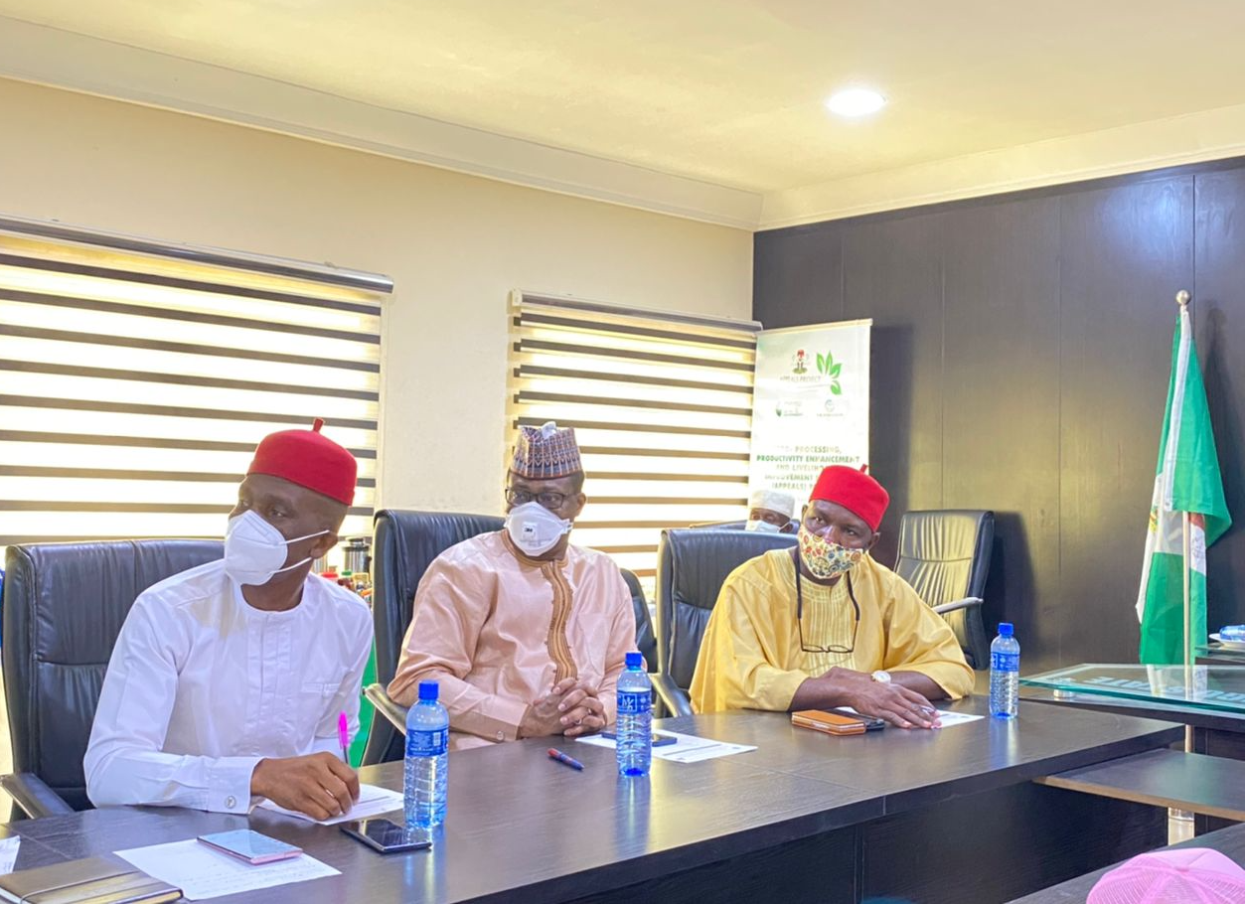
Photos: Town Hall Meeting (Webinar) was conducted on 3rd Feb 2022 during the ED/CEO’s visit to Enugu State to take feedback from the public
Photos taken during the SEZ Town Hall meeting (Webinar) held on 3rd Feb., 2022 to engage the public in the SEZ
The Webninar meeting was Chaired by Her Excellency, Deputy Governor Enugu State
Sen Otazi, ED/CEO NPHCDA, Commissioners, Religious/Traditional leaders in attendance

Slide 21
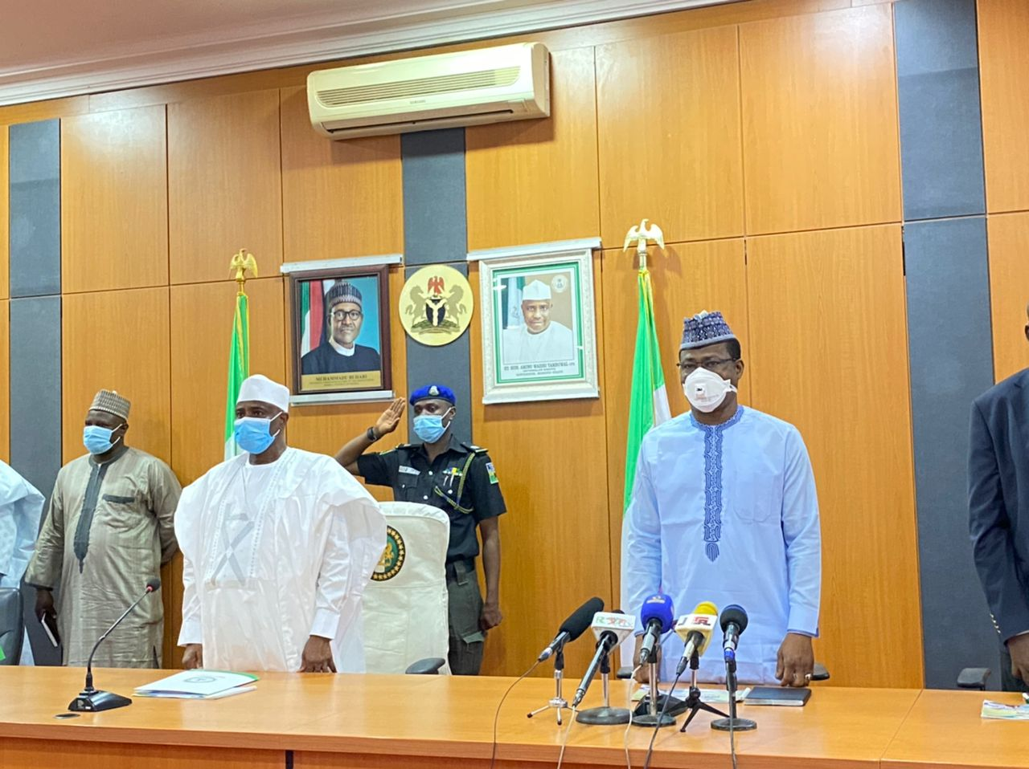
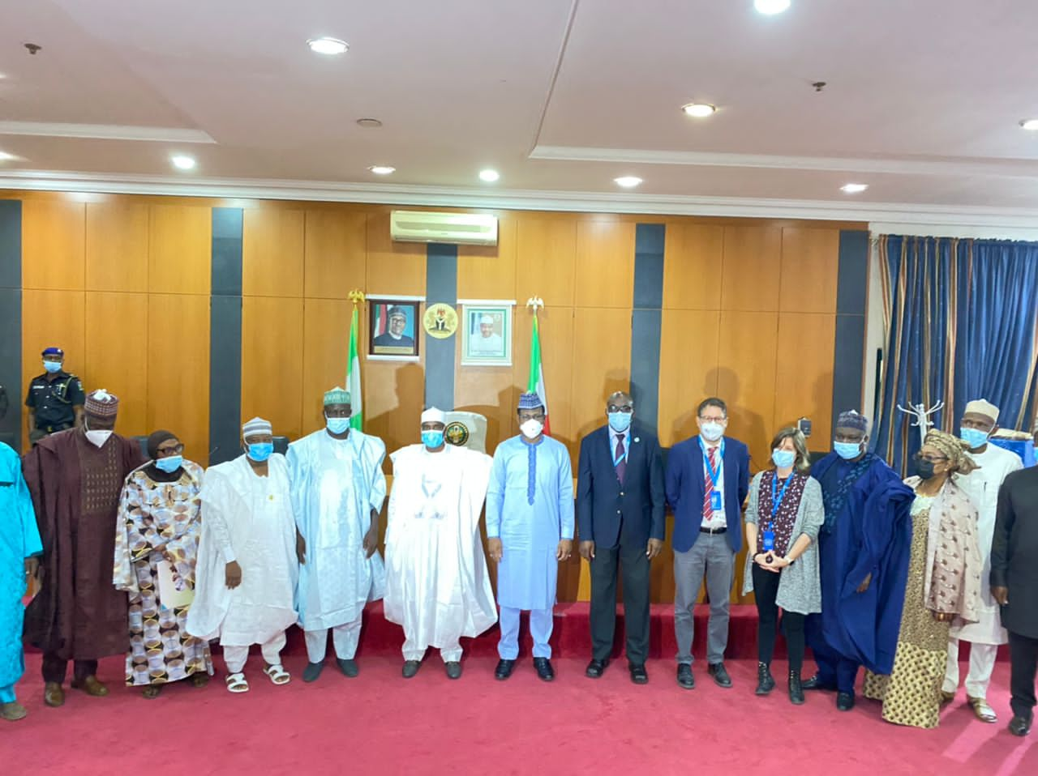
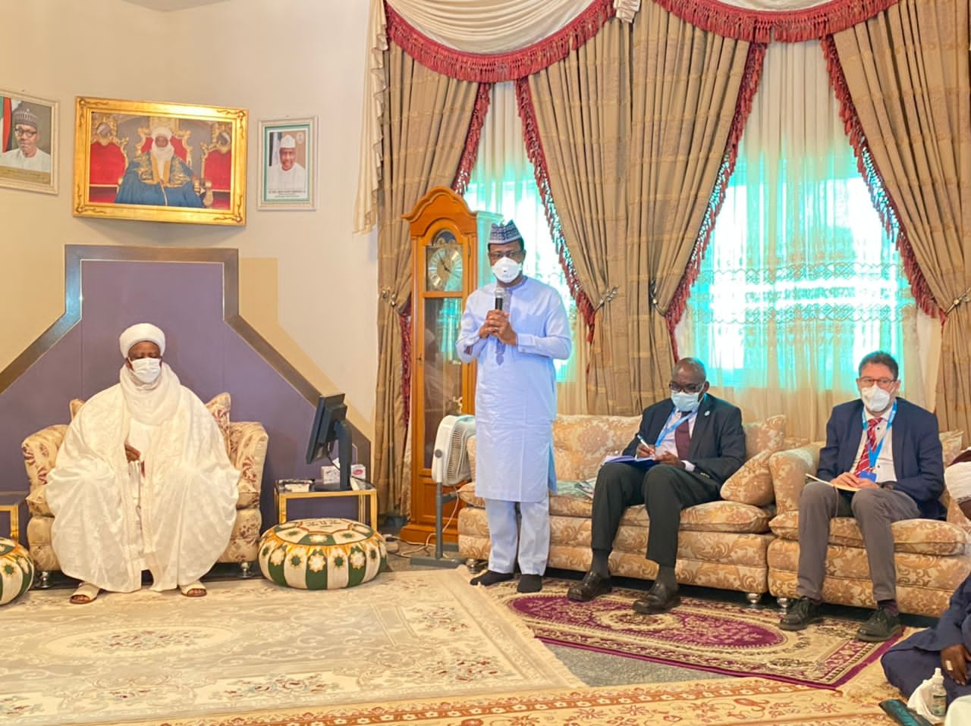
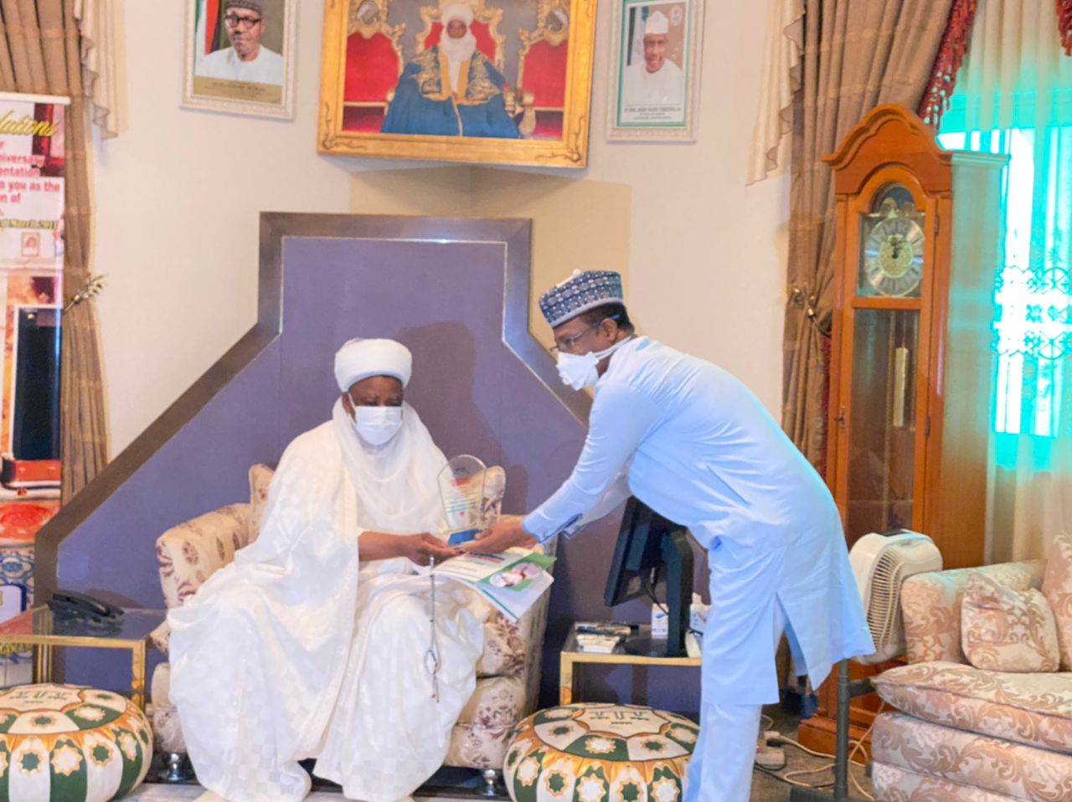
Photos during the ED/CEO’s visit to Executive Governor, Sokoto State and also visit to the Sultan of Sokoto on Improving PHC and COVID-19 vaccination service delivery

Slide 22
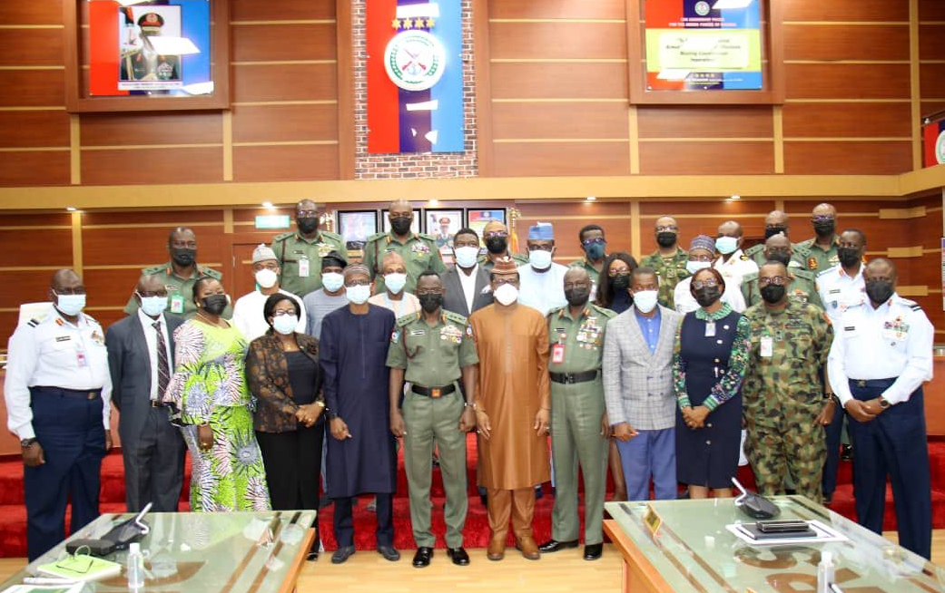
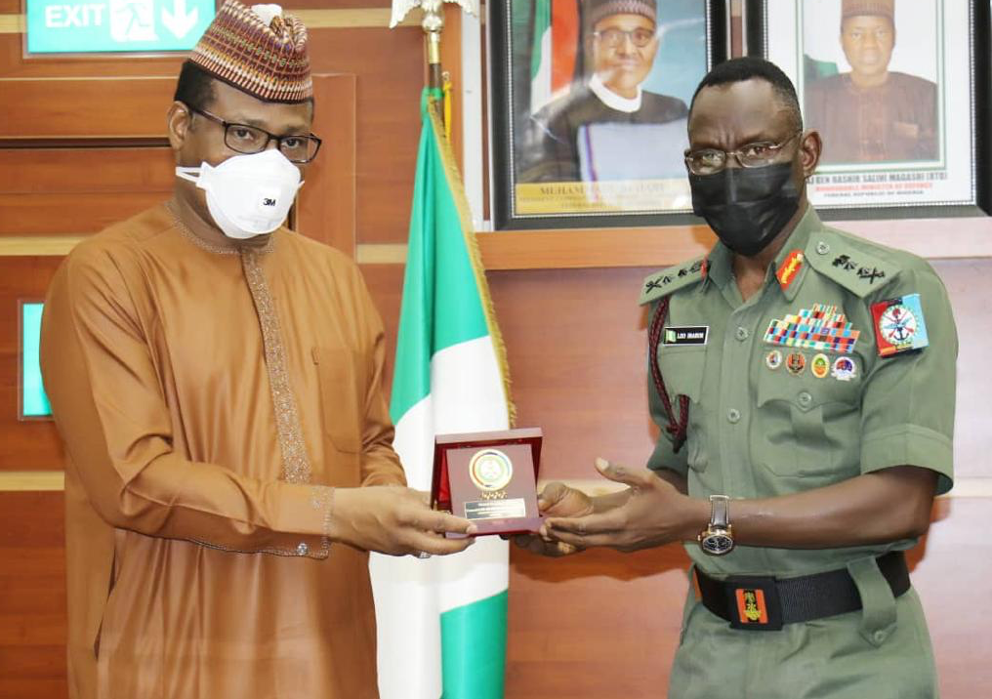
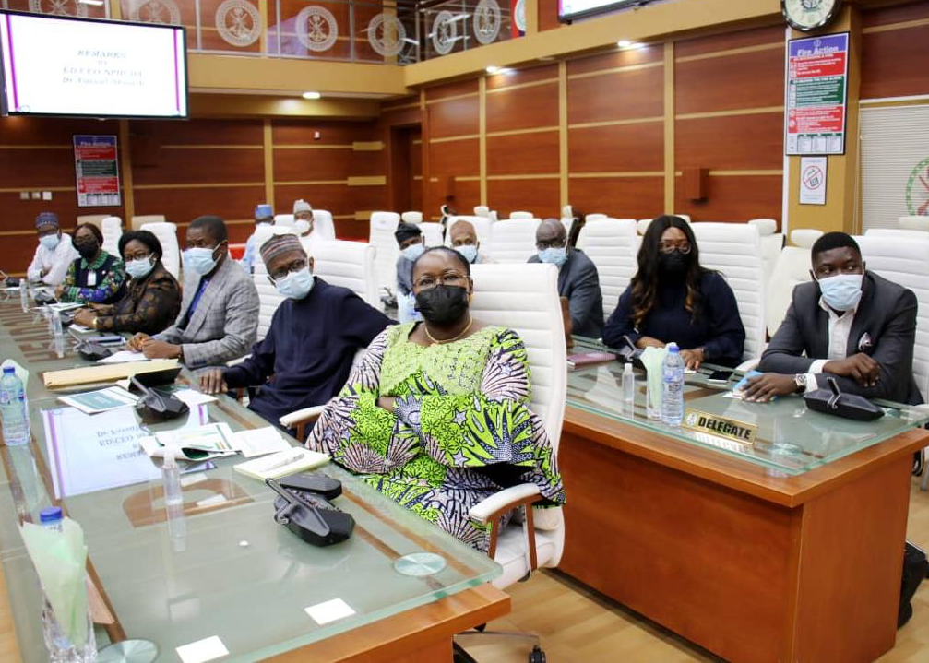
The Agency has engaged with the leadership of the Military to ensure that their personnel/relatives are administered COVID 19 vaccination. There is also collaboration to reach eligible persons in the security compromised areas
Photos: Taken during the visit to the Chief of Defense Staff at the Defense Heaquarters, January 2022

Slide 23
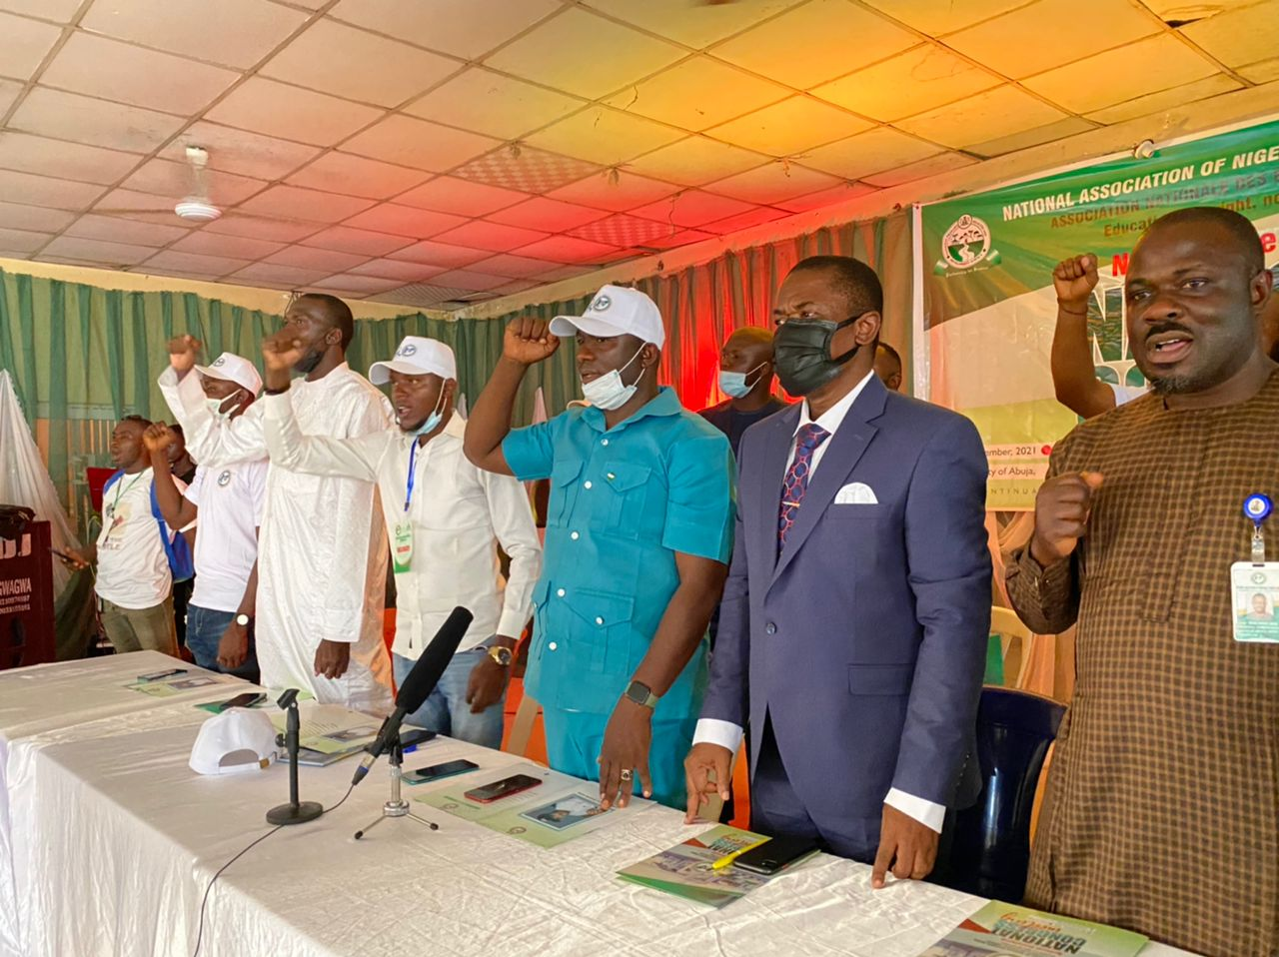
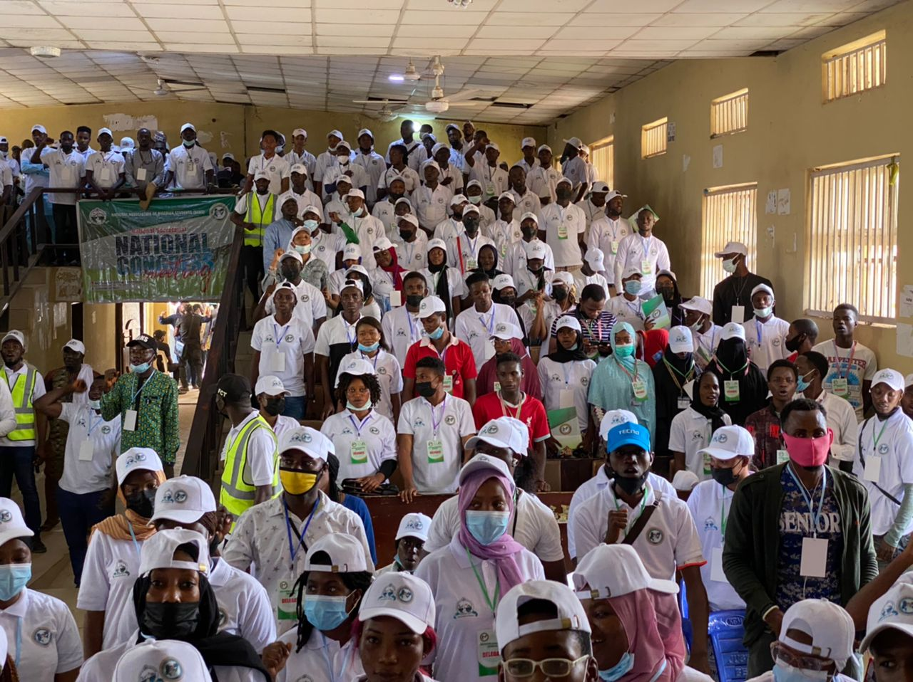
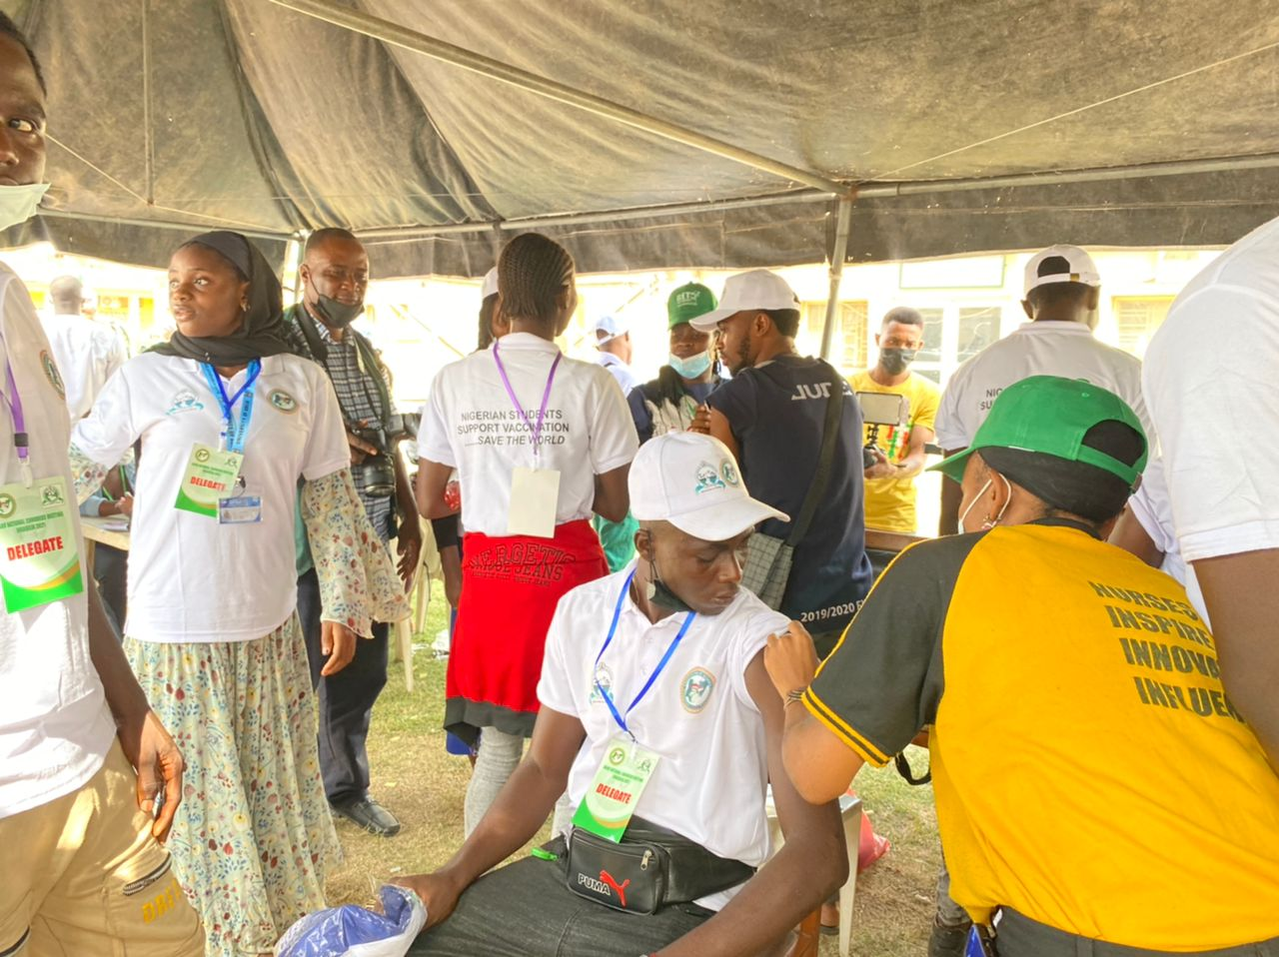
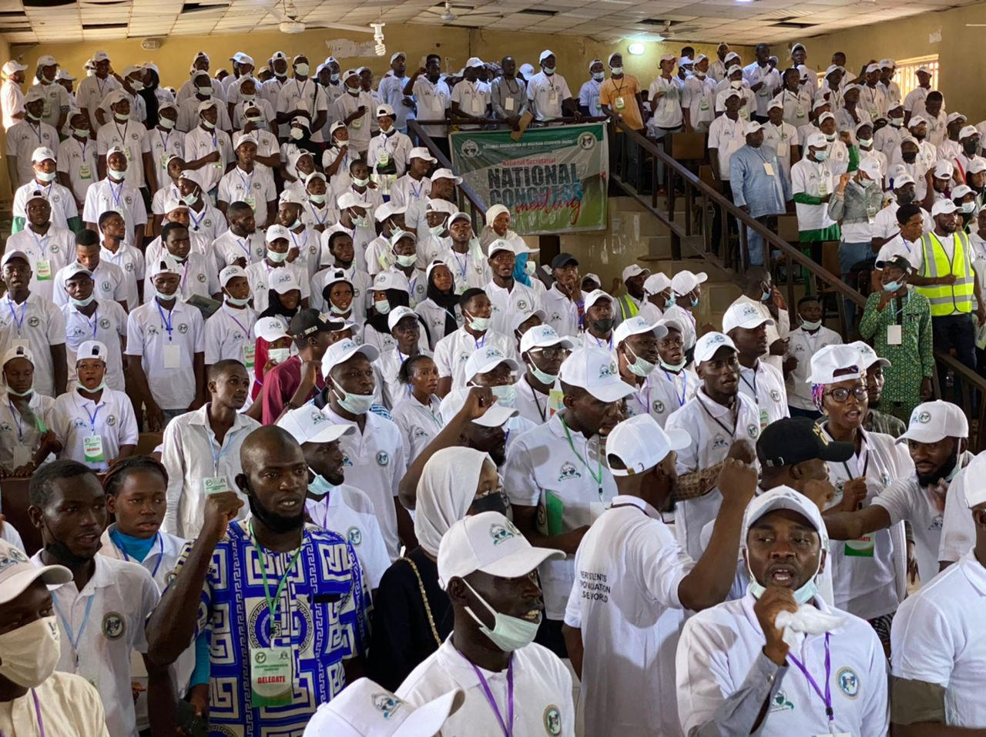
The Agency is engaging with the leadership of tertiary institutions. Campus COVID 19 vaccination was flag-off at the National Convention of National Association of Nigerian Students (NANS) at University of Abuja Gwagwalada Campus
Photos taken during the engagement with the NANS leadership and Cmpus presidents.
Efforts are ongoing to continue to engage the leadership of all tertiary institutions in collaboration with the states
The ED/CEO have also engaged with the leadership of the National Universities Commission

Slide 24
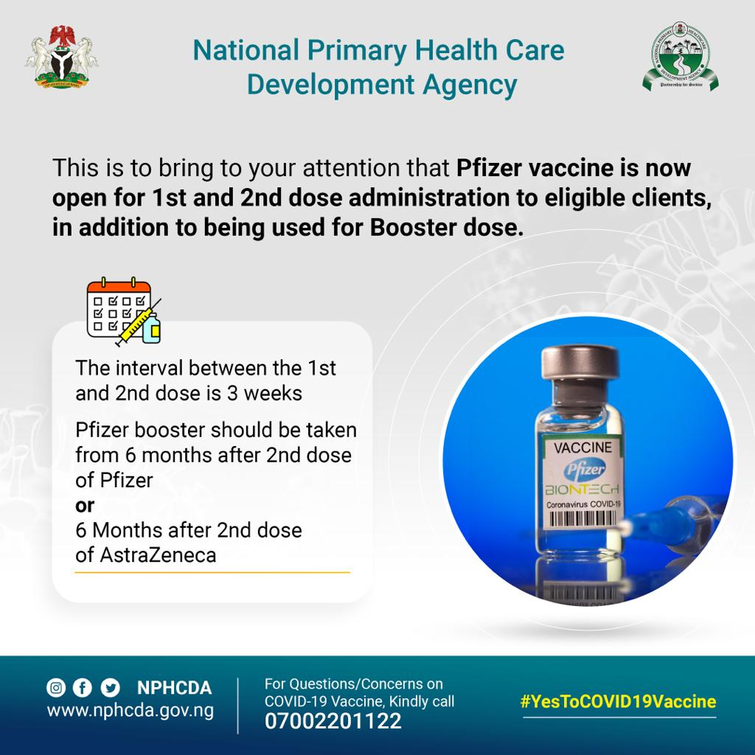
Development and circulation of key messages for awareness creation and confidence building and increased uptake

Slide 25
The Vaccination Site Finder APP was Launched on 22nd February 2022 to guide clients to the nearest vaccination sites for services
To ensure increased and seamless access to vaccination sites, NPHCDA in collaboration with the FMoH and Partners used the opportunity of the Optimized SCALES 2.0 Launch yesterday 22nd February 2022 to Launch the ‘vaccination site finder App’
The vaccination site finder is as shown below:
www.vacsitefinder.nphcda.gov.ng
The app uses geo-location to help locate and guide clients to the nearest COVID-19 vaccination and RI centers
The launch is a unique opportunity to leverage on the SCALES strategy using existing structures to improve both COVID-19 vaccination and RI coverage, with improved efficiency and reduced duplication of efforts

Slide 26
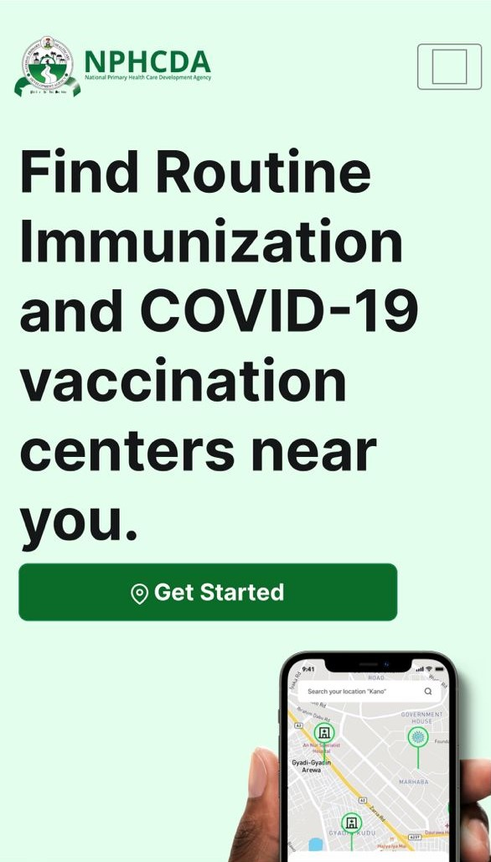
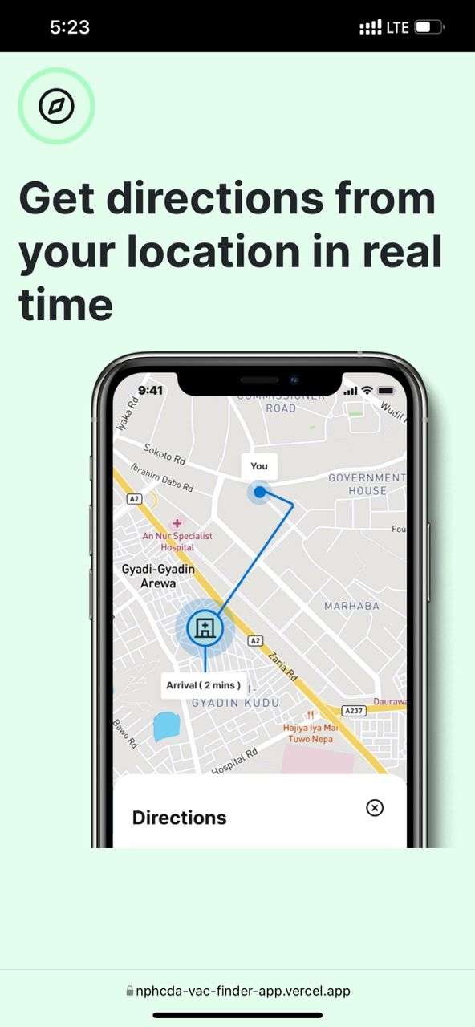
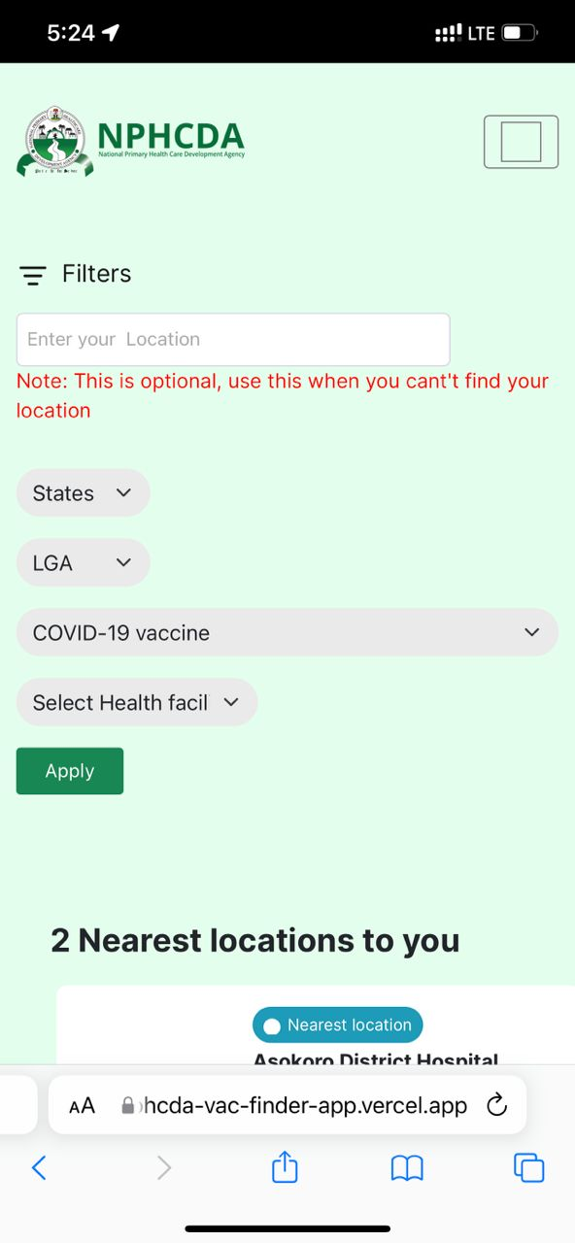
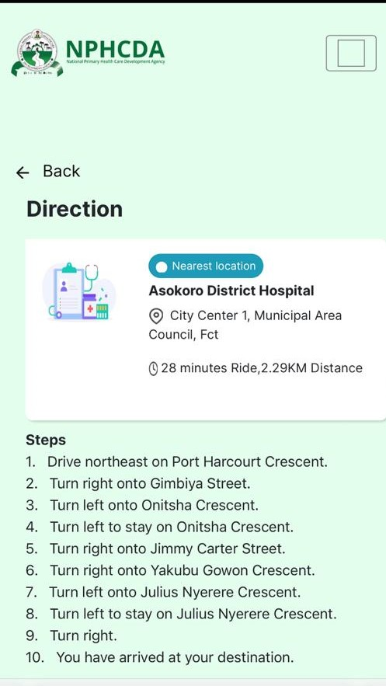
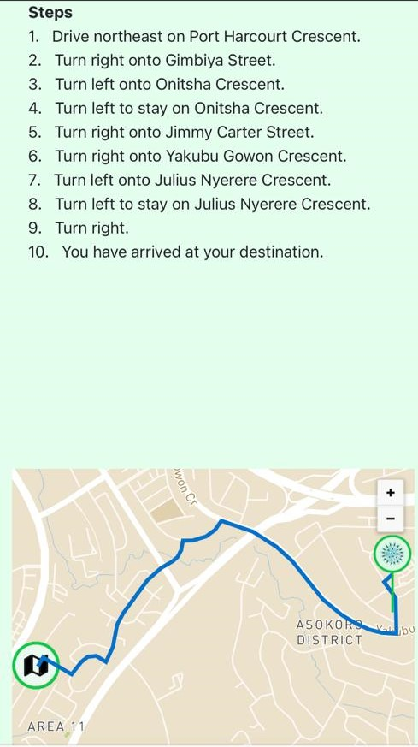
Step-by-step guide to use the Nigeria COVID-19 vaccination sites finder
1
Login into the website
2
To get started, set your location:
3
Click Find Centre near me:
4
Click to Choose a health facility
5
Step by step map to the HF

Slide 27
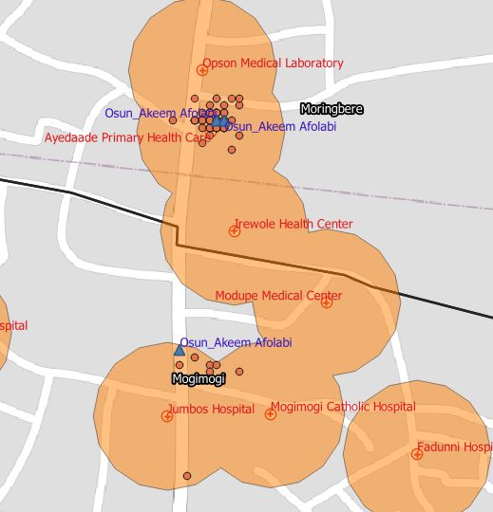
The use of Geospatial Tracking System and ODK and Setting up of Joint Task Force have contributed to an Improvement in accountability
Use of Geospatial Tracking System & Open Data Kit:
In-depth analysis of GTS and ODK submissions of supervisors to ensure staff are present at state of deployment and conducting supportive supervision at vaccination sites
Setting up of Joint Task Force (JTF):
A replication of the national level structure which oversees the State JTF
State JTF inaugurated across all the 36 states + FCT chaired by the ES SPHCBs with membership comprising of SPHCDA, NAFDAC, ICPC, DSS with other security agencies to checkmate vaccination card racketeering.

Slide 28
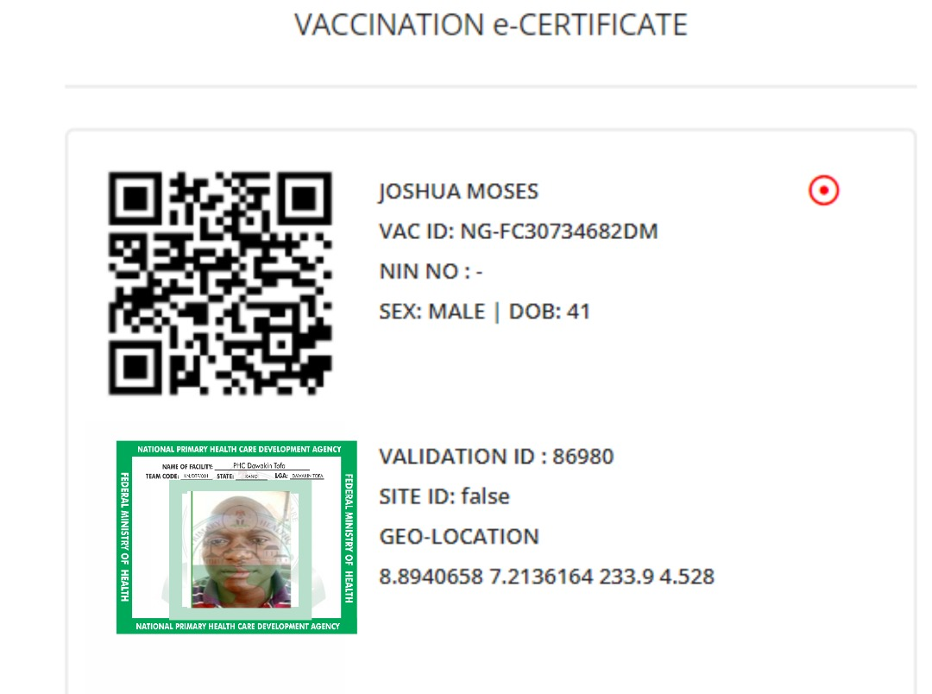
Improving accountability: Validators have been recruited for all the vaccination teams to ensure validation of every client vaccinated
Validation:
Vaccination card racketeering is a global issue. Nigeria has instituted the validation process as an additional security layer to improve the credibility of the vaccination cards
The validation process specifically links the image of the vaccinated client and geo-location of the vaccination site to the vaccination record
Validation can only be done at the designated vaccination site with a pre-programmed device

Slide 29
In spite of the ongoing efforts and successes so far achieved, there are still some Challenges that need to be addressed for a further improved performance in the COVID-19 vaccine rollout in the country
Poor coordination structures and commitment, especially at the sub-national levels (in the identified poor performing states/Local Government Areas)
Slow utilization of the COVID 19 vaccines in most of the states due mostly to due to persistent hesitancy from the public for the COVID-19 vaccine for reason of “No felt needs”; and a decline in the RI performance in some states as confirmed by the preliminary report of 2021 MICS/NICS report
Inadequate resources (human, vaccine distribution, logistics etc) that is required to fully implement the optimized SCALES 2.0 strategy

Slide 30
There are still some other Challenges like inadequate social mobilization activities, suboptimal level of service integration, and challenges in data collation
Inadequate social mobilization activities to address the observed persistent hesitancy in most of the states
The integration process of routine immunization and PHC services, is still suboptimal
There was an initial challenge of receipt of inadequate quantity of COVID-19 vaccines and also delivery of vaccines with very short shelf life; but this has now improved
Challenges in the data collection, analysis and management, especially at the lower levels

Slide 31
Outline:
The Evolution of COVID-19 Vaccine Rollout in Nigeria
Where we are on COVID-19 vaccine rollout and
Routine Immunization
01
What We Have Done to Promote Vaccine Demand
02
What we are doing to restore routine immunization
03
How we have managed the Infodemic
04
Lessons Learnt and Practical Advice
05
Next Steps: What We Will Do
06

Slide 32
There are functional Coordination Structure at ALL levels (National, States, & LGAs) for the delivery of Routine Immunization Programme in the country (1/2)
Following the country’s poor performance of 33% penta 3 coverage in the 2016 MICS/NICS, the National Emergency Routine Immunization Coordination Centre (NERICC) was set up to rapidly improve the country immunization programme.
State Emergency Routine Immunization Coordination Centres (SERICC) were also established at the state level; while LGA Emergency Coordination Centres (LERICC) were also established at the LGAs
The RI team is implementing the Optimized Integrated Routine Immunization Services (OIRIS) as strategy
The leadership of NERICC have been part of the COVID-19 Technical Working Group (TWG) and Strategy Group that met almost every day since the Initial stage of the COVID-19 Lock down in 2020
This has helped in an harmonized planning and implementation with the COVID team

Slide 33
There are functional Coordination Structure at ALL levels (National, States, & LGAs) for the delivery of Routine Immunization Programme in the country (2/2)
As part of the TWG and Strategy Group, training manuals and standard operating procedures (SOPs) were developed that provided guidance to the health workers for the delivery of routine immunization (RI) services during the lockdown, even when there was a SAGE recommendation/guidance to stop RI outreach services
About 220,000 health workers were trained with the developed manuals/SOPs to delivery RI services; and they were also provided with PPEs
RI coordination structures are still functional and there were RI intensification response (activities) immediately after the relaxation of the COVID-19 lockdown
These actions taken by the country before the COVID-19 pandemic and the efforts during the lockdown have contributed to the "not too significant" expected decline in the country performance and restoration of the Routine Immunization services

Slide 34
Several months after COVID-19 vaccine rollout , States have now been supported to develop an integrated micro-plan and work-plan for PHC service delivery
All the 36 States + FCT have been supported to develop an integrated micro-plan and 2022 work-plan to cover COVID-19 vaccination, routine immunization, non-polio SIAs, outbreak responses and other PHC Programs
There was a virtual endorsement ceremony of the Memorandum of Agreement by the Commissioners for Health and Executive Secretaries SPHCBs/As on 4th June 2022 for the commencement of implementation of the finalized work-plans.
The endorsement process of the integrated micro-plans and work-plans by the Government (National), Partners and Donors is ongoing
The actual implementation of the integrated COVID-19 vaccination in the country have started in Lagos, Ogun and Gombe states with the ongoing integrated supplemental immunization activities (SIAs); and is already showing results

Slide 35
Country . Team. Plan. Budget.
One

Slide 36
Justification for integration of PHC Services in Nigeria:
To maximize efficiency in the use of limited resources (Human, material, time and finance)
To provide additional opportunities to optimize service delivery
To reduce duplication of functions by the same limited health workforce
Provides opportunities to get services to the last mile
Enabler of equity in service delivery
Improve coverage for targeted interventions

Slide 37
Integration approaches by thematic area:
Leadership & Coordination
1. Leadership and coordination:
Harmonize coordination structures for SIAs, VAS, RI & COVID 19 Task Force in all states
One country, one team, one plan, one budget
7. Data Management :
Joint data reporting and feedback to all levels
EMID for COVID-19
Data management, M&E
ACSM
2. ACSM:
Integrate all ACSM activities at national and state levels
Mobilization by CHIPS & other community structures for all interventions
6. Supportive supervision:
Integrated supportive supervision
Review the TOR of supervisors for the integrated campaign
Integration
Supportive supervision
Logistics & supply
3. Logistics and supply:
Harmonize logistics movement of SIA, RI, Covid 19 vaccines & VAS to the last mile
5. Service delivery:
Integration of SIA, covid 19, RI , VAS in all fixed posts and temporary fixed post
Integrate RI antigens in all temporary fixed post across the Zero-dose LGAs in Gombe -7, Lagos-3 & Ogun -3 states identified
Service Delivery
Training
4. Training:
Integrated Implementation training at all levels
37

Slide 38
Outline:
The Evolution of COVID-19 Vaccine Rollout in Nigeria
Where we are on COVID-19 vaccine rollout and
Routine Immunization
01
What We Have Done to Promote Vaccine Demand
02
What we are doing to restore routine immunization
03
How we have managed the Infodemic
04
Lessons Learnt and Practical Advice
05
Next Steps: What We Will Do
06

Slide 39
Strengthening the public health response, health systems, and global health security depends on improving management of our entire information ecosystem
Improving management of our entire information ecosystem provides and opportunity to get people the right health information, in the right format, from the right messenger, and at the right time to promote healthy behaviors and resilience to health misinformation.
The rapid overflow of information, combined with information voids and confusing messaging, have all together created an "infodemic" that is making it hard for people to find trusted information and know what actions to take to protect their health and their communities. This confusion leads to risk-taking behaviours and is eroding social cohesion and trust in experts, health responders, epidemic mitigation strategies and health authorities, thereby prolonging the pandemic.
Social media platforms such as Facebook, YouTube, Instagram, Whatsapp and Twitter provide direct access to an unprecedented amount of content and has been used to amplify rumours and questionable information on COVID-19 vaccines
Hence the need to adopt Social listening to help understand the conversation surrounding COVID-19 vaccines and address emerging mis-information about the vaccines. It also provides data that can be used to gauge conversation, raise awareness and improve vaccination uptake in Nigeria. .

Slide 40
Social Listening Framework to track, analyze and manage rumours and myths:
Social listening Mapping the communication ecosystem
Trend monitoring and analysis Developing social listening tracking
Engagement and adjustment Informing CRICC Team
Community feedback
Broadcast media
Polls
WHO EARS
Offline
Social and digital media
Integrated Rumour and trend monitoring
Categorize and visualize
Highlights and actionable insights
Broadcast media
SMS
Telephone calls
Call Center
U-Report
U-Report
Offline
Digital

Slide 41
We generate social and behavioural insights about the uptake of COVID-19 vaccines using various polling streams and tools
Polling Stream
Audience
Tool
Description
Online Scanning
General Population who use social media
Mediatoolkit
Hootsuite
Google alerts
Google Trend
WHO EARS
Media toolkit - Real-time Alerts and Auto Sentiment.; monitor online mentions of COVID-19 and its vaccines
Hootsuite – social media dashboard, that pulls and summarizes conversations Twitter, Facebook, Instagram, LinkedIn & YouTube
Google alerts - Google tool that sends email to the user when it finds new results
Google trends - analyzes the popularity of top search queries in Google Search across various regions
WHO EARS -Early AI-supported Response with Social Listening platform
U-report Polling
U-reporters who use GSM, Facebook & WhatsApp. 3.6 million users
U-report
RapidPro
The program sends SMS polls and alerts to its participants, collecting real-time responses, and subsequently publishes gathered data
Web polling
General population who have access to internet
ArcGIS survey123
ODK/Enketo
Non-probability sampling that involves the sample being drawn from that part of the population that is close to hand; marketing of survey links via SMS, emailing, social media, etc

Slide 42
Example of our Social Media Poll across Platforms
One (1) Poll conducted weekly
Response collated across platforms
Analysis of poll results is shared with the CRICC team for necessary actions

Slide 43
Example of Social Listening Findings on Vaccine confidence for June 6th– June 12th, 2022
The daily social listening reports were tailored to specific states, while the negative sentiments were prioritized for immediate action
Findings that require immediate attention is escalated to the CRICC team and sometimes to the COVAC strategy group to proffer appropriate solutions
Disaggregated COVID-19 vaccination sentiments %
Positive
Negative
Vaccine Confidence
Vaccine Convenience
Vaccine Complacency
Reporting states
Lagos, Oyo, Rivers, FCT, Ondo, Kaduna, Kano, Delta, Rivers, and Edo.
F.C.T, Kogi, Lagos
Lagos, FCT, Oyo, Kano, Ondo, Ogun, Kaduna, Enugu and Kwara
Positive – “There was a post educating people on Adverse following immunizations for COVID-19 vaccine”
Negative – “There was a comment saying the COVID-19 was created to manipulate the system in their favor and there are grave consequences.”

Slide 44
Summary of the Social Listening findings (1/3)
Findings and why it is concerning
Recommendations
1
There was a comment encouraging people to take the COVID-19 vaccine and observe all COVID-19 protocols Someone made a post saying that those who have been vaccinated should fast and pray because of the possible side effect that may occur. This post suggests to those who see it that there may be issues with the vaccine and might make them apprehensive
A comment was made on the lack of improvement in the health sector with the dwindling effect of COVID-19. This shows that people are not aware there’s still COVID-19 in Nigeria
Someone made a post that they were extorted last month after getting the COVID-19 vaccine in the General hospital
Someone mentioned that he was mandated to take the vaccine before getting a job. This shows that hiring companies can contribute to the uptake of the COVID-19 vaccine by mandating employees be vaccinated
There was a comment from someone saying that the COVID-19 Sensitization jingle on the MTN caller tune was not necessary as the COVID-19 era is over. This shows that people are not fully aware that the COVID-19 disease is still rampant.
Posts on the importance of taking the vaccines, and the safety and effectiveness of the vaccines previously developed by the NPHCDA should be shared and reposted across all social media platforms
Posts educating people on the presence of COVID-19 and the need to practice safe and precautionary measures should be reposted across all social media platforms.
Disciplinary measures should be put in place by the NPHCDA to curb fraudulent activities on COVID-19 vaccination.
Hiring Companies can help increase the uptake of the vaccine by ensuring all employees are vaccinated.
Vaccine complacency
Report June 6th– June 12th, 2022

Slide 45
Summary of the Social Listening findings (2/3)
Findings and why it is concerning
Recommendations
2
There was a post informing people on the safety of the COVID-19 vaccine for pregnant women after consultations with their doctors. Posts like this can drive vaccination uptake and clear misconceptions that pregnant women shouldn’t take the vaccine
Someone mentioned they experienced swollen arm, headache, cold, and catarrh after taking the booster dose. This shows the prevalence of AEFI and the lack of knowledge to handle it
There was a comment saying the Pfizer second dose made them sick. This shows low awareness of AEFIA
Someone commented asking if there’s still Coronavirus in Nigeria. This shows there’s low information on the Coronavirus.
There was a post on the need to encourage all to get vaccinated.
Informative posts on the safety and efficacy COVID-19 vaccine for pregnant women should be shared and reposted by the NPHCDA continuously across all social media platforms
Developed posts, FAQs on the possible AEFIs should be shared continuously
Posts educating the public on Corona virus and its health implications should be reshared across all social media platforms.
Posts encouraging the public on the safety and efficacy of the COVID-19 vaccine should be reposted across all social media platforms.
Vaccine confidence
Report for June 6th– June 12th, 2022

Slide 46
Summary of Social Listening findings (3/3)
Findings and why it is concerning
Recommendations
3
Vaccine convenience
There was a comment on the poor storage and distribution of the COVID-19 vaccine. This could discourage people from going to get vaccinated
There was a post saying “When I saw the needle, my arm started paining me from the last shot if one can take the COVID-19 vaccine in Ebonyi after flying from Lagos to Asaba”. This indicates that the availability of the vaccine at different locations enables people to get vaccinated where it is convenient for them
The NPHCDA should enforce rules and regulations to ensure the proper storage of vaccines and adequate distribution of the COVID-19 vaccines to increase uptake
Posts educating people on COVID-19 AEFIs should be reshared across all social media platforms
COVID-19 vaccines should be readily available at health facilities in the country
Report for June 6th– June 12th, 2022

Slide 47
Outline:
The Evolution of COVID-19 Vaccine Rollout in Nigeria
Where we are on COVID-19 vaccine rollout and
Routine Immunization
01
What We Have Done to Promote Vaccine Demand
02
What we are doing to restore routine immunization
03
How we have managed the Infodemic
04
Lessons Learnt and Practical Advice
05
Next Steps: What We Will Do
06

Slide 48
Several Lessons have been learnt in the course of the COVID-19 Response in Nigeria (1/3)
Particularly for primary health care, we have learnt that resources are not enough yet to achieve universal health care and the pandemic exposed those gaps. Our health system needs to be better prepared in terms of resources (human, materials and financial) needed for an emergency response plan
Resources should be identified and reserved to fast-track response to emergencies to reduce lag time, which could be detrimental in curbing spread during a pandemic
Governments at all levels can support the increase in uptake of routine immunization by providing enabling laws, policy and guidelines, political will and proper funding
Government ownership, readiness and community participation, at all levels (national and sub-national) is critical to detect, mitigate and respond to any pandemic
Availability of a functional coordination structure for immunization was helpful as it was immediately expanded to become the COVID-19 TWG and also Strategy Group

Slide 49
Several Lessons have been learnt in the course of the COVID-19 Response in Nigeria (2/3)
Service Providers (health workers) are the frontline in routine immunization service delivery. Their knowledge, skills, attitude, and practice to service delivery can increase uptake of routine immunization
The expansion of vaccination to more vaccination sites, aggressive demand generation effort, integration of COVID 19 vaccination, vaccsite finder app and validation app contributed to increased access and uptake of COVID 19 vaccination and strengthen overall health systems in Nigeria.
Religious and community leaders are gatekeepers at the community level. They can support this course by sensitizing their subjects to bring their children for immunization. Improved contact with persons through community engagements, buy-in from traditional and religious leaders has contributed to an improvement in vaccine uptake
Active social media presence responding to enquiries and debunking rumors and using infodemics have also contributed to an improvement in the vaccine update

Slide 50
Several Lessons have been learnt in the course of the COVID-19 Response in Nigeria (3/3)
Creation of a healthy competition among the States and to reward the best performing state and teams can also lead to an increase in vaccine uptake
Close monitoring and active supportive supervision has also boosted accountability. Supervisors are deployed using data and to areas with low coverage. They are monitored in real time (GTS & ODK) from the National operation room to ensure the work is done and for support to resolve issues that may arise
The introduction of the Electronic Management of Immunization Data (EMID) has contributed to an improvement in timely the of reporting, intervention and validation of persons that have been vaccinated and tracking/follow up of persons that are yet to return for their second or booster doses
Development partners have been very helpful through the provision of technical and financial support for routine immunization service delivery, COVID-19 vaccine rollout, conduct of non-polio SIAs and outbreak responses etc. CSOs and Professional Associations and Bodies have also been of help in implementing

Slide 51
Outline:
The Evolution of COVID-19 Vaccine Rollout in Nigeria
Where we are on COVID-19 vaccine rollout and
Routine Immunization
01
What We Have Done to Promote Vaccine Demand
02
What we are doing to restore routine immunization
03
How we have managed the Infodemic
04
Lessons Learnt and Practical Advice
05
Next Steps: What we will do
06

Slide 52
The Agency working with partners will take the following priority actions to improve on COVID-19 vaccine uptake and RI coverage
Provide support for coordination at State/LGA levels through the state Ministry of Health/State Primary Health Care Boards and deployment of State facilitators for more supervision to the LGAs and health facilities
Sustain mobilization for the required additional resources (human, vaccine distribution, logistics etc) for the full implementation of the Optimized SCALES 2.0 strategy and Launch of the SCALES 3.0 Strategy
Sustain support to the states/LGAs for social mobilization activities through engagement and dialogues with religious/political/traditional leaders and special groups/associations, TV/Radio programs and jingles, town criers; and engagement of mobile operators for SMS reminders and phone calls

Slide 53
The Agency working with partners will take the following priority actions to improve on COVID-19 vaccine uptake and RI coverage
Support the states/LGAs to ensure integration of PHC services and sustain other PHC services delivery in all the health facilities
Provision for incentives/rewards to best performing states/LGAs/teams/individuals; and sanctions where applicable
Leverage upcoming SIAs, OBR rounds and Hajj to boost COVID-19 vaccination
Continue reminder phone calls and messaging to reduce dropout rates

Slide 54
Conclusions
We appreciate the organizers of this training for the opportunity to share the experiences on how Nigeria have worked to promote vaccine demand during the time of COVID-19 and efforts to get more people immunized, manage the infodemic and restore routine immunization
There is need for countries to continue to explore innovative ways to response to the pandemic and plan for the future
Let ALL countries use the opportunity of the available resources for the COVID-19 pandemic response to strengthen the health systems and ensure integration of PHC services for optimal performances

Slide 55
Thank You
Get Vaccinated Get BOOSTED

