Slide 1
Comprehensive training
28 June – 21 July 2022
HOSTED BY GAVI, WHO, UNICEF & US CDC

Slide 2
Social listening and integrated analysis
Tina Purnat
Team Lead for Infodemic Management
Department of Epidemic and Pandemic
Preparedness and Prevention
WHO Health Emergencies Programme
Surani Abeyesekera
Social and Behaviour Change Specialist
Immunization Demand Team
Program Group
Health Section, UNICEF

Slide 3
Outline
Learning objectives​
Key definitions​
Why we need social listening ​
How to conduct social listening​
What is integrated analysis and why it is important​
Examples from the field​
3 truths and best practices​
Navigating different operating environments​
Key References and Resources​

Slide 4
Learning objectives
By the end of this session participants will:​
Be able to describe what social listening is, how it is conducted, and how it fits within the overall infodemic management framework​
Understand what integrated analysis is, why it is needed to effectively address infodemics, and methodological considerations for conducting integrated analysis​

Slide 5
Why do we need social listening?

Slide 6
Fitting transdisciplinary infodemic insights into health authority processes
Phase of epi curve
PREPARE AND MONITOR
DETECT AND INTERVENE
STRENGTHEN

Slide 7
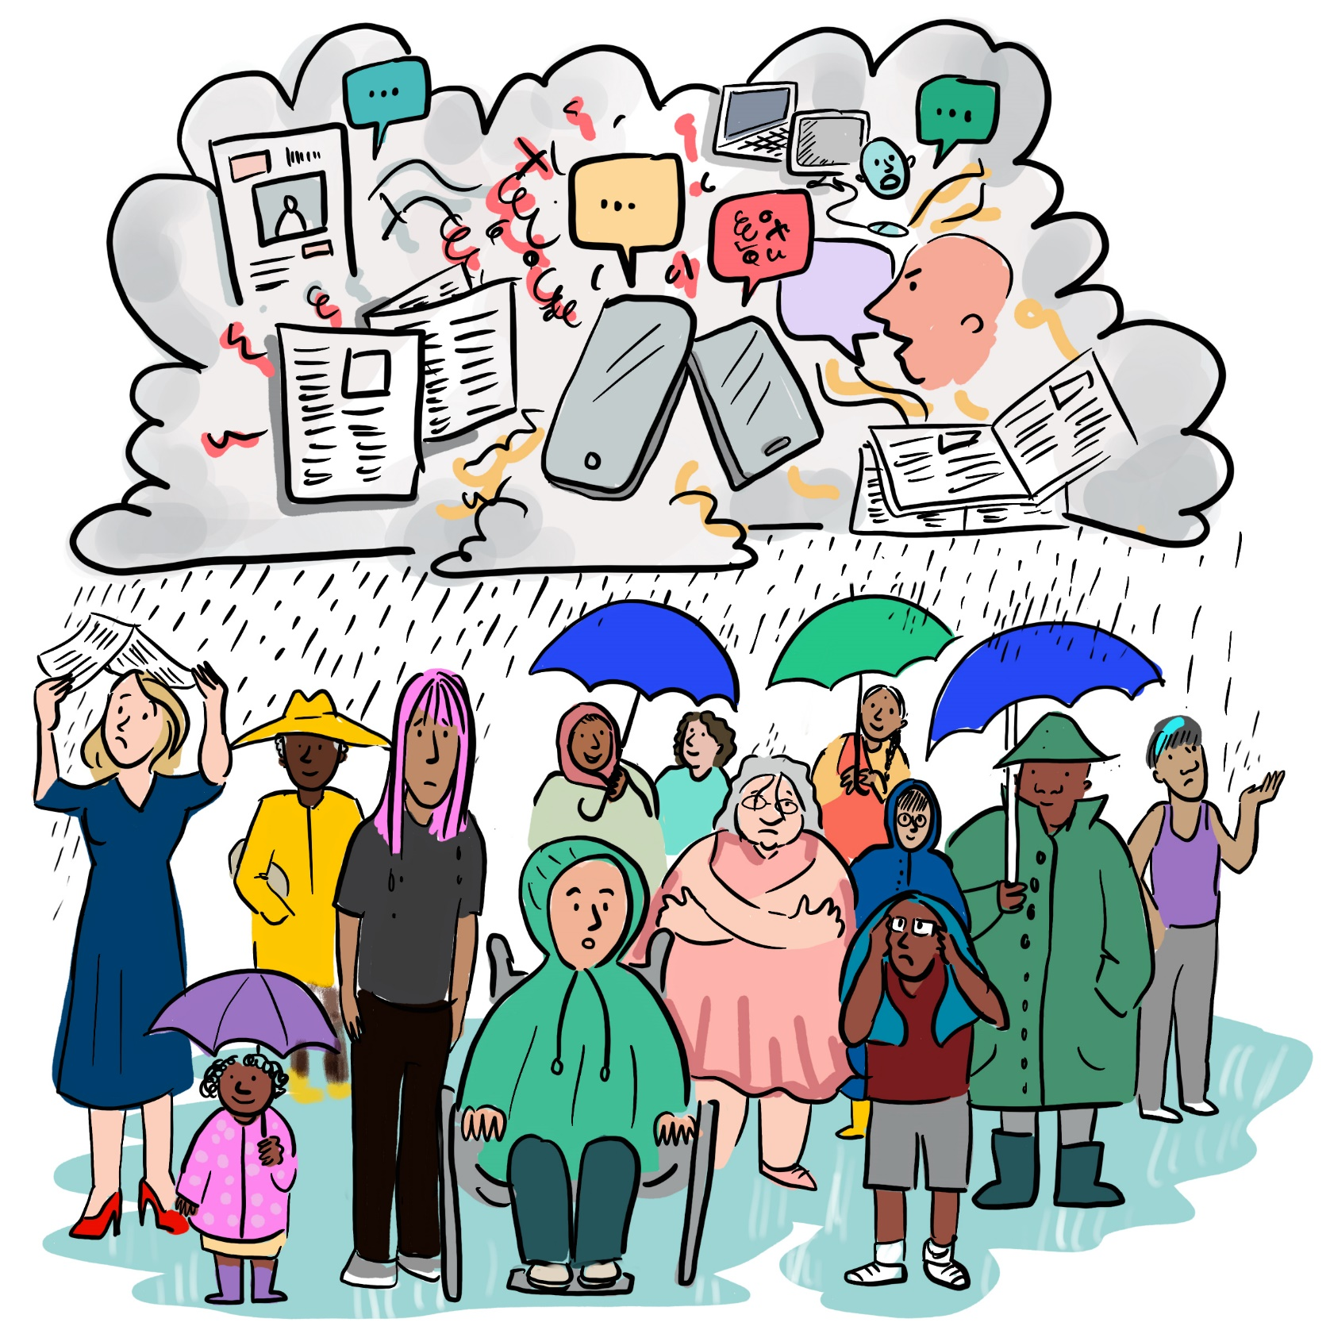
Why do we need social listening activities?
Our overall objective: the adoption of healthy behaviours
People are bombarded by information online and offline
Science generates evidence and changes knowledge slower than media and people need information confusion, distrust, vaccine acceptance to follow health authorities recommendations (PHSM, vaccines, etc)
Social listening helps us to understand questions, concerns, information voids and misinformation in a population on a health topic in order to design adequate interventions
©WHO/Sam Bradd
Notes:
Let’s go back to the basis. Why do we need SL?

Slide 8
The infodemic affects everyone
The infodemic is not only about circulating misinformation or disinformation
It is also about overload of information, outdated information, and information voids
Isolated and vulnerable populations are particulary susceptible to the infodemic
©WHO/Sam Bradd
©WHO/Sam Bradd
Notes:
Health workers, on the frontline of the pandemic and often highly trusted by the population, are in the storm too
They also experiment fears, concerns and crisis of trust despite their medical background

Slide 9
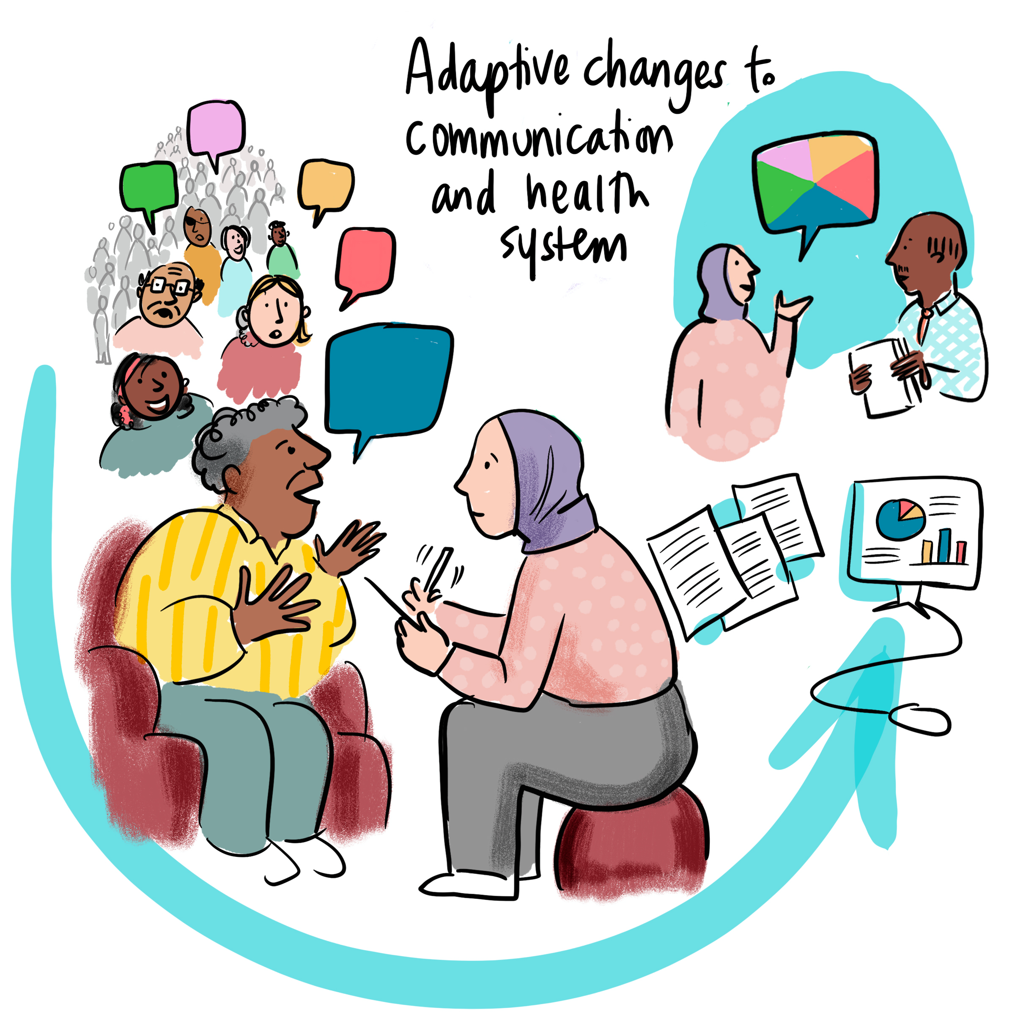
Social listening allows us to understand people’s needs
Looking back on the two past years, we’ve learned that we need to put infodemic insights into action at speed because people’s questions and concerns and health programmatic actions are constantly shifting
©WHO/Sam Bradd

Slide 10
The basics of conducting social listening

Slide 11
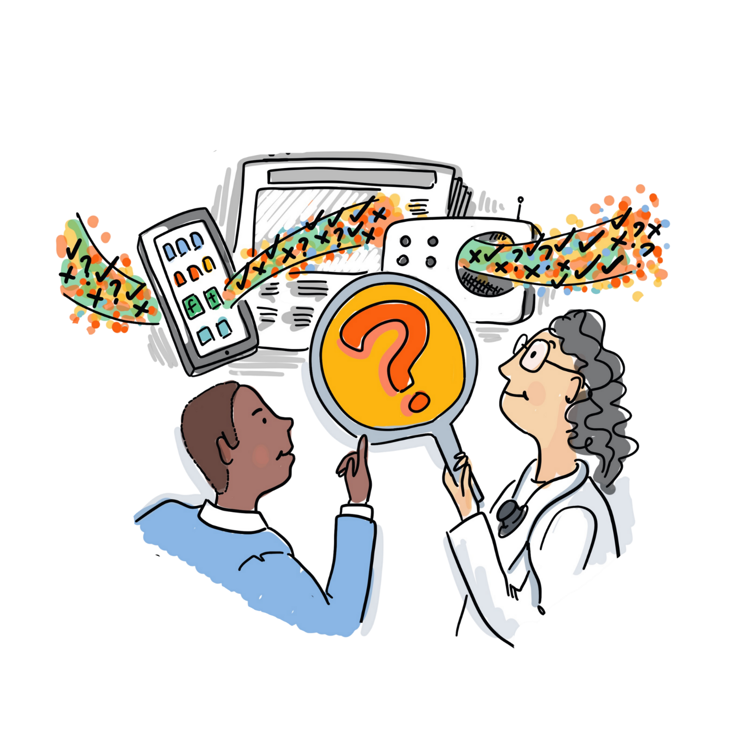
How do infodemic managers practice social listening?
They identify questions and narratives where people are expressing concern, questions or confusion, or information voids where people lack reliable information
They triangulate this with other sources analyze data with the goal to provide infodemic insights for proactive, not reactive action.
©WHO/Sam Bradd
Notes:
You have already heard a lot about social listening, maybe even last week if you attended the RCCE training. All you have learned is valid, especially the concept of two way communication mecanisms to be established in peace time in order to build trust and to ease common understanding of guidance during a crisis.
Today I will present the way infodemic managers, are thinking about social listening, with the focus of generating insights for colleagues, and to ensure a continuous monitoring of activities and impacts.
Refer to the timeline to act which is described in the video to look as an homework (Prebunking/debunking OpenWHO module)

Slide 12
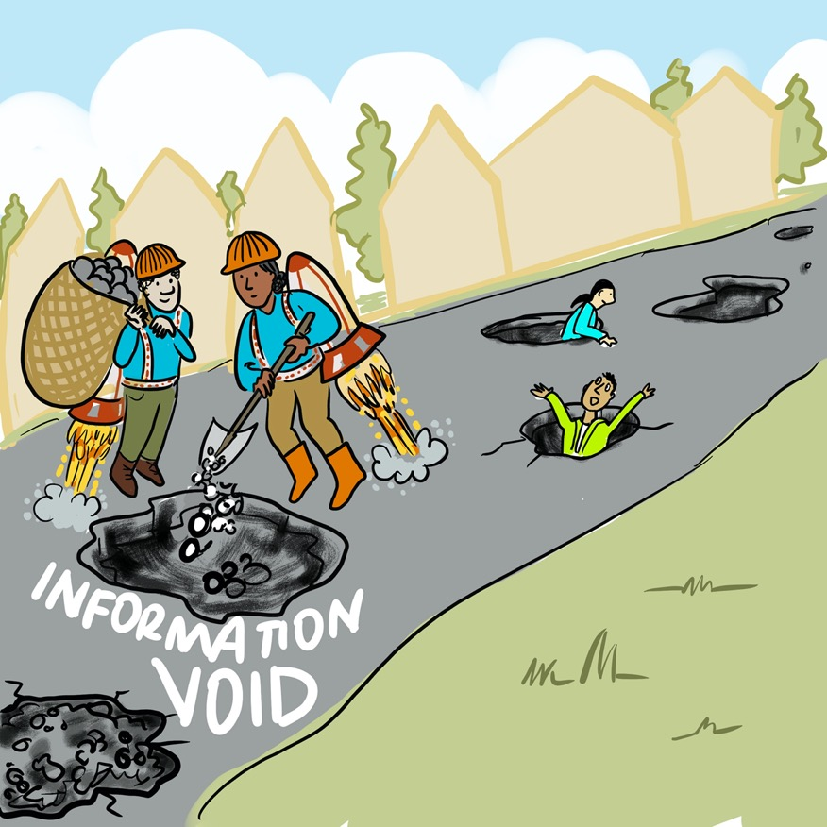
Identifying and acting on information voids is key
Addressing information voids in higher priority than chasing rumors and misinformation
Objective: proactively anticipating what people’s concerns and questions are, so that our infodemic response efforts are meeting the needs of people at any one time.
©WHO/Sam Bradd

Slide 13
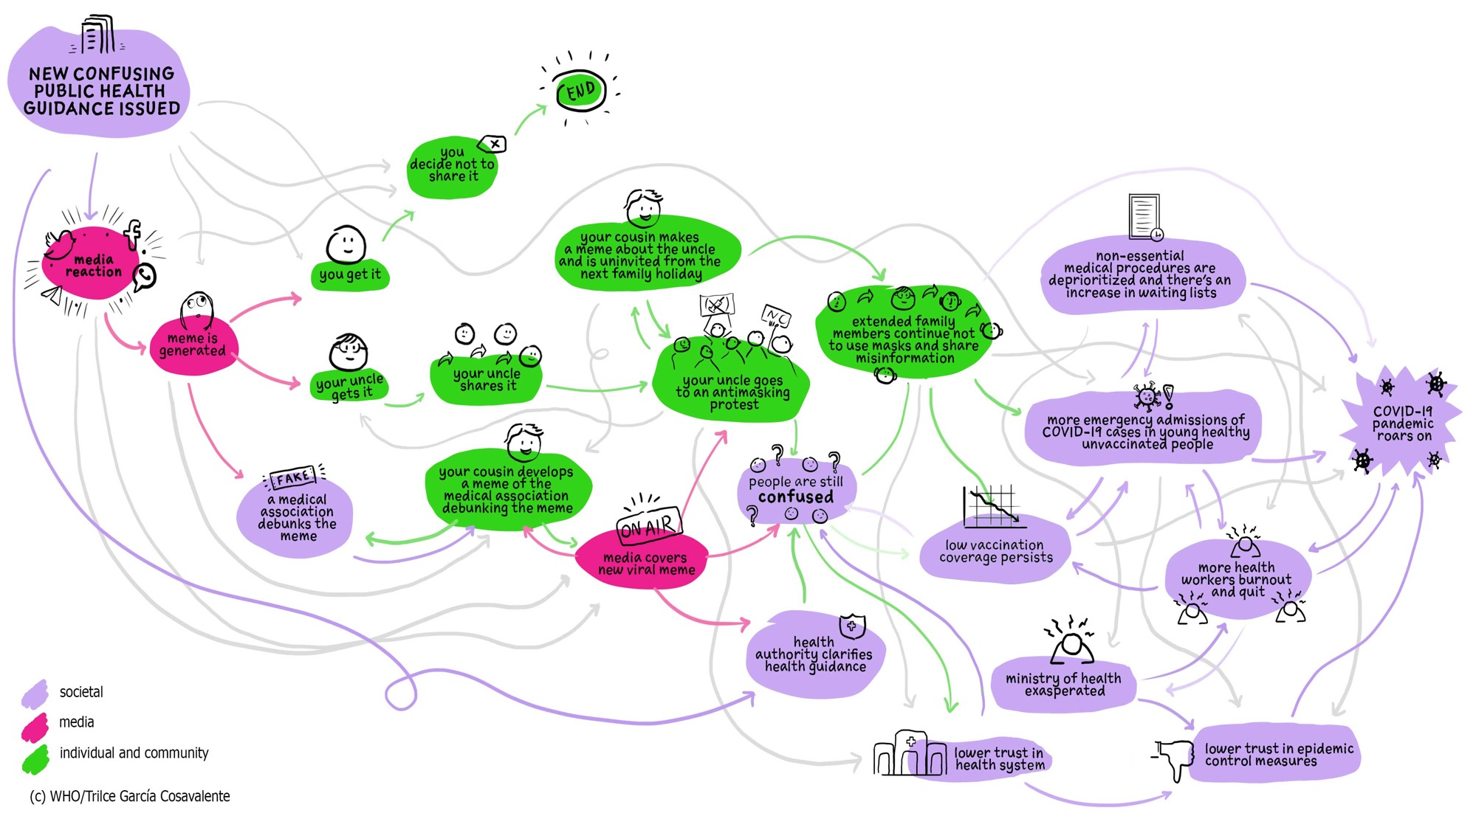
Information circulation is a mix of online and offline interactions
Infodemic can be measured at level of information ecosystem individual, health system and society

Slide 14
What methods to choose for data collection?
community dipstick surveys
surveys of users online (web site users, users of chatbots, etc)
population surveys (via phone etc)
community listening (offline)
closed online groups (hotline reporting, lurking in groups, community informants)
mobility surveys, social media and web metrics (in public health format, not for marketing/PR)
©WHO/Sam Bradd

Slide 15
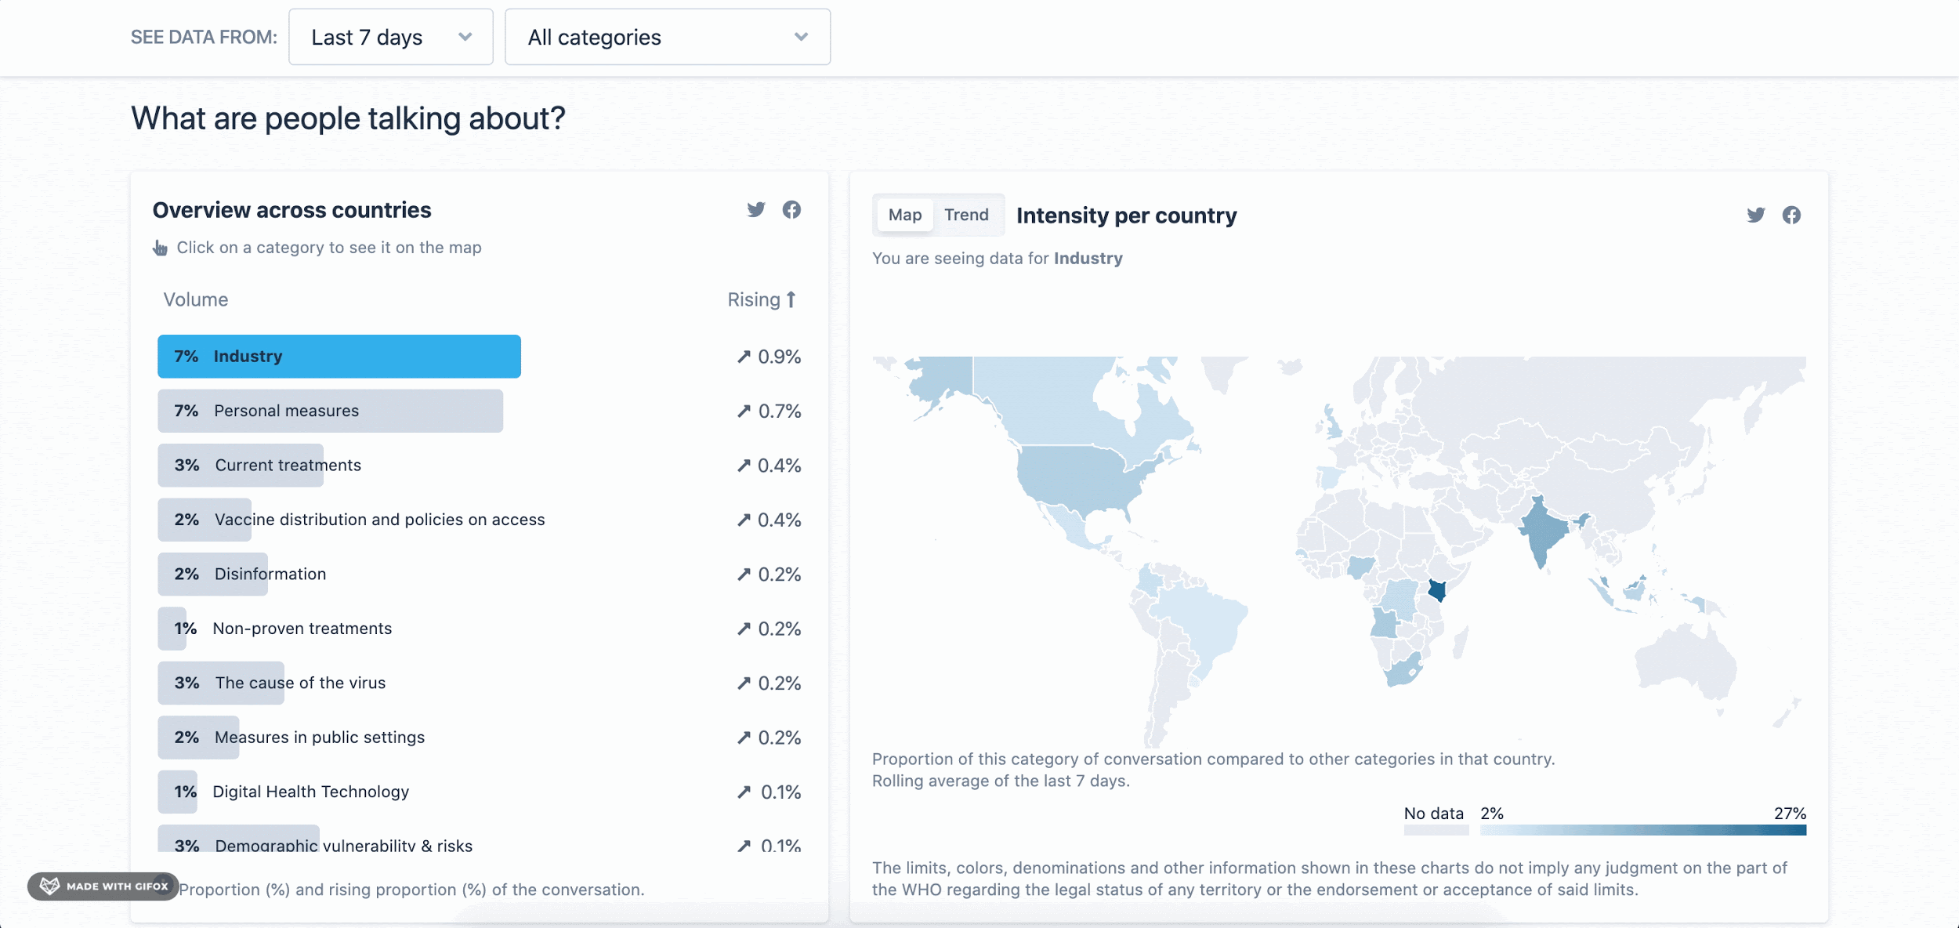
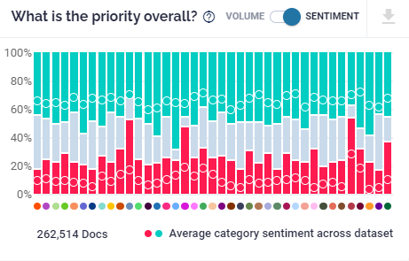
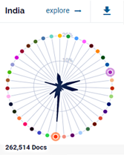
Social listening analytics to inform decision-makers
Real-time analysis allows for earlier response
New tools empower health professionals and help countries detect changing attitudes and critical information gaps; as well as surveys using big data and AI analytics for real-time, flexible, and locally adaptive digital intelligence.
SINCE 15 DECEMBER 2020
30 countries
9 languages analysed (EN, FR, ES, PT)
39 COVID-19 categories tracked
Over 30 million posts analyzed
See whoinfodemic.citibeats.com

Slide 16
What methods to choose for data collection?
WARNING 1
Most digital social listening tools were designed for online marketing
and need to be heavily modified for use for infodemic management in public health.
©WHO/Sam Bradd

Slide 17
What methods to choose for data collection?
WARNING 1
Most digital social listening tools were designed for online marketing
and need to be heavily modified for use for infodemic management in public health.
WARNING 2
Be comfortable that you will work with imperfect data:
Integrate social listening data with other sources that indicate people’s behaviors, attitudes, or health outcomes.
©WHO/Sam Bradd

Slide 18
What is integrated analysis and why it is important

Slide 19
Integrated analysis is triangulation of data and synthesis of insights to inform action
In a nutshell, integrated analysis is a process for synthesizing multiple data inputs and identifying themes through a consensus-building process
Its overarching goal is to produce actionable insights that are grounded in data as much as possible to guide intervention development
To better understand integrated analysis, we need to discuss why it’s so important for successful infodemic management…

Slide 20
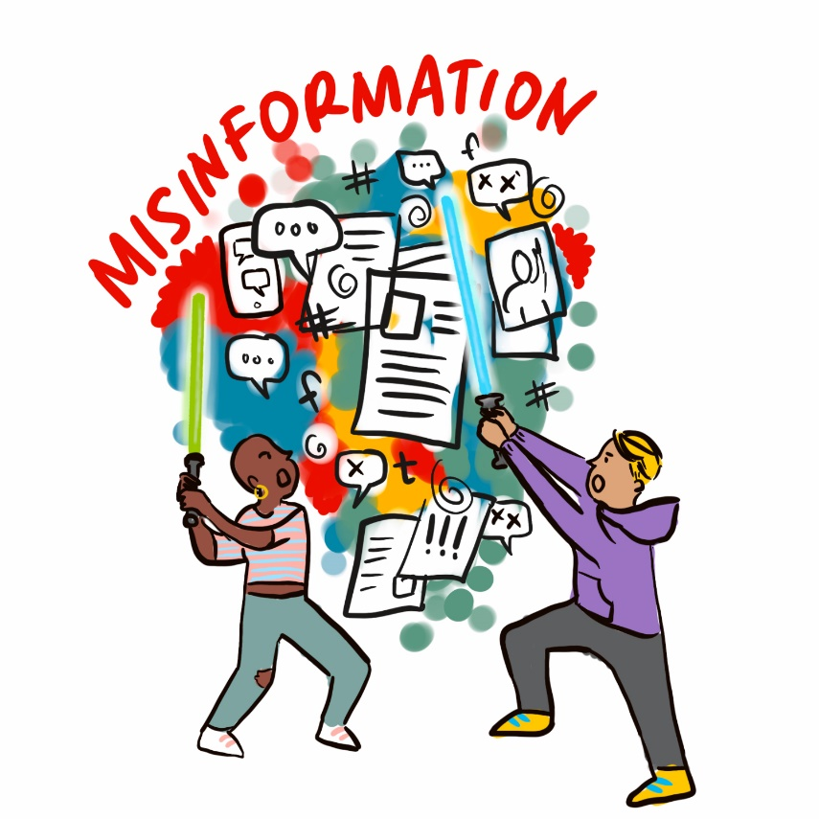
Digital social listening has inherent limitations and should not be the only source of data
Most digital social listening tools were designed for online marketing and need to be modified to be useful for IM
Most of the time, only data that are publicly available on select social media platforms are collected
There is a tendency to rely on a “magic” dashboard without interpretation of data by human analysts
© WHO / Sam Bradd

Slide 21
Offline data sources are often underutilized or unused in infodemic management
There is a common misperception that IM only involves looking at online information environment, leading to exclusion of other important data inputs
Even if offline data are considered, there’s a tendency to rely on KAP surveys, which are:
Expensive
Time-consuming and resource intensive
Cross-sectional and not always suitable for prolonged emergencies during which people’s attitudes and behaviors change
© WHO / Sam Bradd

Slide 22
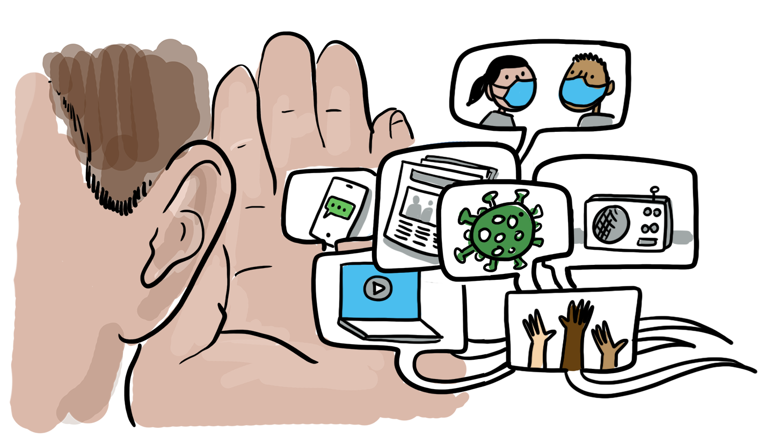
To overcome these limitations, we need to start thinking more broadly about data inputs and domains
Data inputs/collection methods
Domains and questions to explore
Integrated analysis!
Community dipstick surveys
Community listening sessions or townhalls
Hotline call logs
Mobility data
Key informant interviews
Surveys of users online (users of chatbots etc.)
Observation of closed online groups
Web metrics (website traffic data, search patterns)
Social media posts and engagement
Etc...
Where are the information voids?
How is official guidance being shared, discussed, interpreted, remixed?
How are people behaving or signaling related to recommended health behavior?
What (and why) are people confused, anxious, angry, or happy about?
What do people know?
What are people’s perceptions?
What efforts by health authorities are (not) working and why?
What are the internal pain points within health system or emergency response that make it difficult to update communications and programming?
Etc…

Slide 23
Data source 1
Intelligence
Analysis plan 1
Domains of data sources: individual and community sentiment, socio-behavioral insights, identifying information voids, communicating health guidance and societal reaction, signaling and public behavior in relation to health guidance, health authority activities for health behavior promotion, health system pain points
Data source 2
Intelligence
Analysis plan 2
Insights
Recommendations
Data source 3
Intelligence
Analysis plan 3
Data source n
Intelligence
Analysis plan n
Integrated analysis
Scalar judgement based on threat matrix analysis

Slide 24
Considerations for integrated analysis
Think broadly about existing data sources that may be available to you
Routine demographic and health surveys
Microplans
Communications and demand strategy documents
Marketing or communication campaign performance data
Campaign monitoring data
Socio-behavioral assessments / KAP surveys
Peer-reviewed and gray lit papers on population of focus
Social media analytics
Online search trends
Media monitoring report
COVID-19 hotline call logs
Social media comments​
Q&A from recently recorded community meeting​
Email inquiries​
Polls/surveys​
Customer satisfaction survey
Exit interviews​
Maps
Field epidemiology reports​
Intra and after action reports​

Slide 25
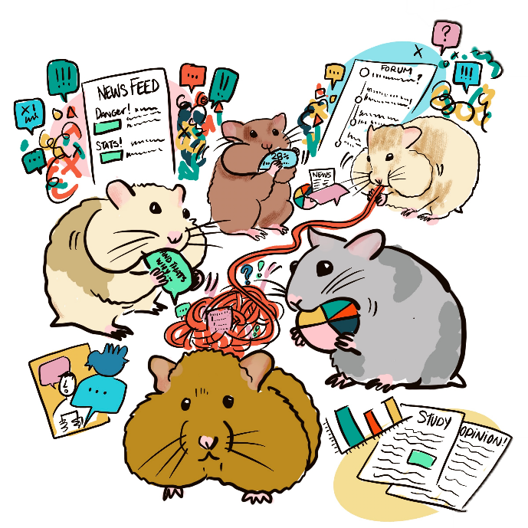
Considerations for integrated analysis
Plan integrated analysis based on programmatic needs
Beware of being a data hamster – avoid duplicating data that already exist or collect data just for the sake of it
Set your objectives and research questions and collect data accordingly
Emphasize data for action that can offer relevant insights quickly

Slide 26
Considerations for integrated analysis
Diversify data inputs as much as possible according to your objectives
Explore as many data sources as possible, as long as they are relevant to your research questions (and as your team’s capacity allows)
Be aware of limitations of each data source
If possible, assign team members to specific data sources to track and monitor regularly and develop a standard way of doing so (e.g., SOP)

Slide 27
Theme Identification and Triangulation
Adapted established methods from qualitative data analysis, including different techniques to identify themes (Ryan and Bernard, 2003):
Repetition: Themes that come up again and again across our data inputs
Similarities and Differences: Data points that differ or are similar to what came before
Indigenous Categories: Technical or slang-sounding terms that are used in new or unique ways by the community under study
Missing Data: What should or could be talked about but is not, such as:
When media reports on a development but social media is quiet on it or
When a discussion about a development is missing critical information that exists (helping us identify information gaps)
Ryan GW, Bernard HR. Techniques to Identify Themes. Field Methods. 2003;15(1):85-109.
Notes:
The team has adapted established qualitative research methods for identifying themes in data, based on published literature in this area.
Repetition is the first one – looking for themes that come up again and again across data inputs.
Looking for similarities and differences is another – they compare data points to see how similar or different they are to one another, and themes that differ from or are similar to what came before in a given reporting period or across all their prior reports.
Indigenous categories is the third technique they use. This requires paying attention to new or unique technical terms or slang that shows up in the data that might warrant further investigation.
Missing data is the fourth technique. It looks for where a theme should be present or a conversation could be happening but is not, such as when media covers a vaccine-related development but social media is silent on it; or when a discussion that is happening is missing critical information, a silence that can help identify information gaps that could be bridged with more research or amplified communication.​

Slide 28
Considerations for creating your own scalar judgement or threat matrix
What data sources are you using in your report? For example, if you do not have any data measuring reach or volume, it would not be possible to determine threat levels based on these indicators. Similarly, it would be difficult to say if a narrative is increasing if you only have qualitative data.
What public health program or disease area are you delivering IM insights for? If your IM reports are focused on a specific public health program, the different needs or priorities of the program would help you conceptualize threat levels (e.g., how does this affect vaccine demand?). There are also other relevant considerations such as vulnerable or at-risk communities specific to your program/disease of focus.
How often are your IM reports delivered? To classify themes based on how they change over time, it could be helpful to think about reporting frequency. For example, a narrative categorized as “emerging” in a weekly report should be interpreted and explained differently than how it would be used in a bimonthly report.
How does your categorization or classification help generate recommendations or next steps? To make your threat matrix/classification system as useful as possible, it is helpful to think about how each category in your matrix/system can inform what you recommend to the audience of your report. For example, what does one need to do differently to address a stable and medium risk narrative, compared to an increasing narrative that is high risk?

Slide 29
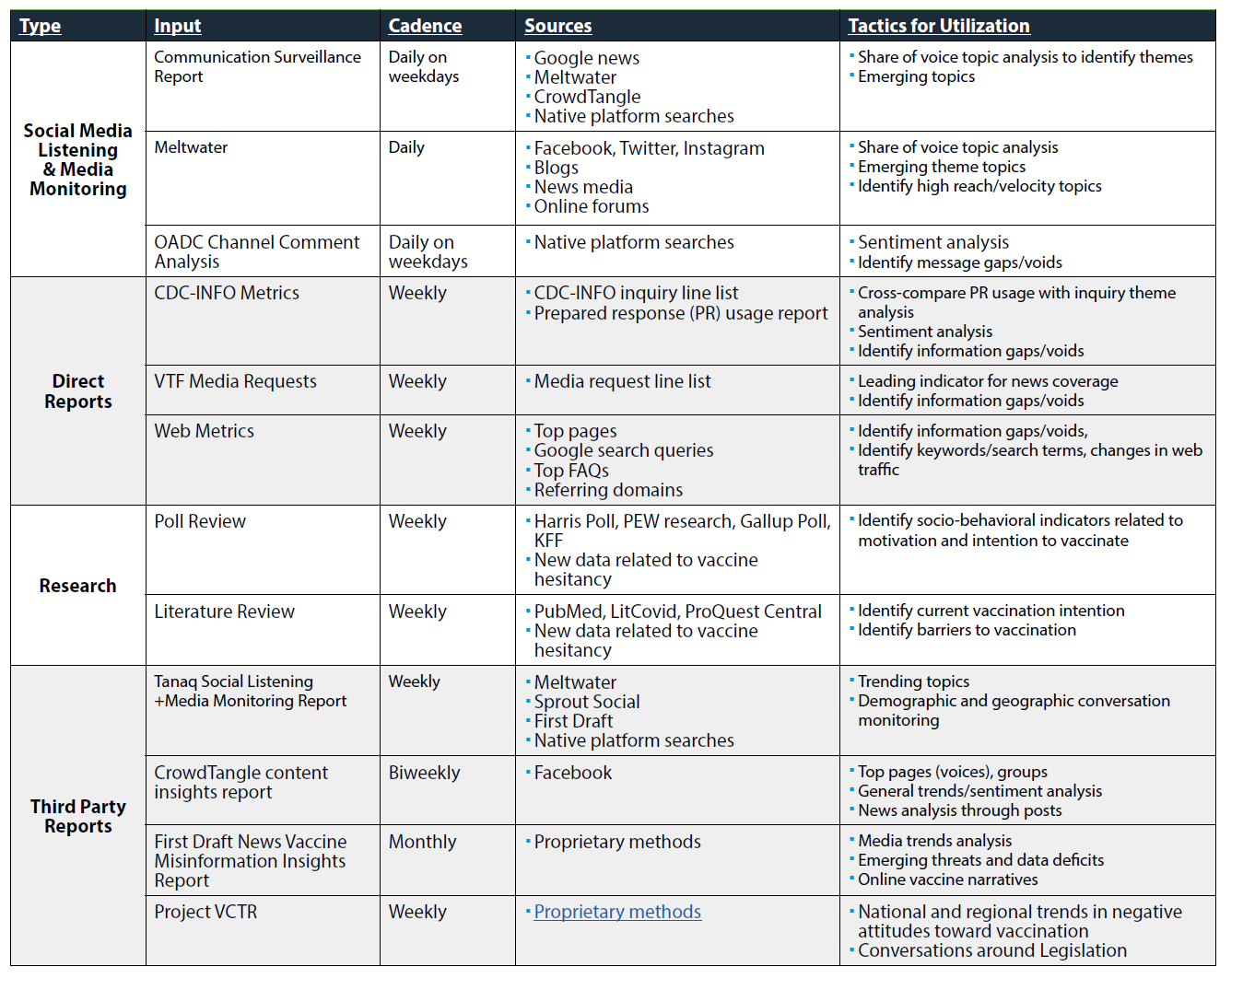
Example from the Field: US CDC COVID-19 State of Vaccine Confidence Insights Report
Quantitative/qualitative analysis of numerous data sources and media sources (ex: digital media, social media, CDC-Info)
Themes created across data sources
Coded
relative threat to vaccine uptake information spread
Recommendations for action identified for each theme.
Notes:
The COVID-19 State of Vaccine Confidence Insights reports are not your average social listening or media monitoring report.​
​
It assesses threats to vaccine confidence rapidly and in near real-time on a biweekly basis with concurrent data collection and analysis.​
In addition to detecting mis- and disinformation as it emerges; we analyze public perception and opinions and identify information gaps and voids, and message penetration issues.​
​
We utilize a mixed deductive and inductive approach. Inductive in that we capture and triangulate relevant themes around vaccines that organically emerge. Deductive in that we make assessments about the themes’ relevance to and effect on vaccine confidence using the CDC’s Vaccinate with Confidence Strategy and underlying framework. ​
​
The report also amplifies actionable next steps focused on communications, outreach and engagement, and research for CDC, other federal agencies, state and jurisdictions, and partner organizations.
Each theme is classified by whether the threat to vaccine confidence is high, moderate, or low. As well, the themes are classified by whether they are increasing, remaining stable, or decreasing over time (since last 2 week period).
-various media sources are from digital media, peer-reviewed research, polling data, social listening platforms, CDC-INFO, and web metric data
-relative threat to vaccine uptake: high, moderate, low
-information spread: rapid, stable, decreasing

Slide 30
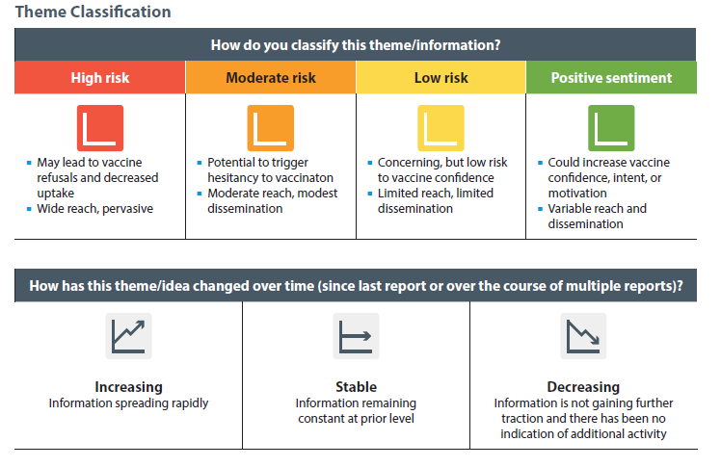
Example from the Field: US CDC COVID-19 State of Vaccine Confidence Insights Report
Vaccine Confidence Threat Classification Matrix
Notes:
Then we apply our theme classification matrix to address a theme’s threat to vaccine confidence. We have four categories, high being something that would directly lead to vaccine refusals, moderate has potential to trigger hesitancy, and low for items that are concerning but low risk to confidence or only for a small proportion of people. We have also included positive sentiment to highlight themes that could boost confidence in vaccinations.​ Last, we consider directionality – is the theme increasing, stable, or decreasing across time.​

Slide 31
Example from the Field: WHO Weekly Infodemic Management Insights Reports
Step 1
Step 2
Step 3
Input:
Weekly, a sample of 20 million content items about COVID-19 from open online sources in 14 languages
Input:
Dataset classified into 35 categories of COVID-19 conversations
Input:
Infodemic intelligence, search patterns, epidemiological and behavioral data, offline data sources
Analysis:
Integrated analysis of intelligence from included data sources through theme identification in narratives and issues, to develop insights.
Expert judgement applying scalar values to each insight/each thematic narrative based on threat matrix. Identify three priority narratives and derive recommendations for them.
Analysis:
Identification, aggregation and categorization of narratives, questions and sentiment into 35 categories of narratives as per public health COVID-19 conversation taxonomy using NLP and AI.
Analysis:
Qualitative analysis by human analysts of week-on-week comparisons and changes in narrative categories and sentiment. Identification of information voids by velocity, confusion, questions, and emergence of misinformation.
persistent
Narratives
re-emerging
emerging
Output:
Classified dataset, presented in Tableau dashboard
Output:
Weekly 50-page infodemic intelligence report and executive summary text message.
low
moderate
high
positive
sentiment
Public health risk
Output:
One page action memo.

Slide 32
Example from the Field: WHO Weekly Infodemic Management Insights Reports
Emerging
Persistent
Re-emerging
A new narrative (or an existing narrative with new changes significant enough to warrant a different response) not previously identified in past weekly reports; may require development of new information materials or further analysis
A previously identified narrative that continuously drives online conversations across multiple reports, without any significant changes in volume or velocity; may indicate an ongoing deficit in addressing information voids
A previously identified narrative that resurfaces after being absent (or low in volume) for multiple weeks; may flag potential challenges that the current approaches need to address more effectively

Slide 33
3 Truths in Addressing Social Listening and Integrated Analysis in the Field
Guiding Principles for Practitioners:
Social listening is a process, not an end product – it needs to inform action!
Diversify your data sources as much as possible, including existing data sources other colleagues may have access to
There is no magic dashboard because analysis can only be integrated by humans

Slide 34
3 Best Practices in Addressing Social Listening and Integrated Analysis in the Field
Tools/Guidance Used by Practitioners:
Start with an analysis plan that is based on your programmatic needs
You should create your own infodemic manager network because partners are essential to your job
Consider creating your own risk scalar judgement or theme categorization matrix to streamline your process of generating recommendations

Slide 35
Example metrics and measures in social listening
# of engagements: Reactions by users that are captured
(e.g. likes, shares, ratings, comments)
# impressions: How often a piece of content is displayed to users
# mentions: How often a keyword appears
Velocity: Change in engagement and narratives over time compared to previous unit of measure
Online observations: Structured observations of online content and reactions by users in a specific online community
Web analytics: Built in data capture and analysis of use of webpages or social media channels (e.g. search patterns, keyword use, bounce rate, popularity, document downloads)
Geolocation data: Change in movement of people based on mobile phone location
Call center logs: Records from hotlines for public health questions and concerns
Community listening: Capturing qualitative information from target audiences about a specific health topic to understand questions, concerns and rumors

Slide 36
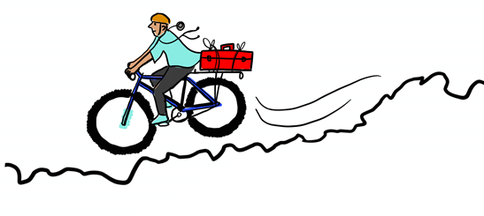
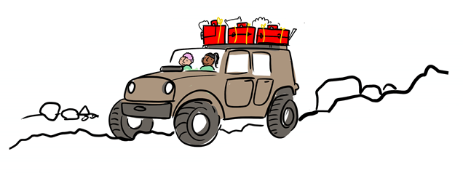
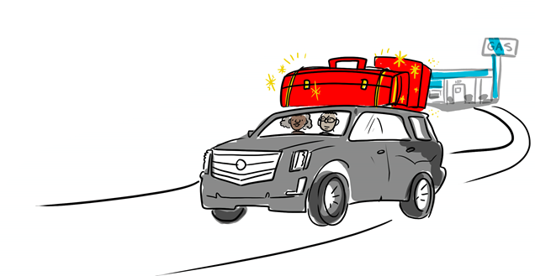
Considerations for different operating environments:
Try to focus on utilizing existing data sources and focusing on understanding most vulnerable populations
Leverage partners and their data sources where possible! If you conduct an analysis with many data sources from partners, you can add value by reporting out new insights to them for them to use.
Work to add more data sources, especially those with better access to vulnerable populations
Set up an IM team with dedicated staff for social listening (e.g. analysts focused on specific data sources)
Actively work to create demand for insights products
Develop new data sources where you have limited availability; consider investing in routine data sources and in representative data collection
Regularly assess the needs of insights report stakeholders in insights products and modify accordingly
Work with communications and program staff to develop improved messages and actions based on social listening insights (better linkage to step #2 for improved communication and program implementation)

Slide 37
Key resources, guidance and tools
Guidance
WHO Infodemic health topic page
First Draft vaccines and misinformation resources
UNICEF vaccine misinformation field guide
US CDC addressing vaccine misinformation page
Readings/Videos
Infodemic Signal Detection During the COVID-19 Pandemic: Development of a Methodology for Identifying Potential Information Voids in Online Conversations
4th WHO Infodemic Management Conference, May 2022 – Advances in Social Listening for Public Health
Subscribe to WHO Infodemic Management Newsflash
https://infodemiology.jmir.org/2022/2/e38343
Tools (available today)
Vaccination Demand Observatory
EARS

Slide 38
Group work

Slide 39
Atsuyoshi Ishizumi
Infodemic Management Team
Department of Epidemic and Pandemic Preparedness and Prevention
WHO Health Emergencies Programme
Christopher Voegeli
Insights Unit Lead, National Center for Immunization and Respiratory Diseases,
US CDC

Slide 40
Extra slides

Slide 41
Deep dive: theme identification and triangulation
© WHO / Sam Bradd

Slide 42
Theme Identification
Data from Media Monitoring:
Source A: North City vaccination sites move from appointments to walk-ins.
Source B: Museum of Natural History will give free tickets for visitors who get vaccinated on site.
Source C: School bars vaccinated teachers, citing fears of viral shedding affecting children.
Source D: South County will pay residents to get COVID-19 vaccine.
Source E: Employers offer on-site vaccinations to employees.
Data from COVID-19 hotline (phone calls):
Will I have to get booster vaccine doses for the rest of my life?
I want to get pregnant, but I am worried about getting COVID-19 from vaccinated people. Should I avoid the vaccinated?
I heard that some vaccinated people still get COVID-19. Does that mean that my vaccine didn’t work?
Is it safe for my children to be around vaccinated adults who might shed the virus?
If most adults are vaccinated, what’s the benefit of my child getting the vaccine?
Notes:
Let’s look at this together, using one technique for identifying themes at a time. Let's start with repetition. As you read these, put in the chat what themes you see repeating themselves across the 10 data points, naming both the theme and how many times you see it come up. Put what you see in the chat.​
​ ​
That's great, thank you.

Slide 43
Theme Identification
Data from Media Monitoring:
Source A: North City vaccination sites move from appointments to walk-ins.
Source B: Museum of Natural History will give free tickets for visitors who get vaccinated on site.
Source C: School bars vaccinated teachers, citing fears of viral shedding affecting children.
Source D: South County will pay residents to get COVID-19 vaccine.
Source E: Employers offer on-site vaccinations to employees.
Data from COVID-19 hotline (phone calls):
Will I have to get booster vaccine doses for the rest of my life?
I want to get pregnant, but I am worried about getting COVID-19 from vaccinated people. Should I avoid the vaccinated?
I heard that some vaccinated people still get COVID-19. Does that mean that my vaccine didn’t work?
Is it safe for my children to be around vaccinated adults who might shed the virus?
If most adults are vaccinated, what’s the benefit of my child getting the vaccine?
Notes:
I believe that many of you noted that 4 media stories discuss different aspects of vaccination sites. In all the cases, there seems to be an initiative to make getting vaccinated more appealing. This is an example of a theme that is implicit – we can give it a name that it does not yet have, let’s call it “efforts to expand vaccine uptake.”​

Slide 44
Theme Identification
Data from Media Monitoring:
Source A: North City vaccination sites move from appointments to walk-ins.
Source B: Museum of Natural History will give free tickets for visitors who get vaccinated on site.
Source C: School bars vaccinated teachers, citing fears of viral shedding affecting children.
Source D: South County will pay residents to get COVID-19 vaccine.
Source E: Employers offer on-site vaccinations to employees.
Data from COVID-19 hotline (phone calls):
Will I have to get booster vaccine doses for the rest of my life?
I want to get pregnant, but I am worried about getting COVID-19 from vaccinated people. Should I avoid the vaccinated?
I heard that some vaccinated people still get COVID-19. Does that mean that my vaccine didn’t work?
Is it safe for my children to be around vaccinated adults who might shed the virus?
If most adults are vaccinated, what’s the benefit of my child getting the vaccine?
Notes:
Then there are concerns about children, which came up in the third media story and Q4 and 5 in the data from COVID-19 hotline. ​
There are also non-repeating but unique themes that we might keep an eye on as we continue with the data analysis. They include Q1 from the call log about booster vaccines and effectiveness of vaccines in preventing COVID and Q2 about pregnancy.​

Slide 45
Theme Identification
Data from Media Monitoring:
Source A: North City vaccination sites move from appointments to walk-ins.
Source B: Museum of Natural History will give free tickets for visitors who get vaccinated on site.
Source C: School bars vaccinated teachers, citing fears of viral shedding affecting children.
Source D: South County will pay residents to get COVID-19 vaccine.
Source E: Employers offer on-site vaccinations to employees.
Data from COVID-19 hotline (phone calls):
Will I have to get booster vaccine doses for the rest of my life?
I want to get pregnant, but I am worried about getting COVID-19 from vaccinated people. Should I avoid the vaccinated?
I heard that some vaccinated people still get COVID-19. Does that mean that my vaccine didn’t work?
Is it safe for my children to be around vaccinated adults who might shed the virus?
If most adults are vaccinated, what’s the benefit of my child getting the vaccine?
Notes:
Let’s dig a little deeper and do an analysis of similarities and differences in one of our repeating themes to make sure that all the data points are really talking about the same thing. Let’s take the “efforts to expand vaccine uptake” theme.
Given our purpose and context, we ended up seeing two different kinds of initiatives aimed at increasing vaccine uptake. One kind expanded access to vaccinations…
By doing things like offering walk-in vaccinations rather than requiring appointments and creating new vaccination sites, such on the locations of employers for their employees. You can see them in brown on the slide.
The other type of initiative offered incentives and rewards for getting vaccinated. This included projects like getting free tickets or receiving payment to get vaccinated. You can see that in the news media data points 2 and 4. For us, it was important to distinguish between those two types of efforts because they were likely to and indeed were eliciting different kinds of responses from people and so they were differently affecting vaccine confidence and uptake. Our framework helped guide how we categorized these sub-themes.
Let’s try another technique for identifying themes: indigenous categories.

Slide 46
Theme Identification
Data from Media Monitoring:
Source A: North City vaccination sites move from appointments to walk-ins.
Source B: Museum of Natural History will give free tickets for visitors who get vaccinated on site.
Source C: School bars vaccinated teachers, citing fears of viral shedding affecting children.
Source D: South County will pay residents to get COVID-19 vaccine.
Source E: Employers offer on-site vaccinations to employees.
Data from COVID-19 hotline (phone calls):
Will I have to get booster vaccine doses for the rest of my life?
I want to get pregnant, but I am worried about getting COVID-19 from vaccinated people. Should I avoid the vaccinated?
I heard that some vaccinated people still get COVID-19. Does that mean that my vaccine didn’t work?
Is it safe for my children to be around vaccinated adults who might shed the virus?
If most adults are vaccinated, what’s the benefit of my child getting the vaccine?
Notes:
The one unique sounding phrase is “viral shedding” and “shed the virus.” You can see them in orange on the slide in data point 3 in news media and data point 4 in the hotline data. “Viral shedding” is a long standing trope in arguments against all vaccines. It is a piece of misinformation that resurfaces regularly with successive immunization efforts. It basically says that people who get the vaccine can shed some of the virus they got in the vaccine and transmit it to people who are not vaccinated. This is something that is a small risk with vaccines made from live-attenuated viruses. It cannot happen with any of the COVID-19 vaccines since none of them use that technology. This piece of misinformation makes people worried about vaccine safety.
In our small subset of data here, we might note that “viral shedding” is an indigenous term being used by people. This will warrant us to take a closer look at the data to see where is the same theme coming up without perhaps using the same terminology.
In Question 2 from the hotline data. The person is talking about her worries that she might get COVID from vaccinated people and since we know that this relates to the "viral shedding" indigenous category, we would group it in with the other two data points.

Slide 47
Vaccination Demand Observatory
A Global Initiative to Increase Demand for Vaccines and Decrease the Impact of Misinformation
An example of social listening

Slide 51
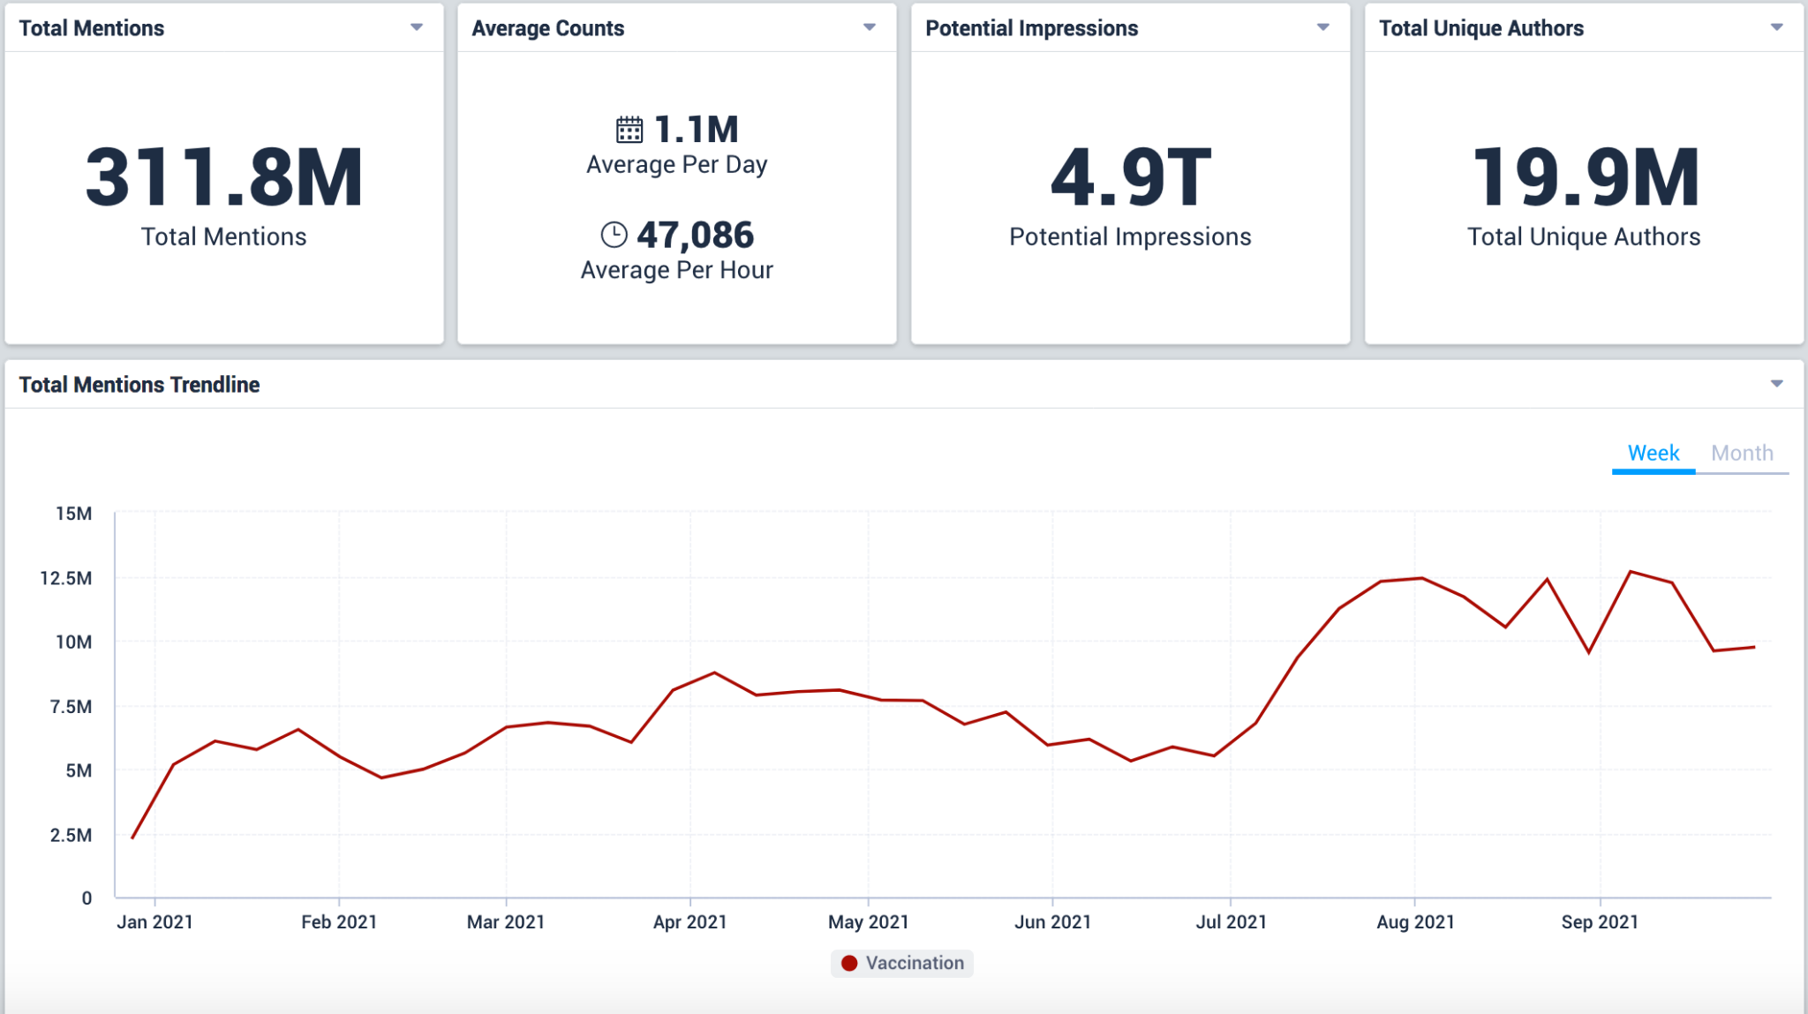
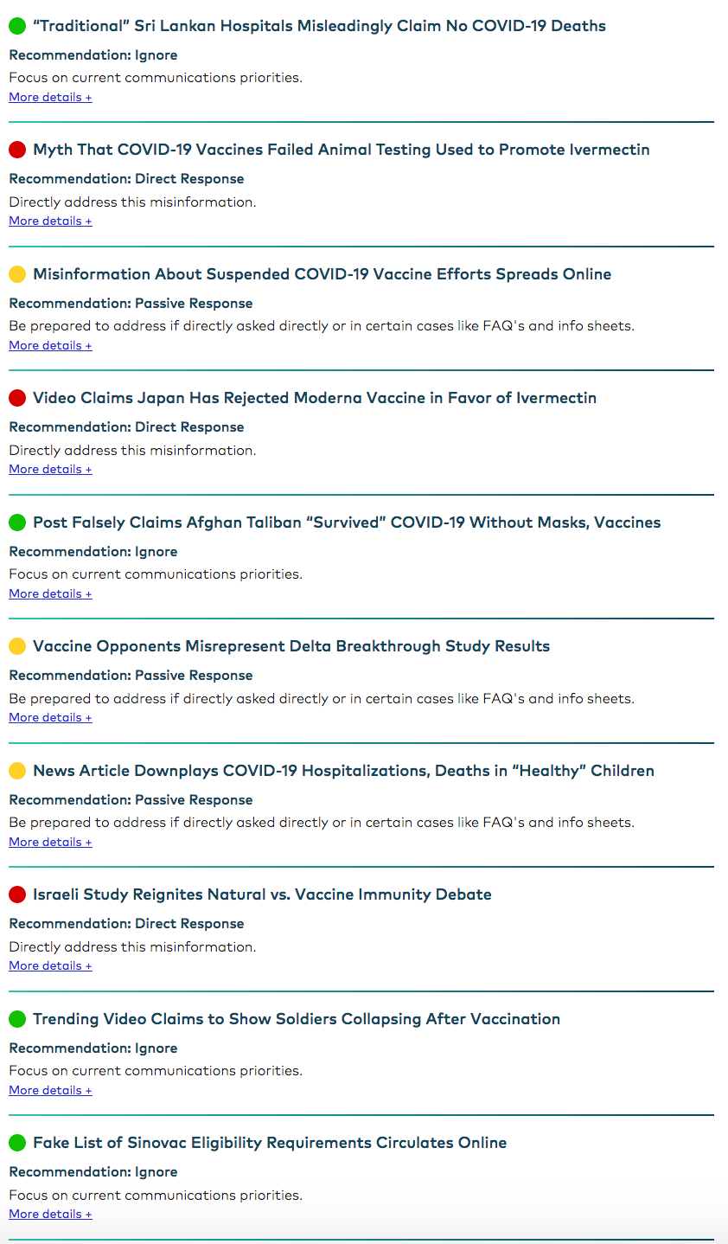
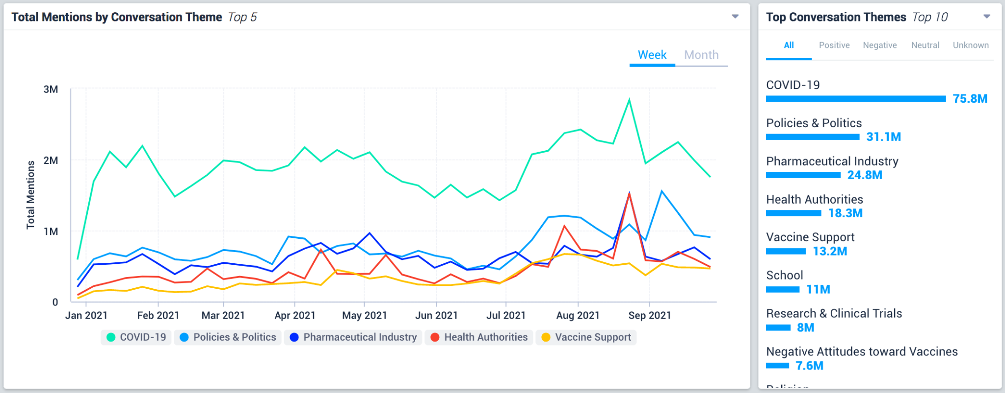
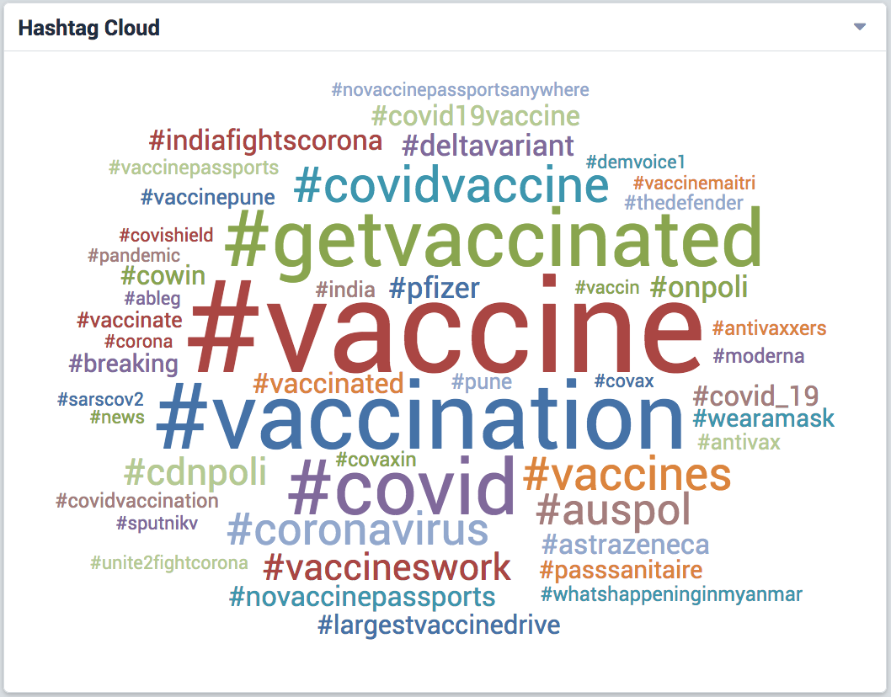
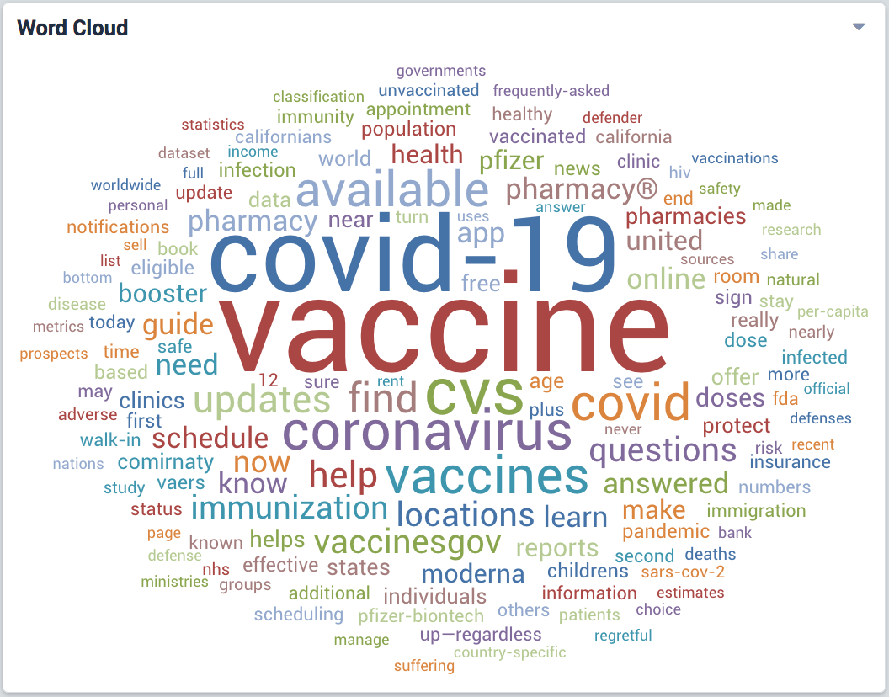
Establishing/Strengthening Social Listening platforms in COs
Driven by needs & identified gaps
VISUALISE
ANALYSE
INPUTS
Newspapers, magazines
Broadcast news
News sites, forums
Social media (FB, YouTube, WhatsApp, Instagram, TikTok, Twitter, Telegram, Snapchat, Pinterest, Reddit, Vimeo, Weibo, WeChat)
API’s
CrowdTangle, Zignal Labs, Meltwater, TalkWalker
Google & Twitter partnerships
Junkopedia
Manual investigation
PENDING INPUTS
U-Report
Viamo 3-2-1
51
Represents only select data, not all data available and analyzed by Vaccination Demand Observatory
Notes:
Metrics captured by Dashboard:
Total mentions: A running count of mentions of vaccines, variations of those words and hashtags, across all sources for a selected time frame.
Average counts: The average mentions per day and per hour, for the selected time frame. This is calculated by the number of mentions/time frame (hours per day) of the dashboard.
Media breakdown: The breakdown of where content is coming from.
Potential impression: The potential impression count for Twitter, news, forums, blogs, Q&A sites, & review sites, over the selected time frame.
Trending stories: The most shared stories by link on social media.
Popular tweets: The most retweeted stories via Twitter, sorted by the number of retweets within the selected time frame.
Top authors by mention: The top authors on Twitter by mentions, the mentions count reflects all mentions over the timeframe selected.
Top authors by influence: The most “influential” Twitter authors engaging in conversation. Influence scoring methodology takes into consideration a combination of Author attributes such as number of followers, number of posts if the author is verified as well as the likelihood of the author to be a bot.
Hashtag cloud: Top Hashtags being used on Twitter and Instagram
World map: Shows mentions tied to a location on a cardinal direction-level basis for each country (West, South, Northeast, etc.)
Manual Monitoring: This section includes information from public health analysts who manually monitor accounts and pages known to share misinformation on platforms that are not included in electronic data ingestion due to data limitations (i.e. Facebook)

Slide 52
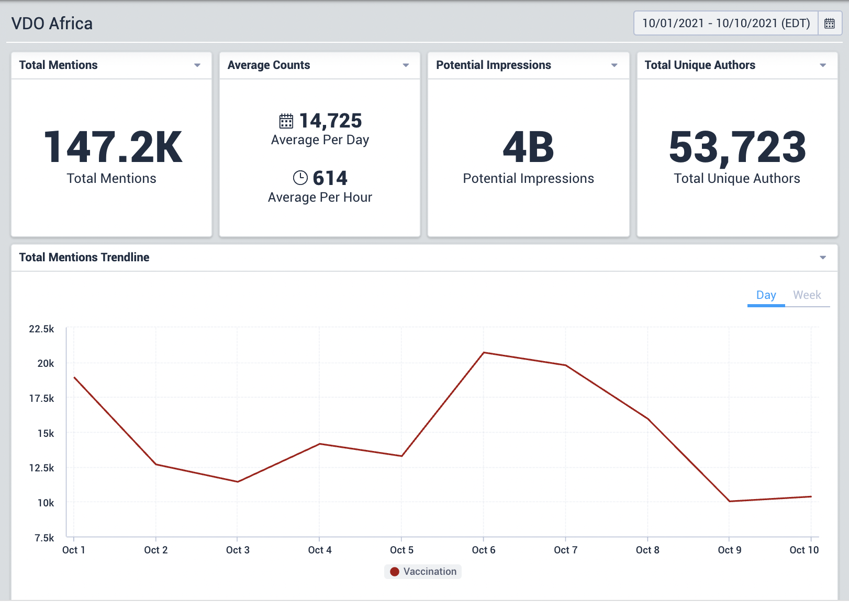
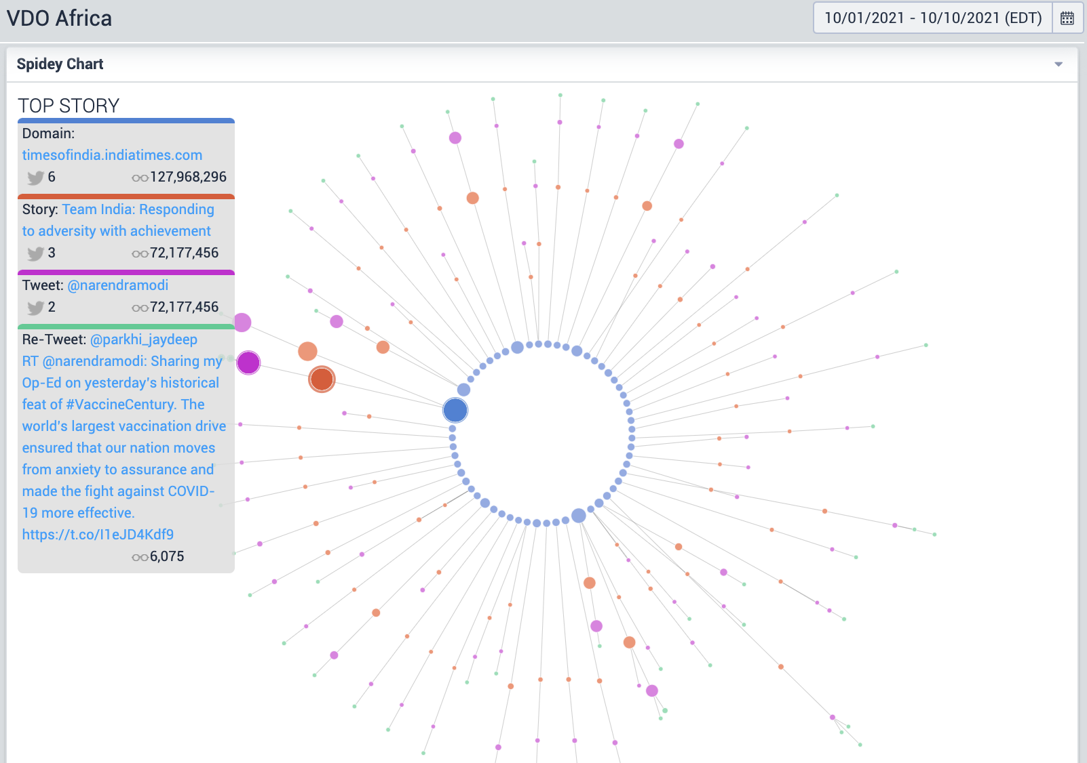
Establishing/Strengthening Social Listening platforms in COs
Driven by needs & identified gaps
We created interactive global, regional and country level dashboards. Key features include:
easily identifiable and customizable metrics filtered by date
visualization tools designed to share real-time vaccination conversations in the target region
From October 2020 - October 2021
284.3M total mentions have been analyzed
Over 150 recommendations made
19.6 Million Conversations Monitored, with themes including:
Negative Attitude towards Vaccines: 7.2M
Research & Clinical trials: 4.8M
Vaccine Ingredients: 2.9M
Negative Health Impacts: 2.7M
Disease Prevalence: 2M
There were also conversations focused on Policies and Politics (25.6M), Pharma Industry (19.7M), Vaccine Support (10M), Schools (7.6M), Family (3.7M) and Religion (3.7M)

Slide 53
Strengths of the VDO data & analytics
Additional Data Coverage
Twitter Firehose
Reddit
Sina Weibo (Chinese Social Network)
VK (Russian Social Network)
4Chan
Traditional News Coverage
Additional Language Coverage
Chinese
Japanese
Locations
Access to over 80 countries
HUMAN ANALYSIS
Automation Analysis: Identify when social media accounts are automated “Bot” accounts or real people.
Identify when automation is impacting or engaging in social conversations
Analyze connectivity and coordination between automated accounts
Discover centers of influence within social conversations
Audience Analysis: Analyze specific audiences to determine their influence and impact on a conversation
Emerging Narrative Detection: Identify when new conversations and narratives are emerging and then track their trajectory across traditional news and social media
Historic Lookback: Instantly search the history of Twitter to identify trends and themes over the last 15+ years
Data Volume Discrepancies
Citibeats Data: ~ 45,000,000 Mentions since 10/15/20
VDO dashboard: ~1,200,000,000 Mentions since 10/15/20

Slide 54
After setting up a country dashboard, PGP analysts prioritize misinformation narratives and assign them a recommendation.
This is a unique offering in this space.
Establishing/Strengthening Social Listening platforms in COs
Actionable Risk Communication Guidance
Direct Response
Directly address this misinformation.
Passive Response
Be prepared to address if directly asked, and in certain cases consider updating FAQ’s and info sheets addressing common myths and misperceptions.
Otherwise, continue to focus on current communications priorities.
Ignore
Focus on current communications priorities.

Slide 55
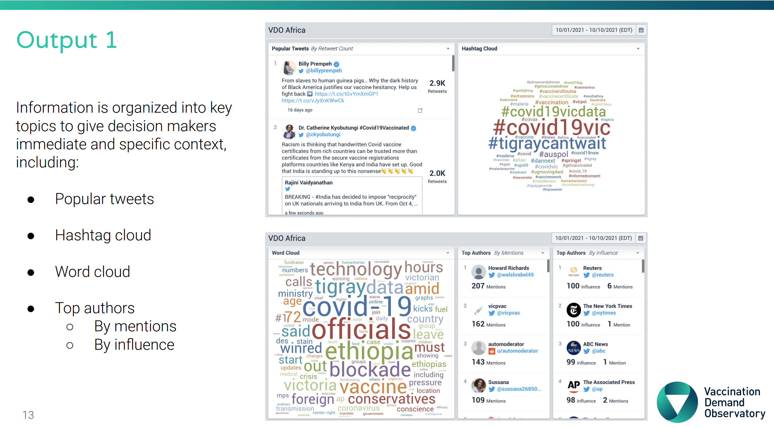

Slide 56
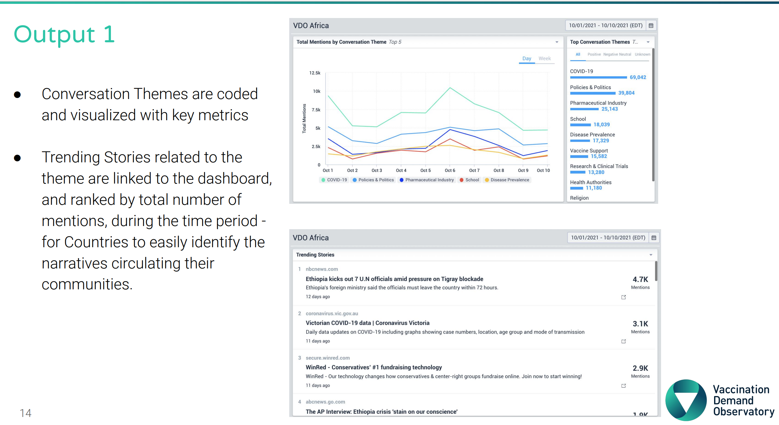

Slide 59
Key Learnings
The VDO has more data than other systems
The VDO is about people and not dashboards
Actionable recommendations supports actions to be taken

