Slide 1
Comprehensive training
28 June – 21 July 2022
HOSTED BY GAVI, WHO, UNICEF & US CDC

Slide 2
Strategies to implement a positive, people-centered immunization service experience
Lisa Oot
Senior Technical Officer
John Snow International

Slide 3
Outline
Overview of Service Experience
Review of Service Experience Components
Examples from Ghana and Nepal
Guiding Principles

Slide 4
Learning objectives
Participants will be able to:
Explain the components that make up the immunization service experience.
Explore how to integrate elements of service experience into their work.
Generate ideas for how service experience can be applied to their work.

Slide 5
Problem statement:
Inequities in immunization coverage have highlighted the crucial component of demand generation and the need for a people-centered model for vaccination where services must be brought closer to people by enhancing service quality and accountability, considering health-worker and client perspectives and needs, and bringing people to services with community engagement and development of a social norm. The bridge between these two components is the immunization service experience.

Slide 6
Key components of a positive, people-centered immunization service experience

Slide 7
Health System and Facility

Slide 8
Facility Environment
Welcoming, calming, safe environment
Condition and management of the facility: look, feel, cleanliness, order.
Equipment and set up of session.
Availability of vaccine storage and storage of registers.
Ghana: Lack of cold chain facilities at the primary level --> HWs traveling 3km to obtain vaccines from cold storage to service delivery points.
Privacy during immunization sessions.
Karen Kasmauski/MCSP

Slide 9
Integration of immunization within a package of services
Integrated delivery to meet the needs of the clients
Lack of time on the part of the client necessitates integration
Structure feasibility and limitations (e.g. HF competency, ability to provide services such as outreach)
Exploring entry and convergence points for immunization that can affect the service experience
Exploration necessary around how quality of integration of immunization and other services is:
Perceived by HWs, clients, communities and
How that is measured vis-à-vis expectations/perceptions
Service provider interaction with clients can be compromised due to integration.
Routine, long hours of service delivery—combined with unmatched staffing demands and compensation—can stress service providers
“When we think about quality of care, we often overlook the quality of care in integration of services.”

Slide 11
Health Worker and Client

Slide 12
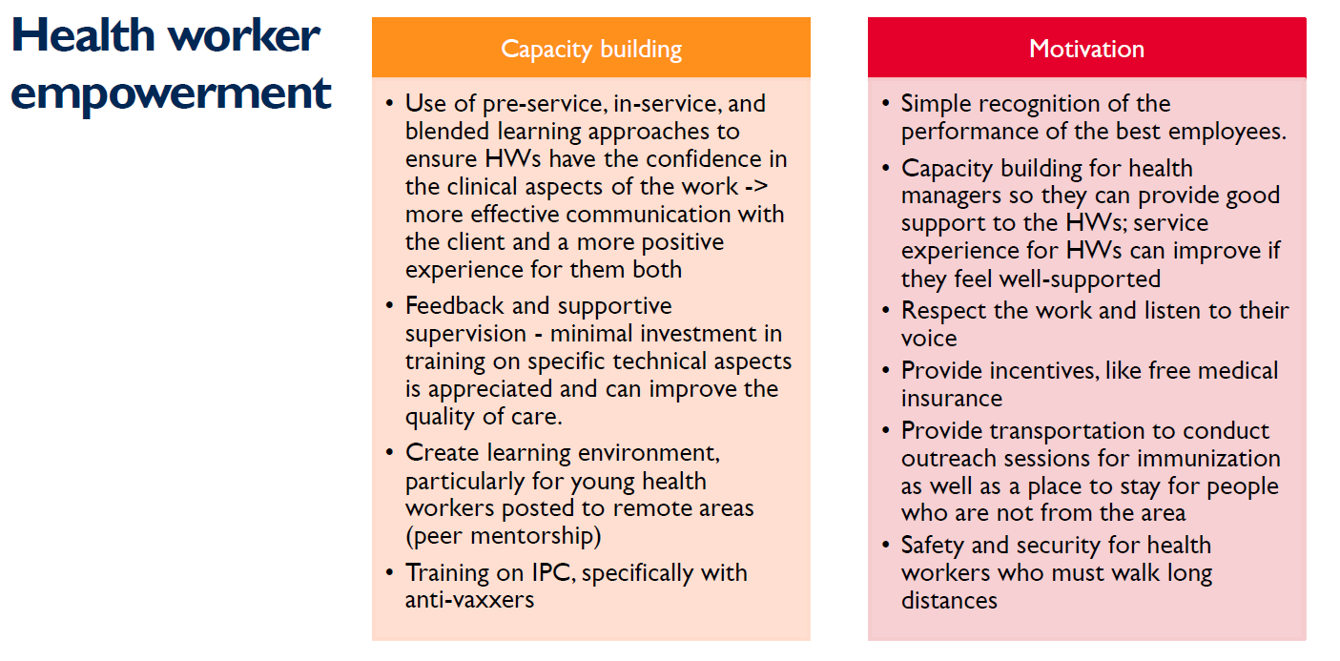

Slide 13
Interpretation and perception of service experience
When the health workers are supported by the system to do their job, they enjoy it more and do not feel like health education or engaging with the client is a burden. They view themselves as primarily responsible for health promotion and patient education.
Capacity building of health staff in IPC is highlighted as a key to improving the interpretation or perception of service experience.
Client interpretation and perception of service experience is influenced by:
Convenience
Respectful and dignified care
Provider attitude and communication
Higher levels of concordance of social characteristics (e.g., age, gender, education, and socioeconomic status) between patients and providers result in higher satisfaction with care.
Provider interpretation and perception of service experience is influenced by:
Staffing
Peer mentorship
Online repository
Support by the health system

Slide 14
Community

Slide 19
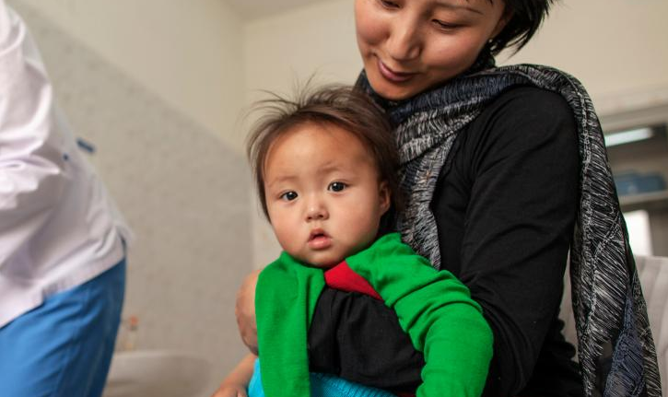
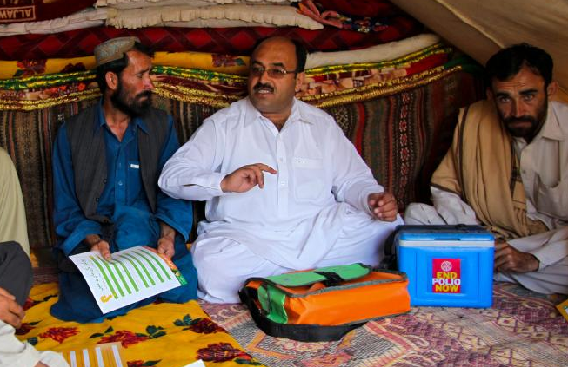
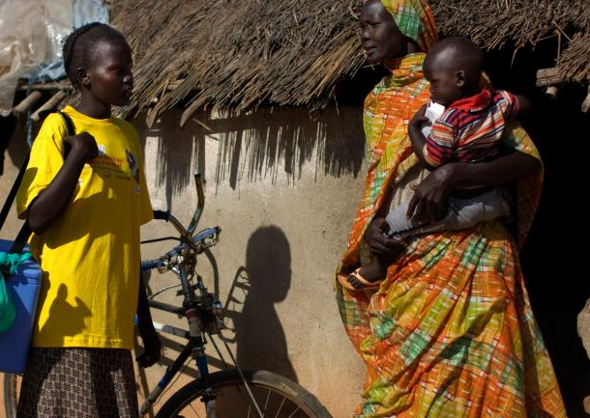
Truths from the field

Slide 20
Quality of the interaction and service provided
"Quality of the interaction is a very important component but needs to be improved; the counselling part is very weak."
Some caregivers do not as questions due to poor provider attitude; they fear how the providers will respond.
Language, literacy, and cultural barriers affect IPC.
Emphasis on IPC skills, vs mentoring, vs clinical skills.
Quality improvement indicators teach to the hoped outcomes and not around building confidence that health workers can do more and that improving the interaction is important.
Who makes sure that the quality skills are being met by the provider?
Mentor and/or supervisor skills to be able to effectively monitor and support providers to improve those skills
Source: IPC/I Package

Slide 21
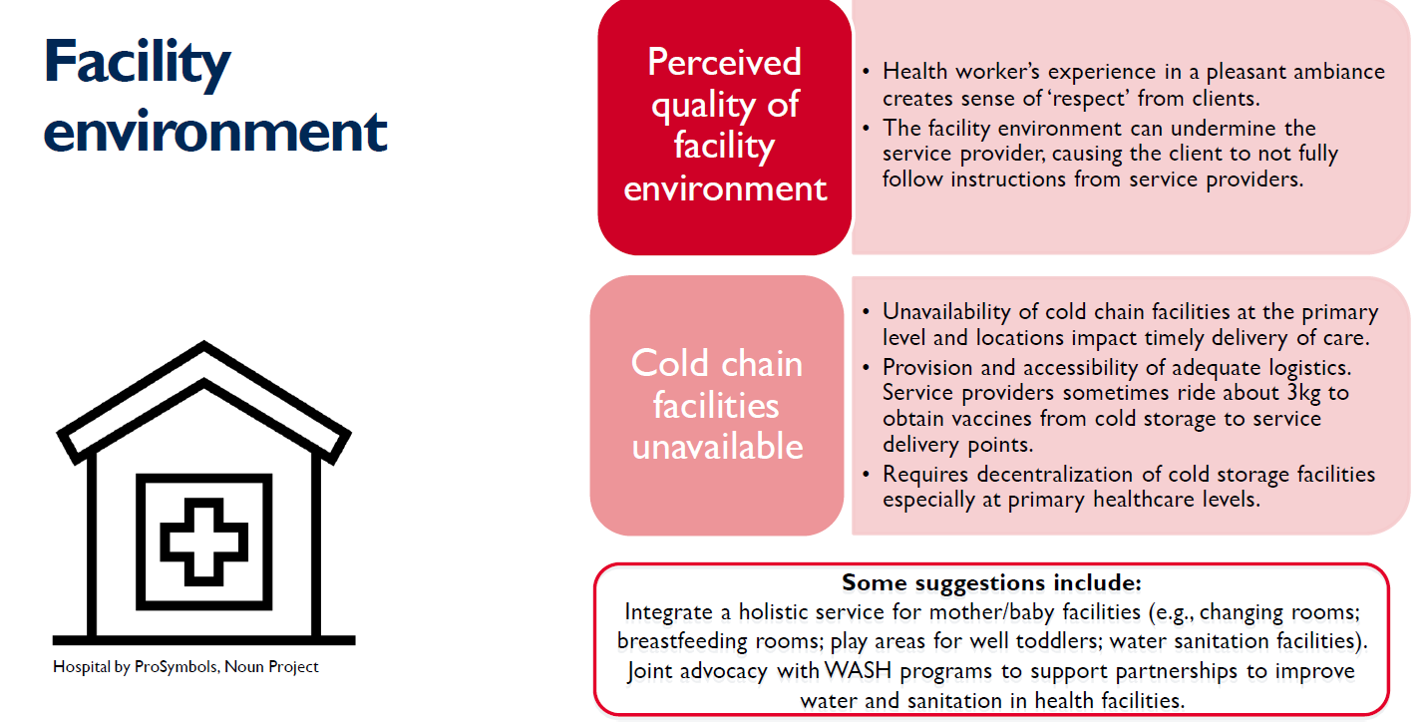
Insights from Ghana

Slide 22
Insights from Ghana

Slide 23
Insights from Nepal

Slide 24
Insights from Nepal

Slide 25
3 Guiding Principles for Service Experience
We need to value and integrate the communities we serve into immunization programming.
We need to recognize that quality of services start with ensuring that HWs can do their jobs, and do them well.
We’re just starting to understand (and measure) what can be achieved through addressing the various elements of service experience.

Slide 26
Strategies for different health care workers
Frontline workers:
Respect the caregiver. Ensure that the caregiver understands the risks and the benifits.
Listen to make sure you understand what you hear.
Ask open-ended questions.
Supportive Supervisors:
Encourage good practices and to identify and address areas for improvement.
Monitor and assess immunization services to help ensure that FLW work-related needs are met
Program Managers:
Establish and maintain a network of organizations responsible for monitoring and evaluation
Develop an annual monitoring and evaluation workplan

Slide 27
Key References and Resources
Strengthening Immunization Service Experience: Global, Regional, and Country Insight Gathering

Slide 28
Group work

Slide 29
Group Exercise
Breakout Activity Steps:
Participants take turns reading sections of the case study out loud.
Discussion Question 1: How has COVID-19 influenced this family’s use of routine immunization? How has it changed the dynamics of the family unit?
Discussion Question 2: What are areas that could be improved at the health facility to improve Alma’s service experience? How do these relate to the Service Experience Framework?
Discussion Question 3: What factors likely impacted the health worker’s ability to provide a positive service experience to Alma and her children?
Discussion Question 4: What are your ideas to improve service experience and enhance health workers ability to provide good care?
Connect these ideas with the Service Experience Framework.

Slide 30
Assessment Questions
Question #1
Which of the following is NOT a main components of Service Experience according to the analytical framework:
Health System and Facility
Health Worker and Client
Community
Vaccine Supply Chain Management
Question #2
True or False: Communities should be engaged in monitoring the quality of immunization services.
Question #3
Which of the following might affect a Health Worker’s feeling of Empowerment A. Access to quality supplies and equipment
B. Clear career options and guidance on promotion
C. Safety and security for HWs when walking long distances to provide services
D. A & B
ALL of the above

