Slide 1
Comprehensive training
28 June – 21 July 2022
HOSTED BY GAVI, WHO, UNICEF & US CDC

Slide 2
Behavioral Interventions to Increase Vaccine Demand & Uptake
Neetu Abad
Team Lead; Demand for Immunizations Team
US Centers for Disease Control & Prevention

Slide 3
Outline
Introduction to behavioral science
Vaccine demand basics & interventions that increase vaccine uptake
Intervention examples
Monitoring & evaluation
Group exercise

Slide 4
Learning objectives
Participants will…
Learn principles of behavioral science how it is applied to designing, implementing, and evaluating behavioral interventions
Learn what behavioral interventions are most associated with increasing immunization uptake
Learn how to implement behavioral interventions taking field realities, challenges, and opportunities into account

Slide 5
Problem statement
When vaccine uptake rates are lower than expected due to behavioral factors, what interventions can we use to increase demand and uptake?

Slide 6
Introduction to Behavioral Science

Slide 7
What is behavioral science?
Behavioral science in the context of public health can be defined as the science of conceptualizing, measuring, and changing health behaviors

Slide 8
Behavioral science draws on many disciplines
Behavioral economics
Psychology
Communications
Anthropology
Social and behavioral sciences in public health

Slide 9
A synthesis of theory, research, and practice is important in behavioral science
Theory
Practice
Research
A set of interrelated concepts that explain behaviors and suggest ways to achieve behavior change
Quantitative and qualitative understanding gained via theoretically informed approaches
Interventions to induce positive behavior change, which are informed by research and theory
Reference: Glanz, K., Rimer, B. K., & Viswanath, K. (2015). Health Behavior: Theory, Research, and Practice. John Wiley & Sons.

Slide 10
The Problem of the Information Deficit Model
Created in the 1970s, the information deficit model assumes that gaps in understanding between scientists and the public are a result of a lack of information or knowledge.
The intervention: a one-way communication model where information flows from experts to the public in an effort to change individuals’ attitudes, beliefs, or behaviors
Let’s test this hypothesis…

Slide 11
Raise your hands if you heard that working out at least 3 times a week is a great way to stay healthy and fit.
Now keep your hands raised if you work out a minimum 3 times a week every week
A number of us (myself included) have to put our hands down. Why?
Because behavior is determined by more than knowledge, it is also determined by culture, religion, emotions, memory, past experiences, etc.

Slide 12
Interventions that Increase Vaccine Demand & Uptake

Slide 13
Willingness to Accept a Vaccine Falls on a Continuum
Notes:
This slide shows how the willingness to accept a vaccine falls on a continuum.
The vaccine demand continuum illustrates behaviors, whereas confidence is both a feeling and can be acted on. Some people might fall in the middle of this spectrum adopting a wait-and-see approach.
We want to move people toward the right. The closer you get to active demand on the right side of the continuum, the increasing confidence the person likely feels in the vaccine, the vaccinator, and the health system, because they actively chose vaccination.
If there is sufficient confidence and trust and ability, then people will seek out vaccines, overcoming barriers to do so. People with less confidence or motivation or ability may be less willing to overcome real or perceived barriers, such as transportation or getting time off work. Next slide.

Slide 14
Measuring Behavioral and Social Drivers of Vaccination
Behavioural and Social Drivers
Thinking and Feeling
Perceived disease risk
Vaccine confidence (includes perceived benefits, safety and trust)
Practical Issues
Availability
Affordability
Ease of access
Service quality
Respect from provider
Motivation
Intention to get/ recommended
vaccines
Vaccination Uptake of recommended
vaccines
Social Processes
Social norms (includes support of family and religious leaders)
Provider recommendation
Gender equity
The Behavioural and Social Drivers (BeSD) Framework. Source: The WHO BeSD working group. Based on Increasing Vaccination Model (Brewer et al., 2017)

Slide 15
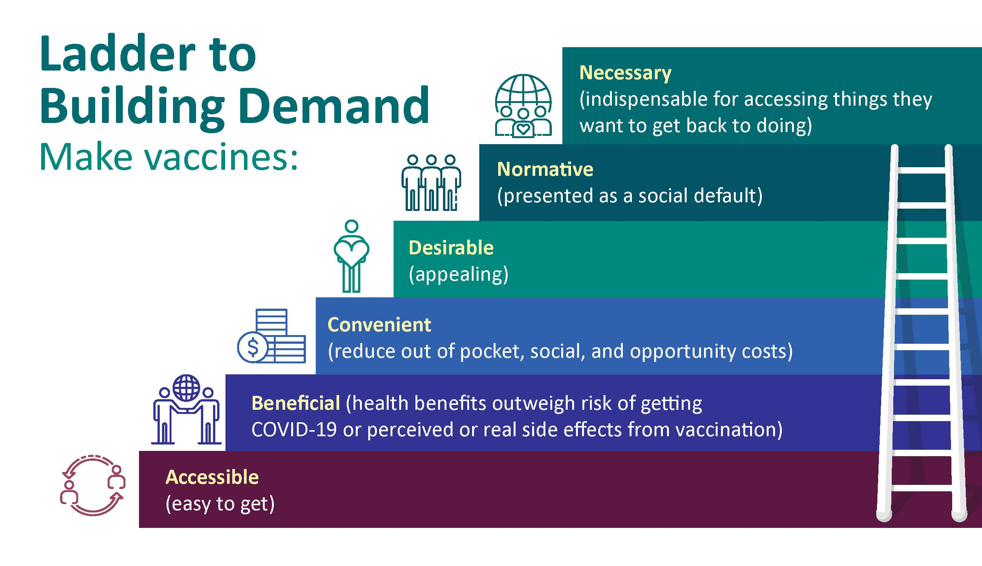
Source: CDC COVID-19 Vaccine Task Force Vaccine Confidence Team

Slide 16
12 COVID-19 Vaccination Strategies for Your Community
https://www.cdc.gov/vaccines/covid-19/vaccinate-with-confidence/community.html
Notes:
State and local health departments, community- and faith-based organizations, and local non-profits are encouraged to try a combination of these 12 strategies to help increase vaccine confidence and uptake.
When implementing any these strategies in your community, consider real-world factors by:
assessing the cost (dollars, time, effort, staffing)
involving community leaders in planning and execution
piloting the effort to measure success before wider execution

Slide 17
Trusted Messengers
Effectively deliver messages and strategies
Validate the credibility of information
Address mis- and disinformation
Help create a feedback loop for addressing questions and concerns
Bridge the gap between healthcare providers and patients
Notes:
Trusted messengers operating in trusted spaces can most effectively deliver messages and strategies to increase vaccine confidence and uptake among Black Americans.
Trusted messengers can be effective resources for providing credible information and addressing misinformation and disinformation about COVID-19 vaccine, particularly in populations who are disproportionately impacted by the disease.
Trusted Messengers serve a crucial role in validating the credibility of information in order to support informed decision making.
Community-based trusted messengers help bridge the gap between healthcare providers and patients. These include:
faith-based leaders
community health workers (CHWs)
public health nurses, and serve a crucial role in validating the credibility of information in order to support informed decision making.

Slide 18
Vaccine Ambassadors
Vaccine ambassadors train community members to disseminate important health information in their communities. Ambassadors are most effective when they are trusted community members and share similar beliefs and characteristics with their peers.
Research justification:
When people think that most people around them want to be vaccinated, they are more likely to be vaccinated as well¹.
Endorsements from peers in one’s own social network can also help spread credible information about the vaccines².
Barriers addressed:
Equity, Access, Prevailing Social Norms, Mistrust, Mis- and Disinformation, Cultural Relevance
¹ Sandra Crouse Quinn, Karen M Hilyard, Amelia M Jamison, Ji An, Gregory R Hancock, Donald Musa, Vicki S Freimuth, The influence of social norms on flu vaccination among African American and White adults, Health Education Research, Volume 32, Issue 6, December 2017, Pages 473–486, https://doi.org/10.1093/her/cyx070
²Attention, intentions, and follow-through in preventive health behavior: Field experimental evidence on flu vaccination (swarthmore.edu)

Slide 19
Vaccine Ambassador Intervention
The “Motivate, Vaccinate, and Activate” campaign encouraged residents of the under-resourced, predominantly Latinx Mission District of San Francisco, California, to be vaccinated against COVID-19.
Community health workers educated the community about the vaccines, texted people to let them know of their eligibility, and used public media to spread the word about vaccination locations.
These efforts helped increase vaccinations and overcome hesitancy due to misinformation, distrust of institutions, and access to the vaccines.

Slide 20
Home-Delivered Vaccinations
Home-delivered vaccination: Bringing vaccines to where people are, including in their homes, is an effective means to reach several hard-to-reach populations.
Barriers Addressed: Equity, Access, Inertia, Friction
Intervention Description: Individuals canvassed specific communities to educate people about the flu vaccine and offered it to people on the spot. They focused on:
People with substance use disorders
Immigrant populations
Older adults
Sex workers
People experiencing homelessness
Outcome: There was increased interest in receiving the influenza vaccine postintervention, especially among members of hard- to- reach populations¹.
¹ Micaela H. Coady, Sandro Galea, Shannon Blaney, Danielle C. Ompad, Sarah Sisco, and David Vlahov, 2008:Project VIVA: A Multilevel Community-Based Intervention to Increase Influenza Vaccination Rates Among Hard-to-Reach Populations in New York City. American Journal of Public Health 98, 1314_1321, https://doi.org/10.2105/AJPH.2007.119586

Slide 21
Monitoring & Evaluation

Slide 22
Priority indicators for COVID Vaccine
DOMAIN | QUESTION | RESPONSE OPTIONS
Thinking and feeling – Risk perception | How concerned are you about getting COVID-19? Would you say… | Not at all concerned, A little concerned, Moderately concerned, or Very concerned?
Thinking and feeling – Confidence in vaccine safety | How safe do you think a COVID-19 vaccine is for you? | Not at all safe, A little safe, Moderately safe, or Very safe?
Thinking and feeling – Confidence in vaccine benefits | How important do you think getting a COVID-19 vaccine is for your health? Would you say… | Not at all important A little important Moderately important, or Very important?
Social processes – Family and friend norms | Do you think most of your close family and friends want you to get a COVID-19 vaccine? | NO YES
Motivation – Intention | Do you want to get a COVID-19 vaccine? Would you say… | No, you do not want to, Yes, you do want to Not sure? You are vaccinated
Practical issues – Know where to go | Do you know where to go to get a COVID-19 vaccine for yourself? | NO YES
Practical issues – Easy to pay | How easy is it to pay for vaccination? When you think about the cost, please consider any payments to the clinic, the cost of getting there, plus the cost of taking time away from work. Would you say… | Not at all easy A little easy Moderately easy, or Very easy?

Slide 23
Priority indicators for RI
DOMAIN/ construct | Childhood vaccination survey |  | COVID-19 vaccination survey
 | Priority question | Indicator | Priority question | Indicator
THINKING AND FEELING Confidence in vaccine benefits | How important do you think vaccines are for your child’s health? Would you say… Not at all important A little important Moderately important, or Very important? | % of parents/caregivers who say that vaccines are “moderately” or “very” important for their child’s health | How important do you think getting a COVID-19 vaccine will be for your health? Would you say… Not at all important A little important Moderately important, or Very important? | % of adults/health workers who think a COVID-19 vaccine is “moderately” or “very” important for their health
SOCIAL PROCESSES Family norms | Do you think most of your close family and friends want you to get your child vaccinated? NO YES | % of parents/caregivers who say most of their close family and friends want their child to be vaccinated | Do you think most of your close family and friends want you to get a COVID-19 vaccine? NO YES | % of adults/health workers who think most of their close family and friends want them to get a COVID-19 vaccine
MOTIVATION Intention to get vaccine | [COUNTRY NAME] has a schedule of recommended vaccines for children. Do you want your child to get none of these vaccines, some of these vaccines or all of these vaccines? NONE SOME ALL | % of parents/caregivers who want their child to get “all” of the recommended vaccines | Do you want to get a COVID-19 vaccine? Would you say… No, you do not want to, Yes, you do want to, or are you Not sure? | % of adults/health workers who want to get a COVID-19 vaccine
PRACTICAL ISSUES Know where to get vaccination | Do you know where to go to get your child vaccinated? NO YES | % of parents/caregivers who know where to get their child vaccinated | Do you know where to go to get a COVID-19 vaccine for yourself? NO YES | % of adults/health workers who know where to get a COVID-19 vaccine for themselves
PRACTICAL ISSUES Affordability | How easy is it to pay for vaccination? When you think about the cost, please consider any payments to the clinic, the cost of getting there, plus the cost of taking time away from work. Would you say… Not at all easy A little easy Moderately easy, or Very easy? | % of parents/caregivers who say vaccination is “moderately” or “very” easy to pay for | How easy is it to pay for vaccination? When you think about the cost, please consider any payments to the clinic, the cost of getting there, plus the cost of taking time away from work. Would you say… Not at all easy A little easy Moderately easy, or Very easy? | % of adults/health workers who say vaccination is “moderately” or “very” easy to pay

Slide 24
Intervention Examples

Slide 25
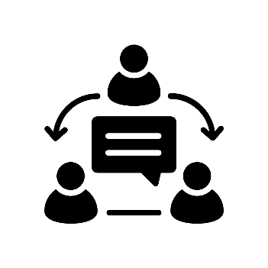
Improving interpersonal communication between HCW and caregivers in Romania
AIM: To design, implement, and evaluate a motivational interviewing-based intervention to increase immunization uptake among children 6-15 months of age
Communication Needs Assessment
Implement training
Evaluate training
Disseminate
findings
Notes:
The aims of this project are to design, implement, and evaluate a motivational interviewing and interpersonal communication intervention in 4 counties in Romania

Slide 26
TOT Training Curriculum
 | Module Table of Contents | Brief Description of Sessions
Day 1 | Module 1: Orientation to Immunization Challenges in Romania | Immunization trends and disease incidence Identifying challenges that are in HCWs control
 | Module 2: Understanding factors that influence caregivers’ attitudes and behaviors | UNICEF caregiver journey framework Effects of information overload
 | Module 3: Vaccine hesitancy | Vaccine hesitancy continuum Presuming vaccination (opt-out approach)
 | Module 4: How to communicate about immunizations | Motivational interviewing approaches
 | Module 5: Communication in the health facility (Part 1) | Practice session
Day 2 | Module 6: Useful tools: What caregivers need to know | Explaining AEFIs, vaccine origin, how vaccines work Addressing rumors related to MMR and COVID-19
 | Module 7: Communication in the health facility (Part 2) | Practice session
 | Module 8: Communication outside the health facility | Communication in home visits Rumor management in the community

Slide 27
Project Outline
Overall:
Primary objective
Among children 6-15 months of age:
Achieve a 10-15% increase in coverage of the third dose of Hexavalent vaccine (D-TT-aCP-IPV-Hib-HepB) and the first dose of measles-mumps-rubella (MMR) vaccine
Secondary objective
Among caregivers:
Improve immunization-related knowledge, attitudes, and practices
Assess quality and effectiveness of interpersonal communication with health worker
Among HCWs:
Improve interpersonal communication and counseling skills with caregivers

Slide 28
Intervention evaluation design
KAP surveys
FGDs
Effect on HCWs
Pre-/post-training survey
KAP surveys
Intervention
Month= 15
Month= 0
Month= 12
12-months
3-months
Baseline
Endline
Registry abstraction (begins)
KAP surveys
Registry abstraction (ends)
Effect on caregivers
KAP surveys
IDIs

Slide 29
3 Truths in the Field
3 Truths or Guiding Principles for Practitioners:
Messages won’t save us: We need to build political commitment for strategies beyond risk communications to change vaccination behavior.
COVID-19 has in some cases interfered with community member’s ability to access services (e.g. loss of income). Reducing out of pocket costs associated with accessing health services is very important.
Power dynamics change during an emergency: Trusted messengers are not always trusted during crisis. Pay attention to how community dynamics change during an emergency, and incorporate this in your intervention.

Slide 30
3 Best Practices in the Field
3 Best Practices or Tools/Guidance Used by Practitioners:
Find ways to listen to the community, and bring that listening into intervention planning, implementation, and evaluation.
Work with a variety of trusted messengers in communities, different communities are influenced by different trusted messengers.
Document and disseminate your interventions/evaluations- maybe you’re onto the next big idea, and others can be inspired by what you’re trying out!

Slide 31
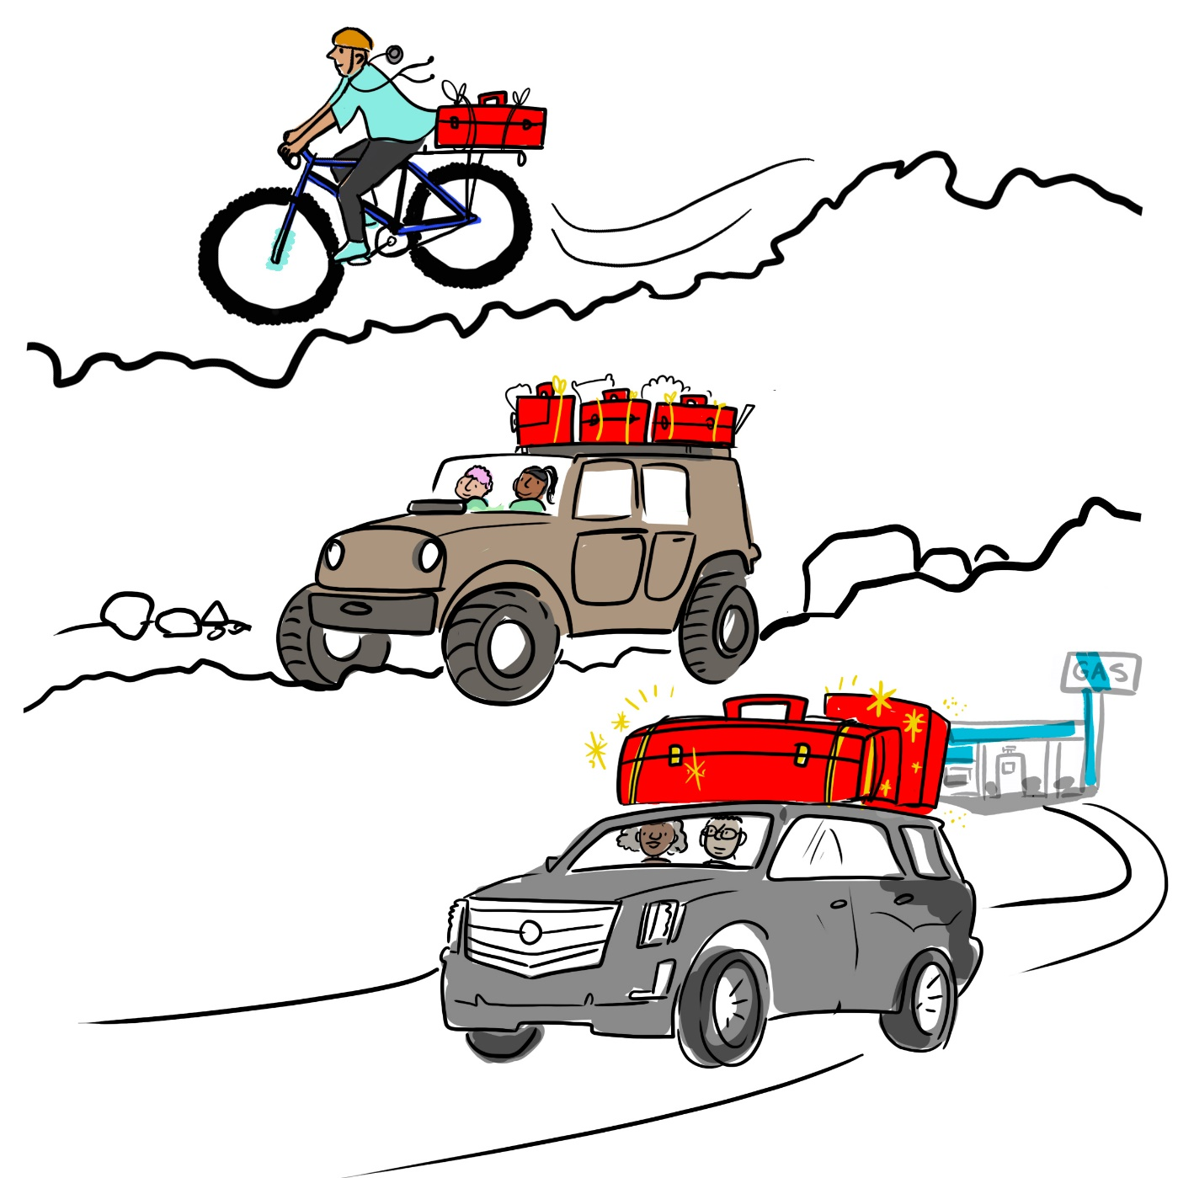
Actions You Can Take in Different Operating Environments
Mountain Bike
Choose an intervention that makes sense with the resources you have and addresses a priority, high impact challenge
Look for ways to incorporate interventions into people’s existing positions (e.g. social mobilizer can also learn MI techniques)
Sturdy 4x4
Pilot intervention in at least 2 contrasting locations (e.g. rural vs urban) in a single district
Include evaluation data where possible- qualitative may be easier with less resources
IDs, FGDs with intervention implementers, community members, community influencers
Luxury Vehicle
Pilot intervention in at least 2 contrasting locations (e.g. rural, urban, semi-urban) in 2 or more districts with different demographics
Include more complex evaluation data (e.g. pre/post, control group, randomization)
Bigger vehicle = larger toolbox of interventions, more ways of promoting vaccine demand and mitigating the infodemic
Notes:
Remember that these are not analogous to LMICs, MICs and HICs (see previous slide), but to maturity of system and structures. Be extremely practical in what one person can do (mountain bike) with limited funding or resources versus someone with a lot of staffing and resources (luxury vehicle)

Slide 32
Key messages
Behavior related to vaccine uptake is highly complex and context-specific
More evidence is needed to determine what behavioral interventions work to increase vaccine uptake, especially in low and middle-income countries
Using behavioral models can help you structure interventions and measure expected outcomes based on a chain of feelings, perceptions and behaviors a person may undergo that ultimately lead to the decision to vaccinate

Slide 33
Key References & Resources
12 COVID-19 Vaccination Strategies for Your Community | CDC
Brewer NT. What Works to Increase Vaccination Uptake. Acad Pediatr. 2021 May-Jun;21(4S):S9-S16. doi: 10.1016/j.acap.2021.01.017. PMID: 33958099. What Works to Increase Vaccination Uptake - PubMed (nih.gov)

