Slide 1
Comprehensive training
28 June – 21 July 2022
HOSTED BY GAVI, WHO, UNICEF & US CDC

Slide 2
Get deployed and get useful
Elisabeth Wilhelm, Health Communications Specialist, Global Immunization Division, US CDC

Slide 3
When You Deploy, It’s to Address a Challenge In-Country
You’re expected to bring the following:
Your brains
Formal education
Workplace experience
Judgment and reason
Emotional intelligence
Cultural competence
Your passport and paperwork
Your equipment
Your humility and listening skills

Slide 4
Being a Deployer has Unique Challenges
You may be asked to deploy virtually.
You’re the new kid on the block and may need to educate others on what you’re doing.
There isn’t always a counterpart to you in the office or government.
You may face cultural, political, and structural challenges to working within UNICEF, with WHO, US CDC, and Ministry of Health and other partner organizations.

Slide 5
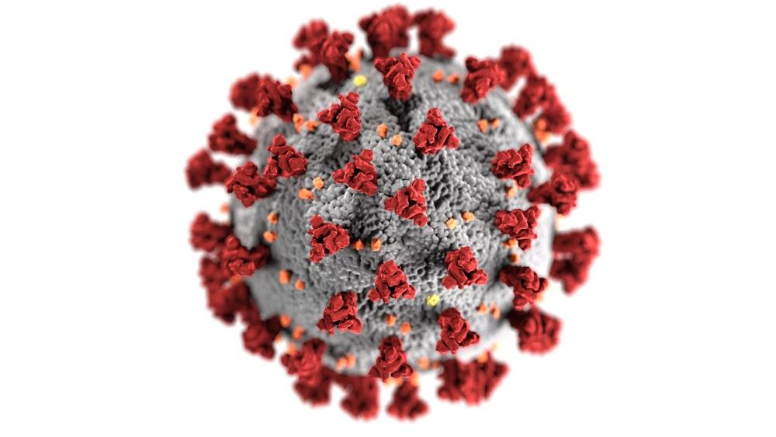
Enter COVID-19.

Slide 6
What Emergency Response Sounds and Feels Like
A lot of noise
Difficult to sift out important information
Competing priorities
Differing lines of communication
Unclear lines of authority
Everything is urgent and important
Not enough staff and time to accomplish objectives
Frequent staff turnover
Data of uncertain provenance

Slide 7
5 Tips for a Successful Deployment

Slide 8
1. Make Yourself Useful Quickly
Everyone is taking time out of their day to help you get up to speed. Return the favor and roll up your sleeves.
Have early discussions with your team to understand your role and expectations of you. Prepare accordingly and be proactive in developing clear shared goals.
Deliver quick wins!

Slide 9
2. If You Offer Critical Feedback to a Problem, Be Prepared to Fix It
Telling someone they have a problem doesn’t actually solve the problem. You just added another problem to their plate.
Come with several solutions.

Slide 10
3. Question Your Assumptions About the Population You’re Serving
Lead with empathy, ask questions if you do not understand, and ask for gut-checks from trusted colleagues.
A single data point is an anecdote and useless for public health programming. Collect, analyze and act on more high-quality data (when possible).
Be conservative in language for observations and recommendations.
Always have a “limitations” section to any report or presentation.

Slide 11
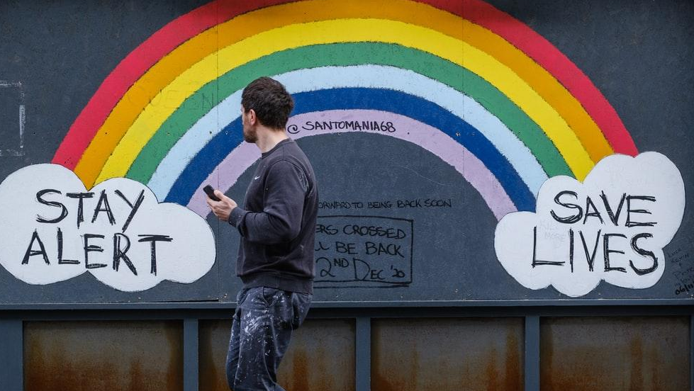
4. Give Everyone the Benefit of the Doubt
The pandemic is rough on everyone. Extreme emotional reactions, burnout, inability to set work/life boundaries and miscommunications (real or otherwise) are common.
If you establish common purpose and demonstrate how you can and will help your colleagues, it goes a long way to alleviate stressors. Tell your manager when you need help.

Slide 12
5. Be Concrete and Realistic in What Demand Strategies to Pursue
The vaccine demand strategies you develop are a reflection of how well (or little) you understand programmatic needs. Your manager can help you understand them.
Document what you’re doing, provide standard operating procedures (SOPs), give program staff the insights they need to make their jobs easier.
Be creative in problem solving—because there will never be enough time, funds, or human resources to do the work needed, so help your team prioritize.

Slide 13
Discussion (15 minutes)
You all have a lot of emergency, field and immunization experience. Now you can share it!
In Slido, write down tips you have for one another on tackling the following common challenges:
Ways to adapt to a new workplace quickly
How to provide critical feedback to a colleague in a diplomatic way
How to deal with conflict in the workplace
How to care for your physical and mental health in stressful situations

