Slide 1
Comprehensive training
28 June – 21 July 2022
HOSTED BY GAVI, WHO, UNICEF & US CDC

Slide 2
Information Environment and Infodemic Management
Tina Purnat
Team Lead for Infodemic Management
Department of Epidemic and Pandemic Preparedness and Prevention
WHO Health Emergencies Programme
Surani Abeyesekera
Social and Behaviour Change Specialist
Immunization Demand Team
Program Group
Health Section, UNICEF

Slide 3
Outline
Learning objectives
Key definitions
The impact of infodemics
What is infodemic management
Challenges posed by the evolving information environment
How infodemic management can adapt to the evolving information environment
Key references and resources

Slide 4
Learning Objectives
Participants will…
Understand different aspects of the information environment that pose a challenge to health authorities during an infodemic
Be able to describe the basic concepts and principles of infodemic management, as they relate to the rapidly changing information environment

Slide 5
Definitions
The exchange of information and communication in a digitized society
Information Ecosystem
An absence of definitive answers or scientific updates to questions that people are seeking answers to
Ability of a person to receive and understand information as intended
Unsettled Science
Message Penetration
People seeking information but find a lack of credible sources
Info Voids
Information, inaccurate or accurate, circulated within a network
Information that is inaccurate
Misinformation specifically designed to achieve an agenda
Rumor
Misinformation
Disinformation
A person being overwhelmed with information which can cause confusion or difficulty to act on guidance
Information Overload
An overabundance of information in digital and physical space — including mis/disinformation— accompanying an acute health event such as an outbreak.
Infodemic

Slide 6
Infodemics: the Problem

Slide 7
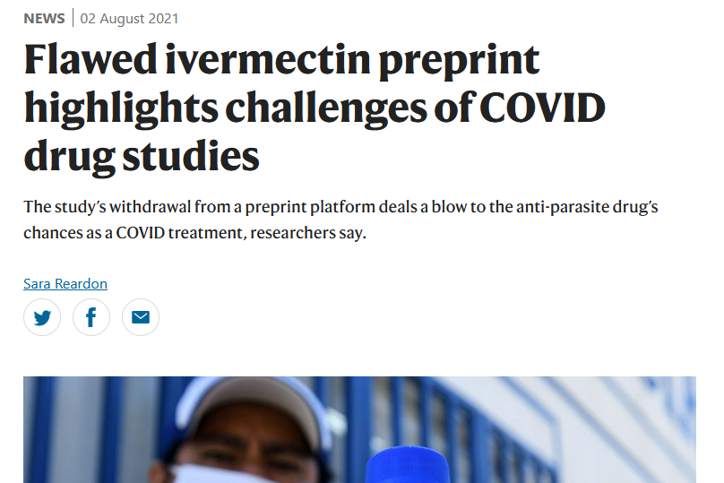
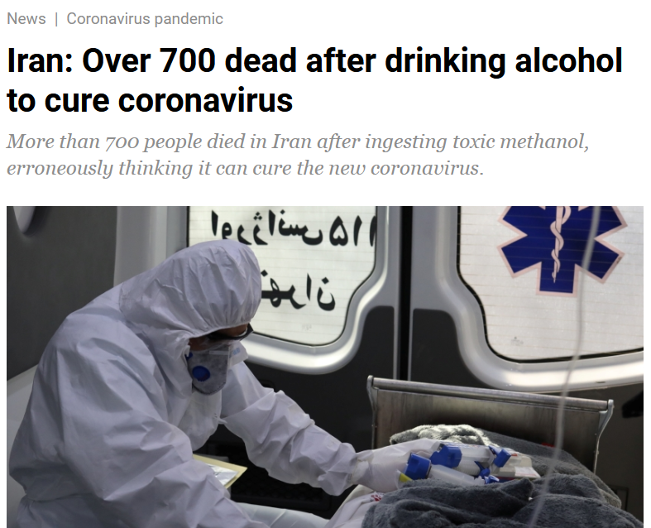
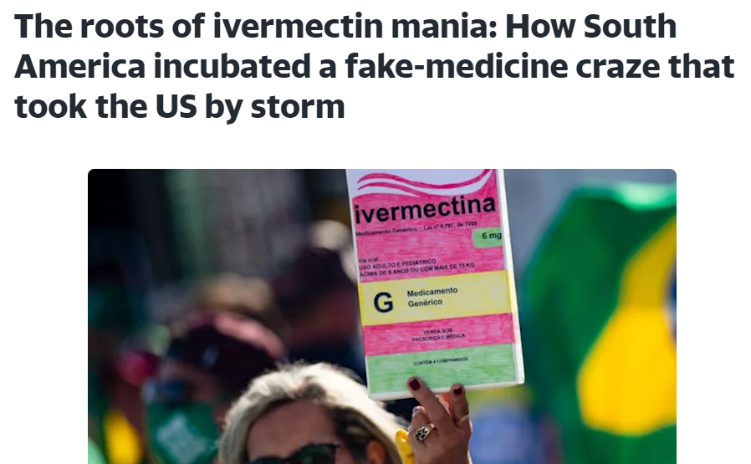
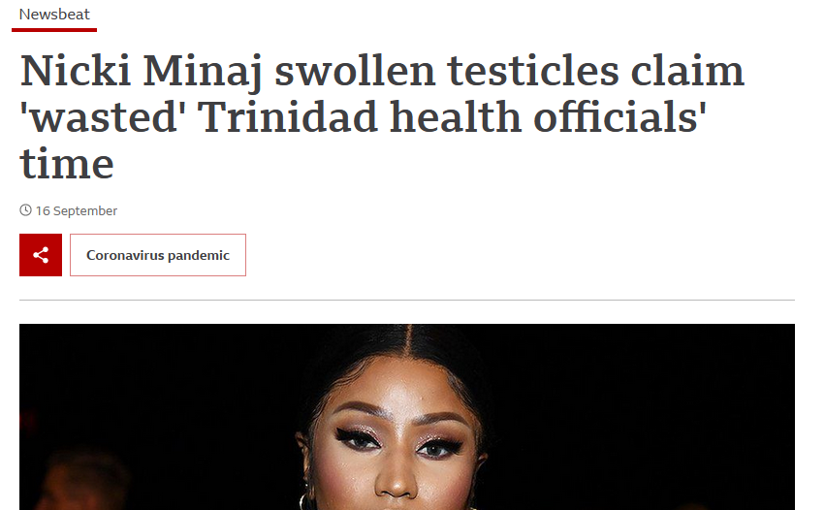
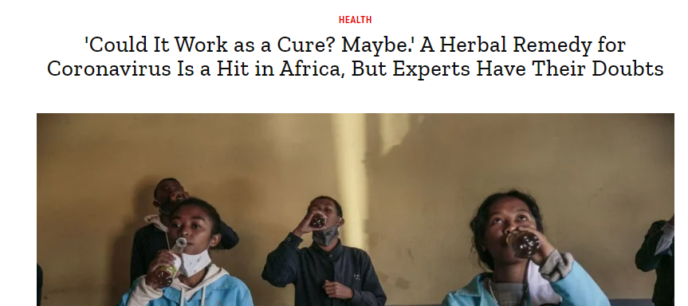
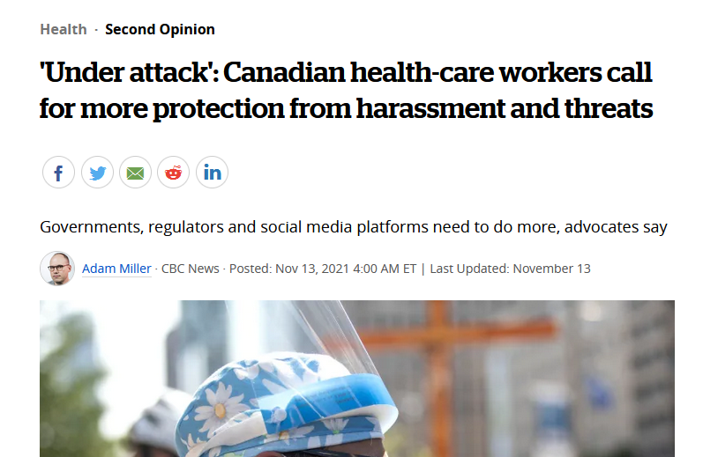
Infodemics can cause real harm
Methanol poisoning in Iran: https://www.aljazeera.com/news/2020/04/iran-700-dead-drinking-alcohol-cure-coronavirus-200427163529629.html; Unsafe use of cleaning products in US, Canada, Qatar: http://www.ajtmh.org/docserver/fulltext/14761645/103/2/tpmd200592.pdf?expires=1598367786&id=id&accname=guest&checksum=FD6627CCBBE5AF07265D20CE59D14EC9, https://www.npr.org/sections/coronavirus-live-updates/2020/04/25/845015236/nyc-poison-control-sees-uptick-in-calls-after-trumps-disinfectant-comments?t=1620240427614, https://www.forbes.com/sites/nicholasreimann/2020/08/24/some-americans-are-tragically-still-drinking-bleach-as-a-coronavirus-cure/?sh=212cc7c16748; Covid Organics in Madagascar and Africa: https://time.com/5840148/coronavirus-cure-covid-organic-madagascar/; Burning Cell Towers, Out of Baseless Fear They Spread the Virus: https://www.nytimes.com/2020/04/10/technology/coronavirus-5g-uk.html ; Ivermectin in US, Australia and worldwide: https://www.nature.com/articles/d41586-021-02081-w , https://www.nytimes.com/2021/08/30/health/covid-ivermectin-prescriptions.html;

Slide 8
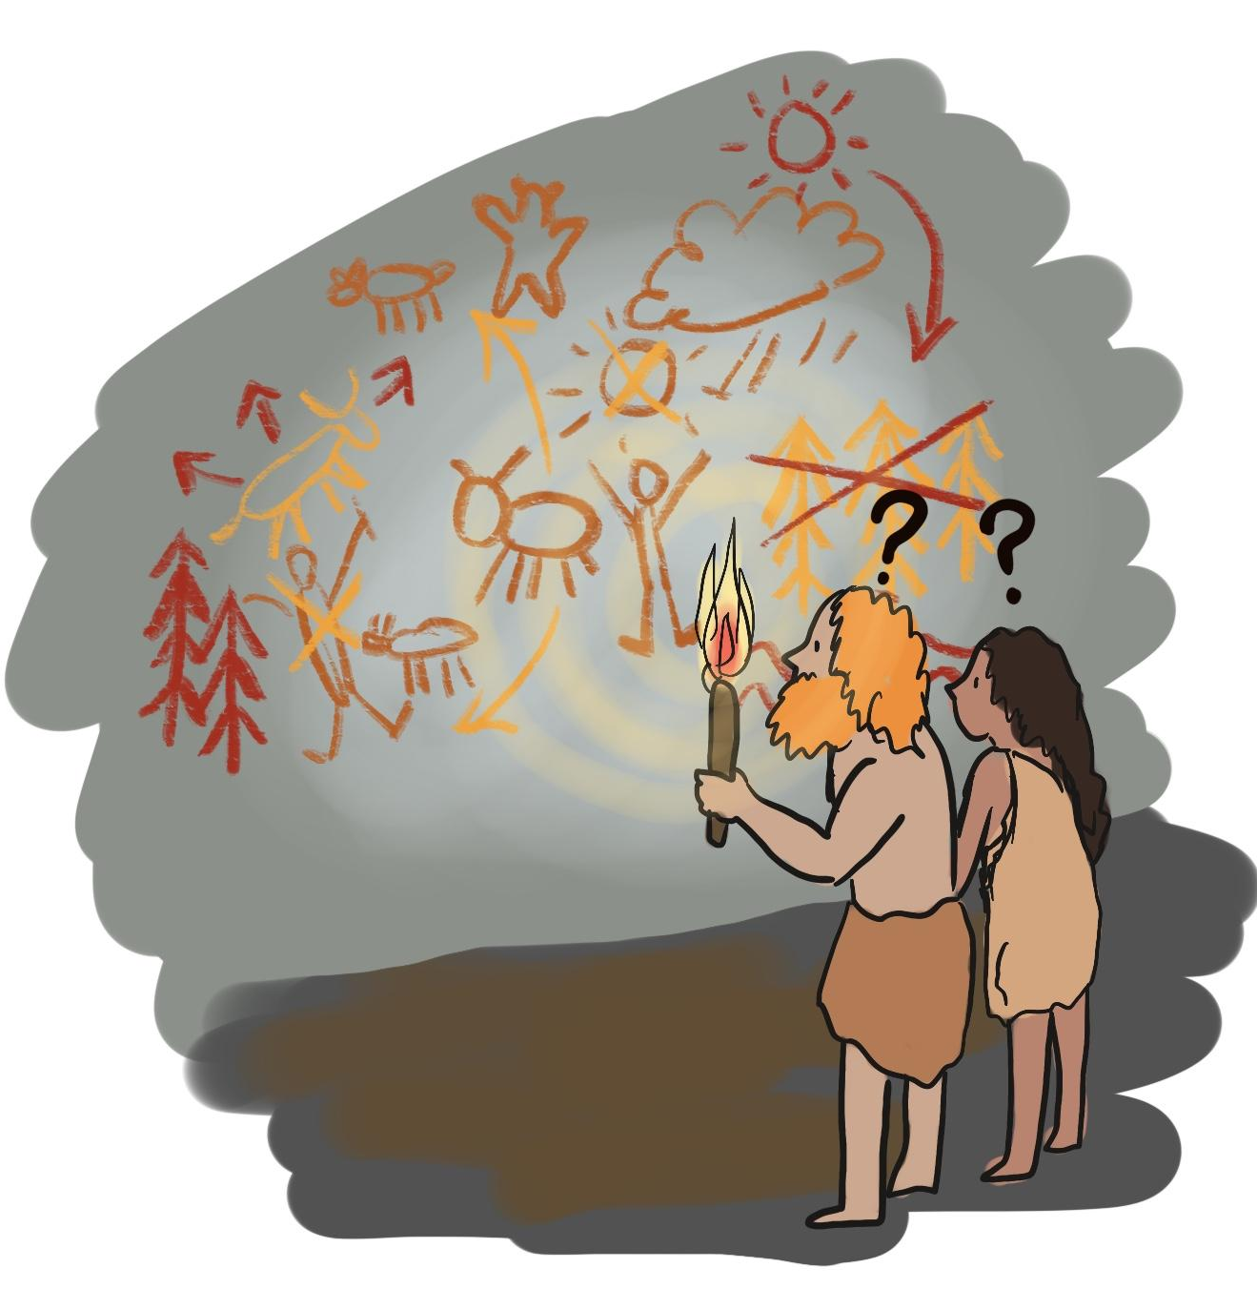
Impact of the infodemic
Direct impact on health (increased morbidity and mortality)
Misunderstanding of health information & behaviors to adopt
Mistrust
In government
In science
In experts
Public health authorities
In response and interventions (vaccine, therapeutics)
Stigma
Undermines social cohesion

Slide 9
COVID-19 infodemic’s impact on behaviors and health systems is hard to measure directly

Slide 10
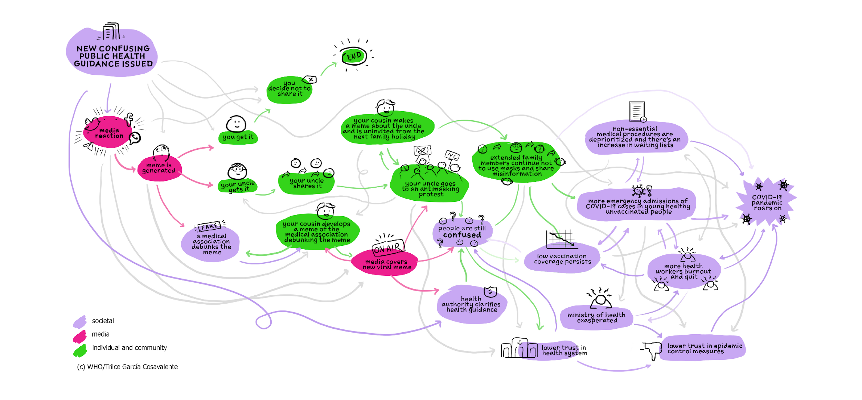
Challenges of the infomation ecosystem
Evolving science
Trust is a process, not an end-state
Publication practices
(preprints, abstracts, etc.)
Who are trusted messengers?
Precursors to misinformation
Distilling science and science communication
The infodemic intertwines with other societal issues which affect behavior
Health authority communication processes
Evidence-based metrics, interventions and evaluation
Source: 2021 WHO Infodemic Manager Training

Slide 11
Infodemic Management
Applies evidence-based interventions by analyzing concerns, questions, narratives, information voids and misinformation to effectively address health information inequalities in at-risk populations and communities of focus to drive health-seeking behaviors.
In·fo·dem·ic
[infō ˈdemic]
an excessive amount of information about a problem that is typically unreliable, spreads rapidly, and makes a solution more difficult to achieve.

Slide 12
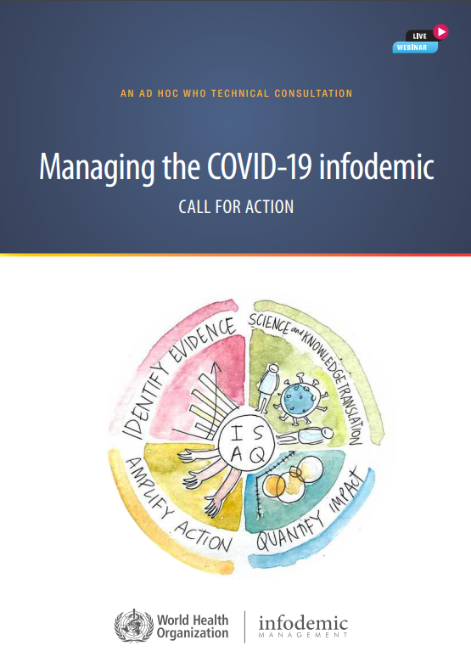
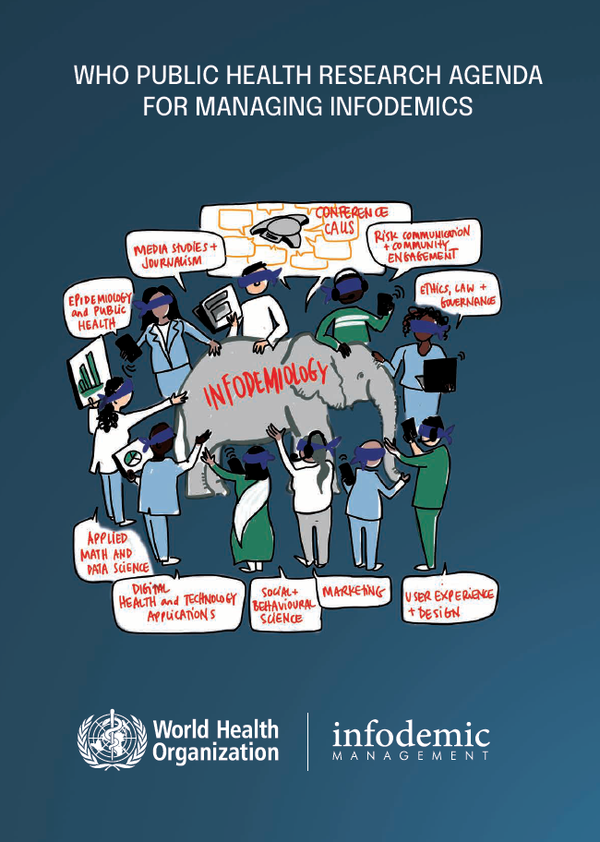
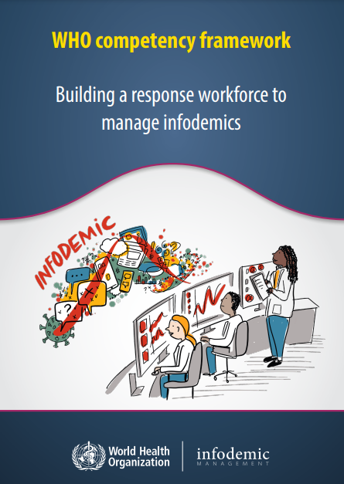
Developing infodemic management
Mandate
Programmatic response
WHA74.7 Strengthening WHO preparedness for and response to health
Emergencies
Framework, strategy and action plan
The science
Country tools and partnerships
Professionalism
1
2
3
4
132 signatories of “cross-regional statement on infodemic in context of COVID-19” to UN Secretary General
Understand community concerns, questions & build trust in interventions
50 global action for whole-of-society
Linking research & practise
768 infodemic managers trained

Slide 13
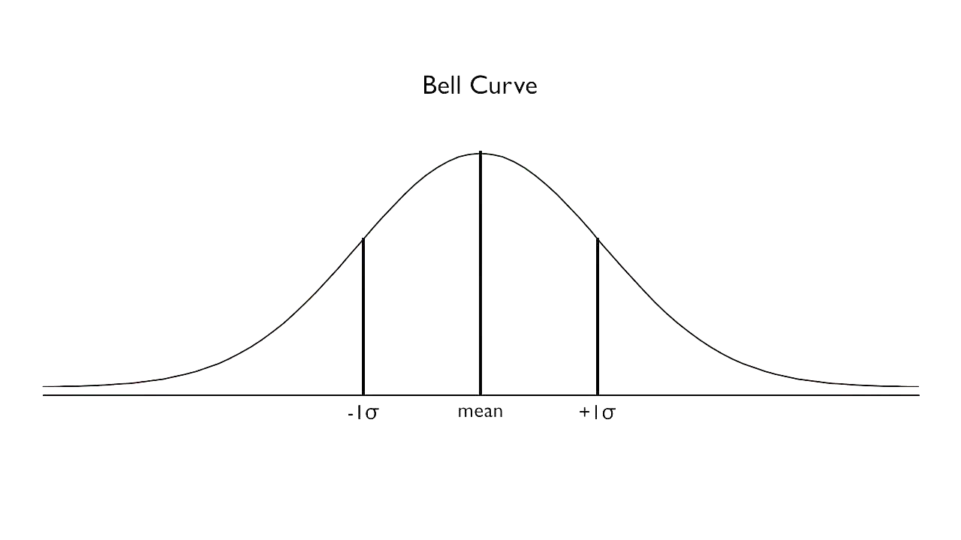
Infodemiology underpins management of epidemics and epidemic risk
Evidence-based tools, methods and interventions
Stream 3: Respond and deploy interventions that protect and mitigate the infodemic and its effects
Stream 2: Detect and understand spread and impact of infodemics
DETECT
INTERVENE
PREPARE
STRENGTHEN
Stream 1: Measure and monitor the impact of infodemics during health emergencies
MONITOR
Stream 4: Evaluate infodemic interventions and strengthen resilience of individuals and communities to infodemics
ENABLE
Stream 5: Promote the development, adaptation and application of tools for the management of infodemics

Slide 14
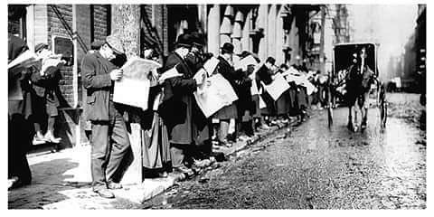
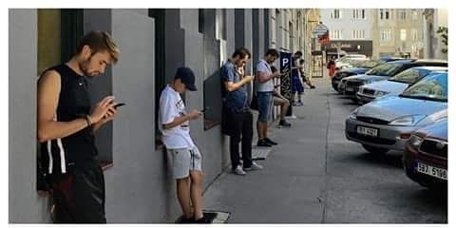
Technology has changed the way information is produced, distributed and consumed
vs
1916
2016
An infodemic thrives online and offline, requiring a whole-of-society and whole information ecosystem approach
Managing the infodemic has become more challenging with more rapid spread of mis and disinformation through digital media
Infodemic management will help us better manage this pandemic and more quickly tackle new and resurgent health threats

Slide 15
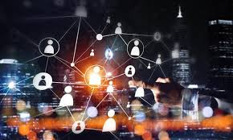
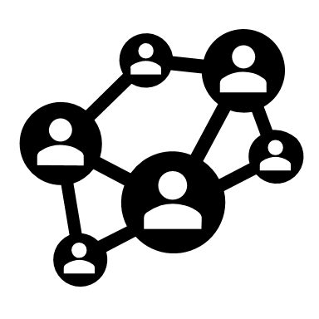
The digitised society of 21st century
Societal impacts of digital transformation are a global phenomenon
The online attention economy a ‘cognitive-tech’ revolution
E-government services and digital health are at the focus of digital transformation of the public sector
Paradigm shift in the way information is produced, distributed and consumed
Adapted by author from: European Political Strategy Centre (EPSC) - Global Trends to 2030: Identities and Biases in the Digital Age, https://espas.secure.europarl.europa.eu/orbis/document/global-trends-2030-identities-and-biases-digital-age; Lutz, C. Digital inequalities in the age of artificial intelligence and big data. Hum Behav & Emerg Tech. 2019; 1: 141– 148.

Slide 16
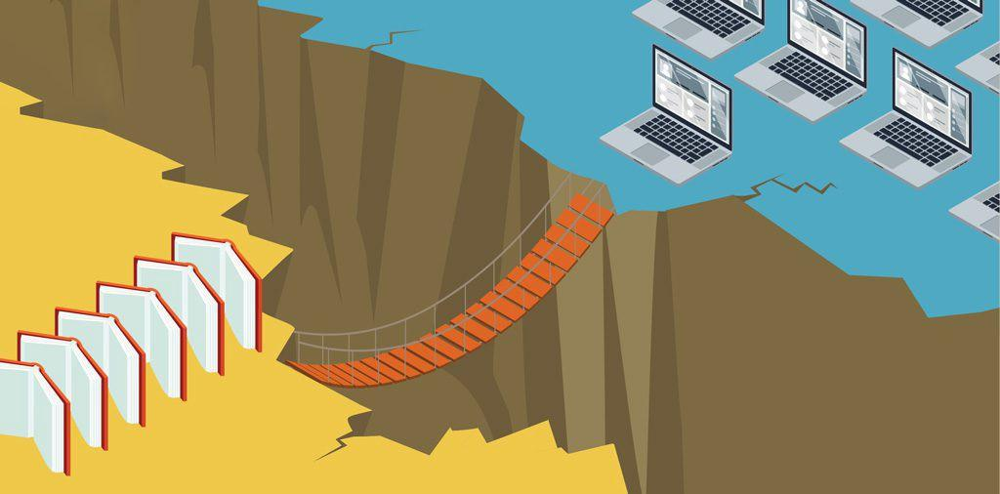
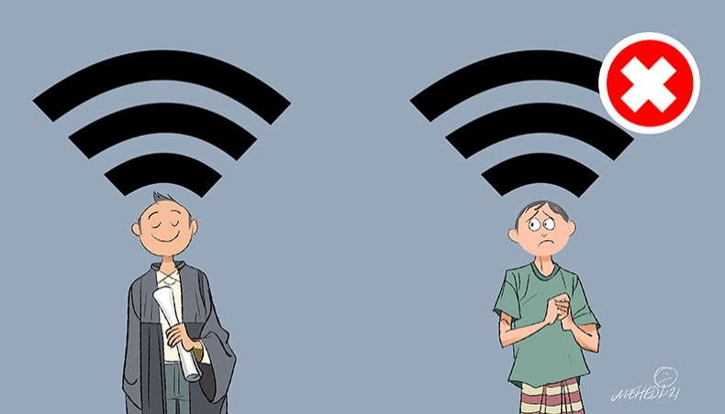
The digitised society of 21st century
https://medium.com/@tamarajulaton/eid100-final-project-the-digital-divide-in-canada-5e3fa0ddc46
Digital divide and digital inequalities in:
Access to internet and internet and communication technology (ICT)
Skills and uses of ICT
In outcomes of internet use
https://www.newagebd.com/files/records/news/202104/135620_171.jpg

Slide 17
Three Truths from the Field

Slide 18
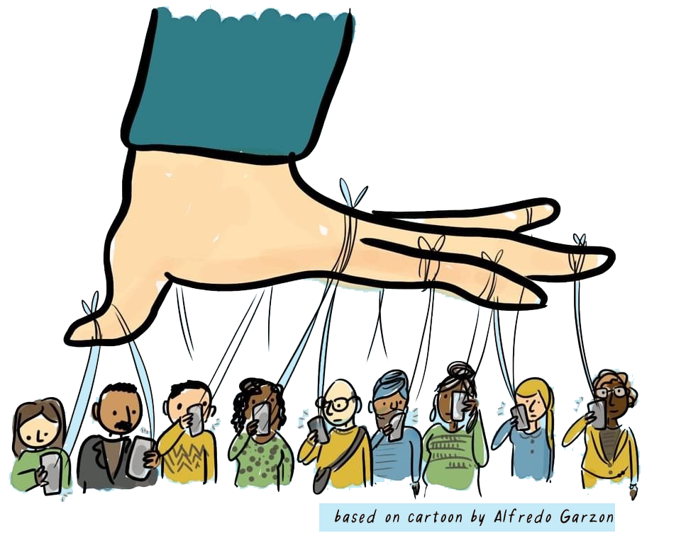
1. Multi-dimensional and interconnected information ecosystem

Slide 19
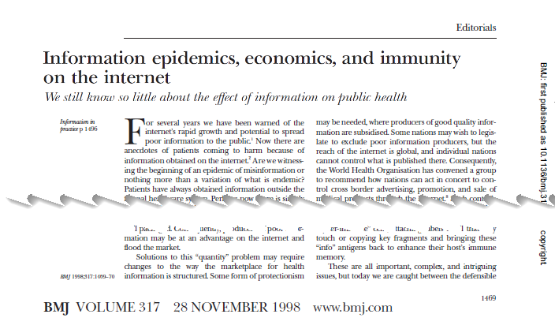
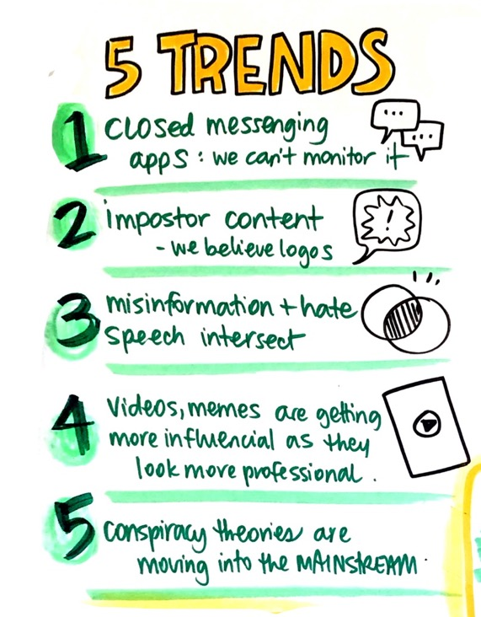
You can forget about borders between online and offline
Web and social media in 1998:
The infodemic during the COVID-19 pandemic:
Social media drives the media cycle across borders
Online hype influences media reporting on TV and radio across the globe
Health information does not compete with low quality information
Bulletin Board System (BBS), bolt.com, sixdegrees.com, and OpenDiary social media networks
AOL search and messenger
ICQ messenger
Google incorporates
Netscape Communicator 4.5
Claire Wardle, FirstDraft News, UK, First WHO infodemiology conference keynote, June 2020, https://www.who.int/teams/risk-communication/infodemic-management/pre-conference-1st-who-infodemiology-conference

Slide 20
2. The information ecosystem is ultra personalised

Slide 21
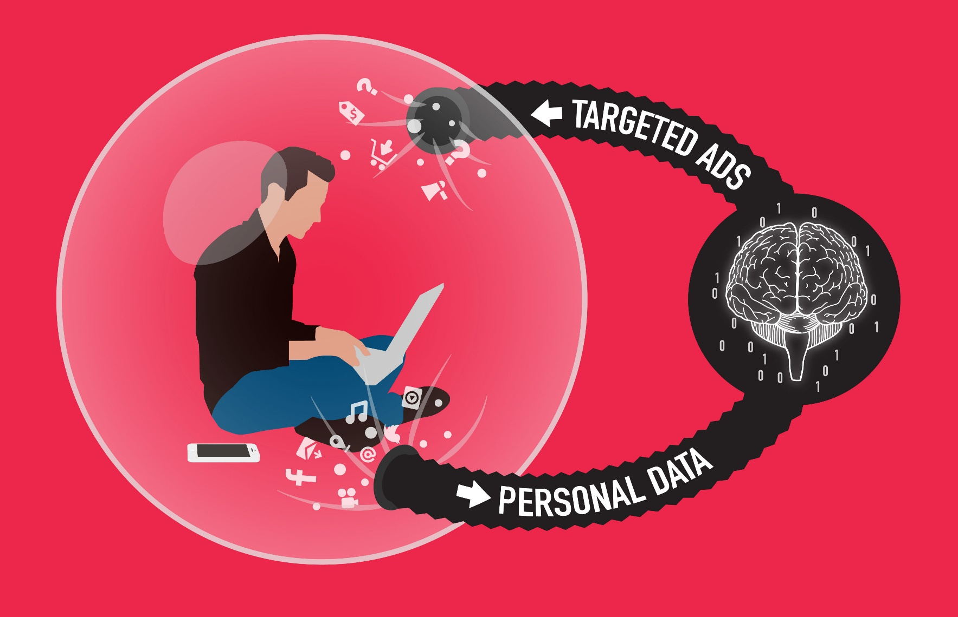
The ecosystem is ultra personalised for each digital user
The way you behave online leaves a digital data trail. This trail teaches digital platforms your preferences.
Based on your personal data and online behaviour, the algorithms, apps, web sites, select ads, suggestions, and content are targeted specifically to your preferences and fill in your bias.
What you see online is unique and tailored to you.
©https://www.sticky.digital/wp-content/uploads/2017/12/Social-media-bubble-e1511819806516.jpg

Slide 22
3. Experience, emotions and addiction are everywhere

Slide 23
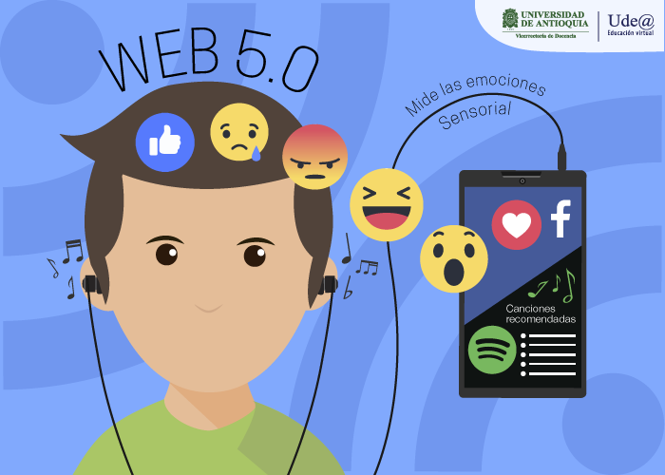
Designed to be addictive and emotive
Web 5.0 will be about the (emotional) interaction between humans and computers. The interaction will become a daily habit for a lot of people based on neurotechnology.
Studies suggest that the “dopamine reward loop” provided by social media keeps people hooked through an endless amount of immediate rewards in the form of attention from others.
Towards emotive sensory Web in virtual health care: Trends, technologies, challenges and ethical issues:https://www.sciencedirect.com/science/article/pii/S2666351121000553
Social media addiction: https://www.addictioncenter.com/drugs/social-media-addiction/

Slide 24
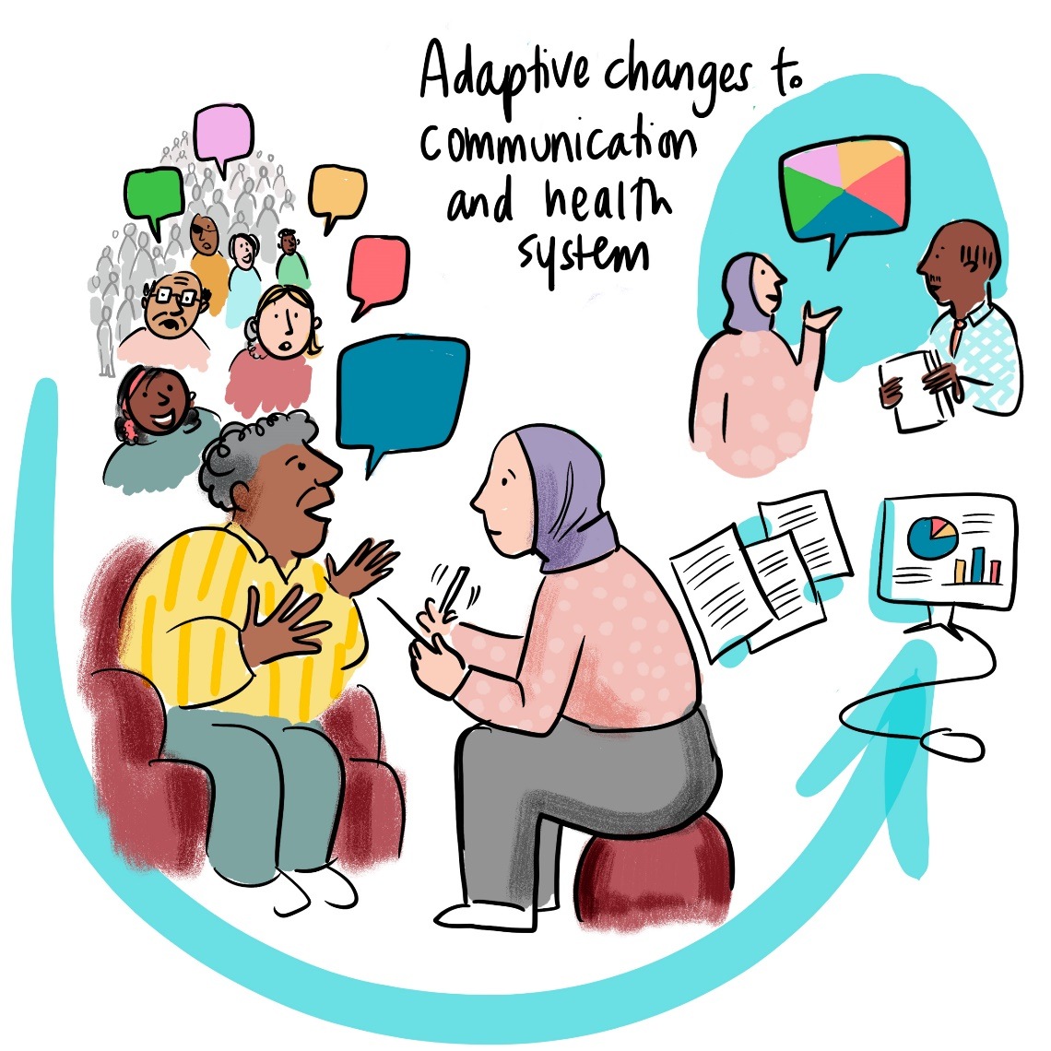
We need to adapt our way of interacting with people

Slide 25
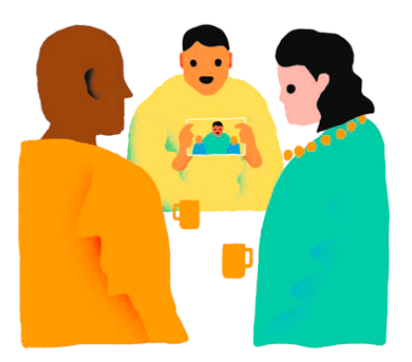
We need to adapt to the new individual reality
We have to challenge our assumptions on:
What people want
How people experience public health prevention activities and interactions with the health system
In order to adapt public health preparedness and response activities accordingly, we need to:
Develop human centered interventions
Go beyond the sentiment analysis done by AI technology
Address the pain points of the population in the entire public health system

Slide 26
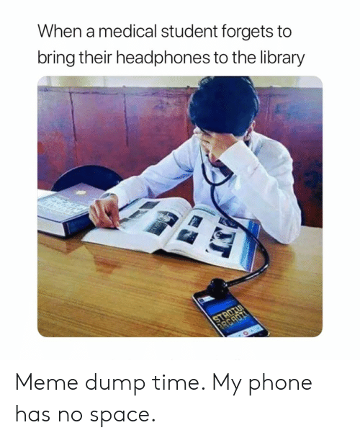
We need to adapt to and capitalize the new mediums
We have to challenge our assumptions and :
develop a more tailored approach using the new mediums and the new vocabulary that allow the information to spread
be constantly connected to people thanks to partnerships across whole of society
adapt to the pace of shift of information and audience focus
adapt and integrate behavioral and design thinking approaches to how we deliver services, information, and interventions

Slide 27
Questions?

Slide 28
Slido

Slide 29
Key messages
An infodemic thrives online and offline, requiring a whole-of-society and whole information ecosystem approach
Managing the infodemic has become more challenging with more rapid spread of mis and disinformation through digital media
Infodemic management will help us better manage this pandemic and more quickly tackle new and resurgent health threats
Going forward, the preparedness planning and tools for responding to infodemics must be evidence-based and taking into account the new reality. We must:
Develop a more tailored approach using the new media and the new vocabulary that allow the information to spread
Be constantly connected to people thanks to partnerships across whole of society
Adapt to the pace of shift of information and audience focus
Adapt and integrate behavioral and design thinking approaches to how we deliver services, information, and interventions

Slide 30
Resources
Calleja, N., AbdAllah, A., Abad, N., Ahmed, N., Albarracin, D., Altieri, E., Anoko, J. N., Arcos, R., Azlan, A. A., Bayer, J., Bechmann, A., Bezbaruah, S., Briand, S. C., Brooks, I., Bucci, L. M., Burzo, S., Czerniak, C., De Domenico, M., Dunn, A. G., … Purnat, T. D. (2021). A Public Health Research Agenda for Managing Infodemics: Methods and Results of the First WHO Infodemiology Conference. JMIR Infodemiology, 1(1), e30979. https://doi.org/10.2196/30979
Rubinelli, S., Purnat, T. D., Wihelm, E., Traicoff, D., Namageyo-Funa, A., Thomson, A., Wardle, C., Lamichhane, J., Briand, S., & Nguyen, T. (2022). WHO competency framework for health authorities and institutions to manage infodemics: Its development and features. Human Resources for Health, 20(1), 35. https://doi.org/10.1186/s12960-022-00733-0
Swire-Thompson, B., & Lazer, D. (2020). Public Health and Online Misinformation: Challenges and Recommendations. Annual Review of Public Health, 41(1), 433–451. https://doi.org/10.1146/annurev-publhealth-040119-094127
WHO. (2022). Health topics: Infodemic. https://www.who.int/health-topics/infodemic

Slide 31
Resources (cont'd)
New vaccine misinformation course from ECDC:
Addresses Online Vaccination Misinformation e-Learning Course
Pilot Edition 20-24 June 2022
This course aims to provide learners with a broad understanding of what online vaccination misinformation is, and what steps can be taken to address it.
Six modules; approximately 3 hour long.
Designed for public health practitioners and risk communication experts at national, regional and local level in the EU/EEA, and is available to all.
Enroll here: https://eva.ecdc.europa.eu/enrol/index.php?id=603

Slide 32
Resources (cont'd)
New e-learning on Addressing Online Vaccination Misinformation:
This course aims to provide learners with a broad understanding of what online vaccination misinformation is, and what steps can be taken to address it.
It's approximately 4 hours long and organised in 6 modules. It's designed for public health practitioners and risk communication experts at national, regional and local level in the EU/EEA. Recently piloted and now available to all.
Enroll here:
Announcements' board - New e-learning on Addressing Online Vaccination Misinformation (europa.eu)
Message Testing: https://www.youtube.com/watch?v=K0_ET_ymrYU&ab_channel=purnatt

Slide 33
Extra slides

Slide 34
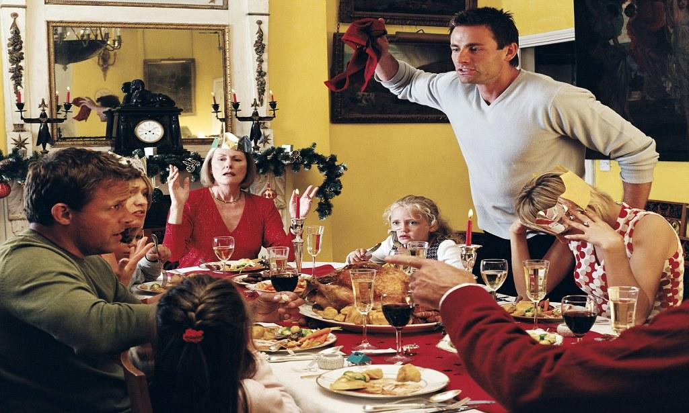
Social inoculation intervention development - The Good Talk!
Chatbot - Misinformation conversation game with family & friends
A project that will help the target audience learn to talk with family and friends, and how to prevent polarization and erosion of relationships
thereby inoculating them to harmful effects of health misinformation in daily life, to create a supportive environment for health behaviors.
A partnership between:
Epidemic and Pandemic Preparedness and Prevention
Pharmacovigilance
Digital Health & Innovation

Slide 35
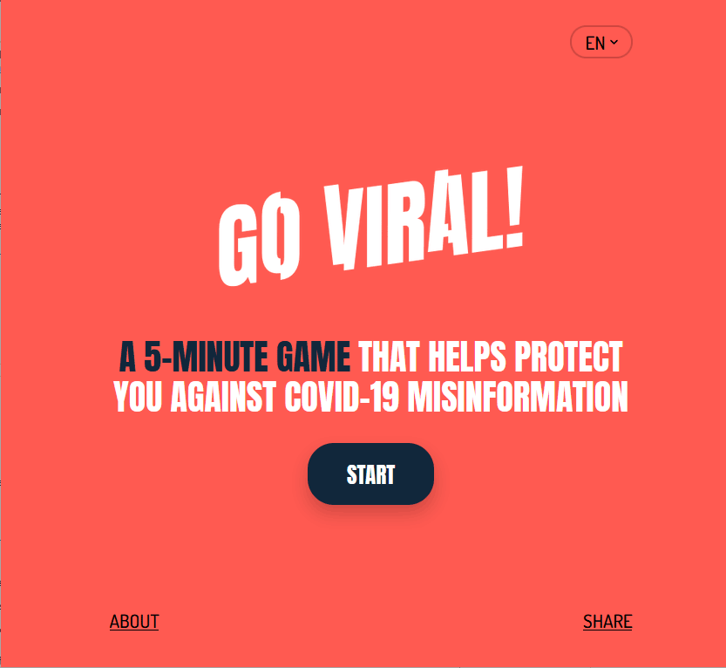
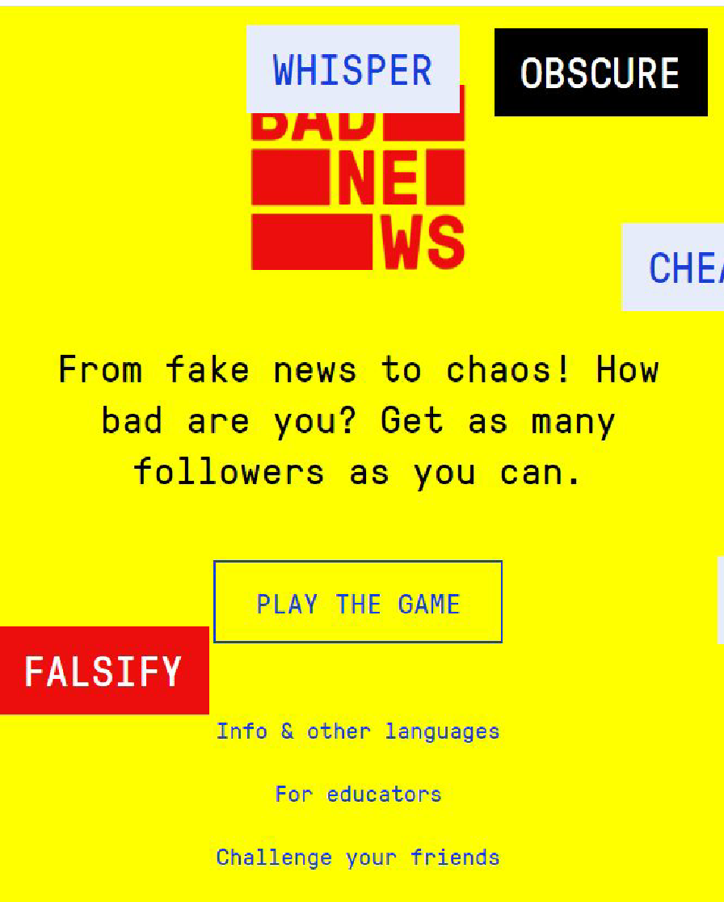
Social inoculation intervention development - The Good Talk!
Chatbot - Misinformation conversation game with family & friends
A ready-to-deploy intervention package to raise people’s resilience to health misinformation in daily life
Can be adapted and translated by countries to be used in chatbots, SMS interactive games, on web sites or on messaging apps
Package includes
Online Game - to be launched for the public (May 2022)
Low Bandwidth Deployment Package - content, logic, graphic assets that can be adapted, with deployment and adaptation instructions
Template protocol for how to evaluate the impact of intervention on selected target audience - can be adapted for context, depending on audience (eg school aged kids, teens) or communication channel
Collaboration with authors of serious games Go Viral, Harmony Square and Bad News

Slide 36
Social inoculation intervention development - The Good Talk!

Slide 37
Social inoculation intervention development - The Good Talk!
Theoretical approach for game: boosting
Process model:
influence of boosting on behavior
Boosting
Skills
Effort
Intention
Behavior
Self-efficacy
Attitude

Slide 38
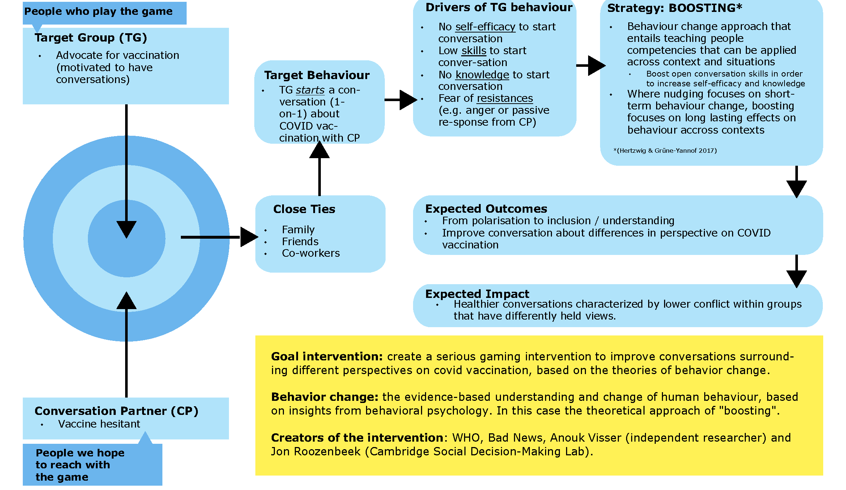
Social inoculation intervention development - The Good Talk!

Slide 39
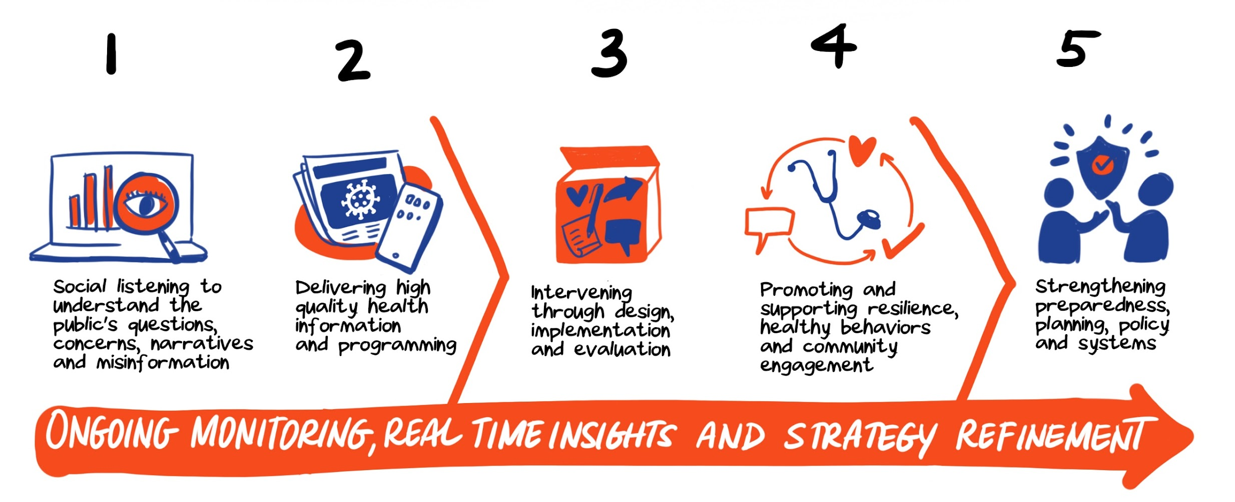
Infodemic management and support to country level efforts for health systems strengthening, promotion of vaccination demand and uptake of PHSM
From preliminary results of Round 3 National pulse survey on continuity of essential health services
Community acceptance and affordability are the biggest challenge to scaling up COVID-19 vaccination. Demand side challenges and health workforce challenges most reported bottleneck for COVID-19 vaccination.
Among top 5 investments in countries: technologies and methods to support infodemic management
Diversified set of practical training packages and backstopping to respond to country needs:
Building on field infodemiologist tools and simulation exercises at 3rd WHO infodemic manager training (Nov-Dec 2021)
OpenWHO course
ToT, simulation and tabletop exercises
Communties of practice, peer to peer support, twinning, and mentoring

Slide 40
OPENWHO Infodemic Management 101 course
👉🏼
For all audiences, to understand what an infodemic is and how to participate in fighting it
Self-paced 3 hours course
Experts’ presentations from the previous 2020 and 2021 IM trainings
1 intro, 5 modules and 3 skills labs to be ready to act
1 final quiz for certification
Comprehensive Training 2022
Notes:
Already 3000 certificates delivered

Slide 41
What is the difference between social media use for marketing/PR versus infodemic management to promote vaccine confidence?
Social Media for PR/Marketing
Social Media for Infodemic Management
Objective:
Use social media unilaterally to raise awareness and engagement about vaccine topics to promote vaccine confidence
Use social media to listen, understand and respond to questions, concerns, information voids and mis/disinformation that affect vaccine confidence
both
Usually more pre-planned content developed and posted according to an editorial calendar
More dynamic and adaptable content developed and posted in response to specific infodemic insights, usually on a rapid timeframe
All content aligned with overall communication and vaccine confidence strategy
Social media channels primarily used to push out content
Attributes:
Content developed based on socio-behavioral insights, communications research and best practice
Social media channels used both for data collection and for deploying infodemic interventions
Call to action may be more narrow and trackable (e.g. “Read this article on childhood vaccine schedules”)
Messages developed for multiple formats, audiences and channels
Call to action may be broader and harder to track (e.g. “Talk to your OB-GYN about fertility questions you may have.”)
Metrics include CTR, impressions, reach, and engagement of individual post/ads
Content developed and tested via A/B testing or other testing
Metrics include scale, directionality, frequency and repetition of common narratives
Comprehensive Training 2022

Slide 42
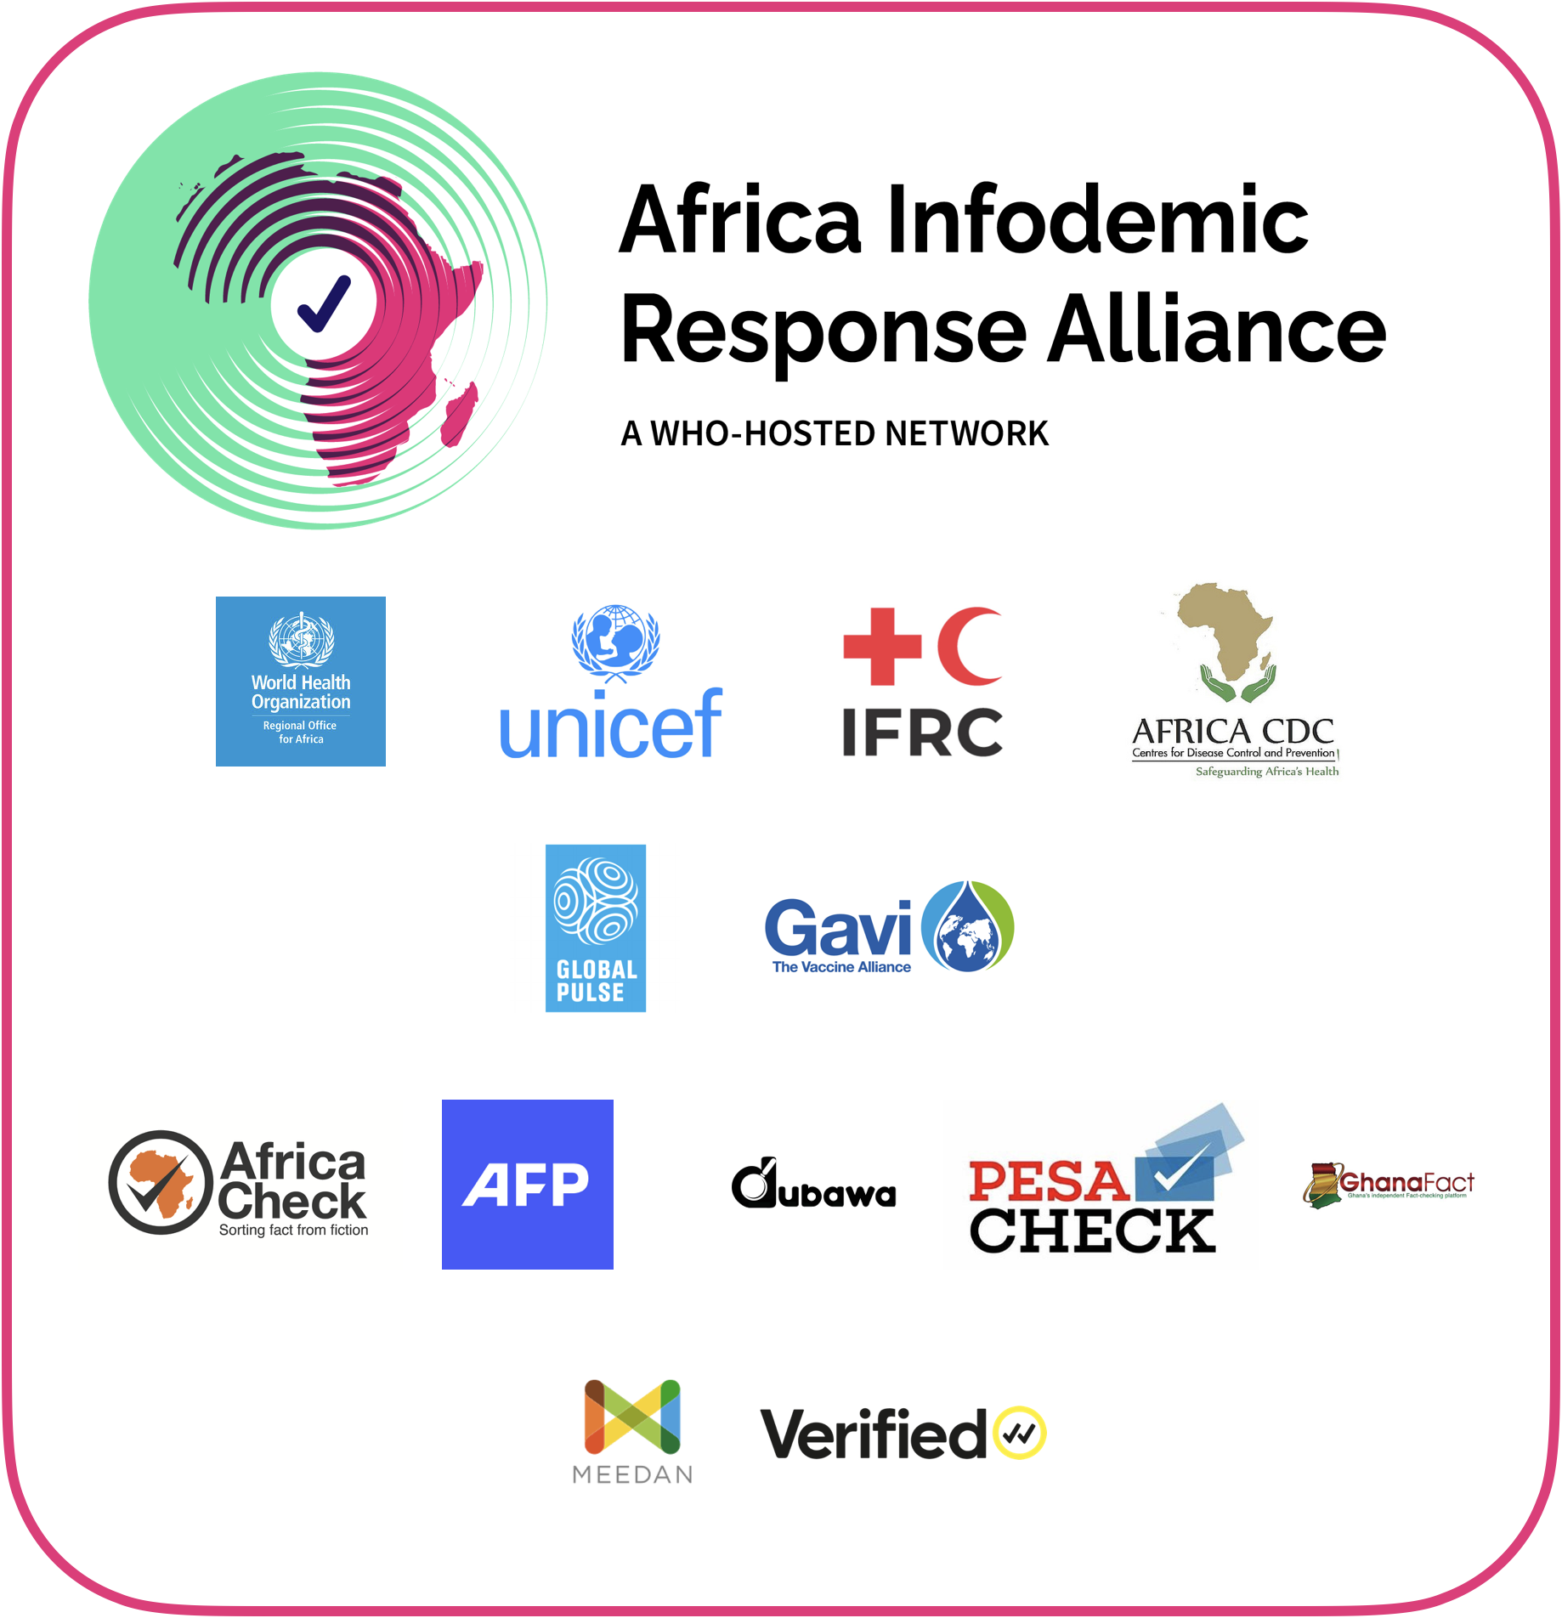
Africa Infodemic Response Alliance (AIRA) is a unique partnership that helps coordinate and amplify fact-checking efforts in the region
Partnership between factcheckers, health authorities, WHO, media and journalists to rapidly use evidence-based methods to respond to questions, concerns, and misinformation in the African region
WHO African Regional Office is the secretariat
AIRA’s various activities include:
Viral Facts: social media content initiative to make high visual, engaging, and shareable health information
Weekly social listening reports focused on region-level insights
Targeted campaigns for building vaccine confidence
Comprehensive Training 2022

Slide 43
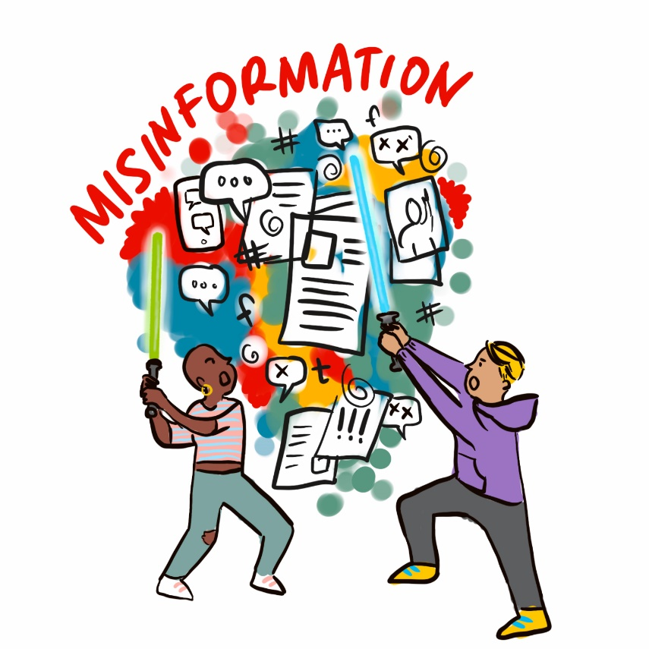
A survey was administered in late 2020 to understand the landscape of factchecking organizations working on health misinformation
Main objectives were to:
Identify organizations managing COVID-19 infodemic and understand their current process of factchecking health information, including facilitators and barriers
Assess the needs and potential for factcheckers to collaborate with health authorities and other public health stakeholders
Methods overview
Survey consisting of multiple choice and open-ended questions was developed by WHO and US CDC with feedback from misinformation experts
Distributed to COVID-19 Factcheckers in Ryerson University’s COVID-19 factchecking database and to members of the International Fact-checking Network (IFCN) listserv
Comprehensive Training 2022
© WHO / Sam Bradd
Notes:
Was part of 3rd IM conference, survey administered towards the end of 2020
Goal: Understand landscape of factchecking organizations working on health misinformation and their involvement of health expertise. Distributed to COVID-19 Factcheckers using an existing network, so a convenience sample.

Slide 44
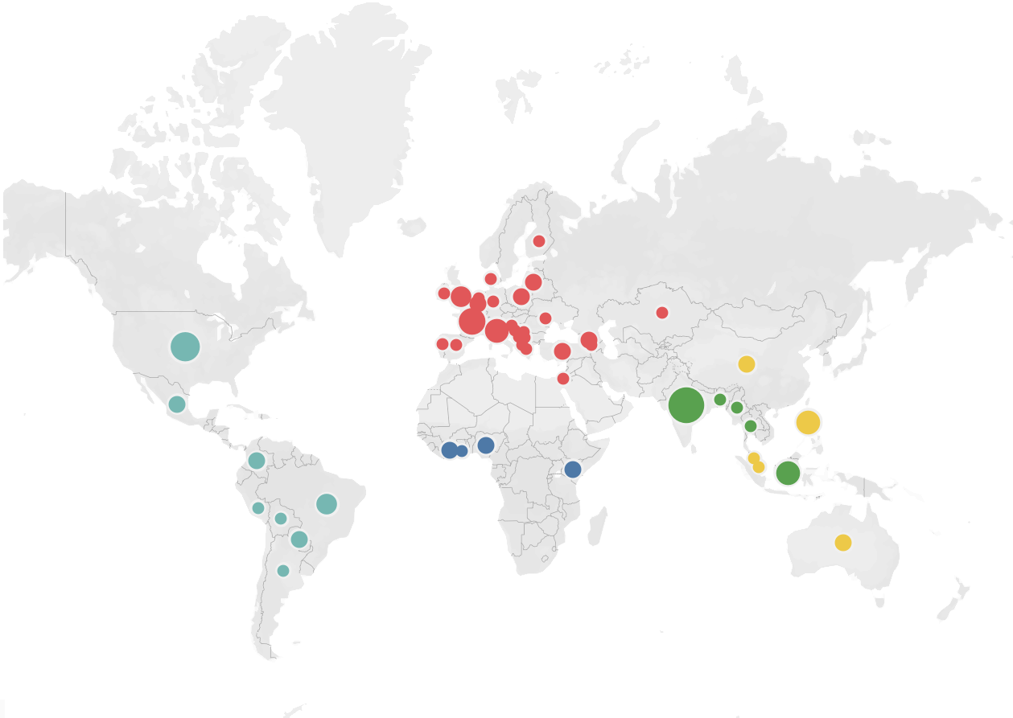
Fact-checking organizations that responded to the survey: a snapshot
91
Organizations
5
WHO Regions
48
Countries
Comprehensive Training 2022
*no respondents from WHO Eastern Mediterranean Region

Slide 45
Many organizations reported challenges in fact-checking health misinformation
Different types of challenges were reported:
Rapidly changing data and evidence
Lack of collaborators in health fields
Lack of access to public data or credible resources
Lack of visibility by health authorities e.g., health authorities do not answer questions publicly
Misleading information spread by official figures and leaders
Unstable funding
Does your organization work with health professionals?
Comprehensive Training 2022
*no respondents from WHO Eastern Mediterranean Region

Slide 46
More recent experiences shared by AIRA offer additional insights
To supplement survey findings with more current insights, we reached out to Africa Infodemic Response Alliance (AIRA) and they shared the following regarding their experiences of working with fact-checkers:
Best practices
Network of regional fact-checkers where organizations can quickly exchange information, share debunks, and alert each other (via WhatsApp)
“WHO certified statements” regularly shared with fact-checkers to validate their debunks; even if a claim has already been fact-checked by media organizations, statements from WHO hold more weight and considered important
Standing meetings with fact-checking organizations to discuss emerging issues and ways to support
Opportunities for improvement
No review or evaluation of best practices and success stories about how WHO can and has been working with fact-checkers
Lack of collaboration with large international media organizations that fact-check
No risk assessment of WHO collaborating with fact-checkers who are publicly perceived to be “political”
Comprehensive Training 2022

Slide 47
Recommendations
Strengthen regional coordination and capacity building particularly in regions where young fact-checking organizations have sprouted (e.g., African, SE Asia and Western Pacific Regions)
Train infodemic managers and health communicators within health authorities and medical associations about fact-checking, including how best they can partner with fact-checking organizations and offer support
Consider documenting and disseminating best practices for collaborating with fact-checking organizations – a written report, workshop, or webinar organized by Pillar 2 on this topic can be helpful
Consider conducting a follow-up assessment (e.g., survey, key information interviews) to understand how the landscape of fact-checkers has changed over the past year, and whether there are new challenges that need to be addressed
Comprehensive Training 2022

Slide 48
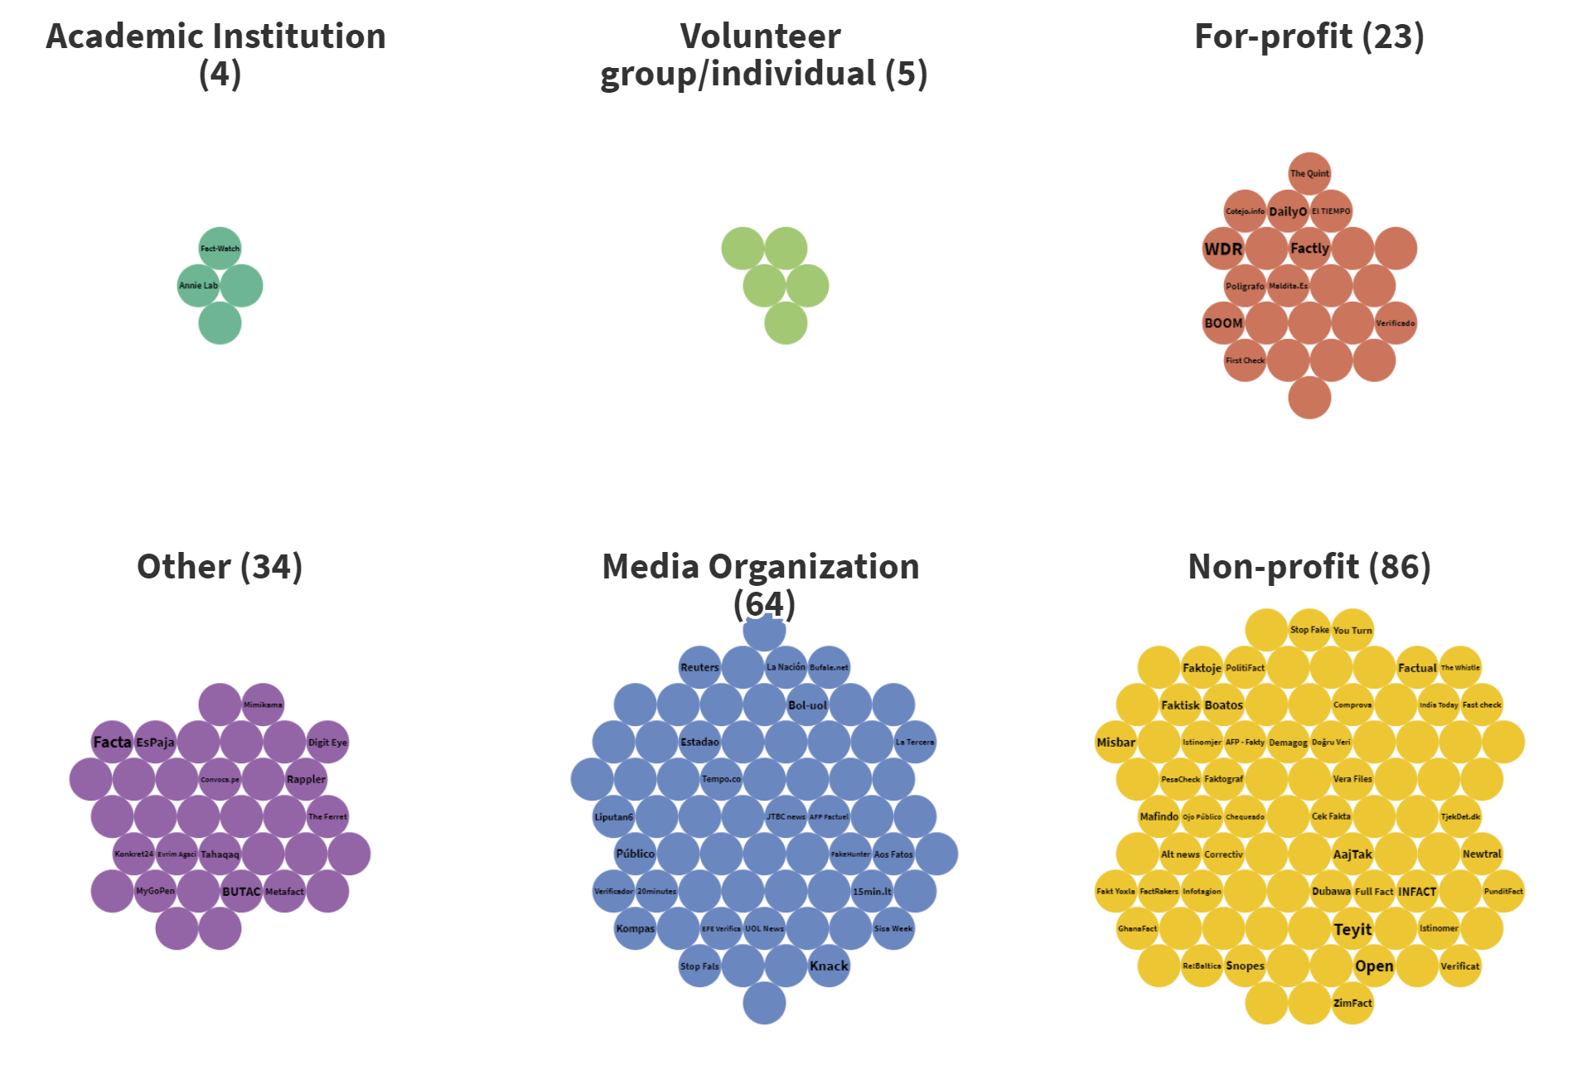
Fact-Checking & COVID-19 Misinformation
Two Projects with Ryerson University
1
2
COVIDGeo Misinformation Dashboard
Track and visualize debunked coronavirus claims that mention or reference a specific geographic location
Facts about COVID-19 Fact Checkers
Dataset of 216 COVID-19 fact-checkers from around the world
https://covid19misinfo.org/misinfowatch/misinformation-watch-covidgeo/
https://covid19misinfo.org/fact-checking/covid-19-fact-checkers/

Slide 49
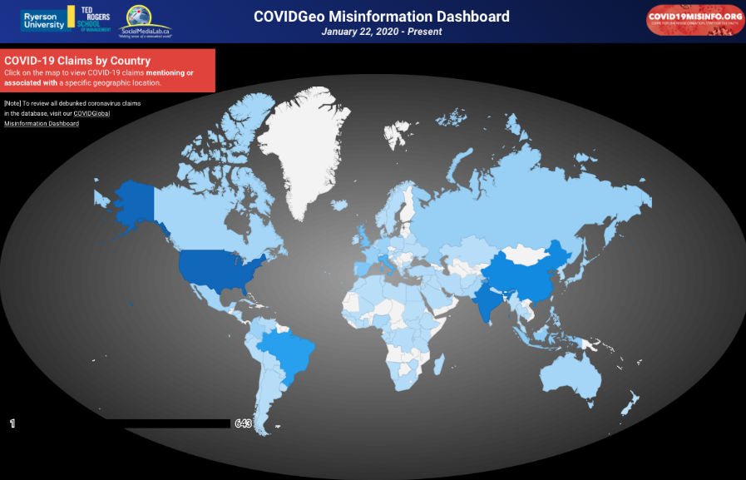
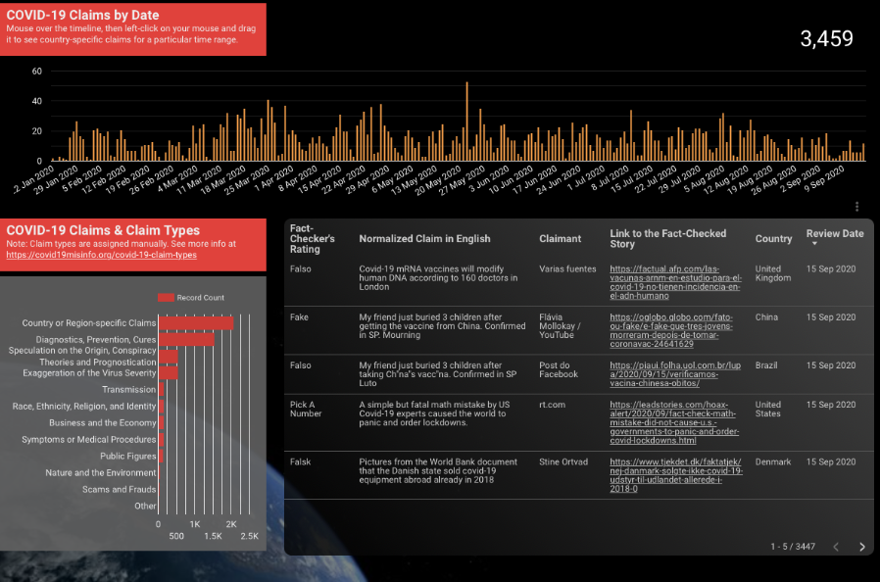
COVIDGeo Misinformation Dashboard
Data from Google Fact Check API.
Interactively, users can:
Learn which countries are more frequently the subject/target of COVID claims.
See what types of COVID claims are circulating online that specifically mention or reference a geographic location.
Discover when are there spikes in the volume of debunked COVID claims.
Track what fact-checkers around the world have chosen to fact-check.
Link: https://covid19misinfo.org/misinfowatch/misinformation-watch-covidgeo/
For a more complete dataset of debunked COVID-19 claims, regardless of whether a particular country is mentioned or not: https://covid19misinfo.org/misinfowatch/global/

Slide 50
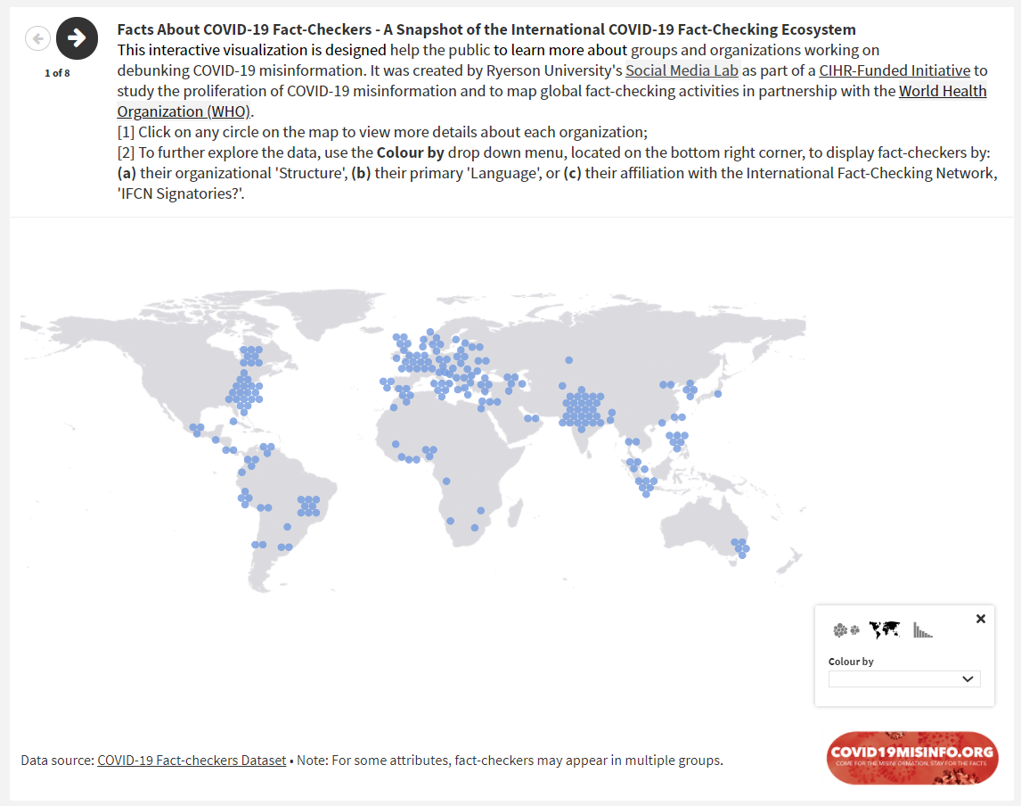
Facts about 216 COVID-19 Fact Checkers
Users can explore fact-checkers by
Language
Structure (academic, for profit, media organization, non-profit,…)
By affiliation with government, academia, media, private sector, independent
By funding source
By topic (i.e. science and technology, politics, …)
2
List can be downloaded at: https://covid19misinfo.org/fact-checking/

Slide 51
COVIDGeo Misinformation Dashboard

