Slide 1
Increasing vaccine demand and uptake Behavioural and social drivers of vaccination
Lisa Menning, Team Lead, Demand and Behavioural Sciences
Department of Immunization, Vaccines and Biologicals
WHO Headquarters

Slide 2
Learning objectives
Participants will…
Understand the behavioural and social drivers (BeSD) of vaccination framework and its domains and constructs
Describe the advantages of using the BeSD surveys, interview guides and priority indicators
Understand what tools to use to address what challenges
Identify the opportunities and key steps for integrating BeSD questions and indicators into existing programme data collection activities and assessments – or be used to supplement
Understand the main steps to using the BeSD tools and who to engage in the process

Slide 3
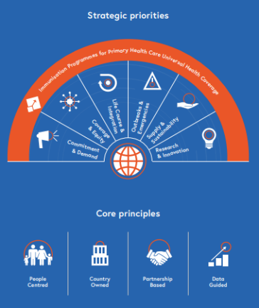
The context
Routine immunization coverage has plateaued in recent years
IA2030 highlights demand and people-centred approaches
COVID-19 has led to a major shift for immunization:
Increased awareness of vaccination
Engagement of new prioritised populations
More attention on equity within and between countries
Global interest in hesitancy and trends in uptake
However, the causes of low uptake are poorly measured
Our understanding of the reasons for low uptake has evolved in recent years, including contribution of hesitancy
→ This topic was presented to SAGE at its October 2021 meeting, with resulting recommendations

Slide 4
What are we measuring?
Behavioural and Social Drivers
Thinking and Feeling
Perceived disease risk
Vaccine confidence (includes perceived benefits, safety and trust)
Practical Issues
Availability
Affordability
Ease of access
Service quality
Respect from health worker
Motivation
Intention to get recommended
vaccines
Vaccination Uptake of recommended
vaccines
Social Processes
Social norms (includes support of family and religious leaders)
Health worker recommendation
Gender equity
The Behavioural and Social Drivers (BeSD) Framework. Source: The WHO BeSD working group. Based on Increasing Vaccination Model (Brewer et al., 2017)

Slide 5
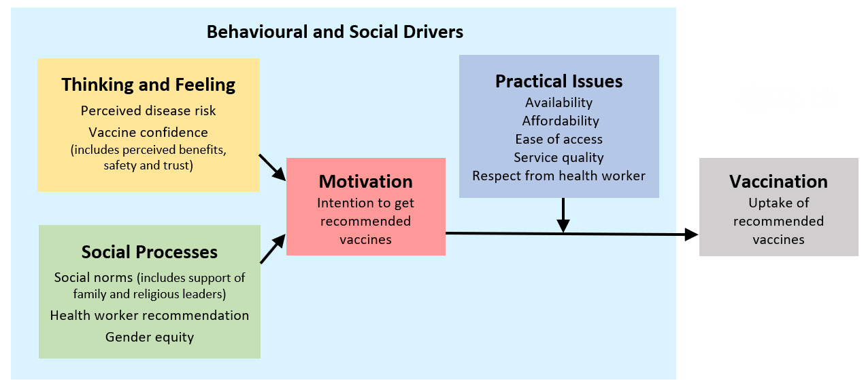
What about hesitancy?
“Vaccine hesitancy” is part of the Motivation domain.
Hesitancy is a motivational state of being conflicted about, or opposed to, getting vaccinated; includes intentions and willingness.

Slide 6
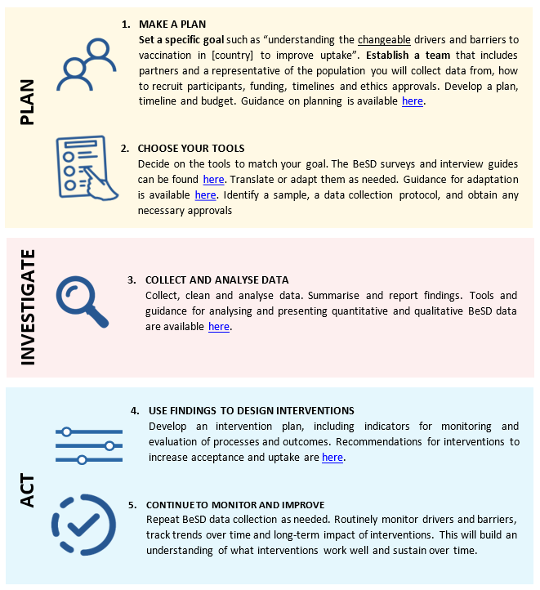
What tools and guidance are available?
Childhood vaccination tools
Survey: for parents of children under 5 years
Qualitative tools: 1) parents, 2) health workers, 3) community stakeholders, and 4) authorities
Practical implementation guidance
1.
2.
COVID-19 vaccination tools
Surveys: for 1) adults, 2) health workers
Qualitative tools
3.

Slide 7
Why measure BeSD?
Understand main reasons for low uptake
Contribute to knowledge on trends, measures and interventions
Guide policy-making, planning and evaluation
Tailor and evaluate specific interventions
Better allocate resources
Enhance transparency and ownership
Support training programmes
Strengthen stakeholder engagement
IA2030 Global Indicators
for Strategic Priority 2
SP2: Commitment and demand
2.1 Proportion of countries with legislation in place that is supportive of immunization as a public good
2.2 Proportion of countries that have implemented behavioural or social strategies (or demand generation strategies) to address under-vaccination

Slide 8
How were the tools developed? (2019-2021)
1
PHASE
KEY ACTIVITIES
END-USER INPUTS
Tool
development
Literature review
Identification of constructs
Qualitative interview questions
Survey items and iterative reduction
Demographic items and survey instructions
Key informant interviews
IVIR-AC consultations (two)
2
Field testing
☑ Languages and countries selected
☑ Study protocol and scripts
Translation of all materials (& translator feedback)
Surveys:
Cognitive interviewing
Analysis spreadsheet: item, results, revisions
Qualitative tools:
☑ Draft qualitative guides
☑ Interviewer debrief form and analysis framework
Regional and Country Offices feedback
EPI programme and implementer feedback
Testing sites:
Indonesia, Sierra Leone, Guatemala, Australia
3
Psychometric validation and indicator selection
☑ Validation study protocol
☑ Translations and data-gathering
Data analysis
Working group review and indicator selection
Implementing end-user feedback on guidebook
Validation sites:
Angola, Ethiopia, DRC, India, Nigeria, Pakistan
4
Continue to gather end-user feedback
Finalisation of all tools and guidance
Tools for childhood vaccination
Tools for COVID-19 vaccination
☑ Guidance for data collection and use
5
SAGE recommendations on systematic gathering and use of data on BeSD, October 2021 (WER report)

Slide 9
Summary of all topics measured: COVID-19 vaccination survey
Thinking and feeling | Motivation | Social processes | Practical issues
✪ Confidence in COVID-19 vaccine benefits | ✪ Intention to get vaccinated | ✪ Family norms | ✪ Know where to get vaccination
 Confidence in COVID-19 vaccine safety |  Vaccine confidence – brand |  Peer norms | ✪ Affordability
 COVID-19 vaccine –see friends and family |  Willingness to recommend vaccine to others |  Religious leader norms |  Received recall
 Perceived risk – self |  |  Community leader norms |  Ease of access
 Confidence in health workers |  |  Health worker recommendation |  Reasons for low ease of access
 |  |  Workplace norms |  Service satisfaction
 |  |  Gender equity – travel autonomy |  Service quality
 |  |  |  On-site vaccination
Demographics
Age
Gender
Occupation
*Health worker role
COVID-19 risk
COVID-19 diagnosis
 Main survey question.  Priority question in main survey.  Optional question.

Slide 10
Priority indicators for routine M&E (with questions)
DOMAIN/ construct | COVID-19 vaccination survey
 | Priority question | Indicator
THINKING AND FEELING Confidence in vaccine benefits | How important do you think getting a COVID-19 vaccine will be for your health? Would you say… Not at all important A little important Moderately important, or Very important? | % of adults/health workers who think a COVID-19 vaccine is “moderately” or “very” important for their health
SOCIAL PROCESSES Family norms | Do you think most of your close family and friends want you to get a COVID-19 vaccine? NO YES | % of adults/health workers who think most of their close family and friends want them to get a COVID-19 vaccine
MOTIVATION Intention to get vaccine | Do you want to get a COVID-19 vaccine? Would you say… No, you do not want to, Yes, you do want to, or are you Not sure? | % of adults/health workers who want to get a COVID-19 vaccine
PRACTICAL ISSUES Know where to get vaccination | Do you know where to go to get a COVID-19 vaccine for yourself? NO YES | % of adults/health workers who know where to get a COVID-19 vaccine for themselves
PRACTICAL ISSUES Affordability | How easy is it to pay for vaccination? When you think about the cost, please consider any payments to the clinic, the cost of getting there, plus the cost of taking time away from work. Would you say… Not at all easy A little easy Moderately easy, or Very easy? | % of adults/health workers who say vaccination is “moderately” or “very” easy to pay

Slide 11
Priority indicators for routine M&E (with questions)
DOMAIN/ construct | Childhood vaccination survey
 | Priority question | Indicator
THINKING AND FEELING Confidence in vaccine benefits | How important do you think vaccines are for your child’s health? Would you say… Not at all important A little important Moderately important, or Very important? | % of parents/caregivers who say that vaccines are “moderately” or “very” important for their child’s health
SOCIAL PROCESSES Family norms | Do you think most of your close family and friends want you to get your child vaccinated? NO YES | % of parents/caregivers who say most of their close family and friends want their child to be vaccinated
MOTIVATION Intention to get vaccine | [COUNTRY NAME] has a schedule of recommended vaccines for children. Do you want your child to get none of these vaccines, some of these vaccines or all of these vaccines? NONE SOME ALL | % of parents/caregivers who want their child to get “all” of the recommended vaccines
PRACTICAL ISSUES Know where to get vaccination | Do you know where to go to get your child vaccinated? NO YES | % of parents/caregivers who know where to get their child vaccinated
PRACTICAL ISSUES Affordability | How easy is it to pay for vaccination? When you think about the cost, please consider any payments to the clinic, the cost of getting there, plus the cost of taking time away from work. Would you say… Not at all easy A little easy Moderately easy, or Very easy? | % of parents/caregivers who say vaccination is “moderately” or “very” easy to pay for

Slide 12
CASE EXAMPLE
A snapshot of findings from Ethiopia Priority indicators for COVID-19 vaccination
Total sample (n=628); health worker (n=304), other adults (n=324). Data gathered July-August 2021

Slide 13
CASE EXAMPLE
South Africa: From data to action for COVID-19 vaccines
 | KEY FINDINGS | ACTIONS TAKEN
Practical Issues | Only 19% think vaccine will be very easy to access | Expanded sites Disseminated list of vaccination sites Explainer videos (steps for registration; steps on site)
Thinking and Feeling | 80% feel vaccine is important for their health BUT 32% will trust the vaccine “very much” 31% noted concerns about efficacy 26% concerns on safety 14% trust in authorities being main reasons for not wanting the vaccine | Live TV broadcast of HWs, President and Minister of Health getting vaccinated, then union leaders Health Minister webinars – national and provincial Carried out daily press conferences Intensified social listening Launched website, disseminated social media GIFs Targeted communications in specific sites Videos of health workers supporting vaccination
Social Processes | 50% think adults in communities and co-workers will vaccinate 74% would recommend vaccine to others | Targeted community engagement in specific areas ‘Vaxscenes’ - video stories of people targeted in each phase talking about their experience getting vaccinated
Motivation | 70% said they will take the vaccine | Planning behavioural interventions

Slide 14
Congo Republic: Rapid data collection
CASE EXAMPLE
Summary of barriers to COVID-19 vaccination
Vaccine access challenges
Local HF don’t have doses
Too far to go to major hospitals for vaccination
Do not know where to go
Not sure if eligible
Low risk perception of COVID-19 compared to perceived importance of vaccination
Concerns about efficacy and AEFIs/safety

Slide 15
Moving from data to action: Promising interventions by BeSD domain to guide planning
Domain where problem is identified | Interventions shown to increase vaccination
Thoughts and feelings and Motivation | Campaigns to inform or educate the public about vaccination Dialogue-based interventions, including one-to-one counseling to encourage vaccination
Social processes | Community engagement Positive social norm messages Vaccine champions and advocates Recommendations to vaccine from health workers
Practical issues | Reduced out-of-pocket costs Service quality improvements Reminder for next dose /recall for missed dose Onsite vaccination at home, work and school Default appointments Incentives School and work requirements (mandates)

Slide 16
Strong emphasis on M&E of interventions for continuous learning
Example of M&E framework included in guidebook:
DOMAIN and INDICATORS | INTERVENTION | INPUTS | ACTIVITY / OUTPUTS | OUTCOMES
Practical Issues % of adults/ HCWs who know where to get vaccines for themselves % of adults/HCWs who believe that accessing vaccination for themselves is "very” or “moderately" easy | Improve access to vaccination Mailed or phone offer of appointment Outreach Reminders, standing orders and walk-in clinics. | Messages to invite, remind, follow-up and inform Mechanisms for delivery of personal invitations | Messages are ready on schedule, pilot-tested, revised and ready for roll-out Mechanisms are available and ready to be put into action | Know where to get vaccine Believe that accessing vaccination for themselves is "very” or “moderately" easy Readiness to seek vaccination Perceived barriers to access

Slide 17
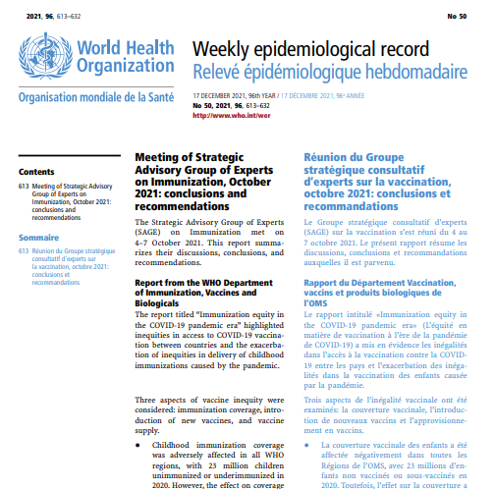
SAGE conclusions and recommendations:
“SAGE recommended the systematic gathering and use of data on behavioural and social drivers to assess the reasons for low uptake, for routine tracking of trends,
and monitoring and evaluation of interventions.”
SAGE, October 2021
WHO Position Paper on BeSD:
https://apps.who.int/iris/bitstream/handle/10665/354458/WER9720-eng-fre.pdf

Slide 18
Steps to use BeSD for local data?
ENGAGE: Establish a core group with key stakeholders
PARTNER: Identify implementing partner to assist with methods, data collection and analysis
PRIORITIZE: Review existing data and challenges, identify prioritized population, formulate research question
TOOLS: Decide what BeSD tools to use: survey (with priority indicators), or interview guides. Test and adapt tools to match local needs and context.
PLAN: Develop project plan including timelines, budget, process for data collection and analysis
ACT: Consider how findings may be used to guide planning and implementation
MONITOR: Continue M&E to guide iterative improvements

Slide 19
Research top tips
Know your objectives
Make sure people understand what you’re asking: translate and test the questions first
Do not change the question wording unless thorough testing indicates otherwise
Do not add or remove response options
Add demographic questions to suit the local setting
Avoid convenience samples for surveys – unless constrained by time and budget
Only measure what you can use

Slide 20
Need more information?
BeSD tools and guidance:
https://apps.who.int/iris/handle/10665/354459
WHO Position Paper on BeSD:
https://apps.who.int/iris/bitstream/handle/10665/354458/WER9720-eng-fre.pdf
WHO vaccine demand webpage:
https://www.who.int/teams/immunization-vaccines-and-biologicals/essential-programme-on-immunization/demand
CONTACT:
Lisa Menning, Team Lead, Demand and Behavioural Sciences
Department of Immunization, Vaccines and Biologicals
World Health Organization, Geneva

Slide 21
Thank you

Slide 22
Extra slides

Slide 23
Group exercise (20 mins total)
Context: Your country has specific ‘hotspots’ with very low uptake on the fringes of an urban centre. You’ve been asked to diagnose the reasons for low uptake.
In groups of 3-5:
Discuss the steps you would take to gather data and convene partners to plan next steps.
Some questions to consider (feel free to specify assumptions to illustrate your approach):
What population would you target? Why?
What would be the core elements of your plan?
What tools and methods would you use?
How would the findings be used?

Slide 24
Quiz questions
1. Why measure behavioural and social drivers? | 2. What is vaccine confidence? | 3. What should always be done before using the BeSD tools?
To understand how people think, feel, and act when it comes to vaccines To identify reasons for low vaccine uptake To guide programme planning and evaluation All of the above | Not trusting health authorities Understanding the importance and safety of vaccines Spreading misinformation about vaccines Lack of willingness to get vaccinated | Adding relevant demographic questions, e.g., ethnicity Translating the tool(s) Testing the tool(s) Make sure that priority questions/indicators are included All of the above
Answer: D | Answer: B | Answer: E

