Slide 1
Comprehensive training
28 June – 21 July 2022
HOSTED BY GAVI, WHO, UNICEF & US CDC

Slide 2
Diagnosing Vaccine Confidence and Demand Challenges
Daiva Yee, MPH
Health Scientist
Demand for Immunization Team
Global Immunization Division
US CDC
Francine Ganter-Restrepo
Technical Officer, Demand and Behavioural Science Essential Programme on Immunization (EPI)
Department of Immunization, Vaccines and Biologicals (IVB)
World Health Organization

Slide 3
Outline
Why are diagnostics important?
The process for gathering community insights
Guidance and resources for diagnosing vaccine demand challenges
Group exercise

Slide 4
Learning objectives
At the end of this presentation you will:
Learn why diagnostics are important for increasing vaccine demand and uptake
Learn the process for gathering community insights
Know how to choose data collection methods
Learn where to find guidance and resources for diagnosing vaccine demand challenges

Slide 5
Why are diagnostics important?

Slide 6
Diagnostics Can Help Us
Understand community perceptions, questions, concerns, about vaccination
Question assumptions on barriers and enablers to vaccination
Design targeted evidence-based interventions that address community needs

Slide 7
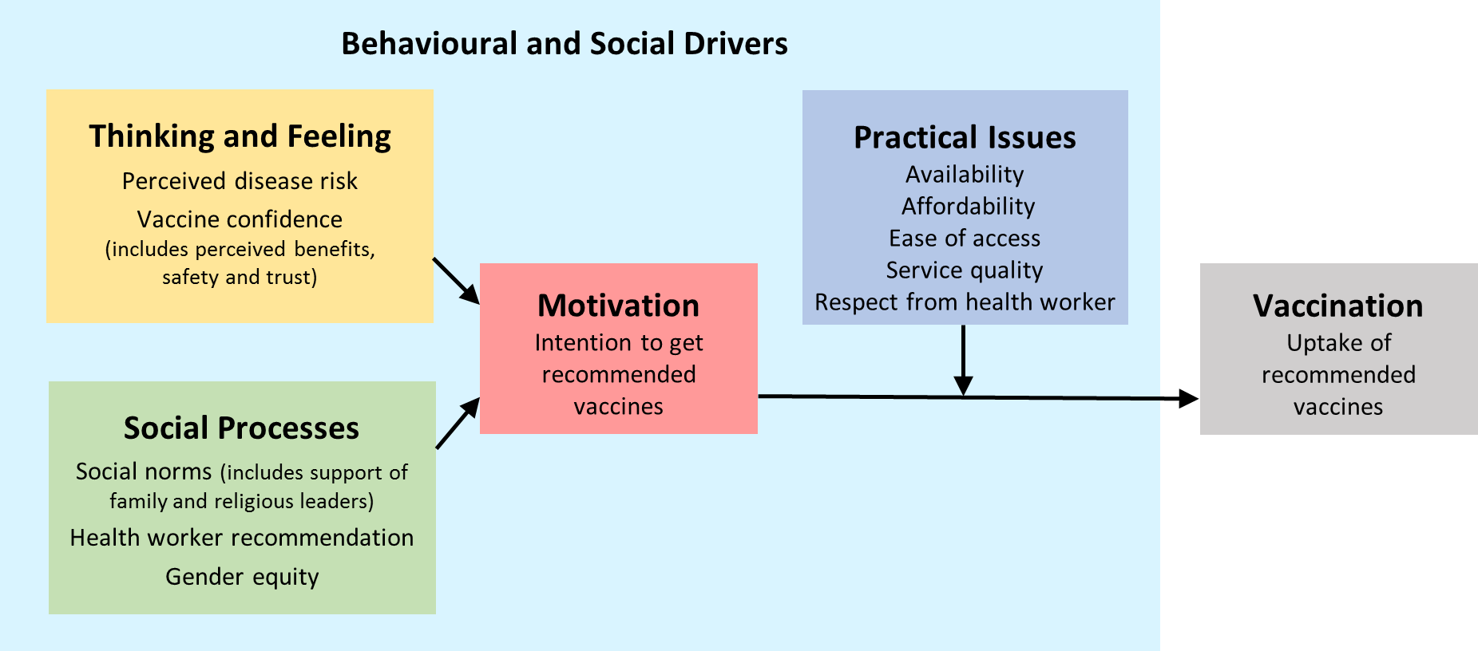
What drives vaccine uptake?

Slide 8
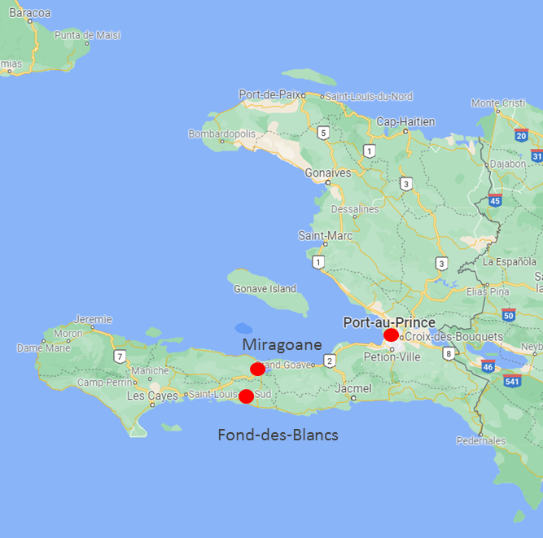
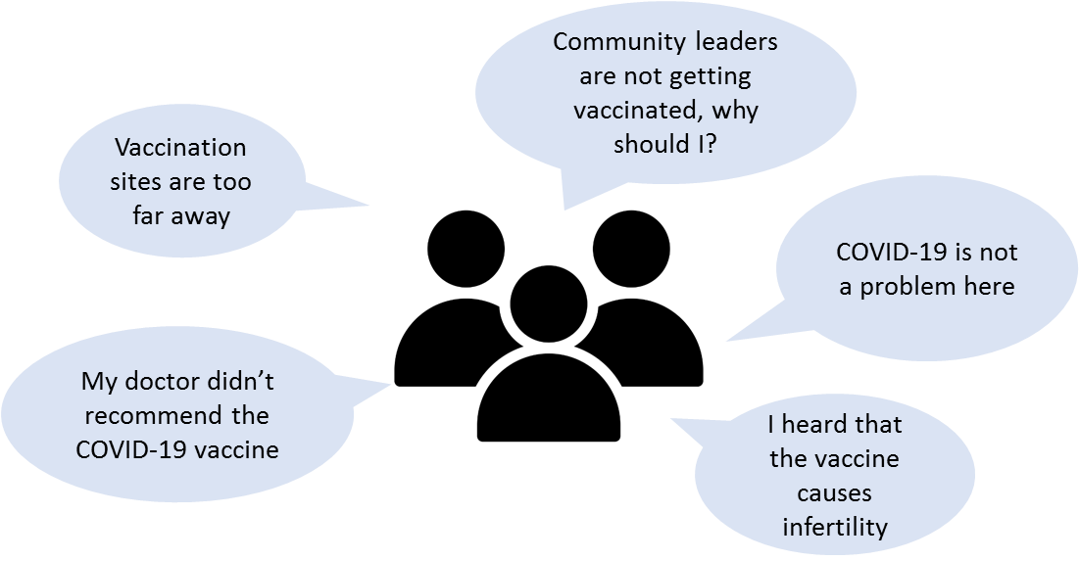
Haiti COVID-19 Vaccination Case Study
COVID-19 vaccine rollout began July 2021
February 2022: only 2% of the population fully vaccinated
Ministry of Health requested assistance with a rapid community assessment to identify barriers to COVID-19 vaccination
Community insights:

Slide 9
The Journey to Vaccination
Disease susceptibility & severity
Vaccine safety & efficacy
Vaccine recommendations
Health centre convenience
Client satisfaction
Interpersonal communication
Financial, occupational and social costs
Lack of convenience
Trust in vaccination institutions
Vaccination benefits
Vaccination norms
Ease of getting appointment for second dose
Adverse event monitoring
Positive reinforcement
Appointment scheduling
Transportation
Childcare
Competing priorities

Slide 10
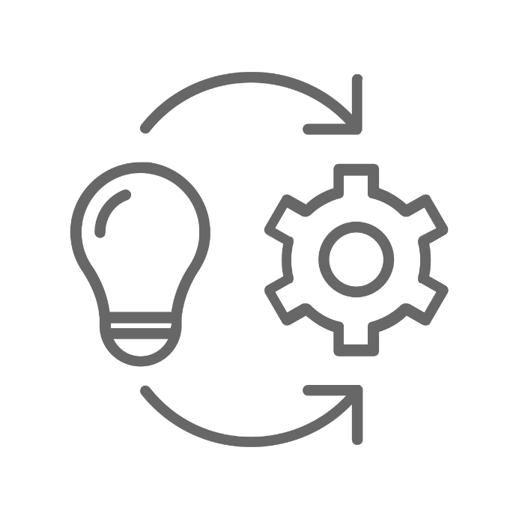
Gathering Community Insights for Intervention Design
Gather
insights and perceptions from the community of focus
Synthesize
findings
and community needs
Co-design interventions with the community
Share recommendations with communities and stakeholders
Implement and evaluate interventions to increase vaccine demand and uptake

Slide 11
Process for Gathering Community Insights

Slide 12
Gathering community insights in 5 steps
Step 1: Determine objective
Step 2: Identify community(ies) of focus
Step 3: Choose data collection methods
Step 4: Form an assessment team
Step 5: Recruit assessment participants

Slide 13
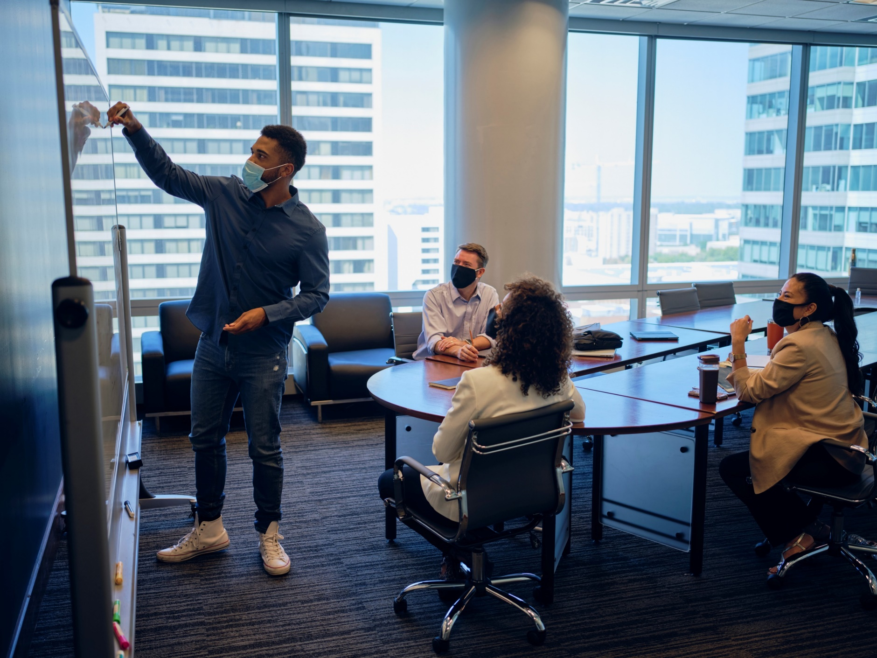
Step 1: Determine Objectives
Sample Objectives:
Identify populations at risk for low vaccine uptake
Identify community leaders, trusted messengers, and important message channels
Assess barriers to vaccine uptake
Identify, implement, and evaluate strategies to increase vaccine confidence and uptake

Slide 14
Step 2: Identify Community(ies) of Focus
Factors for Identifying Communities:
Communities experiencing low rates of vaccine uptake or confidence.
Communities with historically low routine adult or childhood immunization rates.
Communities that have experienced disproportionately high rates of disease or death.
Communities that have high rates of underlying health conditions that place them at greater risk for severe disease.
Communities that likely experience barriers to accessing vaccination services.

Slide 15
Step 3: Choose Data Collection Methods
Think beyond KAP surveys
KAP surveys are not always appropriate for every situation.
However, KAP surveys are:
KAP surveys are useful for:
Understanding misconceptions or misunderstandings.
Identifying information gaps.
Establishing a baseline understanding to be explored further in other assessments.
descriptive
Not frameworks for intervention creation.
Fail to capture nuance and context.
Ignore local variations.
Don’t capture dynamic situations.
quantitative
national (often)
static

Slide 16
Considerations for Choosing Data Collection Methods
1
Identify available resources
2
Consider any existing data sources
3
Identify existing community partnerships

Slide 17
Surveys / Questionnaires
What is it?
Predetermined list of questions given to a group of people.
May be self-administered or administered by a data collector.
Quantitative (pre-determined response options) or qualitative (open ended questions).
When to use it?
When questions/hypotheses are clear, and generalizability is desired.

Slide 18
Interviews
What is it?
Conversations with individuals to understand details on their personal feelings, opinions, and experiences.
May be formal or informal, structured or unstructured.
When to use it?
When trying to understand complex or sensitive topics.
When questions or hypotheses are unclear.
When more detailed information is required.

Slide 19
Focus Groups
What is it?
Discussions with small groups of people.
Requires a skilled moderator
When to use it?
When data or insights generated in conversation would be more accessible in a group setting.
Can be more efficient than individual interviews.

Slide 20
Participant Observations
What is it?
Set of methods where researchers are immersed in the community in which they are studying.
Data collected can be qualitative or quantitative.
When to use it?
To gain an understanding of the context in which study participants live and their behaviors.
Powerful for capturing detailed and accurate information about individuals or communities.

Slide 21
Social Listening / Media Monitoring
What is it?
Monitoring social or traditional media channels for mentions of a specific topic.
When to use it?
To understand online and media conversations around a topic.
Can be used to determine trends, information needs, and circulating mis/disinformation.

Slide 22
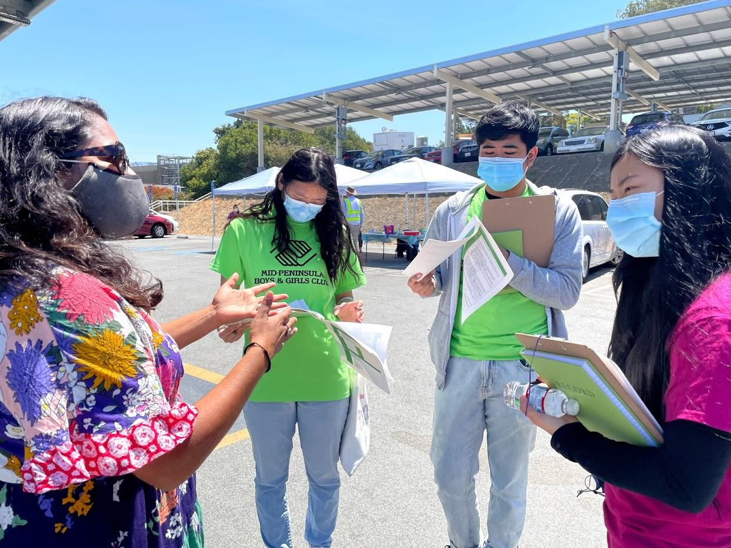
Step 4. Form an Assessment Team
Consider including:
Individuals who are members of the community of focus
Are trusted by the community
Speak the same language as the community of focus
Individuals with existing knowledge about the community of focus
Individuals with experience collecting and analyzing behavioral data

Slide 23
Step 5: Recruit Assessment Participants
Get a broad mix of people within your community(ies) of focus so you can hear all perspectives
Consider including people of different:
Ages
Gender identities
Races/ethnicities
Primary languages
National origins
Education levels
Occupations

Slide 24
Identify Key Stakeholders
Identify people who are invested in the community of focus and in the implementation and outcomes of vaccination programs
Healthcare workers and health system leadership
Social service organizations
Government officials / elected leaders
Faith-based organizations and leaders
Employers

Slide 25
Use a Snowball Sampling Approach to Identify Additional Participants
Ask each person who you talk to about who else you should meet

Slide 26
Identify Places to Visit for Observations and Intercept Interviews
Identify some places to visit where you can observe or speak with community members
Vaccination sites
Healthcare facilities
Community markets
Schools
Restaurants / bars

Slide 27
Tips for Implementation
Clear plan, roles and timelines
Stay connected
continued stakeholder involvement
frequent check-ins with assessment team
Adapt as we learn
create space for reflection and review
allow flexibility in plans

Slide 29
Guidance and Resources for Diagnosing Vaccine Demand Challenges

Slide 30
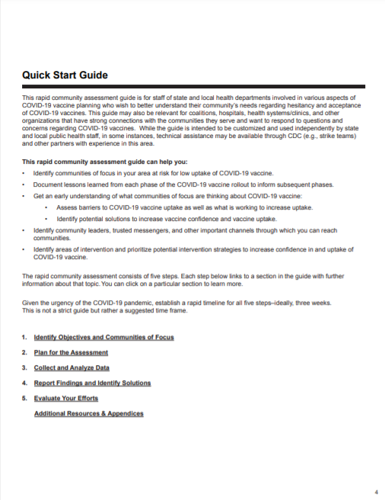
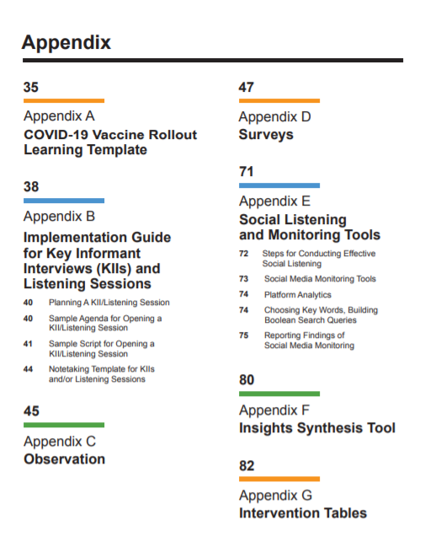
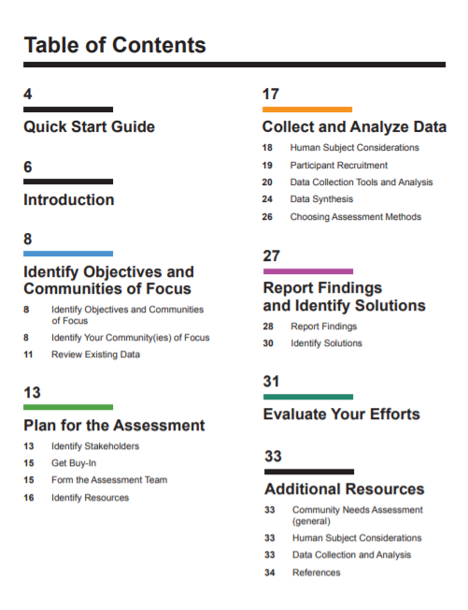
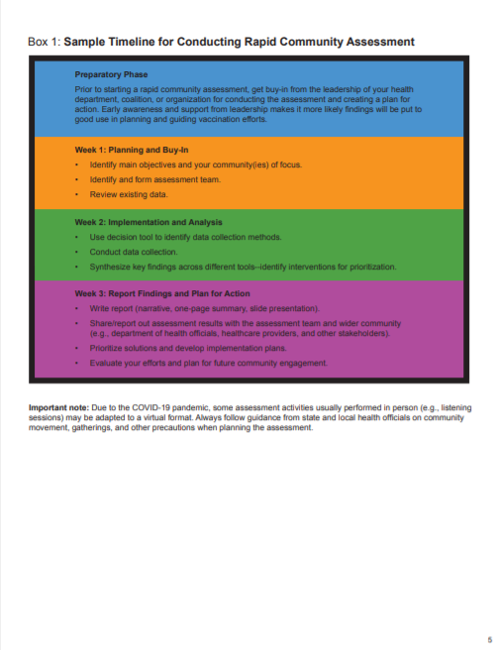
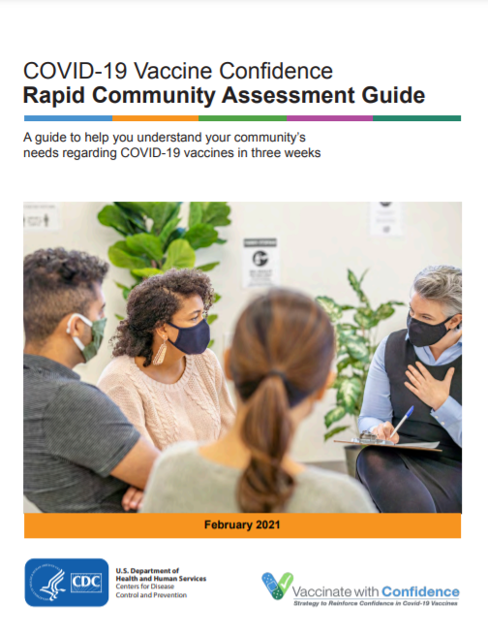
Rapid Community Assessments (RCA)
Process for better understanding and addressing community needs around COVID-19 vaccination in as little as 3 weeks
Includes step-by-step guidance and tools:
COVID-19 vaccine rollout learning template
Key informant interview & listening session guide
Observation form
Survey question bank
Social listening/traditional media monitoring tool
Data synthesis tool

Slide 31
HCD-TIP
Intended to support human-centered and tailored strategies to reach under-vaccinated communities
Can be used as part of microplanning, or to support better workflows for health workers
Designed to be:
People and community focused
Broadly applicable
Adaptable to new situations
Easy to use
Usable at the community & health facility level

Slide 32
BeSD
Tools and guidance for measuring the drivers of demand
Includes:
Behavioural framework for what drives uptake
Ready-to-use surveys
Adaptable qualitative interview guides
Guidance on analysis and templates for reporting

Slide 33
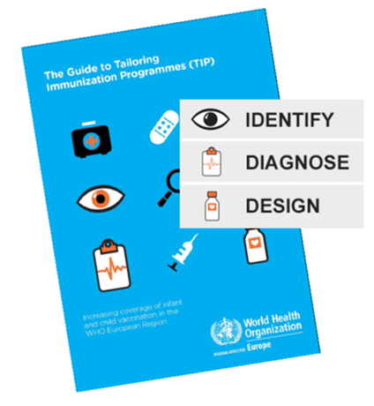
Tailoring Immunization Programmes (TIP)
A structured, adaptable, and participatory process
For under-vaccinated or hesitant target populations
Based on a behavioural theoretical model, linking research to interventions to M&E
Undertaken to understand enablers and barriers to vaccination
To define and evaluate evidence-informed interventions to increase coverage

Slide 34
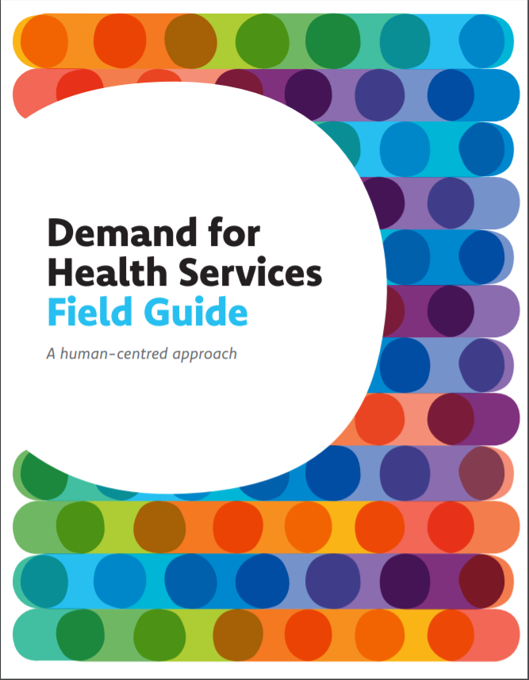
Demand for Health Services
For when health services are available but a subset of the intended population of clients are not actively seeking them.
For health professionals to investigate, understand and respond to opportunities and challenges (drivers and barriers) related to health-seeking behaviours
Human-centered approach: emphasizes both the perspective and participation of the people we are trying to serve at every step—including the services, institutions and communities that surround and influence them.

Slide 35
3 Truths or Guiding Principles for Practitioners
Keep it simple!
Consider how you will use the information you want to gather
Involve stakeholders and the priority group from the start
Notes:
Remember to include any hints on how to strengthen linkage to health systems, and utilize existing data sources, networks, structures and systems.

Slide 36
3 Best practices for diagnosing demand challenges in the field
Three best practices or tools/guidance used by practitioners:
Use behaviour change frameworks to inform assessments
Pilot your assessment tools before conducting full scale assessment
Ensure the assessment team is well trained on data collection methods. Conduct training alongside real practice.

Slide 37
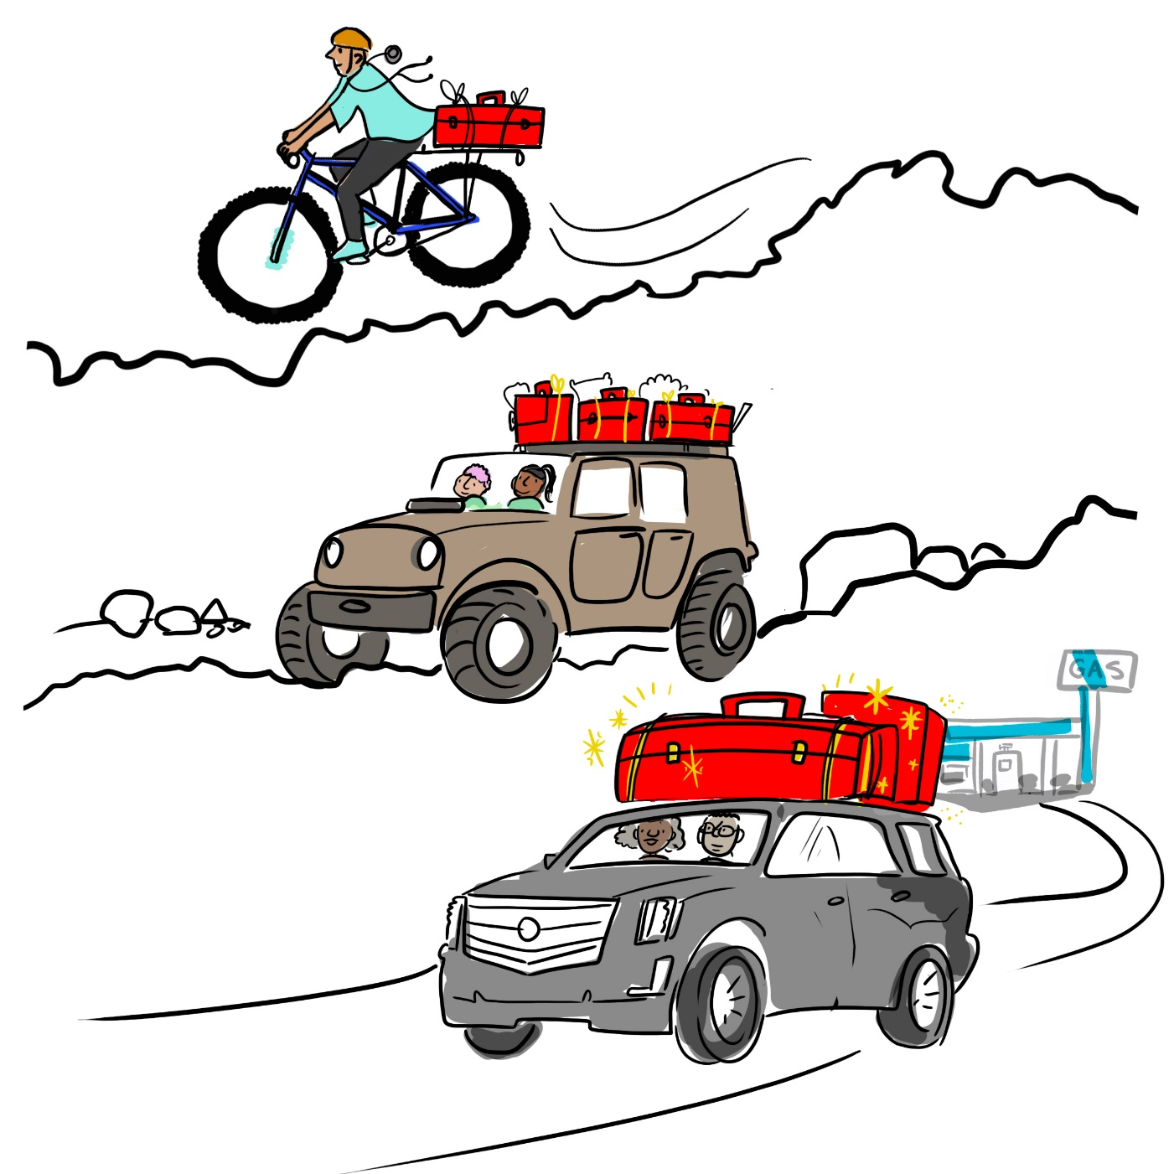
Actions You Can Take to Diagnose Demand Challenges in Different Operating Environments
Mountain Bike
Keep it simple: collect only the data you really need, simplify tools and materials
Coordinate with partners for added support
Consider existing/ planned activities you can piggy-back on
Sturdy 4x4
Plan a rapid assessment building off of any existing data
Form an assessment team who can collect and synthesize data and develop recommendations for action in a 2-3 week time period
Luxury Vehicle
Invest in building local capacity and quality data collection systems
Consider longitudinal studies (change over time)
Bigger vehicle = larger toolbox of interventions, more ways of promoting vaccine demand and mitigating the infodemic
Notes:
Remember that these are not analogous to LMICs, MICs and HICs (see previous slide), but to maturity of system and structures. Be extremely practical in what one person can do (mountain bike) with limited funding or resources versus someone with a lot of staffing and resources (luxury vehicle)

Slide 38
Please feel free to reach out with any questions
Daiva Yee: nrr3@cdc.gov
Francine Ganter-Restrepo: ganterf@who.int

Slide 39
Group work

Slide 40
Breakout Group Activity
In small groups, discuss the benefits and challenges of using the following data collection methods:
Surveys/questionnaires
Interviews
Focus groups/listening sessions
Participant observations
Social listening/media monitoring
Draw on your own experience and considerations for your community
20 minutes

