Slide 1
Comprehensive training
28 June – 21 July 2022
HOSTED BY GAVI, WHO, UNICEF & US CDC

Slide 2
Human Centered Design Approaches to Intervention Development
Dr. Oommen John, MD
Lead, India Health Accelerator Programme
George Institute for Global Health India

Slide 3
Outline
Learning Objectives
Key Definitions
Principles of Human Centered Design
Methods
Field Examples
Hands on exercises

Slide 4
Learning objectives
During this module participants will:
Develop pathways for understanding human needs
Application of design thinking to respond to the needs
Engaging stakeholders through the design process
Systems approach to designing health interventions

Slide 5
Definitions
Human Centred Design (HCD):
A creative process that starts with people and ends with innovative solutions tailored to their needs.
HCD is a problem-solving approach that utilizes a series of iterative, often non-linear steps to tailor-make solutions for complex problems*
Empathy:
The ability to understand and share in the experience of another person and communicate that understanding
* Brest P, Roumani N, Bade J. Problem solving, human-centered design, and strategic processes. Stanford: Stanford PACS; 2015. p. 1–32.

Slide 6
Definitions
Co Design:
A participatory approach to designing solutions, in which community members (stakeholders) are equal collaborators in the design process.
Prototyping:
A simple experimental model of a proposed solution used to test or validate ideas, design assumptions and other aspects of its conceptualisation quickly and optimal resources.

Slide 7
Problem statement
Health Services utilization is influenced by human behaviour
YET…
Health Services design often does not take into consideration the values, beliefs, needs and aspirations of its users
Health Intervention design needs systematic understanding of the real needs and underlying challenges facing health-seeking behaviours

Slide 8
Principles
Human Centered
Empathy
Codesign
Social determinants
Creative Mindset
Questioning
Visualizing
Prototyping
Storytelling
Bon Ku & Ellen Lupton ; Health Design Thinking 2nd Edition 2022

Slide 9
Principles
Human Centred
NEEDS
DESIRES

Slide 10
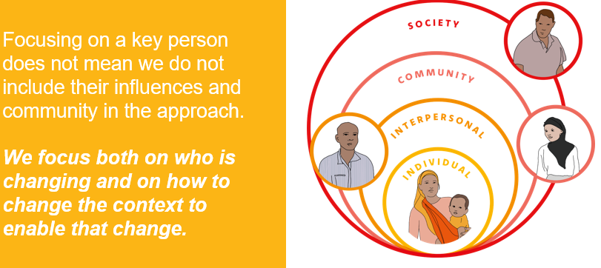
Human Centred
UNICEF; Human Centred Design 4 Health

Slide 11
How do we understand?
Needs
Desires
Observe
Converse
UNICEF; Human Centred Design 4 Health

Slide 12
Observe
Care
Humility
Patience

Slide 13
Conserve
User Interviews builds:
Empathy
Behavioural Insights

Slide 15
Codesign
All stakeholders as active participants
in the design process
Each member has deep knowledge
about their own life experience
Collaborative process

Slide 16
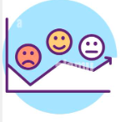
Tools for Codesign
User Interviews
Photojournals
Journey Maps
Brain storming

Slide 17
Principles
UNICEF; Human Centred Design 4 Health

Slide 18
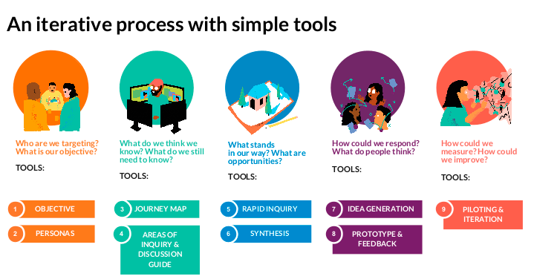
HCD overview
UNICEF; Human Centred Design 4 Health

Slide 19
Practices from the field

Slide 20
UNICEF; Human Centred Design 4 Health

Slide 21
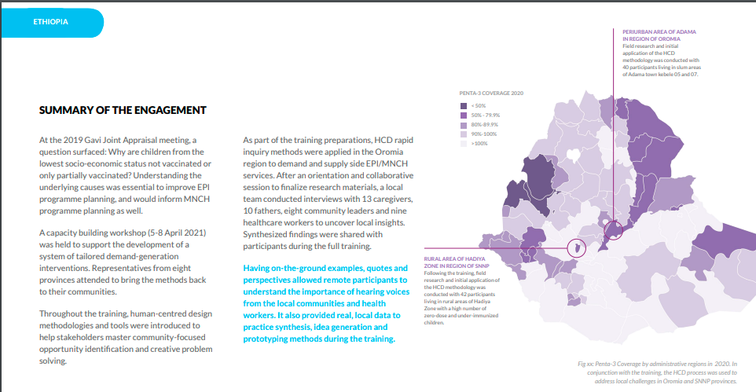
UNICEF; Human Centred Design 4 Health

Slide 22
UNICEF; Human Centred Design 4 Health

Slide 23
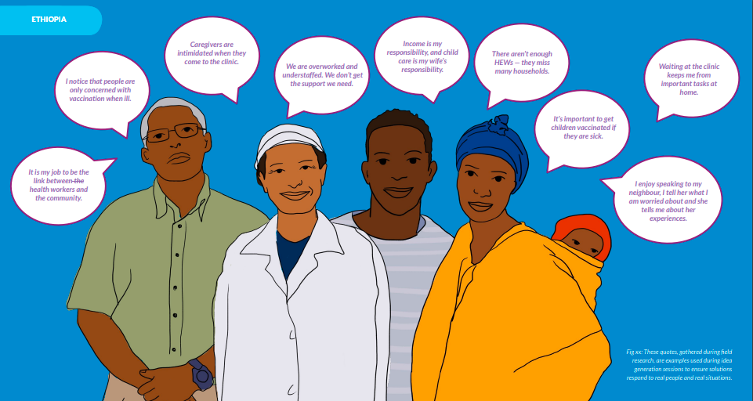
UNICEF; Human Centred Design 4 Health

Slide 24
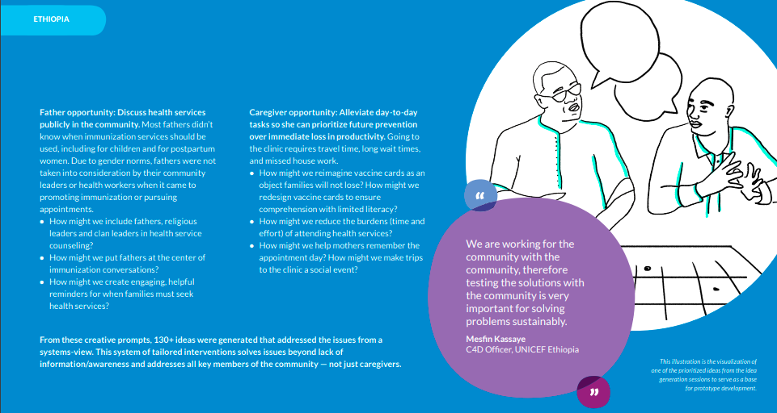
UNICEF; Human Centred Design 4 Health

Slide 25
UNICEF; Human Centred Design 4 Health

Slide 26
Maharashtra , Punjab : India March – July 2021

Slide 27
India case study
Understand the key enablers and barriers to COVID-19 testing among the target population
Understand the conscious and non-conscious drivers of hesitancy or refusal towards COVID-19 vaccine for first and second shot
Identify strategic levers for designing communication and service delivery protocols for boosting COVID-19 tests among the ‘right population’ at the ‘right time’
Identify strategic levers for designing communication and service delivery protocols for boosting COVID-19 vaccine confidence in the target population to drive uptake

Slide 28
Phase 1 : User Interviews

Slide 29
Phase 2 : Rapid testing and validation

Slide 30
Insights

Slide 31
Interventions

Slide 32
Interventions

Slide 33
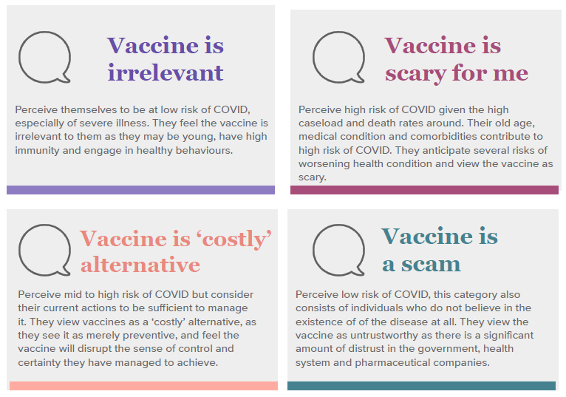
Insights

Slide 34
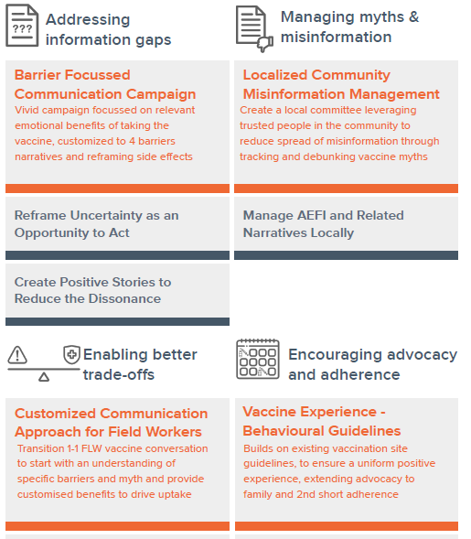
Interventions

Slide 35
3 Truths in incorporating human-centered design in the field
HCD emphasizes skills that re-frame the relationship between design and implementation.
While there is no absolute agreement about what the 'human' part means, it often refers to involving stakeholders, boosting human skills, and keeping human values in mind.
HCD is a flexible but disciplined approach to innovation that prioritizes people’s needs and experiences when designing complex systems.

Slide 36
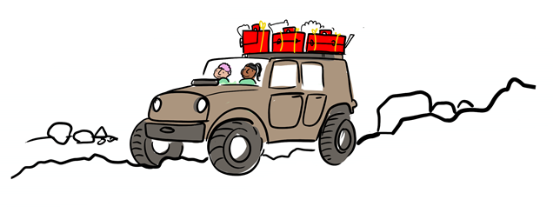
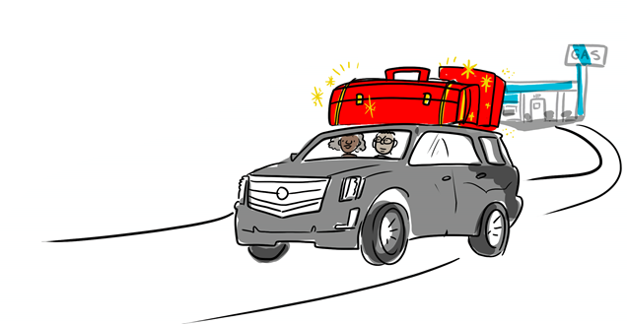
HCD Environnemental Adaptations
Adapt environments to suit people’s needs: When there are long wait times in immunization clinics, people tend not to complete their immunization course. In Lagos, Nigeria a local clinic created a special immunization station for caregivers after checking in at reception. This eliminated the need for the usual procedures of taking a patient’s history and administering a physical examination and led to a 24% increase in the number of vaccines administered monthly.
Reduce cognitive burden: In poor areas of Pakistan, low parental literacy is a challenge for vaccination programmes. To address this barrier, researchers redesigned educational materials given to caregivers. The redesigned materials consisted of easy-to-understand pictorial cards with only three messages for mothers to process.
Minor details have an outsized impact: In Pakistan, data showed a significant drop-off between infants’ first dose of diptheria-tetanus-pertussis (DTP1) and the 3rd dose. The common challenge was the physical reminder card caregivers received after the first dose – it was difficult to interpret. The standard card was too small when folded; the information was crowded and disorderly. The revised card was larger, used bright stickers w/ larger font, and included only essential information.

Slide 37
Key References and Resources
Unicef : Human Centred Design 4 healthhttps://www.hcd4health.org/guiding-principles
Health Design Thinking 2nd edition, Bon Ku, MD & Ellen Lupton , Cooper Hewitt 2022

