Slide 1
Comprehensive training
28 June – 21 July 2022
HOSTED BY GAVI, WHO, UNICEF & US CDC

Slide 2
Public Health and Social Measures for managing epidemics and epidemic risk
Eva Rehfuess
Chair of Public Health and Health Services Research
LMU Munich – Pettenkofer School of Public Health

Slide 3
Outline
Public Health and Social Measures (PHSM)
Definition
Problem Statement
PHSM Concept
Aims
Measures and Mechanisms
Further Key Aspects
Example: School Measures
Key Messages with Regards to PHSM

Slide 4
Learning Objectives
Participants will…
Understand what PHSM are and what their role in managing epidemics is.
Understand how PHSM can be conceptualized.
Apply the concept of PHSM in an example.

Slide 5
Definitions
Public Health and Social Measures (PHSM):
Are measures or actions by individuals, institutions, communities, local and national governments and international bodies to slow or stop the spread of an infectious disease, such as COVID-19.
Examples: face masks, ventilation, vaccination, lockdowns.

Slide 6
Problem Statement
PHSM:
Essential for managing epidemics and epidemic risks.
Defined, planned and implemented very differently.
Consequences:
Lack of evidence on effectiveness.
Insufficient attention paid to unintended consequences.
No agreed tools for decision-makers and practitioners.
Need:
Shared language and understanding of PHSM.

Slide 7
From the field: 1.COVID-19 School Measures
Challenge:
School measures have been implemented worldwide.
Variation in packages of measures and their mode of implementation.
Variation in educational settings, populations targeted and context.
Unclear definitions, e.g. "mandatory masks": Who wears which type of mask in which situation?
How can we know what works (best)? ​
How are school measures affected by vaccination?

Slide 8
What are the aims of PHSM?
Reducing transmission
Addressing unintended consequences

Slide 9
PHSM – Measures and Mechanisms
What are the mechanisms?
Specific mechanisms
Overarching mechanism
Reducing contacts
Reducing transmission-relevant contacts
Making contacts safer
All PHSM operate through two basic mechanisms.
This principle applies with both airborne (e.g. SARS-CoV-2) and other modes of transmission (e.g. Ebola).
Notes:
Add as much content here to address learning objectives; however lecture will be provided in “long” format and presented in a condensed format in class.

Slide 10
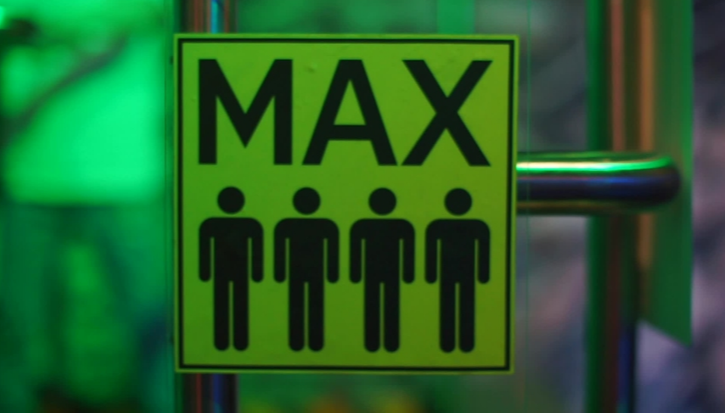
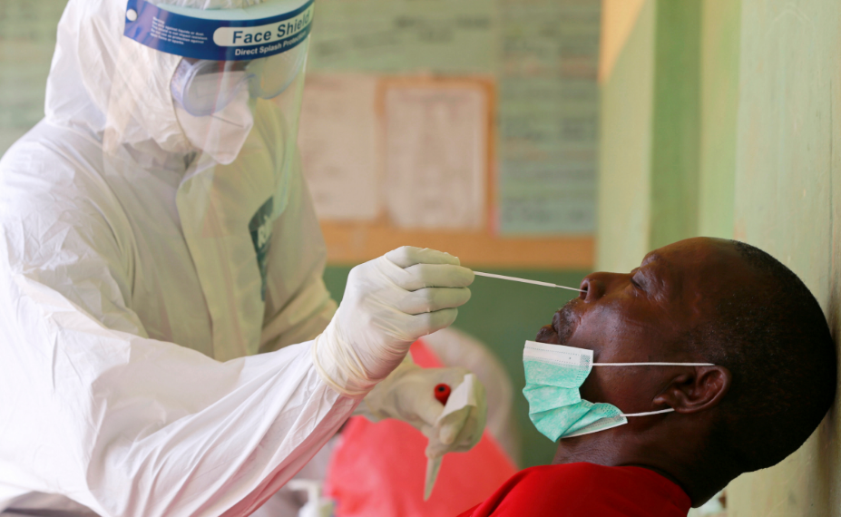
PHSM – Measures and Mechanisms
Reducing contacts
Making contacts safer
Reducing contacts and making contacts safer

Slide 11
PHSM – Further Key Aspects
How? (Mode of Enactment)
Facilitating uptake
Enforcing uptake
To Whom? (Population)
Where? (Settings)
Outcomes
Transmission-related
Unintended consequences-related

Slide 12
From the field: 2.COVID-19 School Measures
e.g.: reducing transmission in school
e.g.: hand hygiene (or school closure)
e.g.: restricting choice by making it mandatory
e.g.: students, teachers, school staff
e.g.: in primary schools
e.g.: fewer cases and hospitalisations
Why?
What?
How?
To Whom?
Where?
Outcomes?

Slide 13
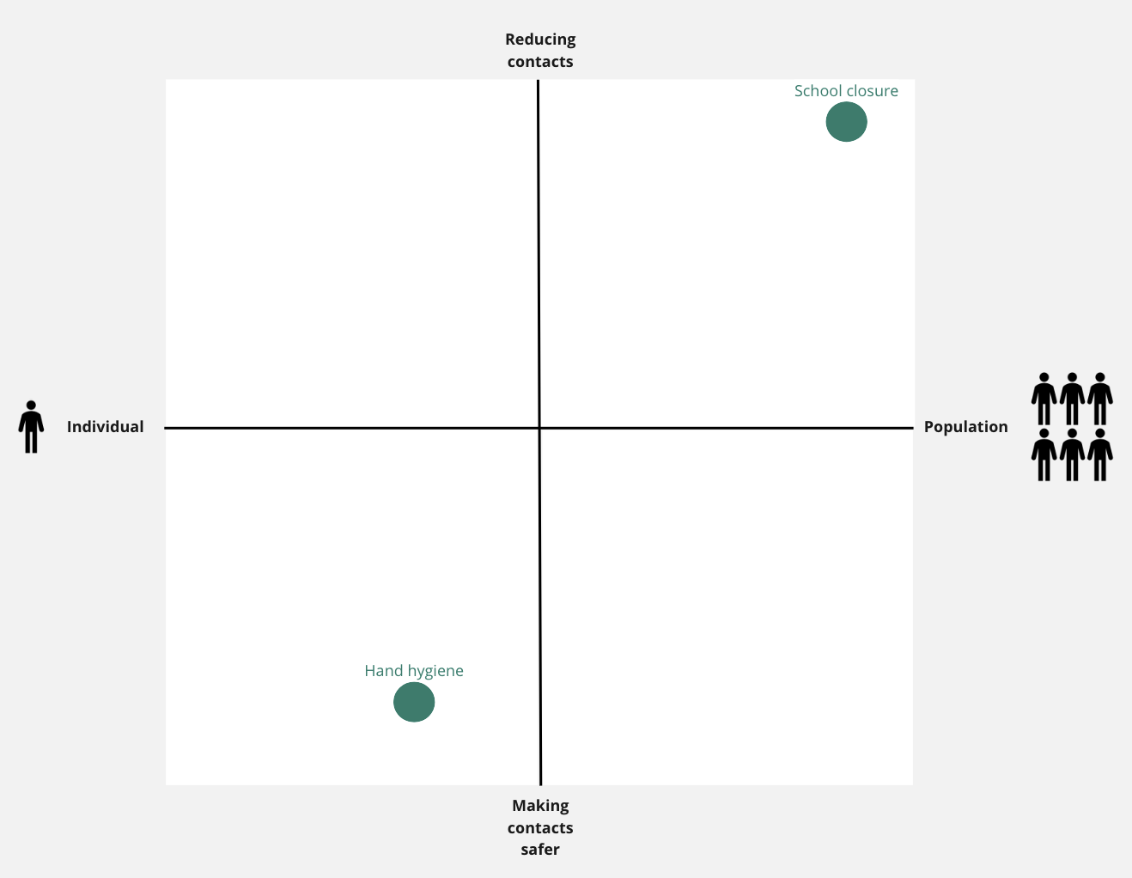
From the field: 3.COVID-19 School Measures

Slide 14
PHSM Guiding Principles
3 Guiding Principles for Practitioners
PHSM are essential in managing epidemics and epidemic risk.
PHSM operate through two basic mechanisms: reducing contacts and making contacts safer.
PHSM operate as packages and have to be adapted to population, setting and epidemic situation.

Slide 15
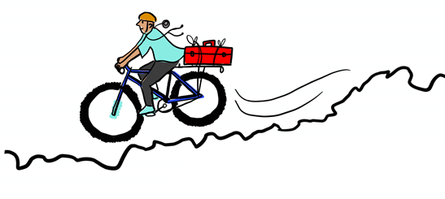
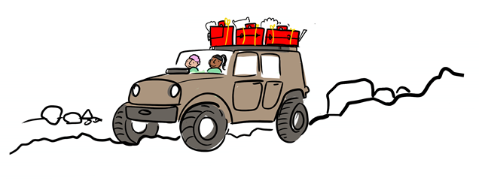
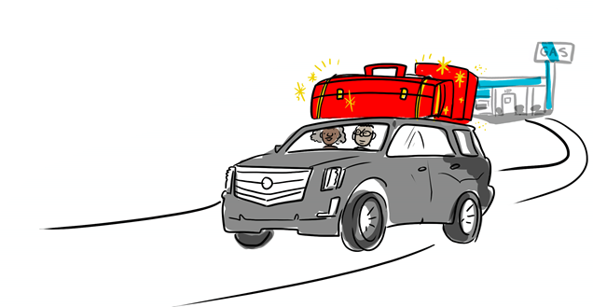
Adaptations for different environments
Individuals: practice frequent hand hygiene, physical distancing, respiratory etiquette, use of masks if ill or attending to someone who is ill, and environmental cleaning and disinfection at home.
Communities: Reduce crowding, limit access to, or close public spaces, restaurants, sporting events, sports clubs, entertainment venues, places of worship, or venues with limited ventilation
Governments: Communicate risk, policy and plans, regularly and often • Develop strategies and products to counter mis-information and myths • Engage with communities in decision-making and to strengthen engagement for public health measures • Identify local networks and engage communities, businesses, religious leaders, and local influencers; • Support police and security forces to ensure clear role and avoid mishap

Slide 16
Key References and Resources
World Health Organization. (‎2021)‎. Considerations for implementing and adjusting public health and social measures in the context of COVID-19: interim guidance, 14 June 2021. World Health Organization. https://apps.who.int/iris/handle/10665/341811.
Krishnaratne S, Pfadenhauer LM, Rehfuess E et al. Measures implemented in the school setting to contain the COVID-19 pandemic: a scoping review. Cochrane Database Syst Rev. 2020 Dec 17;12:CD013812. https://www.cochranelibrary.com/cdsr/doi/10.1002/14651858.CD013812/full
Kratzer S, Verboom B, Biallas R, Featherstone R, Klinger C, Movsisyan A, et al. Unintended consequences of measures implemented in the school setting to contain the COVID-19 pandemic: a scoping review. Cochrane Database of Systematic Reviews, in press.

Slide 17
Group work

Slide 18
Group Exercise
Design a 20-minute group exercise that can be done virtually in breakout groups, keeping in mind that breakout groups will be done by language (English and French) and if you need facilitators, provide facilitator guidance.
Key exercise components to include:
Objective of group exercise with linkage to lecture (PPT format)
Agenda
Facilitator guide
Instructions for participants
Design of group activity (including any templates for reporting)
Example materials or data
Tools you want to use (Slido, Google Slides and Miro are supported)
Number of people needed to support this exercise and roles (including language ability)
Special technical requests (e.g. play video)
To be developed.
We will ask participants to place a selection of measures on the graph displayed in SLIDE 12 – this will hopefully lead to a lot of interesting discussions regarding whether measures address individuals vs. populations and reduce contacts vs. make contacts safer.
Notes:
Note that participants will not be asked to read, prepare or conduct research prior to group exercises. Each exercise needs to be self-contained.
Consider that not everyone is going to be on a laptop with availability to toggle between many screens and that any materials need to be translated and available in both English and French

Slide 19
Assessment Questions (not part of presentation)
Provide three questions, multiple choice, and bold the correct answer. These questions will be used for assessment in quizzes administered on participants.
1. What defines Public Health and Social Measures (PHSM) appropriately?
a) PHSMs predominantly intend to slow or stop the spread of an infectious disease
b) PHSMs predominantly target populations, not individuals
2. Vaccinations are a Public Health and Social Measure (PHSM). Through which mechanism does this measure operate?
a) Reducing contacts
b) Making contacts safer
Notes:
predominantly stt bestbest

