Slide 1
Comprehensive training
28 June – 21 July 2022
HOSTED BY GAVI, WHO, UNICEF & US CDC

Slide 2
Crisis Emergency Risk Communication and Science Communication in Uncertain Times
Richard Quartarone
Immunization Services Division
US CDC

Slide 3
Outline
Introduction to CERC
Principles of CERC
Psychology of a crisis
Principles of CERC
Science Communication & Literacy
Group exercise

Slide 4
Learning objectives
Participants will:
Understand the basics of crisis and risk communication
Be able to apply CERC principles in their immunization work
Explain the importance of science literacy

Slide 5
Definitions
What is CERC?
Crisis
Emergency
Risk
Communication

Slide 6
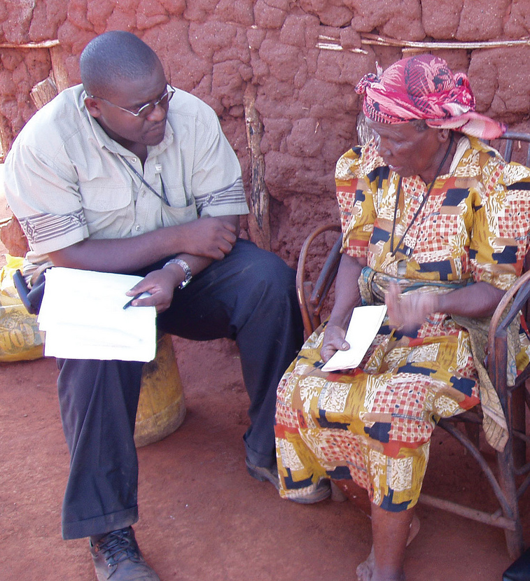
Problem statement
In a serious crisis affected people:
Search for information differently
Take in information differently
Process information differently
Act on information differently

Slide 7
How does our brain work under stress?
We simplify & limit intake of information
We cling to current beliefs
We remember what we see or previously experience
Look for additional information or opinions
Panic myth???
Notes:
BMB
Many times our recommendation go against beliefs
Amanda Ripley survival arch: denial, deliberation, decisive moment
- Process information at several levels below their educational level

Slide 8
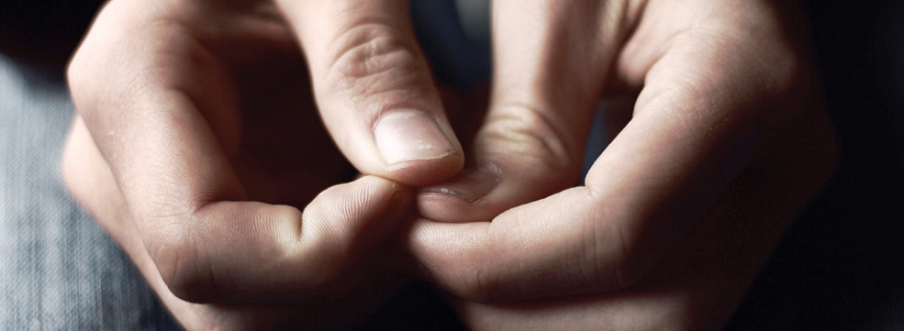
People under stress…
Experience psychological barriers to our messages and messengers
Denial
Fear, anxiety, confusion, dread
Hopelessness or helplessness
Notes:
BMB

Slide 9
Risk Communication
Create and maintain trust
Acknowledge and communicate even in uncertainty
Coordinate
Be transparent & fast with the first and all communications
Be proactive in public communication
Involve and engage those affected
Use integrated approaches
Build national capacity, support national ownership

Slide 10
6 Principles of CERC
Be First: Crises are time-sensitive. Communicating information quickly is crucial. For members of the public, the first source of information becomes the preferred source.
Be Right: Accuracy establishes credibility. Information can include what is known, what is not known, and what is being done to fill in the gaps.
Be Credible: Honesty and truthfulness should not be compromised during a crisis.
Express Empathy: Crises create harm and the suffering should be acknowledged in words. Addressing what people are feeling and the challenges they face builds trust and rapport.
Promote Action: Giving people meaningful things to do calms anxiety, helps restore order, and promotes some sense of control.
Show Respect: Respectful communication is particularly important when they are vulnerable. Respectful communication promote cooperation and rapport.
Notes:
BMB

Slide 11
CERC Best practices
Allow people the right to feel fear
Don’t over-reassure
Acknowledge uncertainty
Give people meaningful things to do
Under-promise and over-deliver
CERC is an approach to inform all public health activities

Slide 12
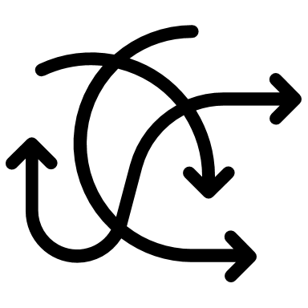
5 communications failures that kill operational success
Mixed messages from multiple experts
Information released late
Paternalistic attitudes
Failing to counter rumors and myths in real-time
Public power struggles and confusion

Slide 13
3 Truths from the field
The right message…
at the right time…
from the right person can save lives.
Dr. Barbara Reynolds
CDC CERC Author (Ret.)

Slide 14
Science Communication and Literacy

Slide 15
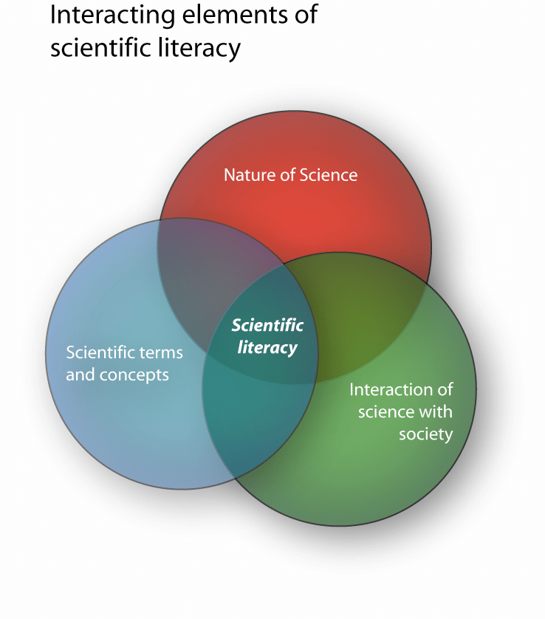
What is science literacy?
= “familiarity with the enterprise and practice of science” (National Academies of Sciences, Engineering and Medicine, 2016)
Critical to understand scientific results and evidence-based recommendations
Allows for judgment of the quality of scientific studies and results
Enables integration of evidence into own judgment, decision-making and behavior
Source: Murcia, 2006

Slide 16
Relevance of science literacy for emergency preparedness & response
Emergencies are characterized by:
High level of uncertainty
High and imminent risk
Emotionally loaded and high stakes
Rapidly evolving science and overabundance of information (infodemic)
Science literacy acts like a protective umbrella:
Facilitates understanding of the science underlying public health measures
Reduces susceptibility to mis- and disinformation
Promotes evidence-based judgments and decisions
Facilitates uptake and adherence to evidence-based public health measures
Source: https://tasteofsavoie.com/2019/05/15/le-flacon-carouge-geneva/

Slide 17
Science communication – the OBJECTIVES
Identify most relevant science
Determine what people know
Design
communi-cation to fill critical gaps
Evaluate the adequacy of communi-cation
Fischhoff & Scheufele (2012)

Slide 18
Science communication during COVID-19
Identify most relevant science
Determine what people know
Design
communi-cation to fill critical gaps
Evaluate the adequacy of communi-cation
Constantly evolving
Social listening
Public trust
Adherence to measures
Knowledge-behavior gaps
Social listening
Public surveys
Risk communication
Infodemic
Complex issues
Uncertainty
Changing recommendations
Fischhoff & Scheufele (2012)

Slide 19
Metrics and evaluation
When the crisis is over, it is important to evaluate the performance of the communication plan, document lessons learned, and determine specific actions to improve crisis systems or the crisis plan. A crisis is a very important learning opportunity. Failure to learn the lessons from it increases the chance of a failed response in the future. It is easy for us to focus on the level of tactics and implementation and not consider our overall communication strategy. When the crisis is over:
Evaluate responses, including communication effectiveness.
Document and communicate lessons learned—what worked and where were the challenges?
Determine specific actions to improve crisis communication and crisis response capability.
Create linkages to pre-crisis activities

Slide 20
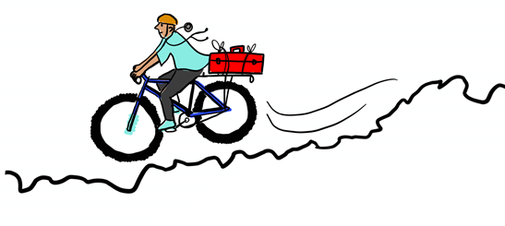
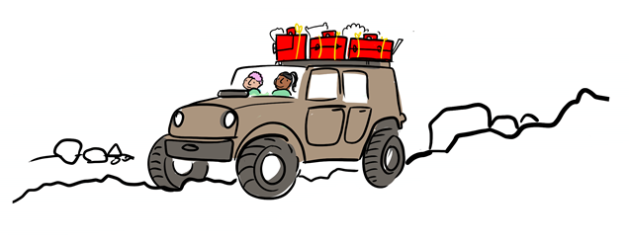
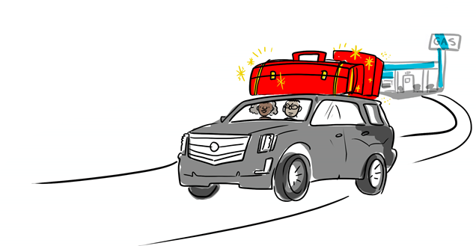
Communications activities at different levels of engagement
Website updates
Social media updates
Press releases
Newsletters
Email blasts
Microsite for web syndication
Radio PSAs
Factsheets & billboards
Advisory groups
Community forums
Hotlines
Press conferences & telebriefings

Slide 21
Resources
Crisis & Emergency Risk Communication (CERC): https://emergency.cdc.gov/cerc/
Emergencies: Risk communication: https://www.who.int/emergencies/risk-communications
EPI-WIN: WHO Information Network for Epidemics: https://www.who.int/teams/epi-win
WHO global conference on communicating science: https://www.who.int/news/item/06-07-2021-who-global-conference-on-communicating-science-during-health-emergencies-sparks-enormous-public-interest

Slide 22
Group work

Slide 23
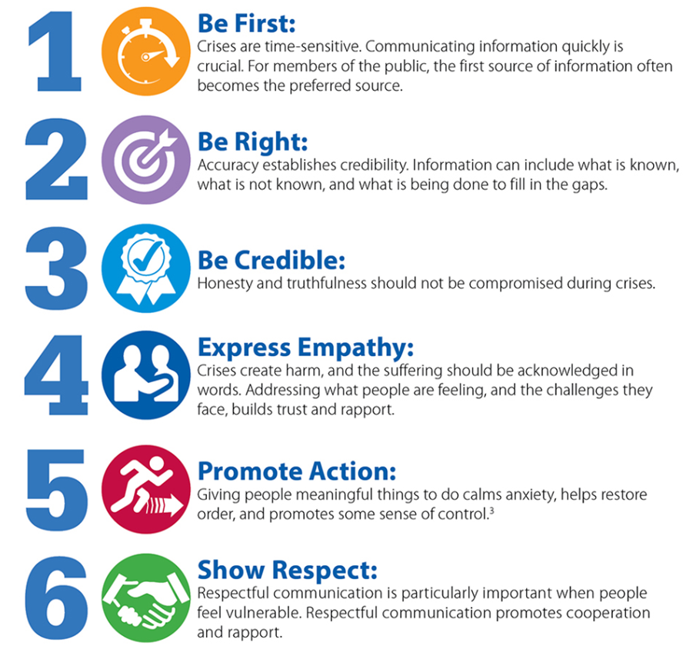
Discuss with your group how these CERC principles can be put into practice to increase confidence in COVID-19 vaccines.
What actions could you take to:
Be First
Be Right
Be Credible
Show Respect

Slide 24
Extra slides

Slide 25
Science communication – the WHAT and WHY
“The use of appropriate skills, media, activities, and dialogue to produce one or more of the following personal responses to science:
Awareness, including familiarity with new aspects of science;
Enjoyment or other affective responses, e.g. appreciating science as entertainment or art;
Interest, as evidenced by voluntary involvement with science or its communication;
Opinions, the forming, reforming, or confirming of science-related attitudes;
Understanding of science, its content, processes, and social factors.”
Burns et al. (2003)

Slide 26
Science communication – Building bridges
Media
Source: Matta, G. Science communication as a preventative tool in the COVID19 pandemic. Humanit Soc Sci Commun 7, 159 (2020).

